Slide 1

Combined Heat and Power System
Ryan Christie
Nathan Duray
Cory Donavon
Joseph Mudd
Jason Dikes
Ronald Stepanek
Supreme Manufacturing

Slide 2
Concept Generation
Refined Problem Statement
Initial brainstorming with concept generation
Concept Selection
application of creative design
Updated Timeline

Slide 3
Problem Statement
Supreme Manufacturing is dissatisfied with the cost, reliability, and overall efficiency of their current power supply.

Slide 4
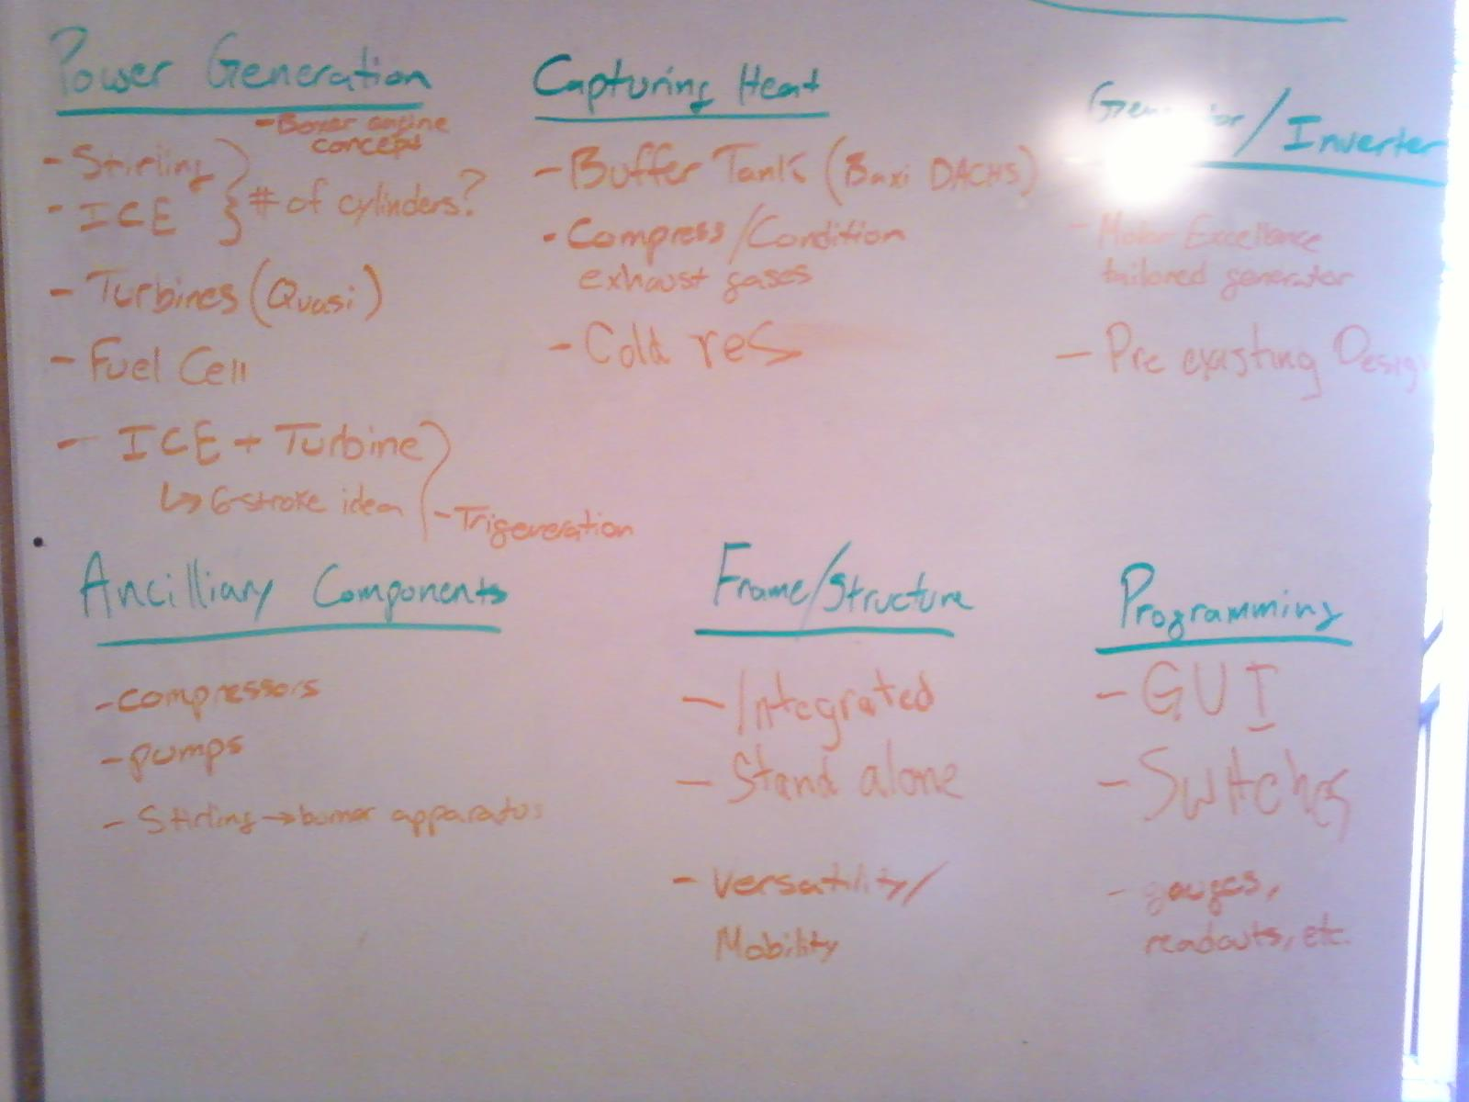
Raw DATA

Slide 5
Morphological Chart
Attributes | Options
Fuel | Natural Gas | Diesel | Propane | Solar
Power Generation | Stirling | Internal Combustion | Turbine | Fuel Cell
Capture Heat | Buffer Tank | Compress/Condition Exhaust | Cold Reservoir
Generator/Inverter | Purchase Tailored Design | Off-the-Shelf
Frame/Structure | Integrated | Stand Alone | Versatility/Mobility
Programming | GUI | Switches | Gauges

Slide 6

Concepts
Stirling Engine Power Production
Beta-Type
Horizontally Opposed Stirling Engine

Slide 7
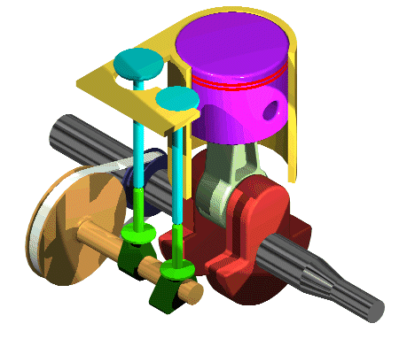
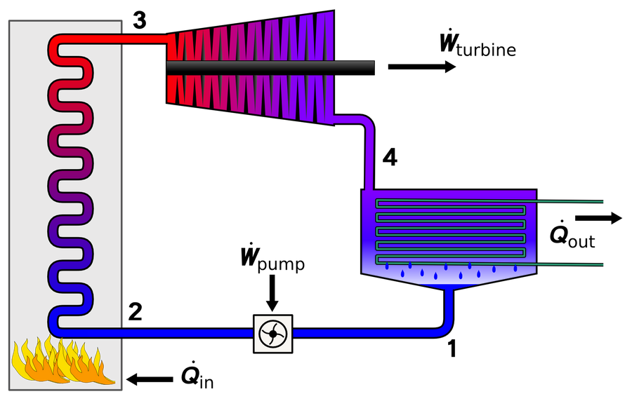
Concepts
6-Stroke Concept
Rankine Cycle

Slide 8
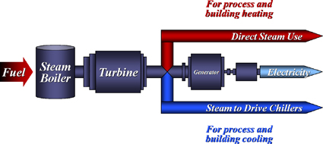
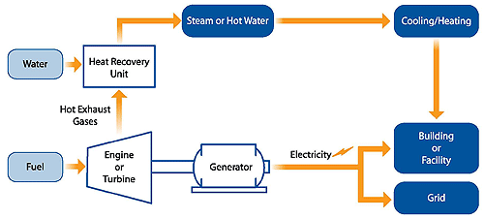
Concepts
Trigeneration
Alternative Fuel I.C.E. with Heat Recovery System

Slide 9
Weighting Factor Tree

Slide 10
Decision Matrix

Slide 11

Levels of Design
Selection
Alternative Fuel ICE
Configuration
Ancillary Engine
Parametric
Engine Displacement/Geometry
Original
Heat Capture

Slide 12
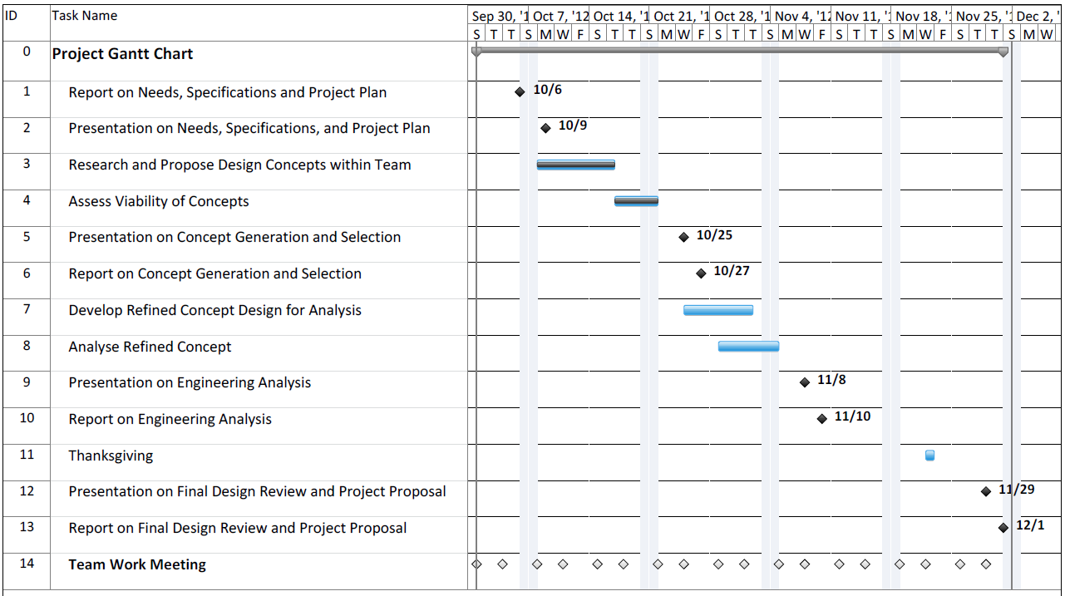
Timeline

Slide 13
References
Beta-Type and Horizontally Opposed Stirling Engine Pictures
http://upload.wikimedia.org/wikipedia/commons/4/4e/Stirling_Animation.gif
Six Stroke GIF
http://www.ridelust.com/wp-content/uploads/2011/02/IC_engine_cam_crank_animation.gif
Rankine Cycle Picture
http://upload.wikimedia.org/wikipedia/commons/thumb/0/00/Rankine_cycle_layout.png/330px-Rankine_cycle_layout.png
Trigeneration Picture
http://rm.awarenessnetworks.com/4683660753899389940.jpg
Alternative Fuel I.C.E. with Heat Recovery System Picture
http://www.epa.gov/chp/images/basic_schematic1_small.gif
Onion Photo
http://indianapublicmedia.org/amomentofscience/files/2010/06/onion-940x626.jpg

Slide 14
Questions

Slide 15
Analytical Hierarchy
 | Total Volume | Integration | Initial Cost | Operating Cost | Rate of Return | Electricity Generation | Power Generation | Control System | Heat Transfer Device | Life Expectancy | Repair/ Replace | Efficiency
Total Volume | 1 | 1/5 | 1/6 | 1/5 | 1/7 | 1/8 | 1/7 | 1/3 | 1/3 | 1/5 | 1/2 | 1/6
Integration | 5 | 1 | 1/5 | 2 | 1/6 | 1/5 | 1/4 | 4 | 5 | 3 | 4 | 1/3
Initial Cost | 6 | 5 | 1 | 2 | 1/2 | 1/3 | 1/3 | 3 | 5 | 1 | 2 | 1/5
Operating Cost | 5 | 1/2 | 1/2 | 1 | 1/3 | 1/4 | 1/4 | 4 | 4 | 3 | 1 | 1/4
Rate of Return | 7 | 6 | 2 | 3 | 1 | 1/3 | 1/3 | 5 | 6 | 3 | 5 | 2
Electricity Generation | 8 | 5 | 3 | 4 | 3 | 1 | 1 | 5 | 6 | 3 | 2 | 2
Power Generation | 7 | 4 | 3 | 4 | 3 | 1 | 1 | 7 | 8 | 2 | 6 | 2
Control System | 3 | 1/4 | 1/3 | 1/4 | 1/5 | 1/5 | 1/7 | 1 | 1 | 1/4 | 1/2 | 1/7
Heat Transfer Device | 3 | 1/5 | 1/5 | 1/4 | 1/6 | 1/6 | 1/8 | 1 | 1 | 1/6 | 1/2 | 1/5
Life Expectancy | 5 | 1/3 | 1 | 1/3 | 1/3 | 1/3 | 1/2 | 4 | 6 | 1 | 2 | 1/2
Repair/ Replace | 2 | 1/4 | 1/2 | 1 | 1/5 | 1/2 | 1/6 | 2 | 2 | 1/2 | 1 | 1/5
Efficiency | 6 | 3 | 5 | 4 | 1/2 | 1/2 | 1/2 | 7 | 5 | 2 | 5 | 1
Judgment of Importance | Numerical Value
Extremely more Important | 9
 | 8
Very Strongly more Important | 7
 | 6
Strongly more Important | 5
 | 4
Moderately more Important | 3
 | 2
Equally Important | 1

Slide 16
Normalized Pairwise Comparison matrix
 | Total Volume | Integration | Initial Cost | Operating Cost | Rate of Return | Electricity Generation | Power Generation | Control System | Heat Transfer Device | Life Expectancy | Repair/ Replace | Efficiency | Overall Importance
Total Volume | 0.017 | 0.008 | 0.010 | 0.009 | 0.015 | 0.025 | 0.030 | 0.008 | 0.007 | 0.010 | 0.017 | 0.019 | 0.175
Integration | 0.086 | 0.039 | 0.012 | 0.091 | 0.017 | 0.040 | 0.053 | 0.092 | 0.101 | 0.157 | 0.136 | 0.037 | 0.862
Initial Cost | 0.103 | 0.194 | 0.059 | 0.091 | 0.052 | 0.067 | 0.070 | 0.069 | 0.101 | 0.052 | 0.068 | 0.022 | 0.951
Operating Cost | 0.086 | 0.019 | 0.030 | 0.045 | 0.035 | 0.051 | 0.053 | 0.092 | 0.081 | 0.157 | 0.034 | 0.028 | 0.711
Rate of Return | 0.121 | 0.233 | 0.118 | 0.136 | 0.105 | 0.067 | 0.070 | 0.115 | 0.122 | 0.157 | 0.169 | 0.222 | 1.637
Electricity Generation | 0.138 | 0.194 | 0.178 | 0.182 | 0.314 | 0.202 | 0.211 | 0.115 | 0.122 | 0.157 | 0.068 | 0.222 | 2.103
Power Generation | 0.121 | 0.155 | 0.178 | 0.182 | 0.314 | 0.202 | 0.211 | 0.162 | 0.162 | 0.105 | 0.203 | 0.222 | 2.217
Control System | 0.052 | 0.010 | 0.020 | 0.011 | 0.021 | 0.040 | 0.030 | 0.023 | 0.020 | 0.013 | 0.017 | 0.016 | 0.273
Heat Transfer Device | 0.052 | 0.008 | 0.012 | 0.011 | 0.017 | 0.034 | 0.026 | 0.023 | 0.020 | 0.009 | 0.017 | 0.022 | 0.251
Life Expectancy | 0.086 | 0.013 | 0.059 | 0.015 | 0.035 | 0.067 | 0.105 | 0.092 | 0.122 | 0.052 | 0.068 | 0.056 | 0.771
Repair/ Replace | 0.034 | 0.010 | 0.030 | 0.045 | 0.021 | 0.101 | 0.035 | 0.046 | 0.041 | 0.026 | 0.034 | 0.022 | 0.445
Efficiency | 0.103 | 0.117 | 0.296 | 0.182 | 0.052 | 0.101 | 0.105 | 0.162 | 0.101 | 0.105 | 0.169 | 0.111 | 1.605

Slide 17
Pairwise Comparison

