Slide 1

Alternative Power Source for Dental Hygiene Device
Team Concussion
Nizar Almansouri
Ningbiao Jiang
Francisco Heath
Jin Niu
Jiaqi Xie

Slide 2
Contents of Presentation
Problem Statement
Component Overview
Testing Procedure
Objectives and Constraints
Gantt Chart
Conclusion
References

Slide 3
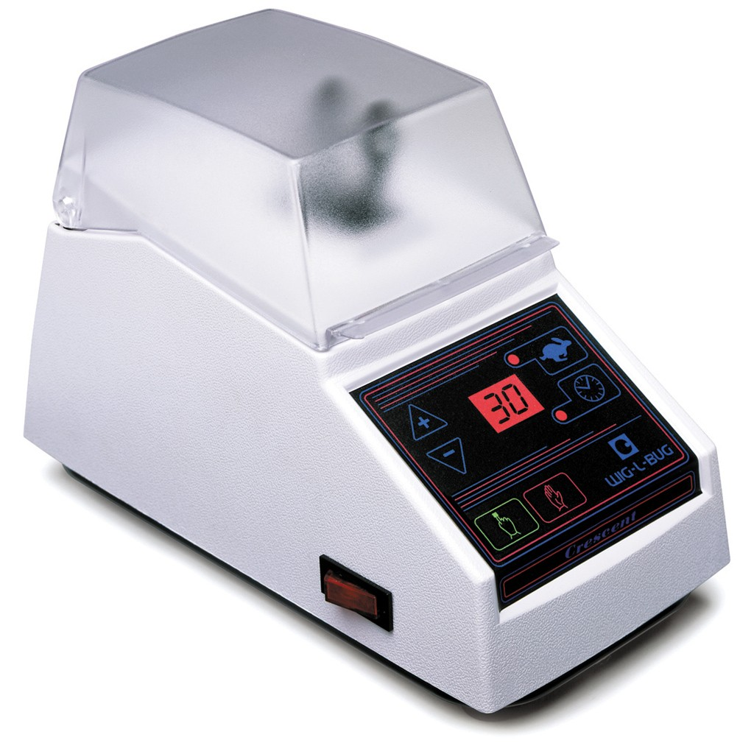
Problem Statement
NAU Department of Dental Hygiene
Humanitarian work in remote areas
No electricity available to power Wig-L-Bug
Our goal is to build them a working power supply

Slide 4
Components
 | Dimensions | Weight | Cost
Battery | 8×5×3in | 4lb | $322.95
Charger | 6×3×2in | 1lb | $36.95
Inverter | 6×3×2in | 1lb | $85.00
Total |  | 6lb | $444.90

Slide 5
Battery
Capacity | 240Wh
Nominal Voltage | 16.8V
Regulated Voltage | 12V
Max Discharge Rate | 10A
Dimensions | 8 x 5 x 3in
Weight | 4lb
Grams equivalent lithium | ~ 20g
Cost | $322.95

Slide 6
Charger
Input Voltage | 100-240V
Output Voltage | 16.8V
Fully Charge Time | 9h
Dimension | 6×3×2in
Weight | 1lb
Cost | $36.95

Slide 7
Inverter
Specification | Pure sine wave inverter
Input Voltage | 12V DC
Output Waveform | Pure Sine Wave
Output Voltage | 120V AC at 60Hz
Power Output | 180W
Maximum Efficiency | 90%
THD | <3%
Size | 6×3×2in
Weight | 1lb
Cost | $85

Slide 8
System Test
Wig-L-Bug Test
 | Idle | Lowest | Low | Medium | Max
Nominal Power | 0W | 38W | 42W | 46W | 48W
Continuous Power | 1W | 35W | 39W | 41W | 45W
Maximum Power | 1W | 38W | 42W | 48W | 50W

Slide 9
System Test
Bulb Test
Discharge the system with a bulb of 60W power and it takes 3 hours 56 minutes to drain the battery.
Battery Charging Rate Test
After the battery is fully discharged, it takes 8 hours 50 minutes to charge the battery.

Slide 10
System Test
Output Test
The output of the system is 113V at 60Hz.
When Wig-L-Bug is plugged in it works well with the output from the power source.

Slide 11
Constraints
Must have a stable AC voltage output of 110 V @ 60 Hz √
Maximum output of 1.2 Amps √
Must be able to power device continuously for 10 hours ×
Must be able to operate device for 10 hours √
Cannot weigh more than 27 lb √
Must be able to fit in 22 ×18 ×10 in container √
Must be able to charge on 220 V @ 50Hz √
Must be able to charge 0 - 100% in eight hours √

Slide 12
Work that needs to be done
Safety
Make sure the device cannot be hooked up improperly
Provide instruction sheet with warnings
Label all components and connections
Packaging
Case must contain all components
Case must provide adequate protection
Further testing
Repeat discharge/charge test

Slide 13
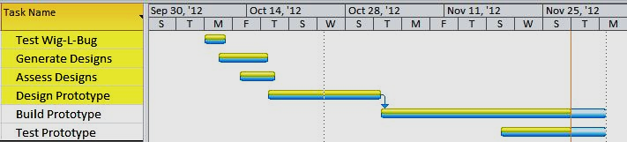
Gantt Chart
We still have one week to finish testing and make everything look good

Slide 14
Conclusion
Specifications of the components
System Test
Constrains
Work that needs to be done
Components | Weight | Cost
Battery | 4lb | $322.95
Charger | 1lb | $36.95
Inverter | 1lb | $85.00
Total | 6lb | $444.90

Slide 15
References
http://www.bomara.com/powerware/wp_harmonics.htm
http://www.stecasolar.com/index.php?Inverter_selection
http://www.batteryspace.com/
http://safetravel.dot.gov/

