Slide 1
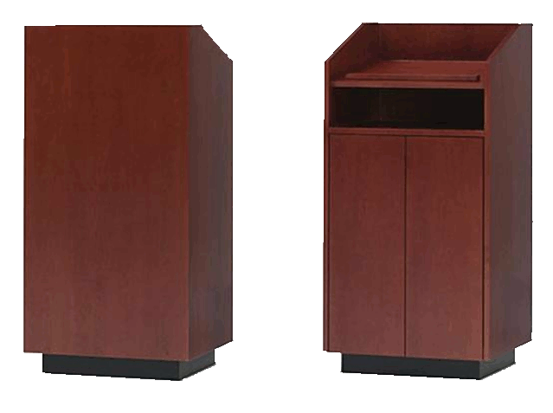
A Universal Design for the Classic Teaching Lectern
Robin Schwartz • Kevin Clark • Eric Neisen • Adam Yoder

Slide 2

Team Members
  Adam Yoder
  Sponsor Liaison
  Proposal Coordinator
  Eric Neisen
  Secretary/Historian
  Website Coordinator
  Kevin Clark
  Budget Lead
  CAD Lead
  Robin Schwartz
  Scheduling Lead
  Faculty/Technical Advisor Liaison
Eric Neisen

Slide 3


Acknowledgements
The design team would like to thank:
Steelcase Inc. for their generous financial support that made this project possible
Byrne Electrical for the donation of their AxilTM-Z product
Clinton Baker, Systems Administrator Sr., NAU Engineering IT
Eric Neisen

Slide 4
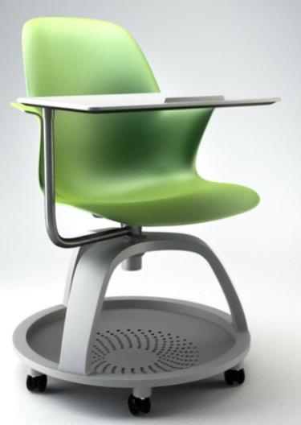
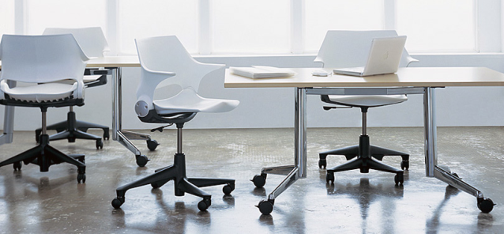
Client Description:
Steelcase Inc.
  Largest furniture manufacturer in US
  Contacts: Steelcase Workplace Consultants
      Alejandro Rengifo
      Matt Beals
  2011 revenue of approximately $2.4 billion with nearly 10,000 employees
  –Steelcase.com
  Target market → higher education professors
Eric Neisen

Slide 5
Project Definition
  Design a marketable lectern, that is:
  easily accessible by anyone, with or without a disability
  supportive of a wide variety of teaching styles
  designed through a user-driven design lifecycle
concept
refine
user testing
Eric Neisen

Slide 6
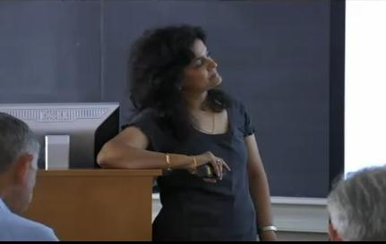
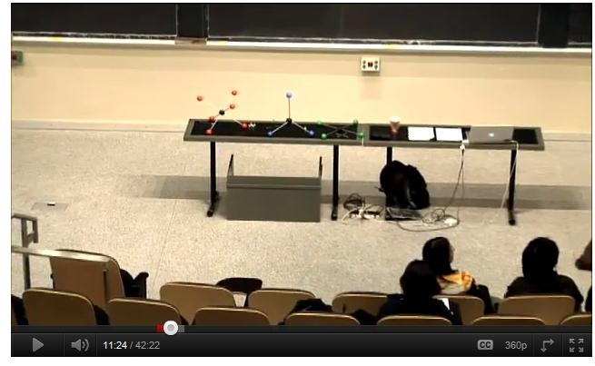
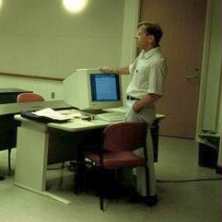
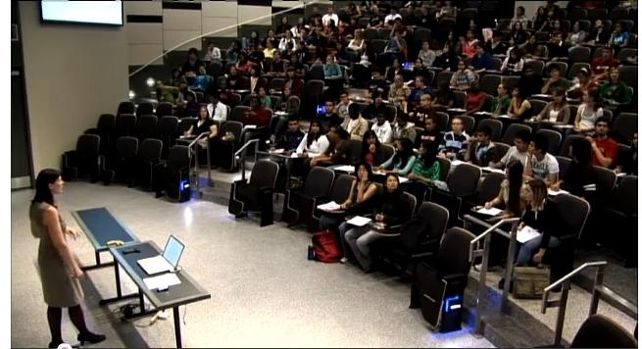
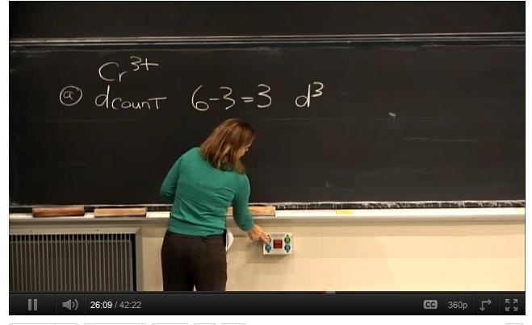
  What is a lectern??
  A structure or device which…
  (1) provides access to current teaching technologies
  (2) allows control of classroom media
    Source: youtube.com\education
Robin Schwartz

Slide 7
Project Motivation
  Typical lecterns and podiums are not accessible by users with disabilities
  SOLUTION → Universal Design
  “Universal design is an approach to design that incorporates products as well as building features which, to the greatest extent feasible, can be used by everyone.”
  -Ron Mace, founder of universal design
“An estimated 54 million individuals within the US alone have some type of limitation.”
-Source: Survey of Income and Program Participation (SIPP)
Robin Schwartz

Slide 8
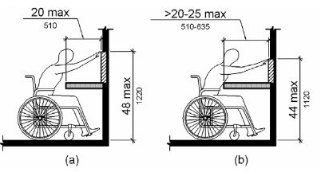
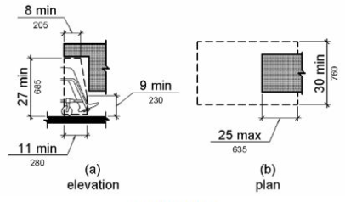
Specifications
2010 ADA Standards | Met?
Toe Clearance Depth - 17”- 25” | Y
Knee and Toe Clearance Minimum Width - 30” | Y
Knee Clearance Minimum Height - 27” | Y
Work Surface Maximum Depth – 25” | Y
Work Surface Height - 28”- 34” | Y
BIFMA Product Standards
Work Surface Static Load Requirement - 300 lb. | Y/N
Racking Test | Y
Steelcase Requirements
Meets Budget - $1,000 | N
Promotes Sustainability | ??
Aesthetics Similar to Steelcase Products | ??
Allows for sitting and standing work | Y
Appropriate wire and utility management | Y
Accommodates technology now, and in near future | Y
Obstructed High Forward Reach
Knee Clearance
image source: 2010 ADA Standards
Robin Schwartz

Slide 9

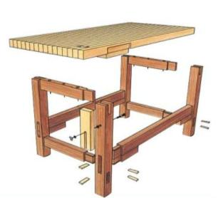
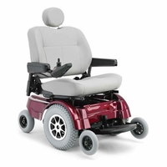
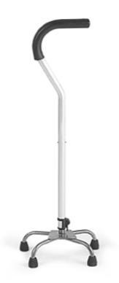
State of the Art Research
[1] Knowledge Bases
  Steelcase and general furniture design
  General universal design
  ADA and disability
  Furniture manufacturing
  [2] User Input
    Instructors
    Facilities staff
    Disabled users
Image source: TheScooterStore.com
Robin Schwartz

Slide 10
Fall 2011 Research:
Professor Interviews
A majority of users…
Prefer standing (“Sitting does not engage students…”)
Enjoy the freedom to move around the room
Want easy electronic connectivity
Need a dedicated room PC
A substantial amount…
Want all room controls integrated
Want less complexity
Use doc cams, when available
Complained of having to “click slides”
A few…
Sit frequently during lecture
Kevin Clark

Slide 11
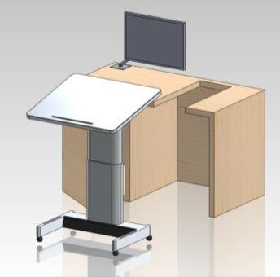
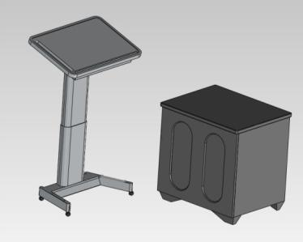
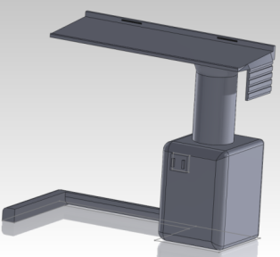
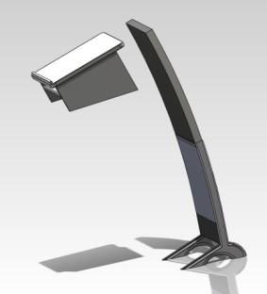
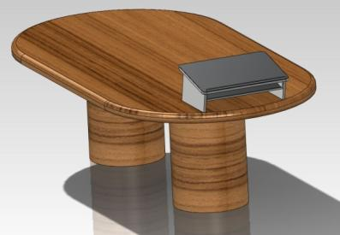
Design Selection
Concept 1: Rotary Lectern
Concept 3: Two-Part Lectern
Two-part concept selected by Steelcase. Inc
Concept 2: Modular Lectern
Kevin Clark

Slide 12
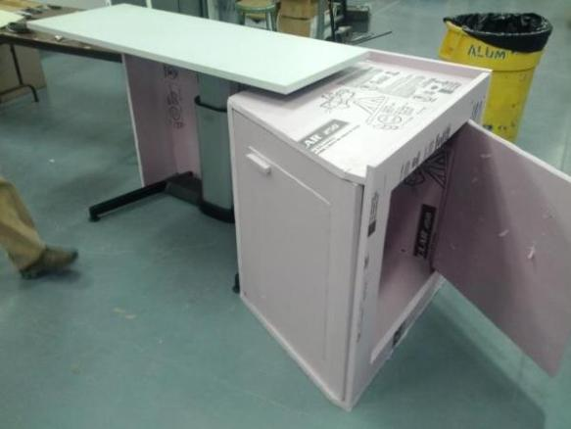
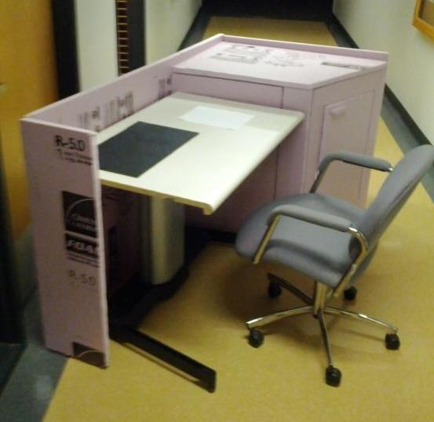
Spring User-Testing
Reached 53 instructors from various specialties at Northern Arizona University
Suggestions for improvement
Base cabinet and lectern surface were too large
Surface must be tilt adjustable
Positive Feedback
Ease of wheelchair access
Height adjustment mechanism
Wireless freedom
Conflicting Feedback
Necessity of sidewall
Monitor placement
Power source
Kevin Clark

Slide 13
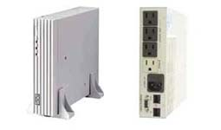
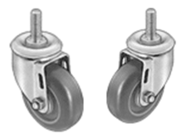
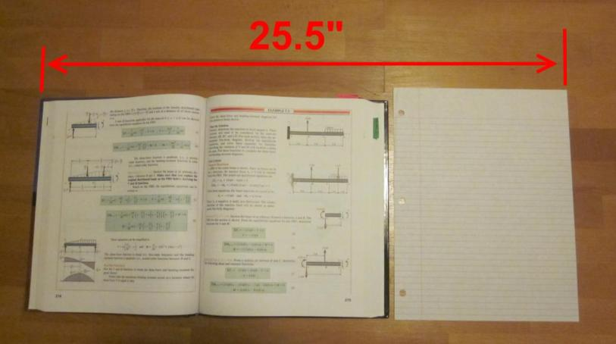
Application of User-Test Results
Interview Outcome |  | Design Addition
1
2
3
4
5
Wanted more freedom to move around the room
Attach casters, and reduce overall weight
surface of the foam prototype was excessively large
Use an open textbook and piece of
8.5 x 11” paper to size final surface
vertical computer monitors are a barrier between teacher and students
Inlay a monitor into the surface, which can be written upon, or tilted upwards
Powercom UPS
angled surfaces are more comfortable to use
Design a mechanism that allows entire surface to tilt
Specify an uninterrupted power supply, which can run on battery power, or be bypassed with outlet power
conflicting preferences on type of power source for the lectern
Kevin Clark

Slide 14
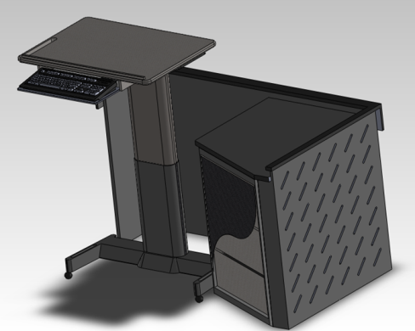
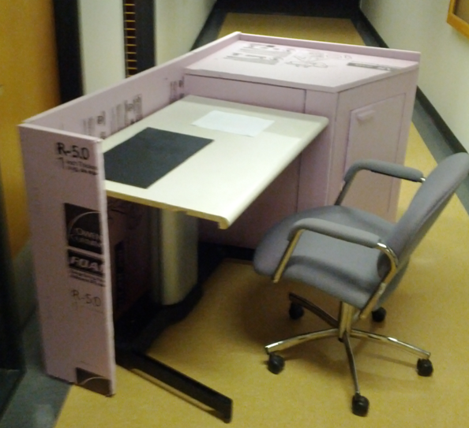
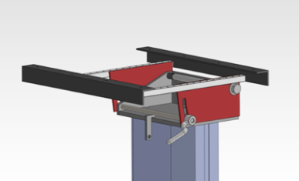
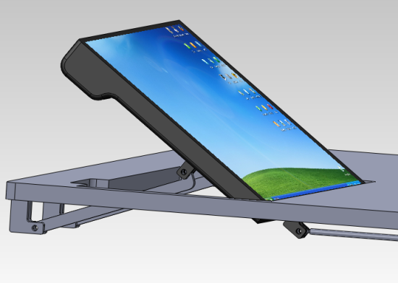
Design Lifecycle
January 2012
February 2012
Refined chosen concept
Prototype for user testing
April 2012
March 2012
Surface tilt mechanism
Adjustable mount for inlayed monitor
Kevin Clark

Slide 15
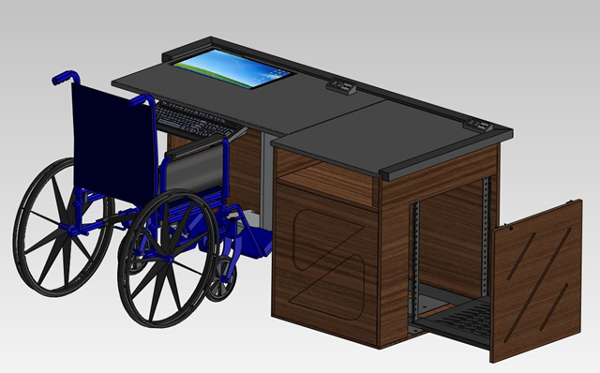
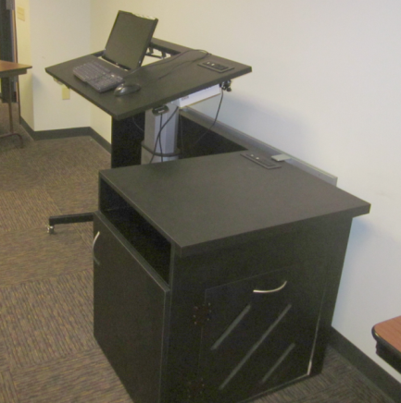
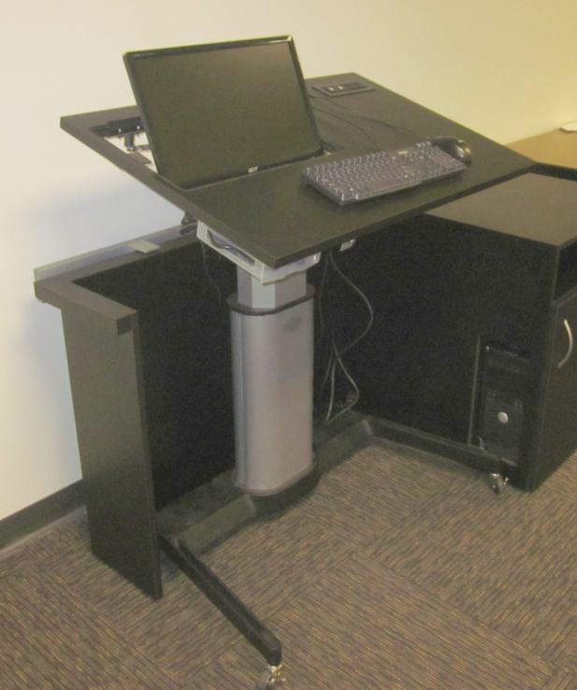
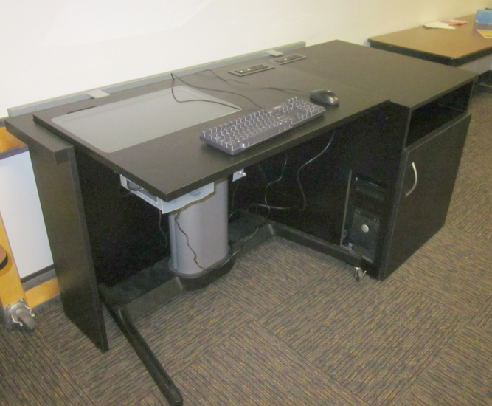
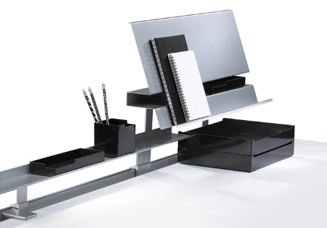
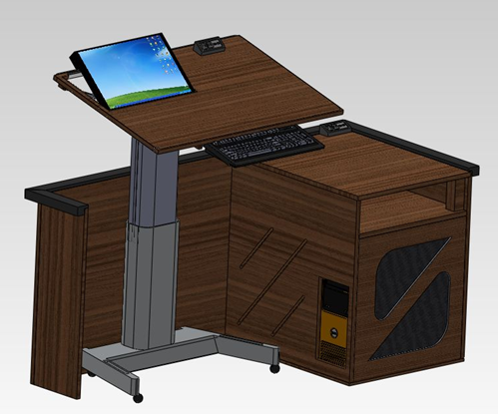
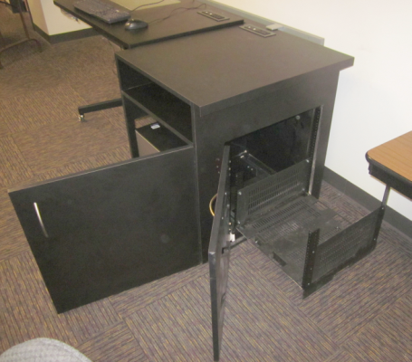
Final Product
[1] Mobile lectern
[2] Stationary base
[3] Together
Together
compliant with 2010 ADA standards
60” work surface, with desk seating
laptop/tablet connectivity
Spill-proof outlets (Byrne Electrical)
Stationary base
  ventilated AV housing
  doc cam storage
  slide-out AV rack, accessible through side (IT use)
  access to PC tower
  customizable SotoTM Rail
Mobile lectern
  spring-assisted, height and tilt adjustability
  completely wireless
  12 hours battery power
  inlayed, adjustable computer screen
Adam Yoder

Slide 16


Final Product
Bill of Materials
Item | Quantity | Vendor
Steelcase Airtouch® column | 1 | Steelcase Inc.
HOST AV rack | 1 | Steelcase Inc.
SotoTM rail | 1 | Steelcase Inc.
19” flatscreen monitor | 1 | Target
wireless KVM | 1 | Cables Unlimited
uninterrupted power supply (500VA) | 1 | Powercom
Axil-ZTM power faceplates | 2 | Byrne Electric
¾” laminate | 64 sq. ft. | Associated Woodworks
bolts, washers, & spacers | 10 | Ace Hardware
threaded casters | 4 | McMaster Carr
Adam Yoder

Slide 17
Budget Details
Item | Cost | Source
Initial Prototype
Foam, threaded rod, glue | $57 | Home Depot
Final Prototype
Airtouch® column | $650 | Steelcase Inc.
HOST AV Rack | $430 | Steelcase Inc.
SotoTM Rail | $250 | Steelcase Inc.
computer monitor | $125 | Target
custom laminate surface | $75 | AZ Top Shop
fasteners | $11 | Ace Hardware
electronic components | $110 | Newegg.com
Axil-ZTM faceplates | $0 | Byrne Electrical, donation
custom cabinet base | $0 | Associated Woodworks
OVERALL TOTAL | $1,708
Adam Yoder

Slide 18
Project Schedule:
Progression
Phase 1: Background research and concepts
October 1st , 2011 – January 16th , 2012
Phase 2: Form and function
January 16th - February 14th
Completed CAD assembly
Phase 3: Seating & wheelchair accommodation
February 14th - February 26th
Phase 4: Modularization and adjustability
February 19th – March 8th
Included user testing with Prototype 1
Phase 5: Technology integration
March 8th – March 23rd
Phase 6: Wire, utility, and peripheral management
March 21st – April 6th
Phase 7: Manufacturing refinement
April 3rd – April 20th
Culminated with Prototype 2 completion
Adam Yoder

Slide 19
Project Schedule:
Manpower Estimates
Scope of Work | Hours | Group Total
Fall 2011
state-of-the-art research | 190 | 416
proposal writing | 46
concept development | 180
Spring 2012
user testing | 80 | 524
prototype design | 160
component sourcing | 84
NAU Machine Shop | 150
reports & presentations | 50
OVERALL TOTAL | 940
* Totals of each row are sums between 4 group members
Adam Yoder

Slide 20
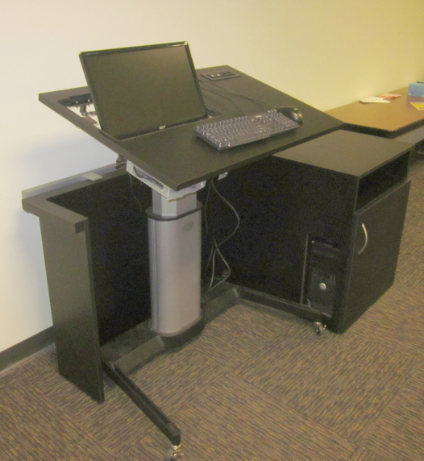
Final Deliverables
To client: Steelcase, Inc.
Final, to-scale prototype
  April 27th
Design report
  May 4th
  Manufacturing specs
Adam Yoder

Slide 21
Conclusions
The project goal was met
  Design a lectern that is easily accessible by anyone, with or without a disability
Design changes were driven by actionable user requests
Product is unique in the current market due to:
Compliance with 2010 ADA standards
Height & tilt adjustability
Final prototype is fully specified and documented for manufacturing
Eric Neisen

Slide 22
Questions ?

