Slide 1

AERO Design
Brian Martinez
Chase Beatty
Mohammed Ramadan
Noe Caro

Slide 2
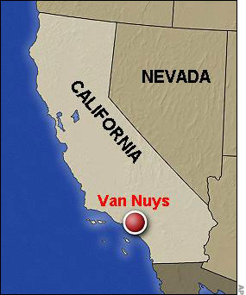
Description/Responsibilities
SAE AERO group 2012 competition
Van Nuys, California
March 16-18
Chase Beatty: Team Leader
Brian Martinez: Organizer
Mohammed Ramadan: Financial Officer
Noe Caro: Historian

Slide 3
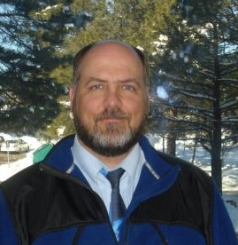
Customer Description
Dr. John Tester
  SAE advisor since 2000
Judges at AERO competition

Slide 4
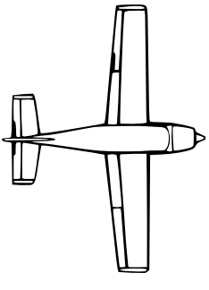
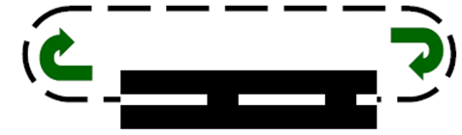
Project Description
Design and build an airplane
Combined dimensions cannot exceed 225”
Take off within 200ft
Land and stop within 400ft
Payload and airplane cannot exceed 55lbs
Fly in a circle at least once
No lighter than air aircrafts or helicopters
Land within 400’
Takeoff within 200’

Slide 5
Project Description cont.
Propeller cannot be made out of metal
Fiber-Reinforced Plastic is prohibited
No fuel pump
Cannot used gear boxes—gear ratio
Fuel supplied by competition
No gyroscope
Must raise our own funds

Slide 6
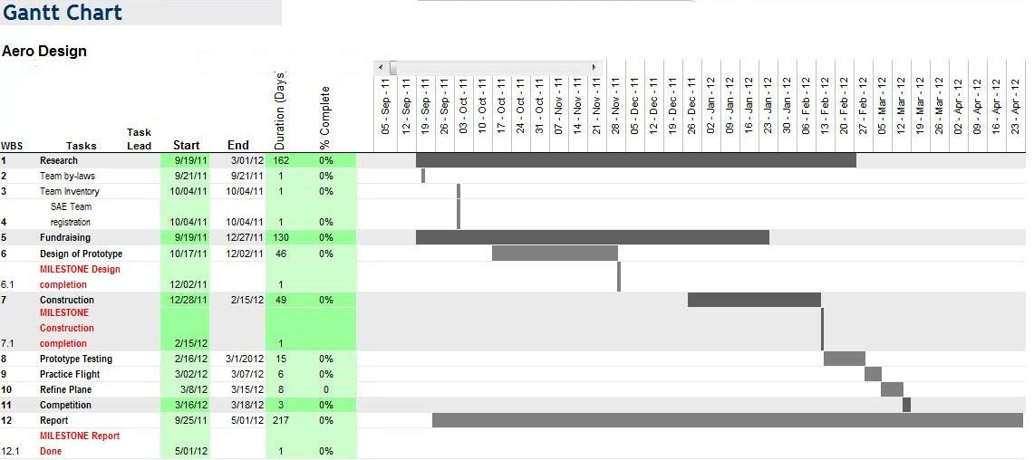
Preliminary Project Schedule

Slide 7
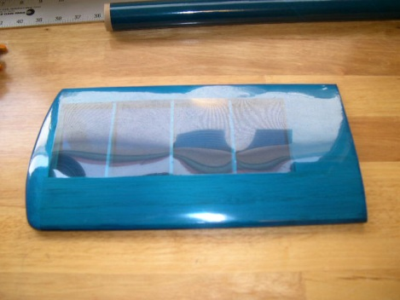
Materials
Balsa Wood
Fuel Tank
Bass Wood
Engine
Heat Shrink Plastic Film
Wood Glue
Reicever

Slide 8
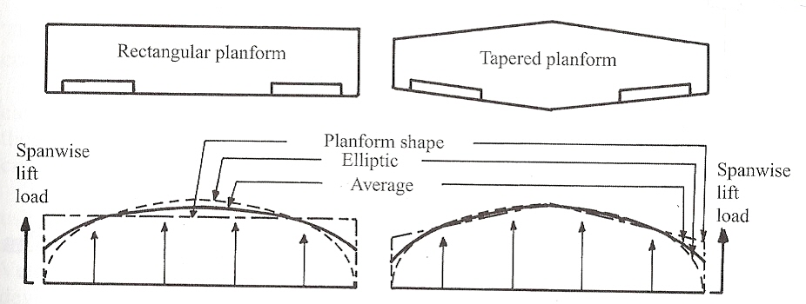
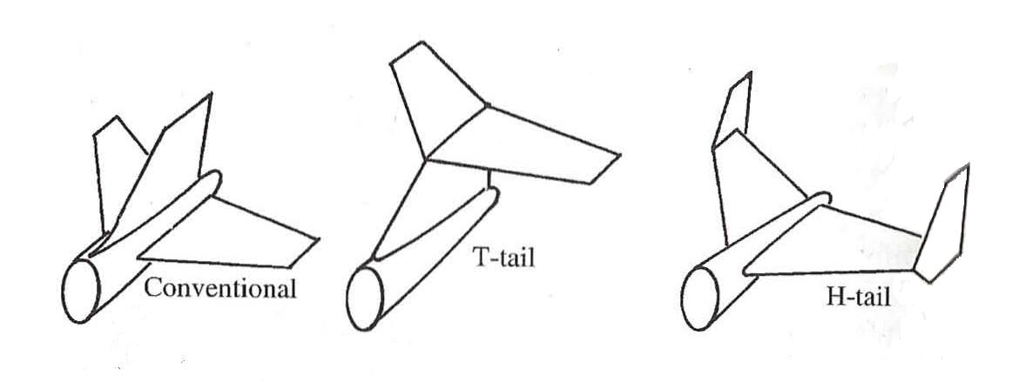
Preliminary Research
Wings
  Eppler airfoil
  Rectangular Planform
Tail
  Conventional tail
Fuselage
  Round
  Square

Slide 9
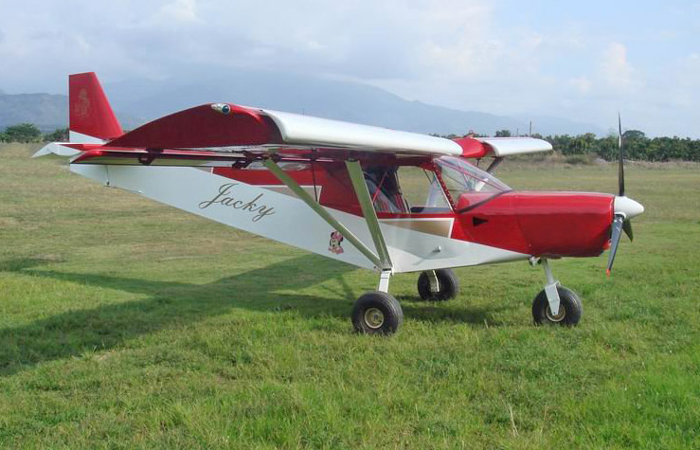
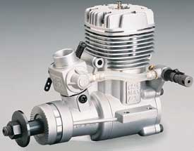
Preliminary Research cont.
Landing Gears
  Tricycle
  Tail dragger
  Retractable
Engine System
  Propulsion
  O.S 61FX w/E-4010 muffler

Slide 10
Conclusion
Solidworks model
Software for airfoil analysis
Regular meetings to keep group on track
Goal: Build aircraft in time for competition and practice real life engineering

