Slide 1
NAU AERO TEAM 2012
The Lumberjacks
Team 017
03/16/12
Brian Martinez

Slide 2
AERO TEAM
Capstone Members
  Chase Beatty
  Mohammed Ramadan
  Noe Caro
  Brian Martinez
SAE Advisor
  Dr. John Tester
Academic Advisor
  Dr. Tom Acker
Brian Martinez

Slide 3
DESIGN OVERVIEW
Components
  Wing Design
    Airfoil (E 423)
    Non-tapered
  Fuselage
  Landing Gear
  Tail
    Airfoil (N-14)
Brian Martinez
Notes:
Airplane consists of a under-campered. We researched flat bottomed, over-campered.

Slide 4
PROJECT SCHEDULE
October 1st –December 15th – Research, Trade Studies
December 15th-January 6th –Solid works modeling
January 1st-February 1st- SAE Report writing
February 1st-February 24th-Construction of plane
February 25th –flight test
Went over construction of plane, which cancelled our flight test.
Construction wasn’t done until March 10th
Brian Martinez

Slide 5
MATERIALS
Balsa Wood
  Majority of the airplane
Bass Wood
Honeycomb (Aluminum)
Engine
  OS .61 FX
Monokote
Brian Martinez

Slide 6
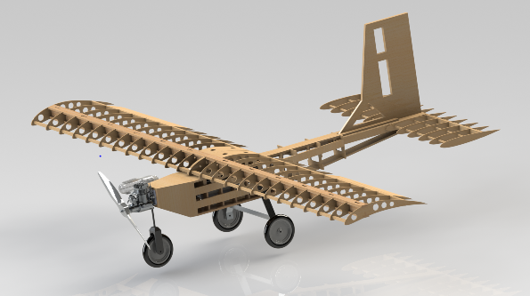
FINAL DESIGN
Brian Martinez

Slide 7
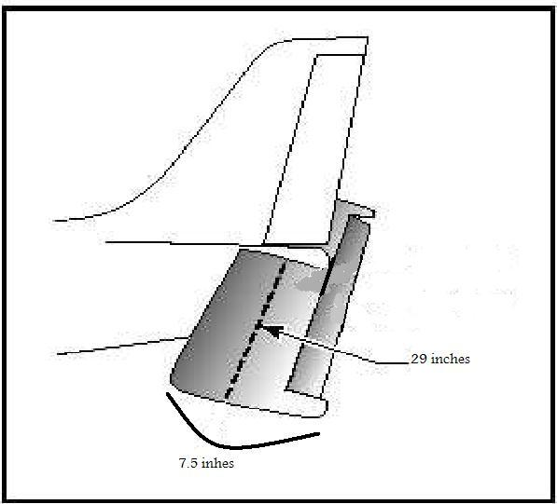
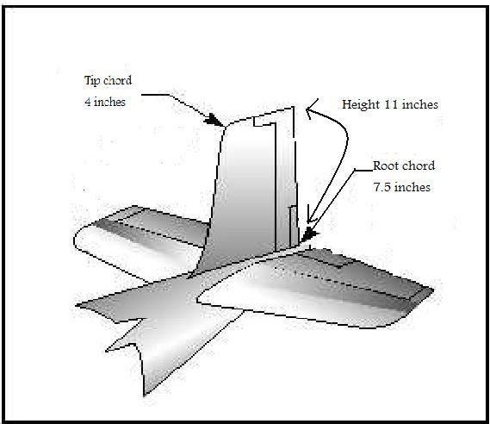
TAIL SIZING
Horizontal Tail
An Aspect Ratio of 4 will be used for the horizontal tail section
  This horizontal span will be about 32 in with a chord of 9 in
There will be no taper in the horizontal tail
Vertical Tail
Aspect Ratio will be 1.5
The vertical tail will be tapered at a ratio of 50%
Will have a root chord of 11.75 in
Will have a tip chord of 4.5 in
Will have a span of 14 in
(Anderson)
Noe Caro

Slide 8
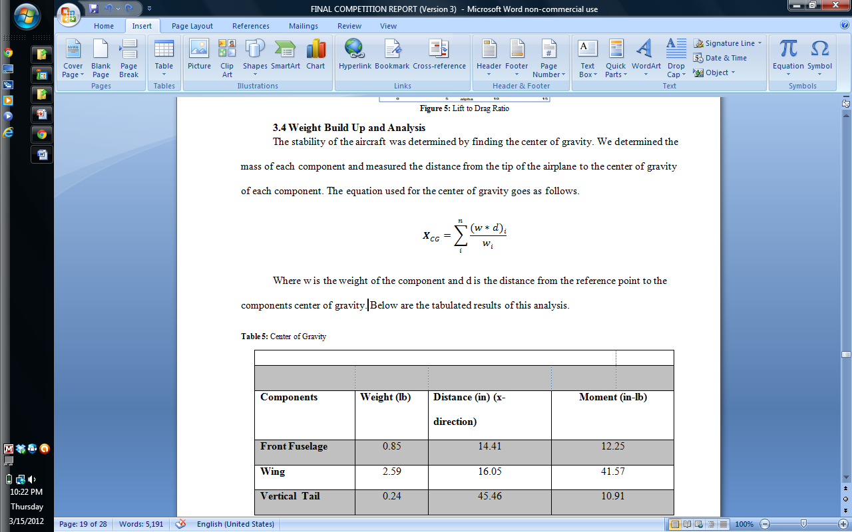
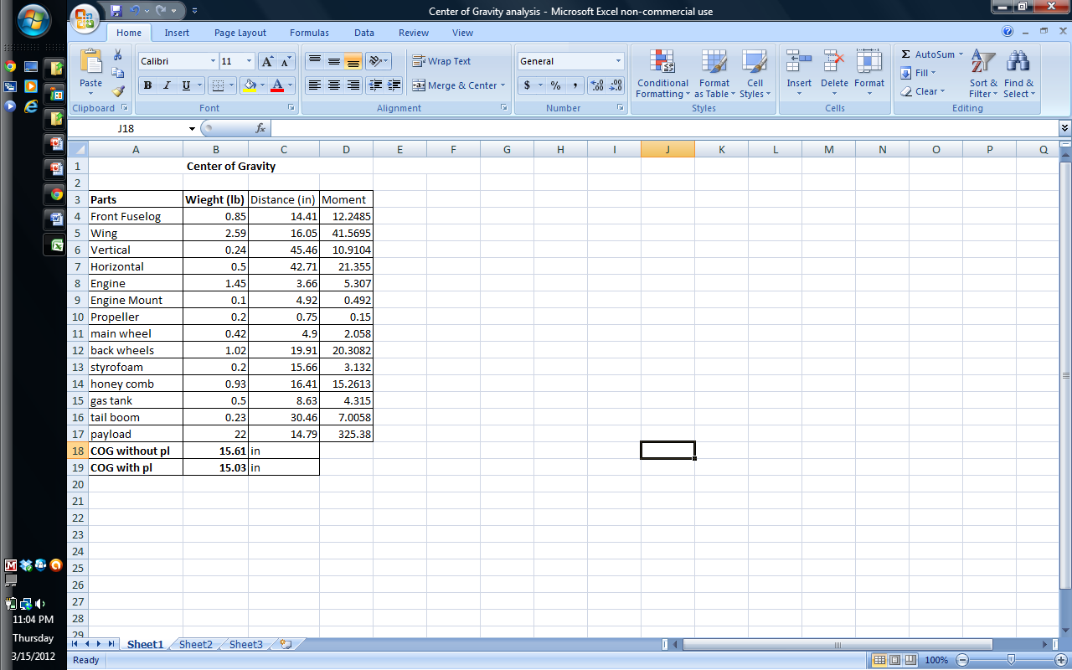
CENTER OF GRAVITY
C.G. is located 15.61 inches without payload from the tip of engine
C.G. is located 15.03 inches with payload from the tip of the engine
Noe Caro

Slide 9
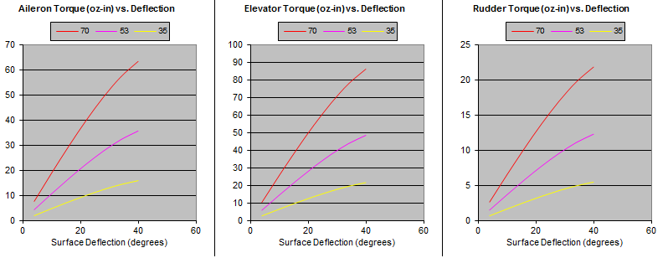
STABILITY & CONTROL
With C.G. we found the static margin using Aerodynamics, Aeronautics, and Flight Dynamics, John Wiley
Found that the plane was stable with and without payload
Neutral points were 2.18 and 2.74 inches from C.G.
Using different speeds
Based on results used different servos for elevator than the rudder and ailerons.
(Referenced from Aircraft Proving Ground)
Noe Caro

Slide 10
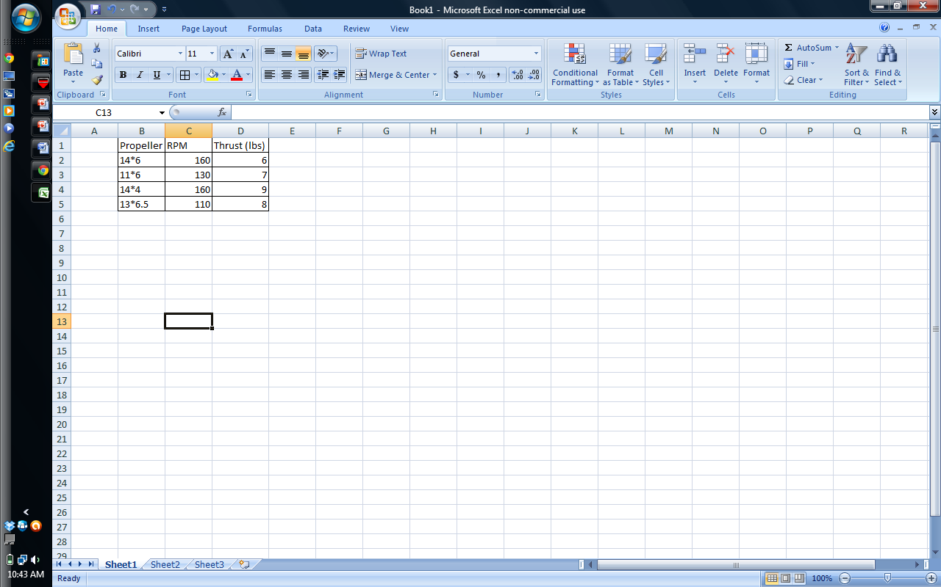
PROPULSION TESTING
Testing done with different propellers at elevation similar to Van Nuys.
Results indicated should use a 14*4 propeller

Slide 11
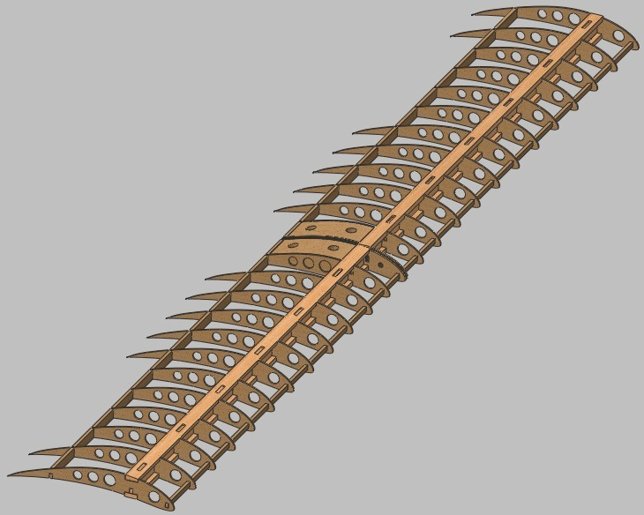
WING DESIGN
Wing span = 84 inches
Chord = 13 inches
Aspect Ratio =6.5
Rectangular Planform
Four lightening holes on
the airfoils
Three spar locations
Wing is built completely from
balsa wood
Mohammed Ramadan

Slide 12
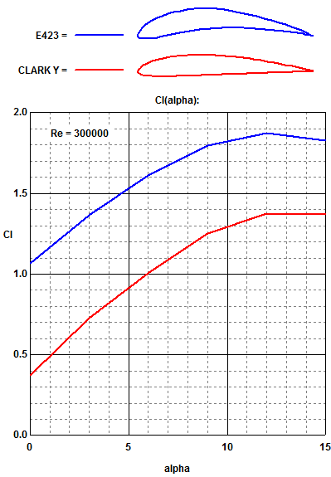
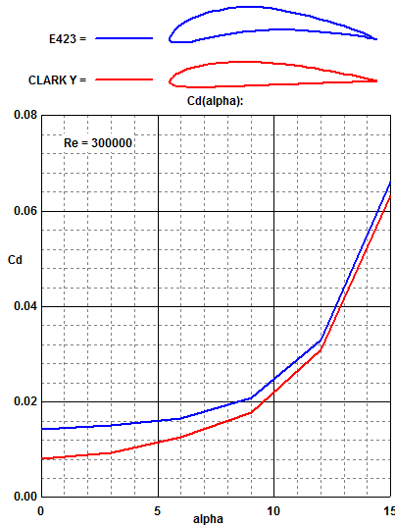
PERFORMANCE (DRAG & LIFT)
The calculated total Drag of the aircraft from induced drag, lift drag, and cooling drag
is 0.126
Mohammed Ramadan

Slide 13
PERFORMANCE (TAKEOFF)
Chase Beatty

Slide 14
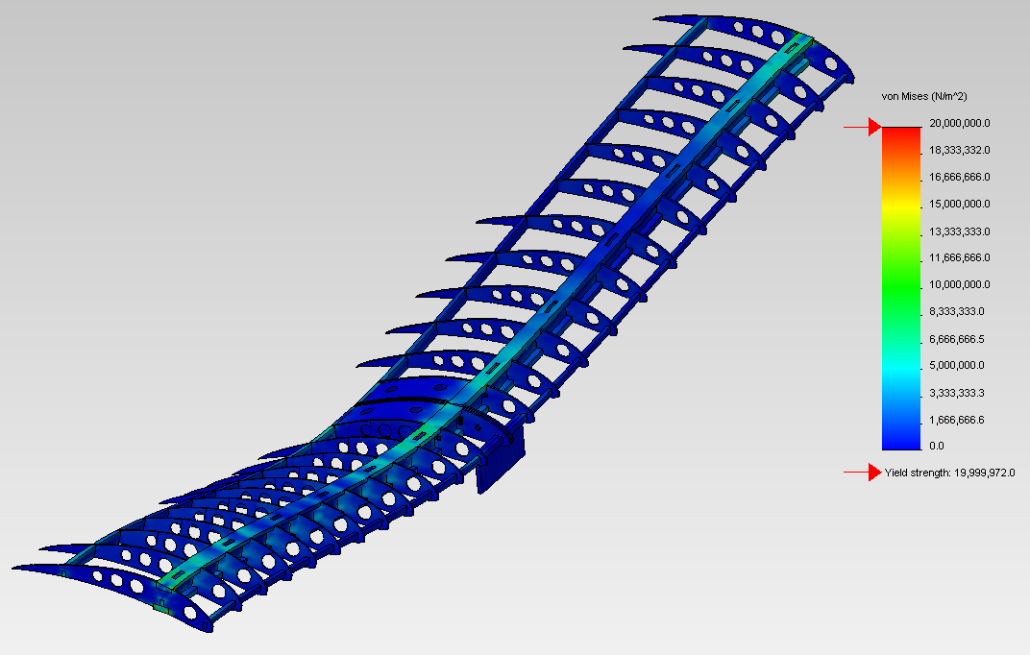
Wing Structural Analysis
22 lb loading with ends of the wings fixed
Maximum Stress- 2600 psi
Maximum displacement- 1.1 in
Yield Stress of balsa- 3000 psi
Chase Beatty

Slide 15
CONCLUSION
4 main categories
  Wing Design
  Stress Analysis
  Center of Gravity
  Performance

Slide 16
QUESTIONS?
Chase Beatty

Slide 17
REFRENCES
Anderson, John D., fundamentals of Aerodynamics, McGraw-Hill, New York, 2011
B. W. McCormick, Aerodynamics, Aeronautics, and Flight Dynamics, John
Wiley, 1995
Garner, W. B., “Model Airplane Propellers” 2009
Nicolai, Leland M., Estimating R/C Model Aerodynamics and Performance, Lockheed Martin, 2009
Aircraft Proving Ground. -http://www.geistware.com/rcmodeling/calculators.htm
Raymer, Daniel P., Aircraft Design: A Conceptual Approach, American Institute of Aeronautics and Astronautics, Virginia, 1999
Philpot, Timothy. Mechanics Of Materials. Hoboken: John Wiley and Sons Inc, 2008. 411-421.
Anderson, John D., aircraft performance and design, McGraw-Hill, New York, 1999

