Slide 1
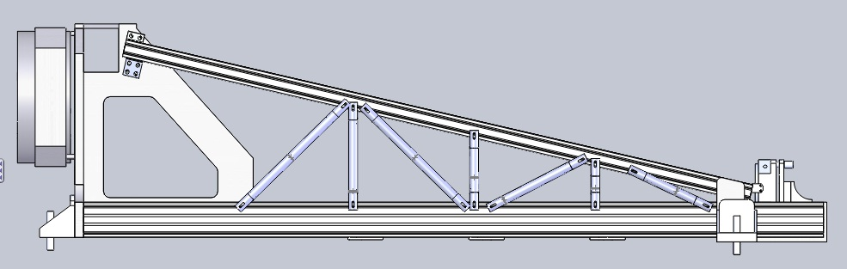
Stiffening an Off-Axis Beam Compressor Mount for Improved Performance
Notes:
Sarah

Slide 2
DSK Engineering
Derek Blash
  Team Leader
  Faculty Liason
Sarah Hoefker
  Secretary
Kyle Latz
  Finance Officer
  Client Liason
Notes:
Sarah

Slide 3
Client Description
Navy Prototype Optical Interferometer (NPOI)
Naval Research Lab
James H. Clark, III
  Started in 1990
  Optomechanical Lead Designer
Naval Research Lab/Lowell Observatory
Joel Dugdale
  NPOI Mechanical Engineer
Academic Advisor
Dr. Ernesto Penado
  Chair of Mechanical Engineering
Notes:
Sarah

Slide 4
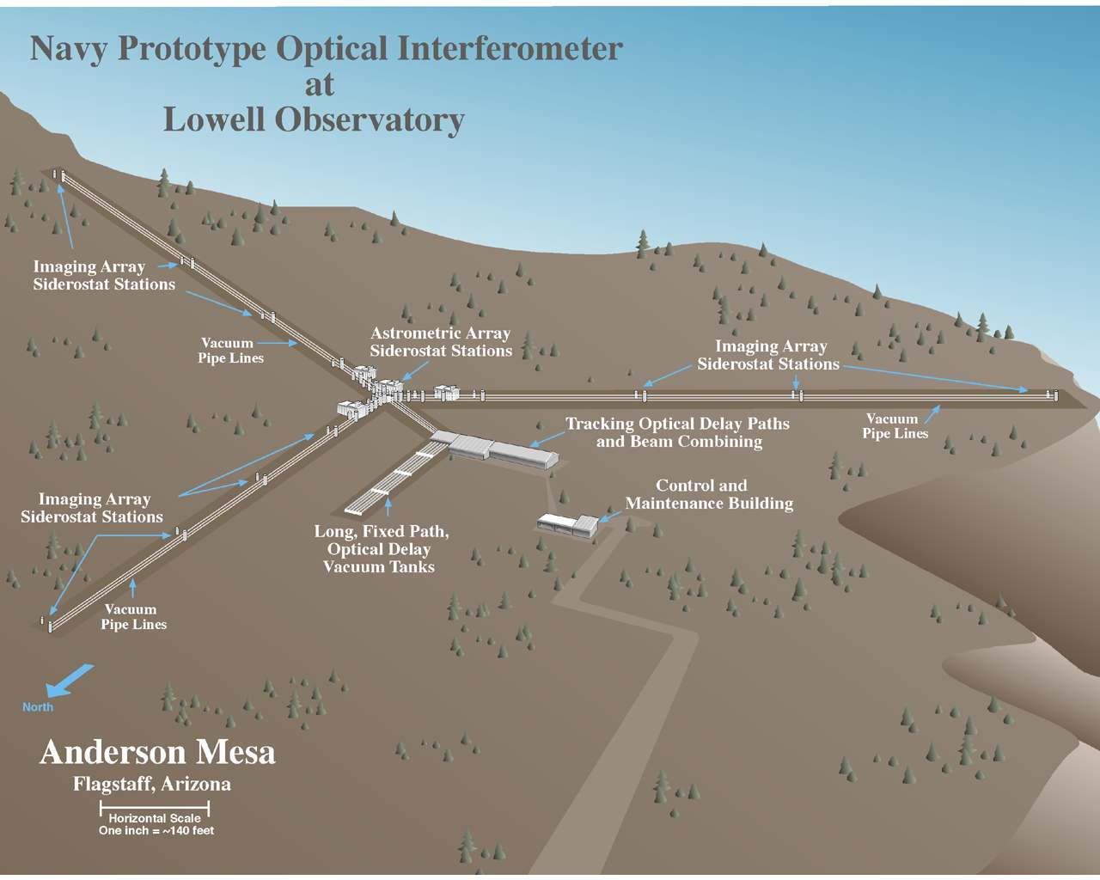
What is NPOI?
Notes:
Derek

Slide 5
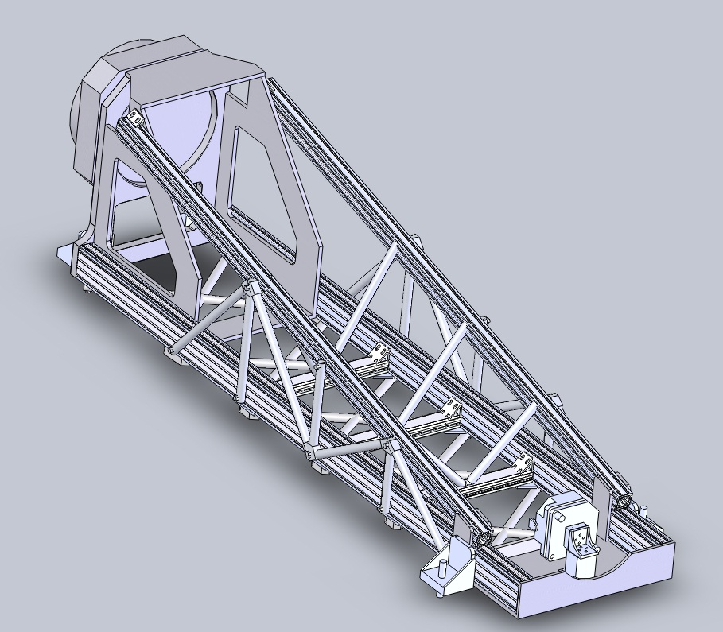
What is the Big Beam Compressor?
Placed between siderostat mirror and vacuum tube
Compresses the 14in beam to 5in beam
More photons per square inch
Notes:
Derek

Slide 6
Problem Definition
Beam compressor begins to vibrate at a low frequency which disturbs the beam of starlight
Verify finite element analysis (FEA) presented in client/advisor’s paper
Project Goal: To design and modify the current beam compressor to increase its fundamental frequency and reduce the amplitude of the vibrations increasing visibility from 7,000 to 70,000 stars.
Notes:
Derek

Slide 7
Specifications
Weight Limit (Beam Compressor) | Must not exceed 258 pounds (or 10%)
Materials | Aluminum 6061 thin walled tubing
Material dimensions | 1 inch diameter with .0625 inch wall thickness
Budget | $300
Mounts | 4
Frequency | Within 30% of desired 128 Hz
Notes:
Kyle

Slide 8
State of the Art Research
“Stiffening an off-axis beam compressor mount for improved performance” published by Ernesto Penado, James H. Clark, III, and Frank Cornelius
ISOTRON accelerometers
  Endevco website
  National Instruments
LabView manual
Mechanical Vibrations by S.S. Rao
Notes:
Kyle

Slide 9
Budget
Material | Price | Purchased From
Aluminum Tubing | $104 | Industrial Metal Supply
Hardware | $7 | Copper State Nut & Bolt
Computer Costs | $75 | Data Doctors
Poster Mounting | $60 | Michael’s
Total Cost | $246
Allocated Budget: $300
Notes:
Kyle

Slide 10
Schedule
Phase 1: Research (9/27/2010 - 10/25/2010)
Phase 2: Design and Manufacture Support Modifications (10/11/2010 - 3/1/2010)
Phase 3: Testing for Max Displacements of Beam Compressor (3/1/2011 – 3/19/2011)
Phase 4: Data Reduction (3/19/2011 – 4/1/2011)
Phase 5: Prep for possible Optics Lab testing (4/22/2011-5/8/2011)
Total Hours: 240 hours (Jan-April 2011)
Notes:
Sarah

Slide 11
Deliverables
Memo showing final prototype for structural members (2/17/2011)
Memo describing our testing results (4/1/2011)
Reports with Tables and Graphs Comparing Actual Data to Predicted Data (4/17/2011)
Final Presentation/Poster (4/29/2011)
Final Capstone Paper (5/6/2011)
Notes:
Sarah

Slide 12
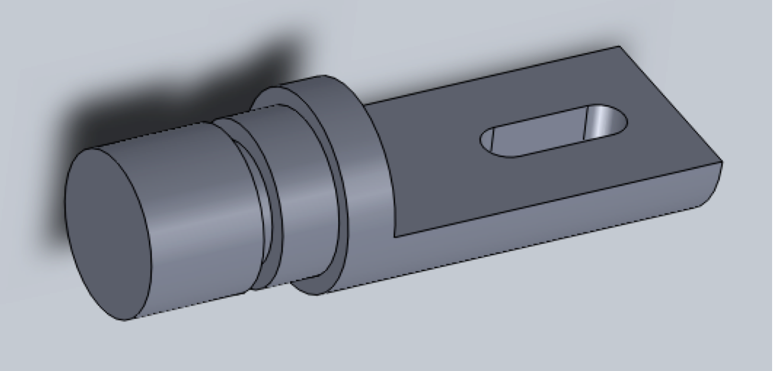
Concept Development
Prototype 1: Machined joint/end attachment
Notes:
Kyle

Slide 13
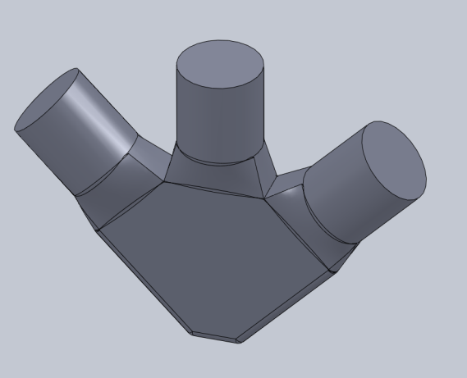
Concept Development
Prototype 2: NASA joint
Notes:
Kyle

Slide 14
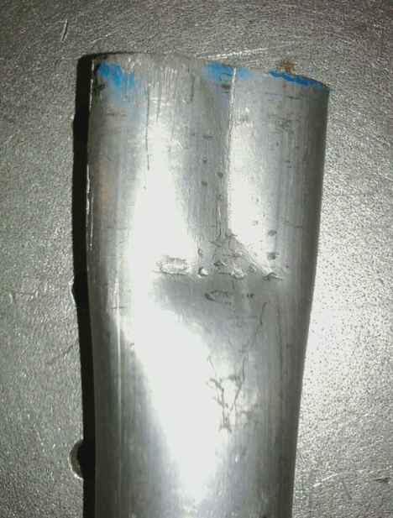
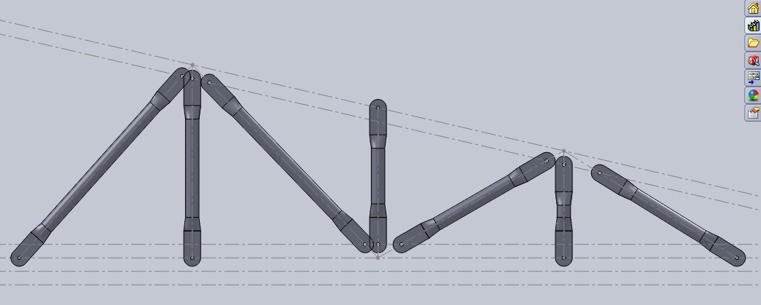
Concept Development
Prototype 3: Crimped tubing (Rounded edges)
*Desired by Client*
Cracked: Unable to use
Notes:
Kyle

Slide 15
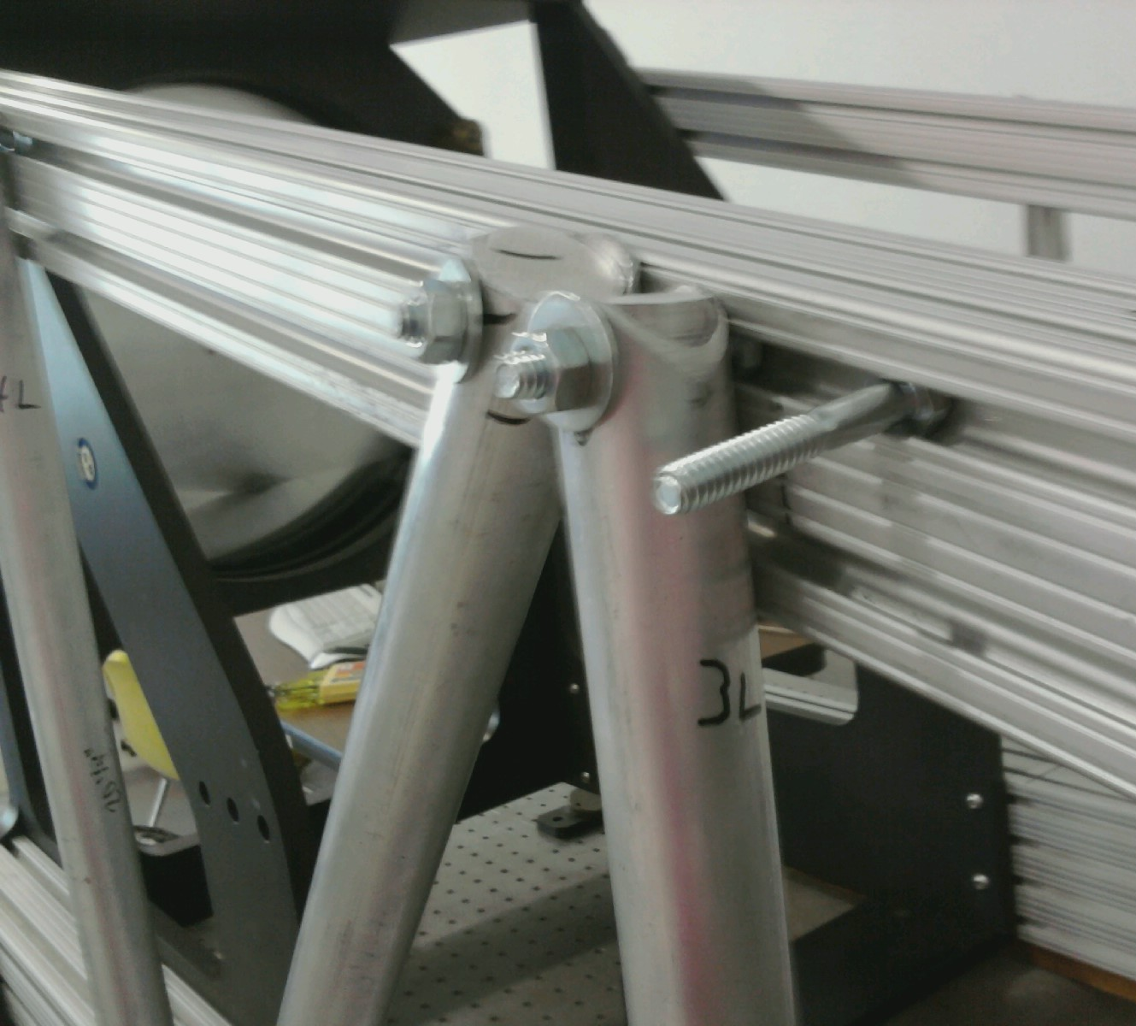
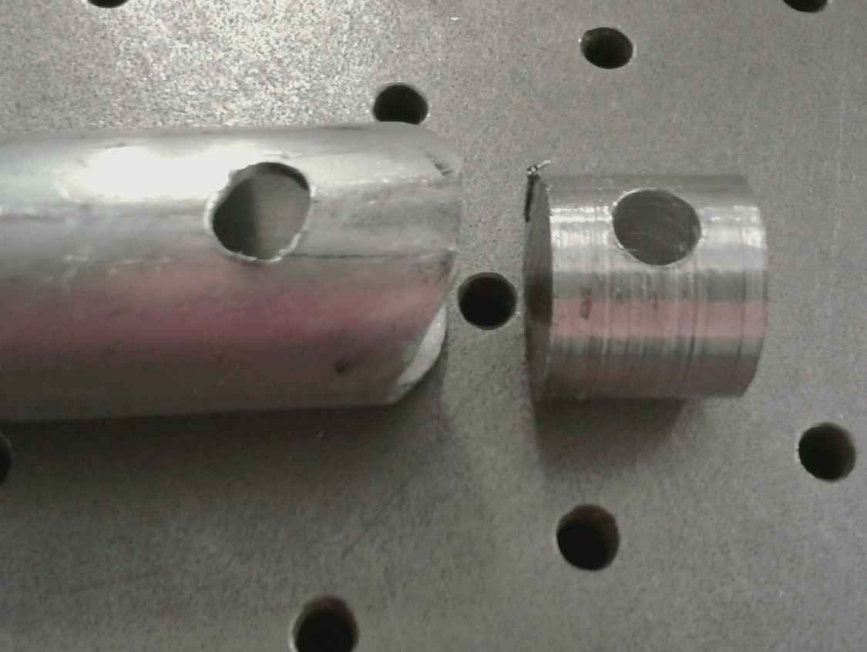
Actual Development
Prototype 4: Plugged ends to prevent crushing
Open source loading
Notes:
Kyle

Slide 16
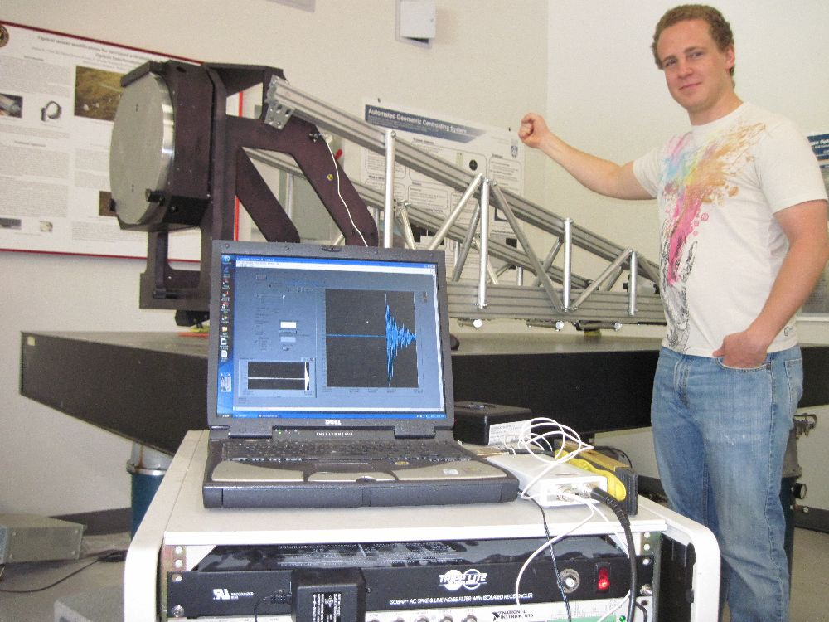
Testing
Tested max displacement points
Tested other points
LabVIEW VI (virtual instrument)
Notes:
Derek

Slide 17
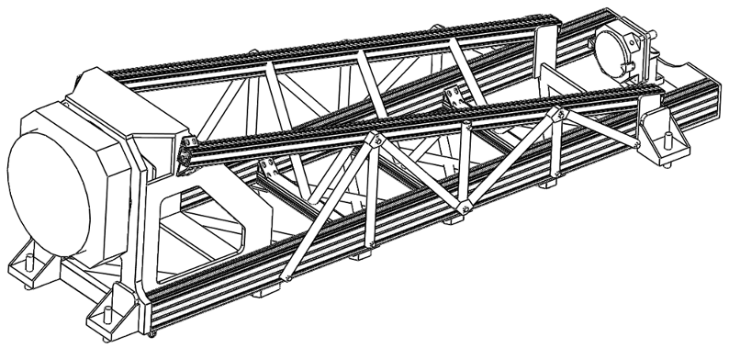
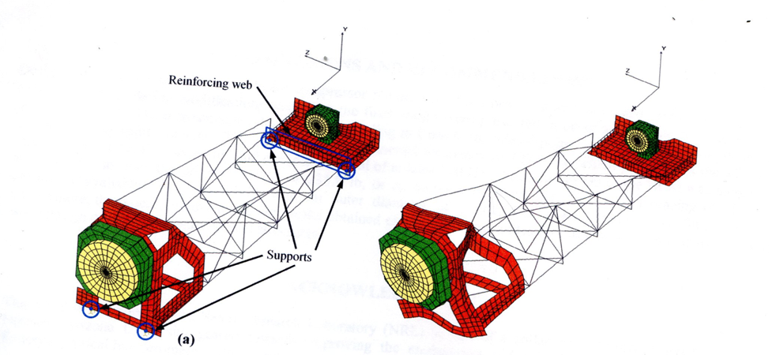
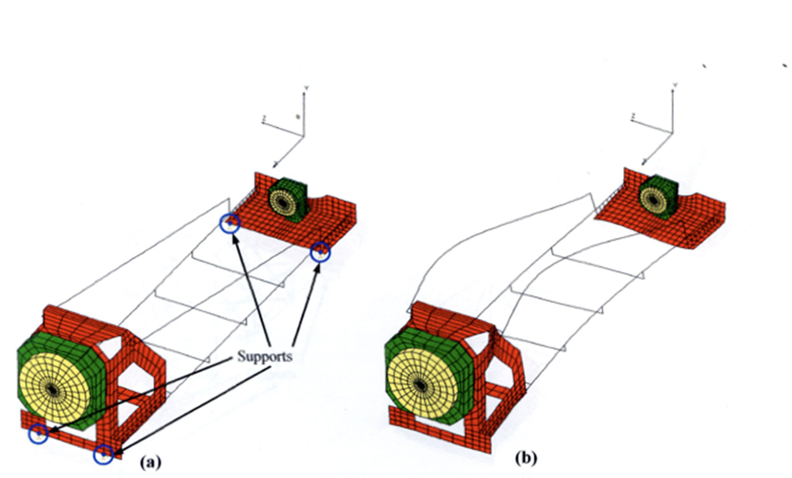
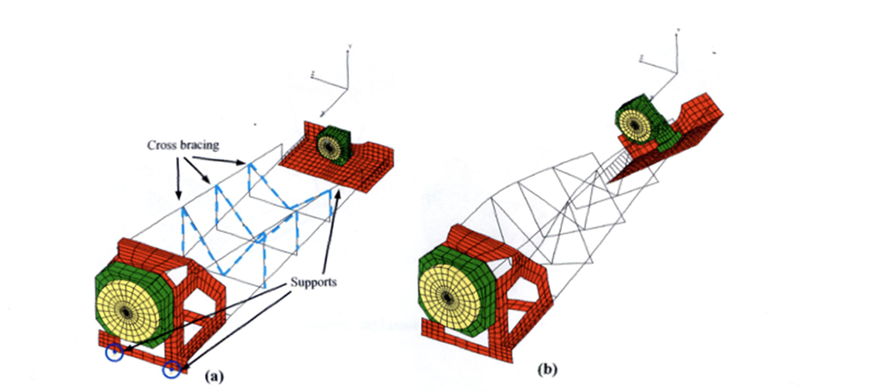
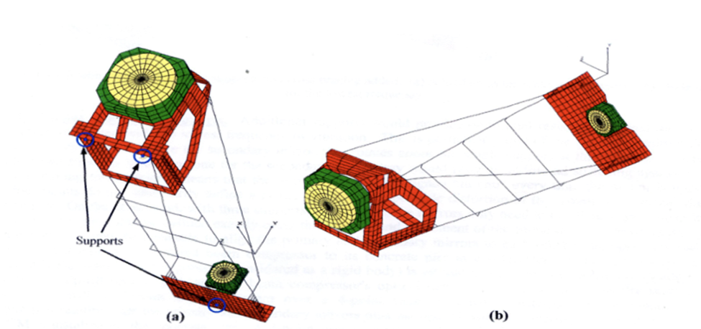
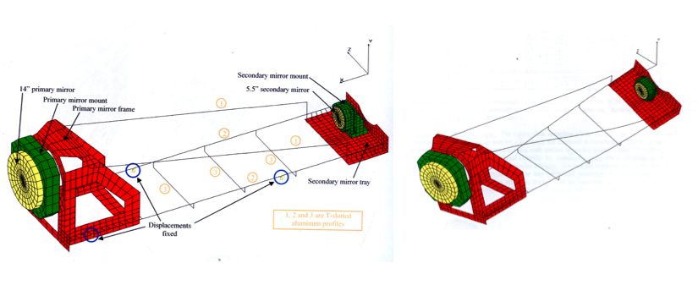
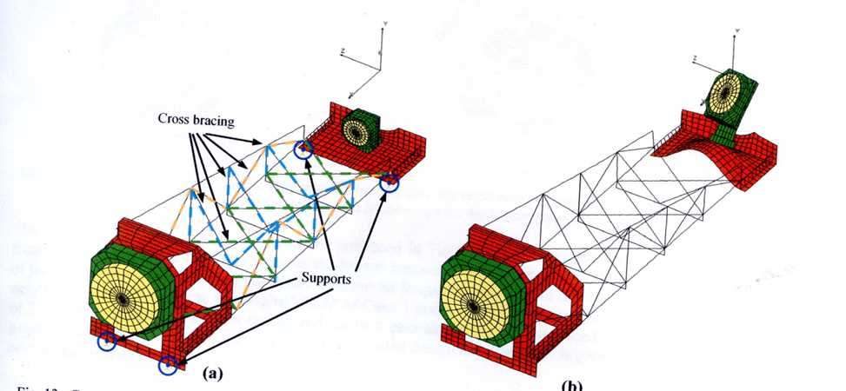
Testing Results
Test Cases | Frequency (Hz) FEA Actual |  | Difference | % Error
1 | 17.4 | 13.3 | 4.1 | 23.6
2 | 33.2 | 31.0 | 2.2 | 6.6
3 | 36.1 | 32.0 | 4.1 | 11.4
4 | 66.5 | 60.0 | 6.5 | 9.8
5 | 113.7 | 84.4 | 29.3 | 25.8
6 | 127.6 | 95.9 | 31.7 | 24.8
7 | >127.6 | 97.3 | 30.3 | 23.7
 | Frequencies (Hz)
Test Cases | FEA | Actual | Difference | % Error
1 | 17.4
2 | 33.2
3 | 36.1
4 | 66.5
5 | 113.7
6 | 127.6
Notes:
Derek

Slide 18
Results
Original Frequency: 13.3 Hz
Final Frequency: 97.3 Hz
Notes:
Derek

Slide 19
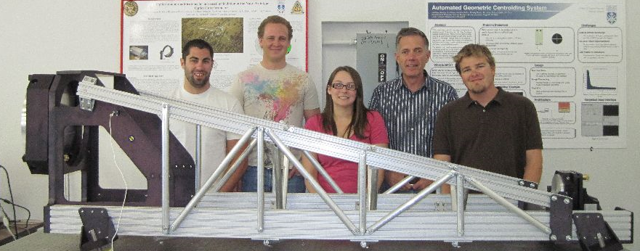
Conclusion
Final Weight: 257.4 lbs (<10%)
Test Results within 30%
4 points of contact
Recommendations
Notes:
Derek

Slide 20
Questions?

