Slide 1


Design applications for girls ON Raspberry PI PLATFORM (DAGPI)
EGR 486C – Fall 2016
Q8 Engineering Team
Hussain Alfadhli
Anwar Albloushi
Ammar Alnajjar
Abdulaziz Alsharhan

Slide 2
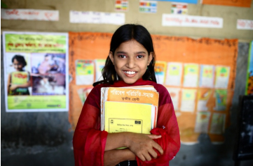
Girls Education – the facts
There are still 31 million girls of primary school age out of school.[1]
34 million female adolescents out of school in lower secondary school. [1]
Two-thirds of the 774 million illiterate people in the world are female. [1]
Courtesy UNESCO [1]

Slide 3
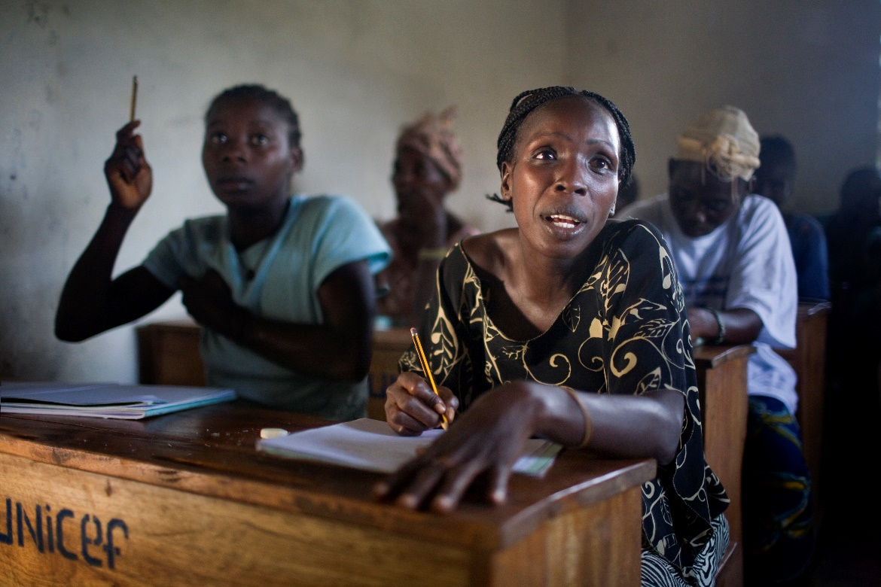
Why Educate?
Mothers’ education improves child nutrition.[2]
Girls with higher level education are less likely to have children at an early age.[2]
Education narrows pay gaps between men and women.[2]
Educated women are more likely to find work.[2]
Courtesy UNESCO [3]

Slide 4
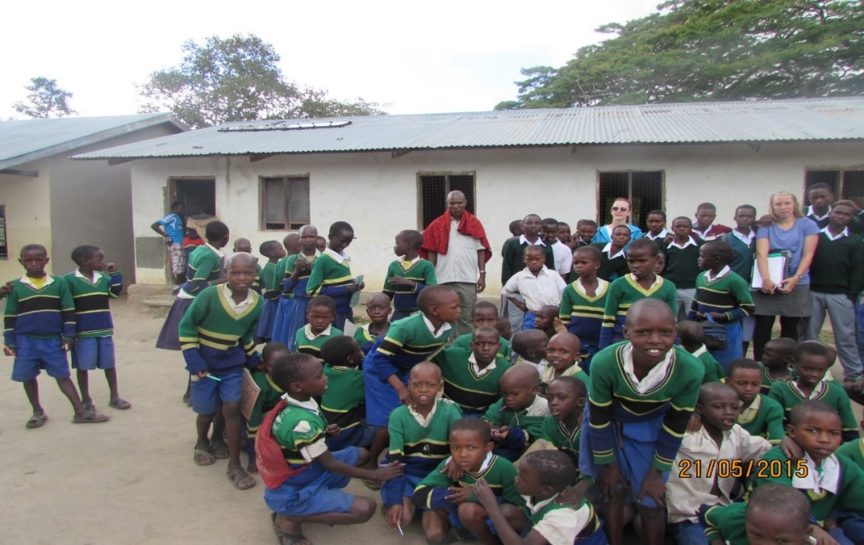

Project Scope and Goal
Increase proficiency in STEM education for girls through technology
Using DAGPI for field work and educational projects
Courtesy Dr. McDonnell [3]

Slide 5

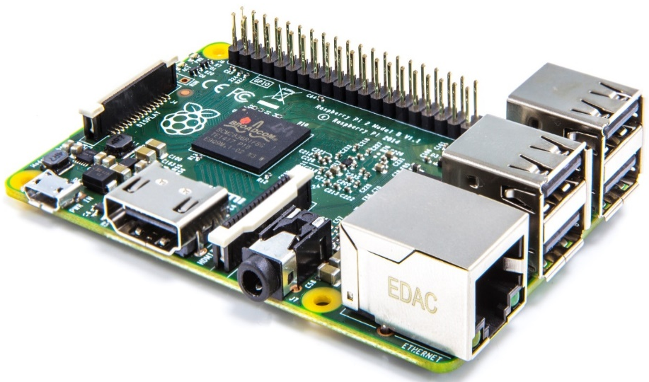
Tablet
Design Criteria
Robust Case
Cost Effective
Available
Learning opportunity (girls can build and maintain them)
Design Option
Raspberry Pi with 2.8 PiTFT Touch Screen

Slide 6
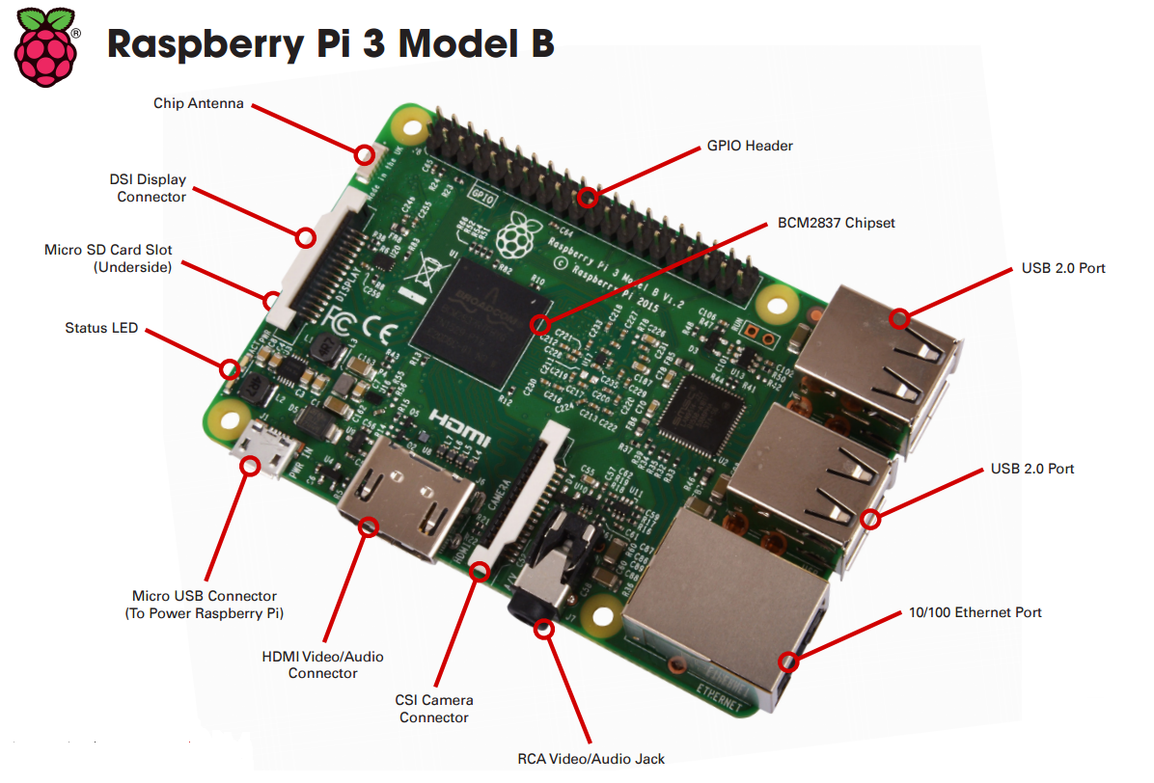
DAGPI Specifications
Table characteristics of the raspberry pi 3
Parameters | Raspberry pi 3
Processor | BCM2837
USB (2.0) | 4
RAM | 1 GB SDRAM
Storage | Micro-SD Card
Ethernet interface | 10/100 Mbits/s
Wireless | 802.11n / Bluetooth 4.0
Video output | HDMI / composite
Audio output | HDMI / Headphone
GPIO | 40
Price | $35
[4]

Slide 7
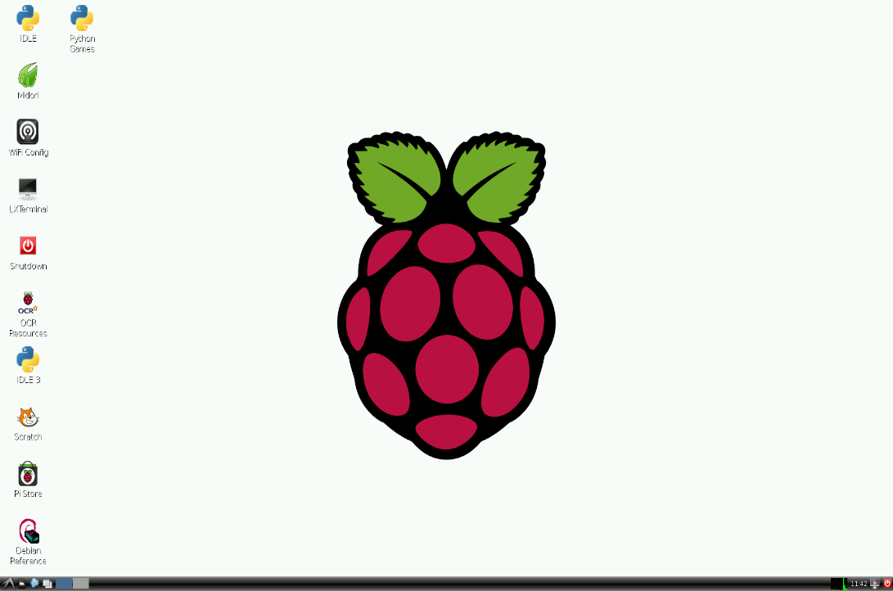
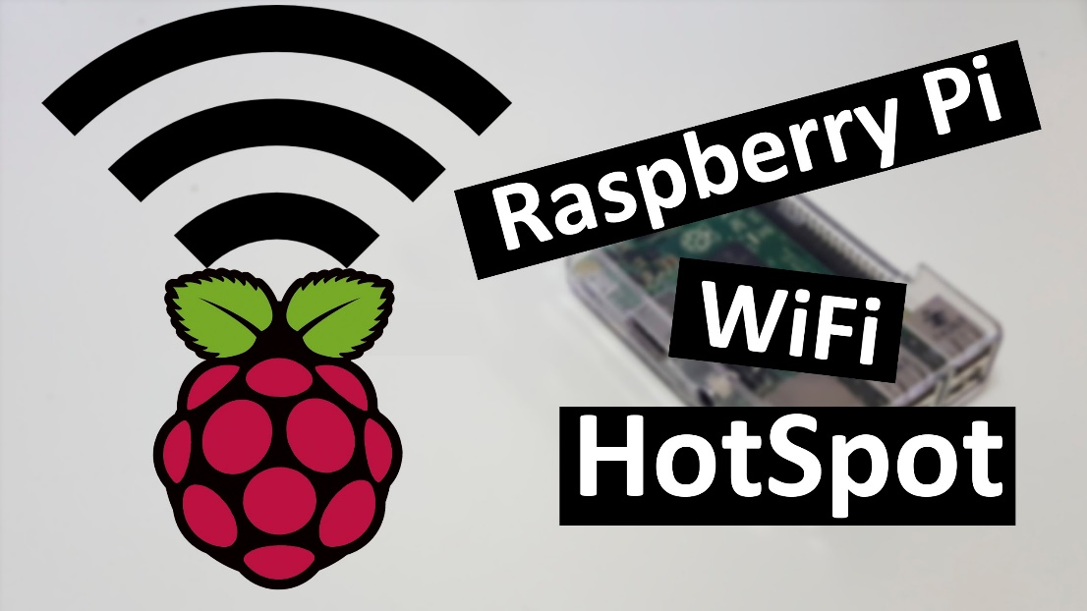
DAGPI Programming
Operating system (Raspbian)
Wi-Fi Access Point

Slide 8
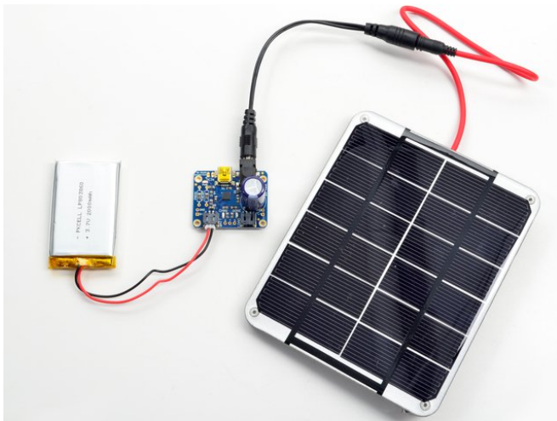
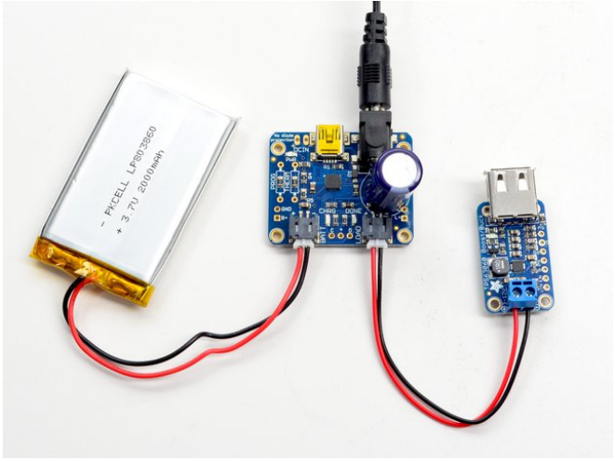
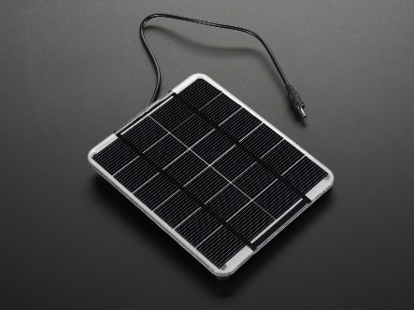
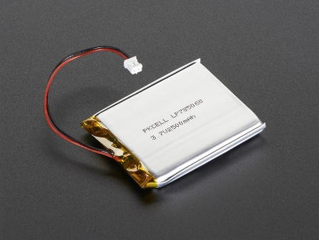
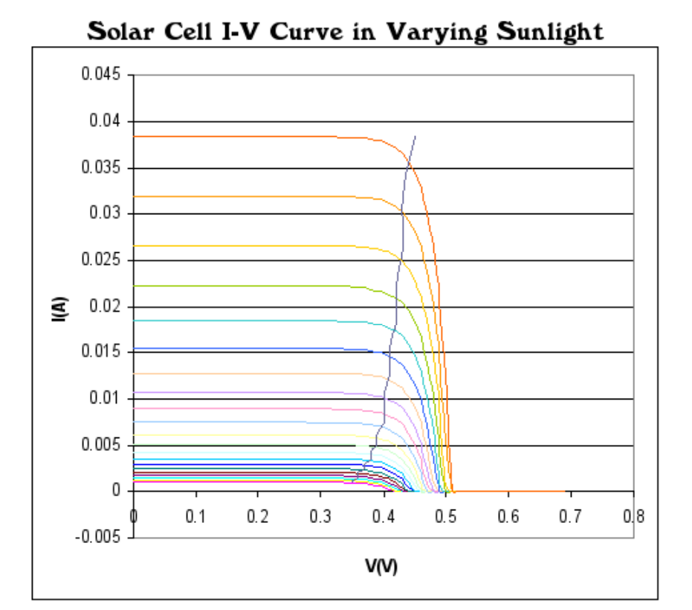
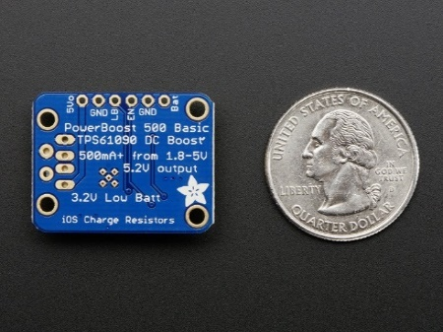
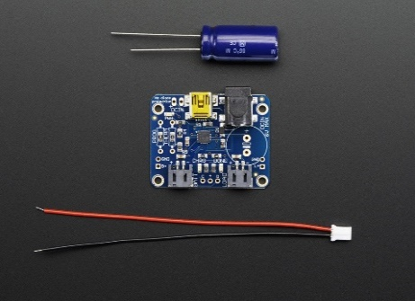
DAGPI Power
Powering DAGPI through 2W solar panel
Solar cell I-V curve in varying sunlight
Courtesy Adafruit [5]

Slide 9
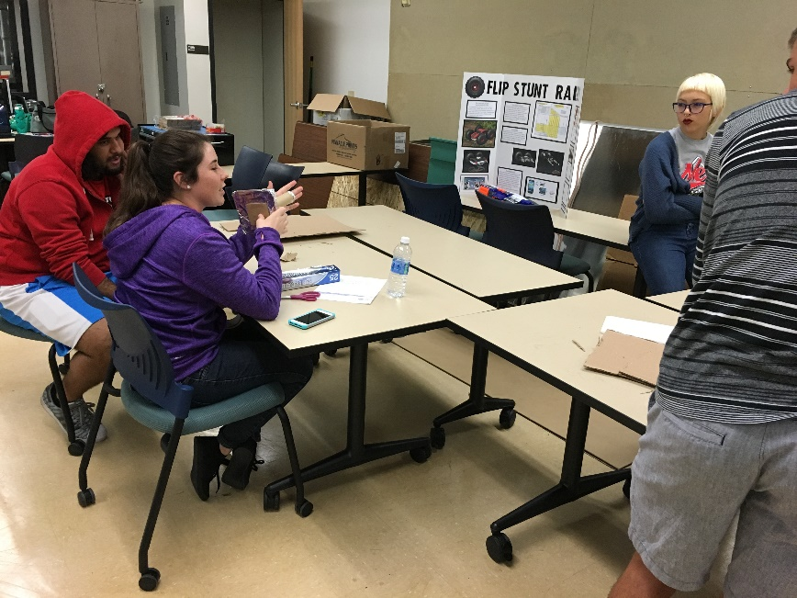
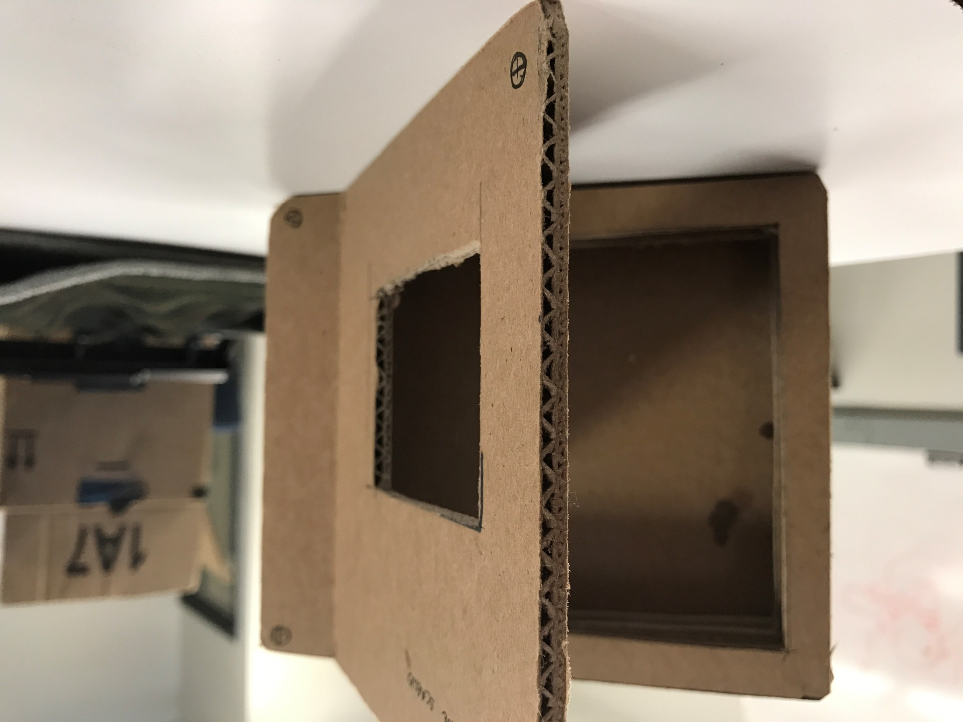
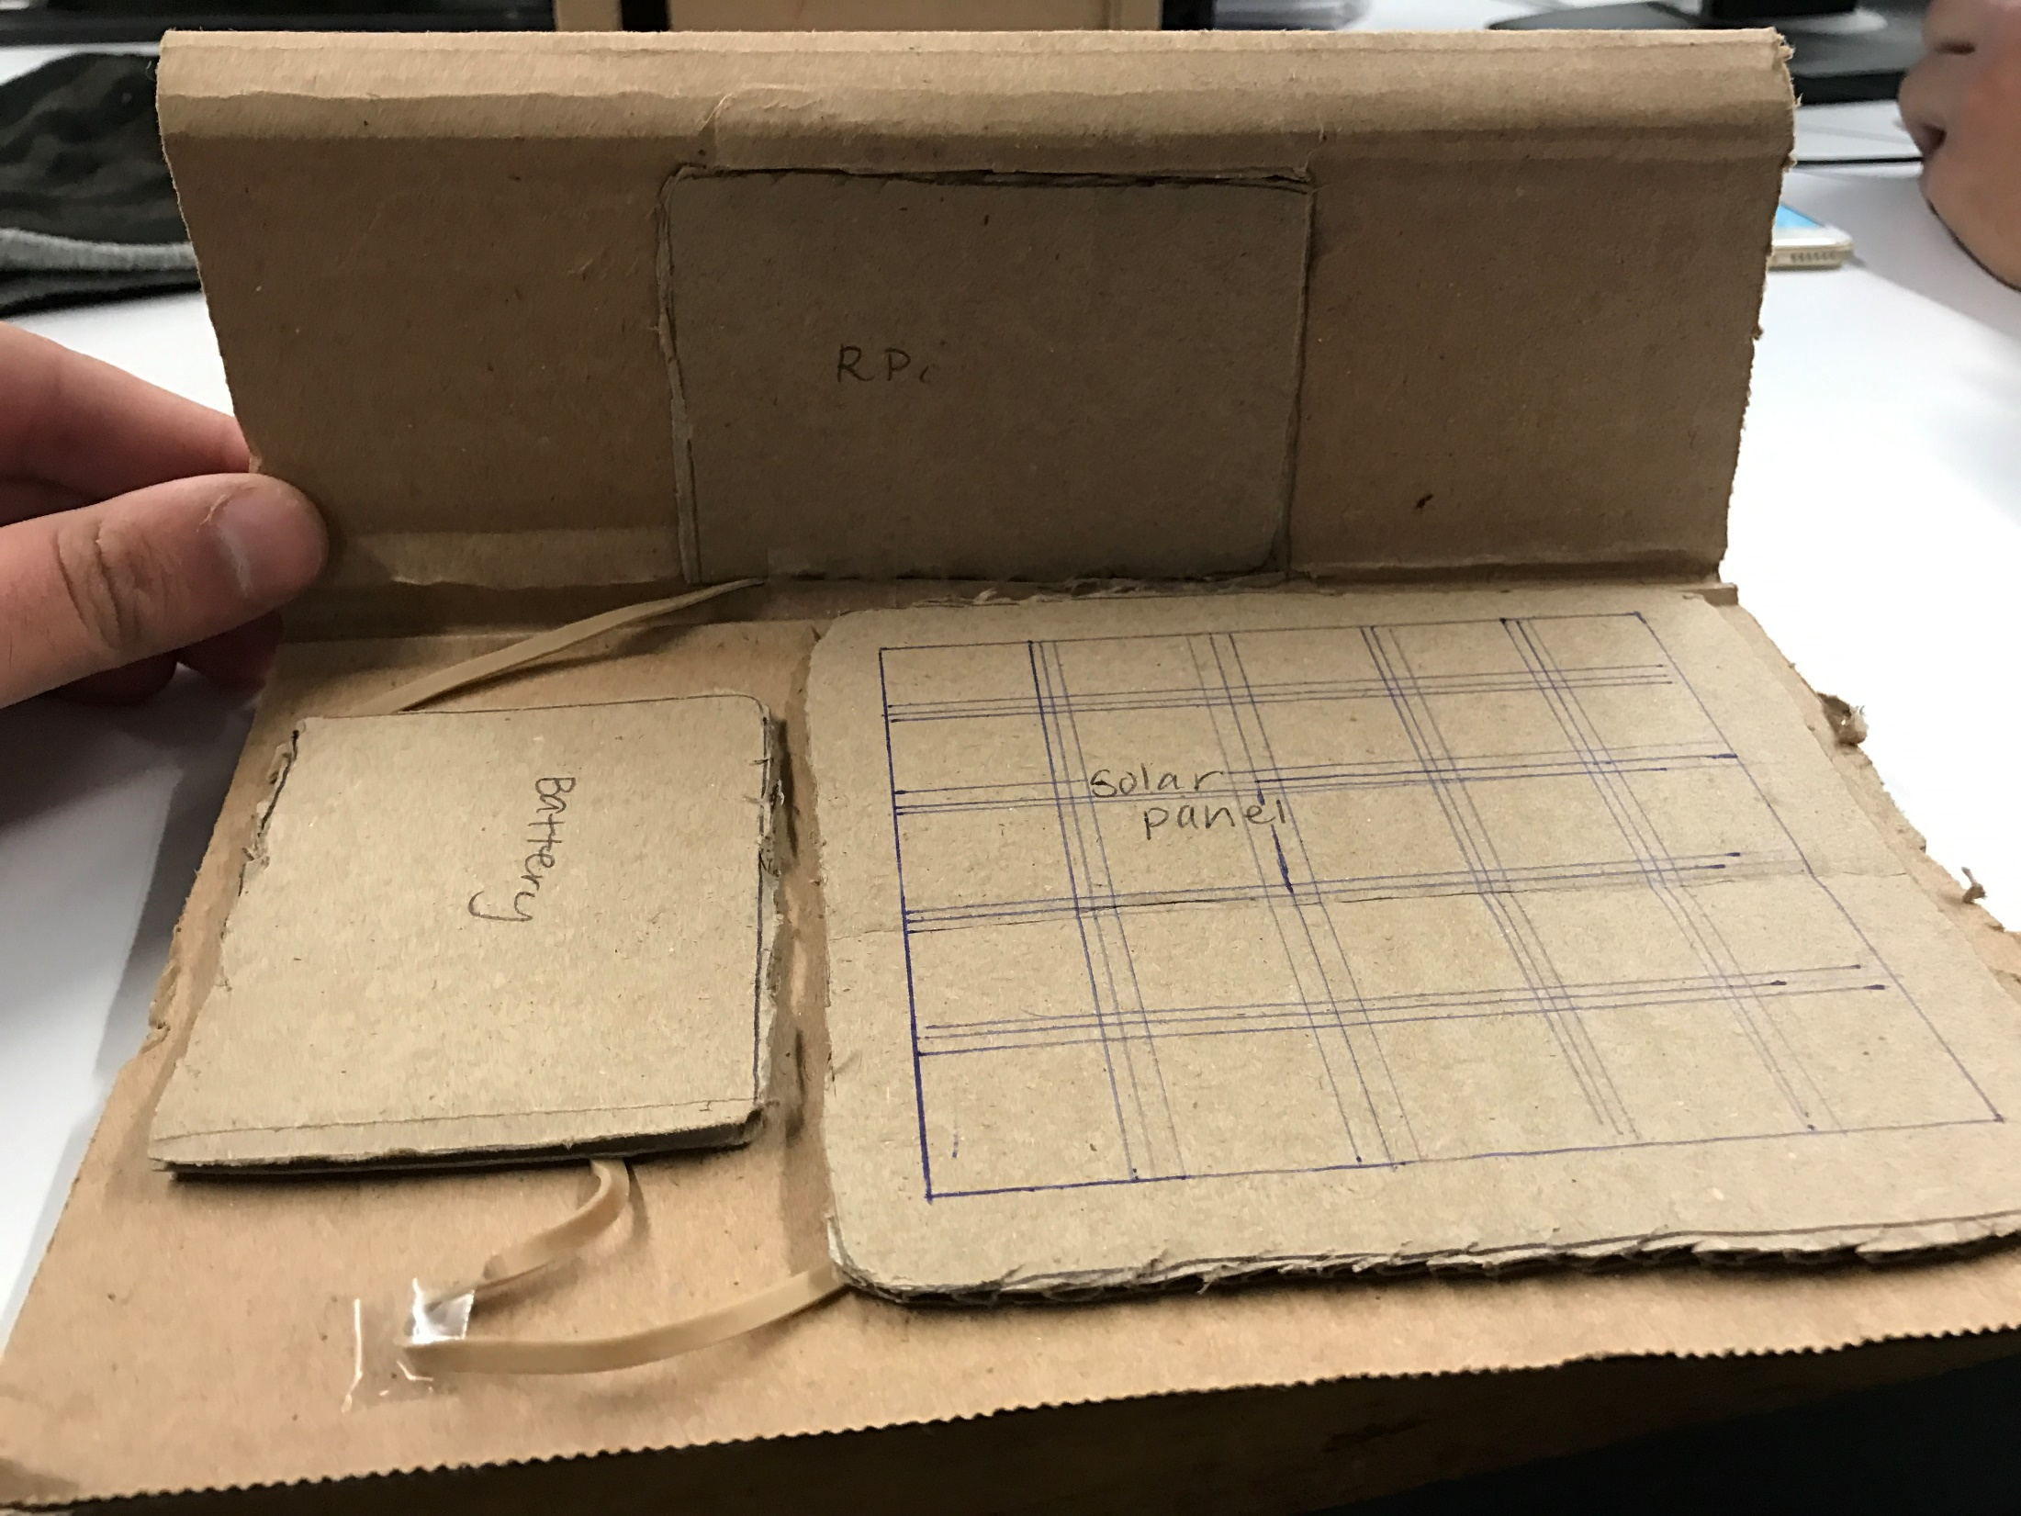
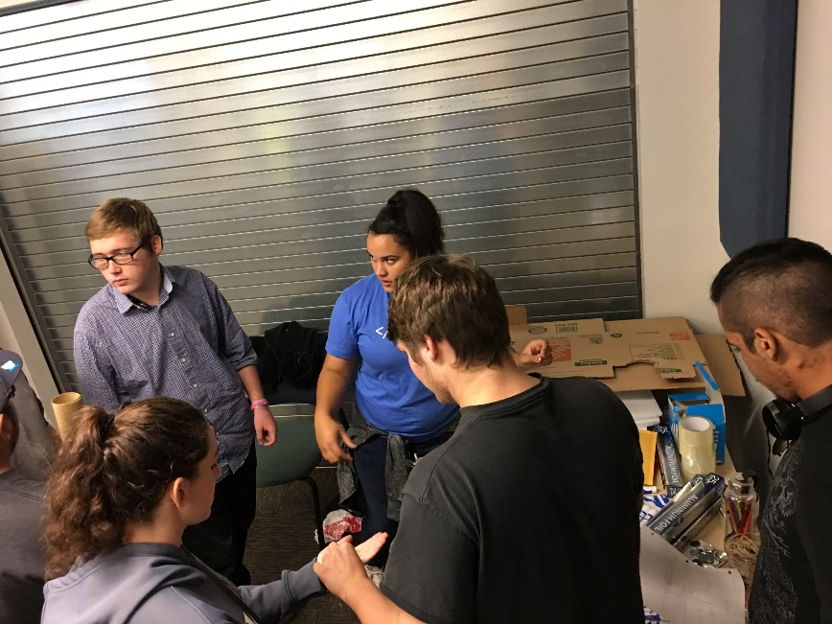
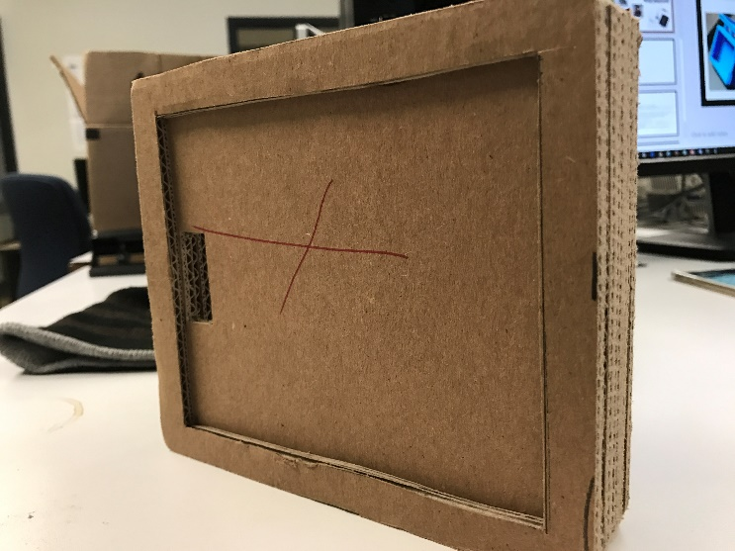
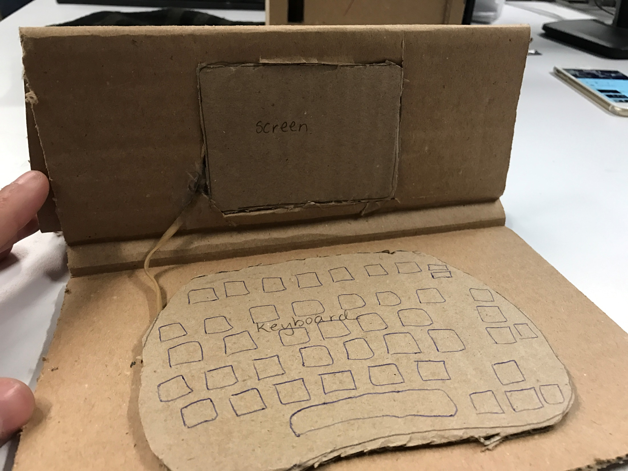
EGR 186 Rapid Prototypes

Slide 10
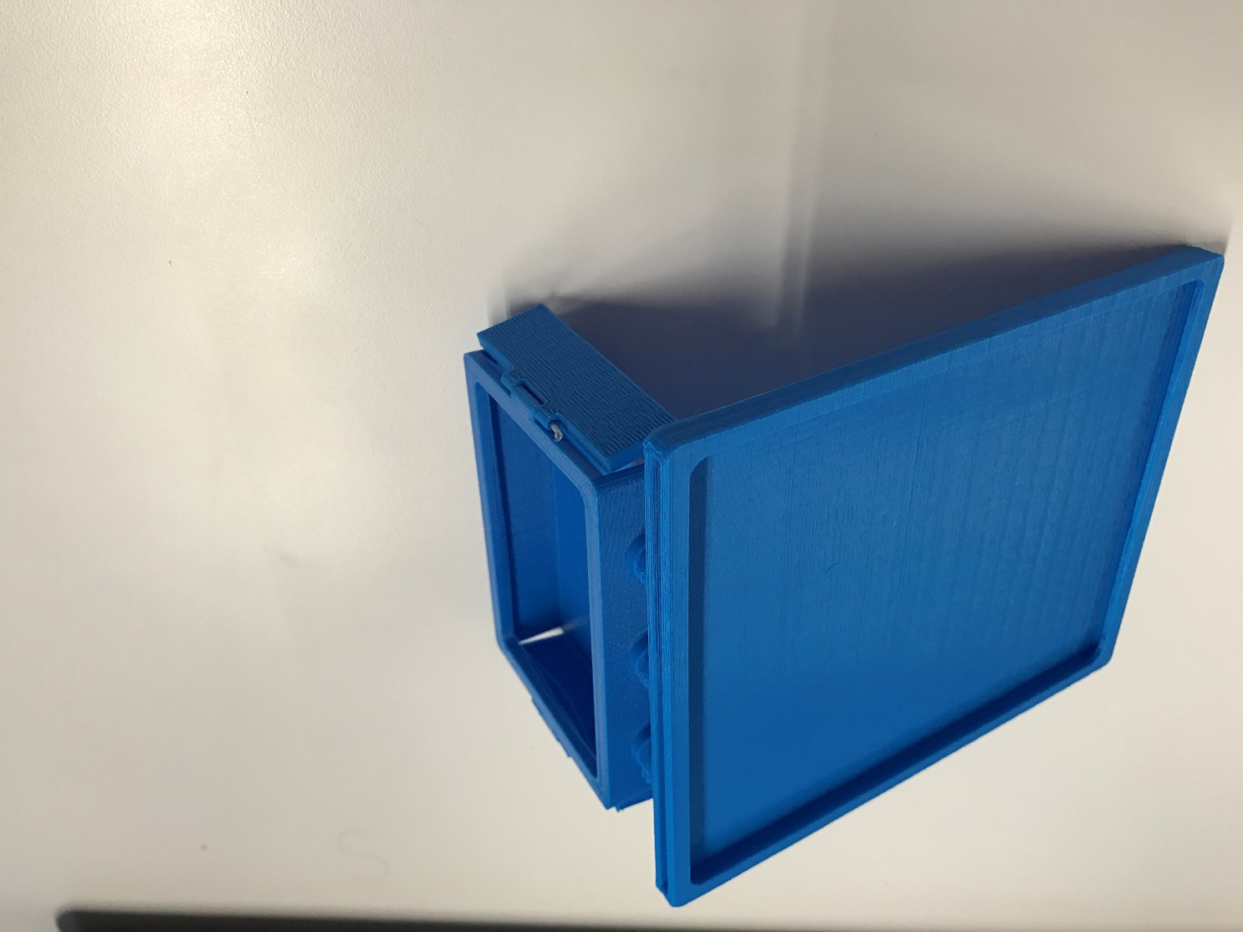
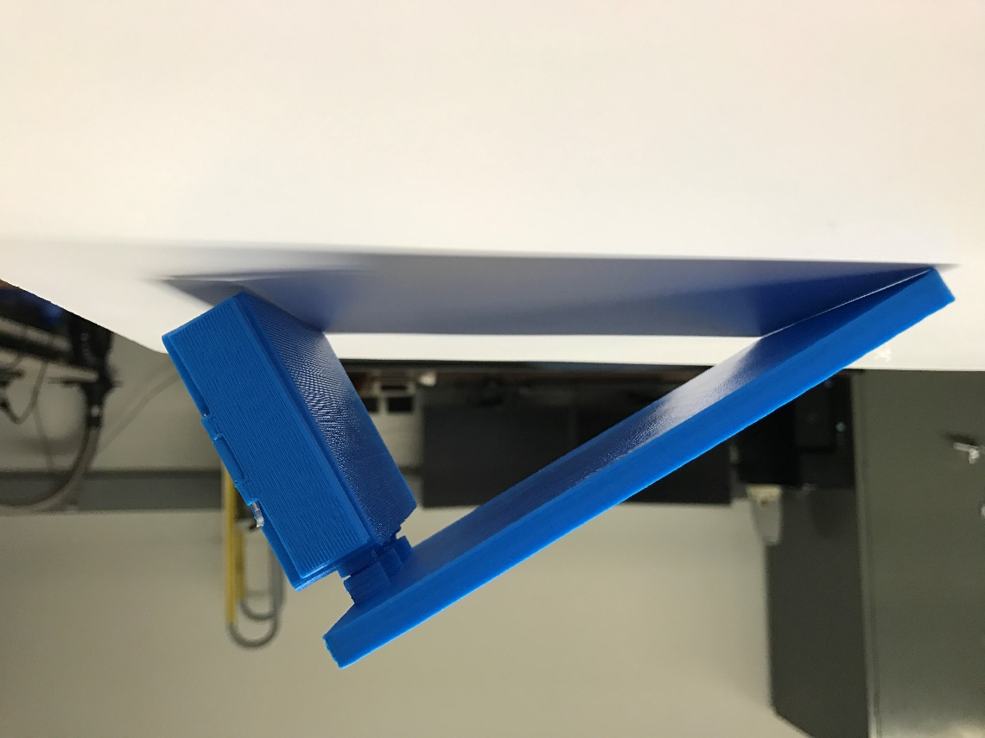
DAGPI Final Case

Slide 11

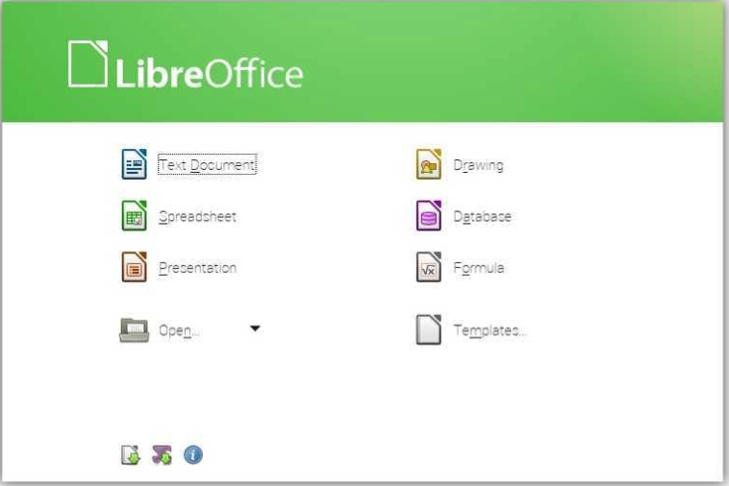

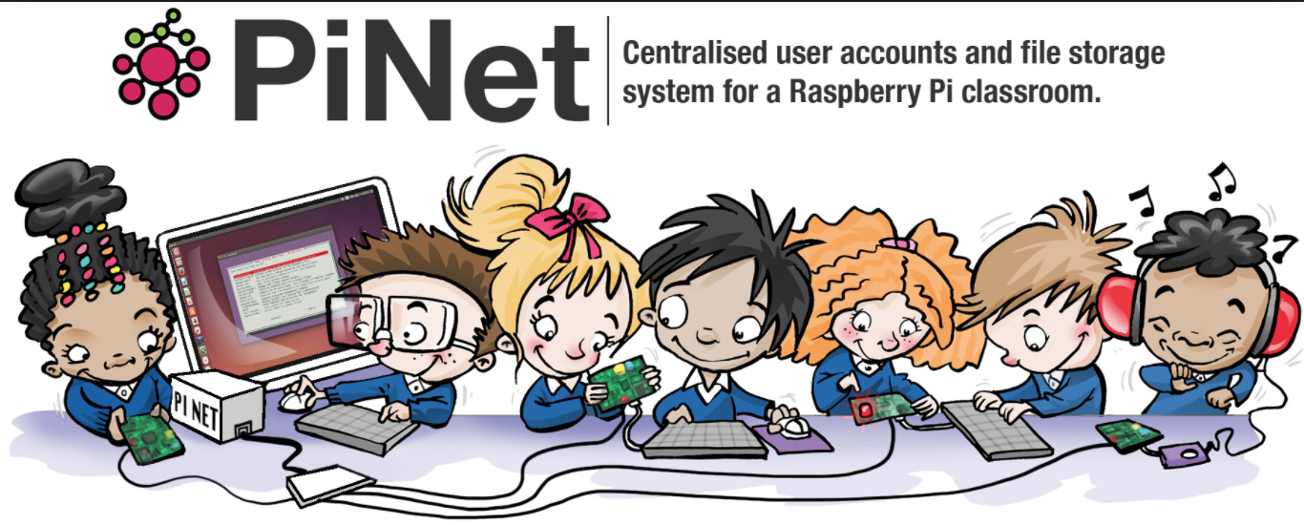
Applications on DAGPI
Scratch

Slide 12
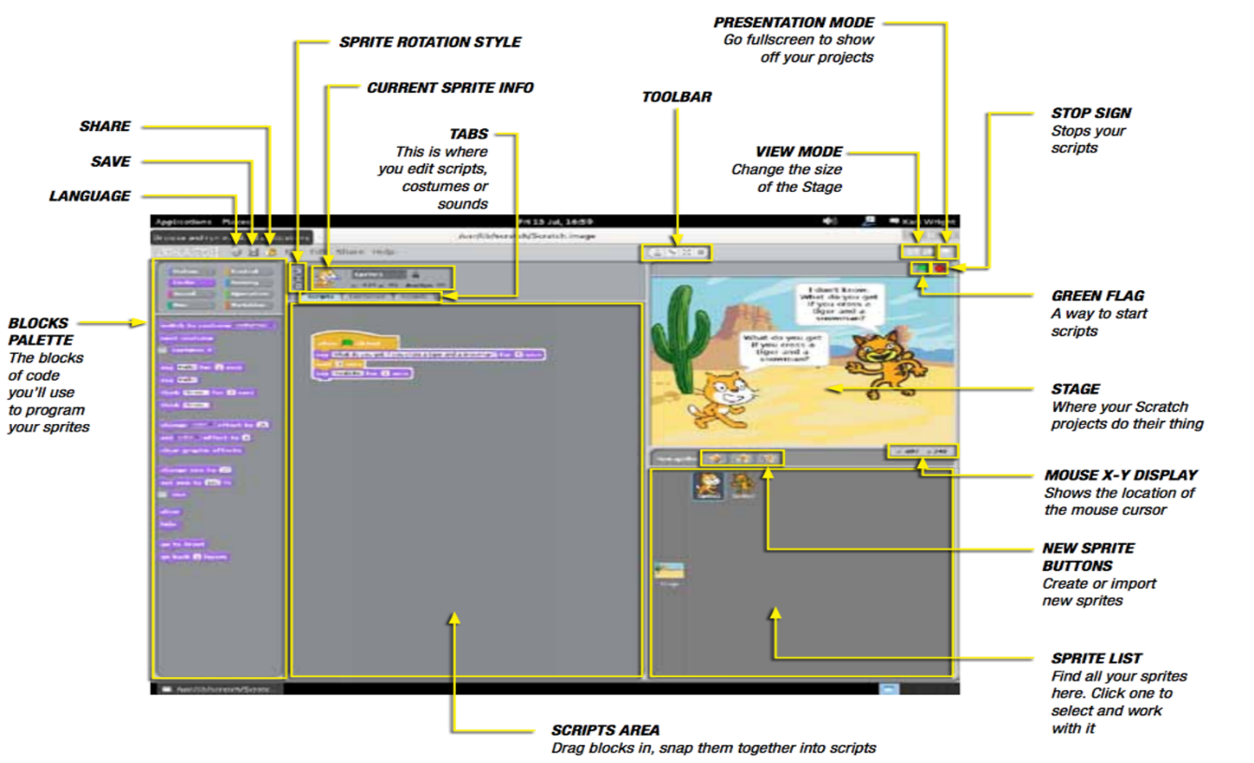
Applications for girls
Scratch | Animations and games with a drag-and-drop interface Using some programming techniques without having to write a code
PiNet | Free and open source server. Network based user accounts Shared folders Work collection system Automated backups

Slide 13



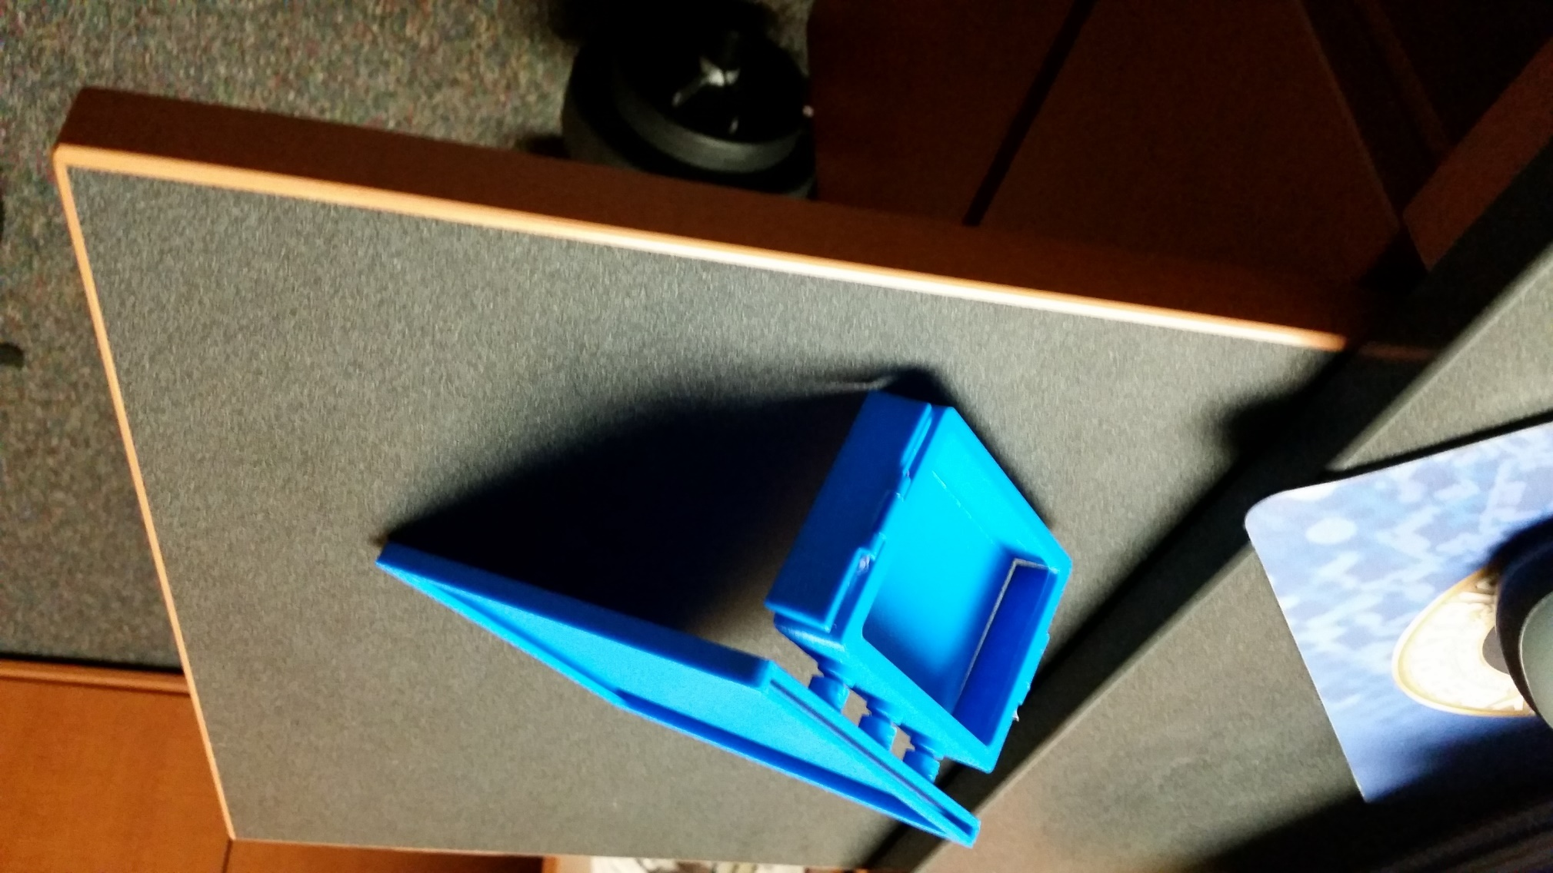
Summary

Slide 14
Acknowledgement
Dr.Dianne McDonnell
Ashwija Korenda

Slide 15
References
[1]"Girls' Education - the facts", unesco, 2013. [Online]. Available: https://en.unesco.org/gem-report/sites/gem-report/files/girls-factsheet-en.pdf. [Accessed: 03- Dec- 2016].
[2]P. Rose, "Rural women miss out on education — and decent jobs", World Education Blog, 2016. [Online]. Available: https://gemreportunesco.wordpress.com/2012/03/05/rural-women-miss-out-on-education-and-decent-jobs/. [Accessed: 03- Dec- 2016].
[3] D. McDonnell, “Project Background and Needs,” 2015.
[4] “Raspberry Pi 3 is out now! Specs, benchmarks & more - The MagPi Magazine,” The MagPi Magazine, 2016. [Online]. Available at: https://www.raspberrypi.org/magpi/raspberry-pi-3-specs-benchmarks/. [Accessed: 29-Apr-2016].
[5]L. Ada, Adafruit, 2011. [Online]. Available: https://cdn-learn.adafruit.com/downloads/pdf/usb-dc-and-solar-lipoly-charger.pdf. [Accessed: 03- Dec- 2016].

Slide 17
QUESTIONS ☺

