Slide 1


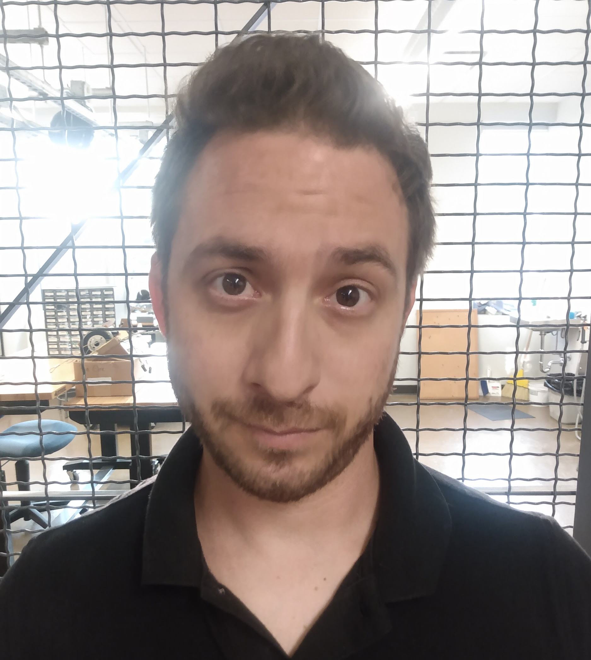


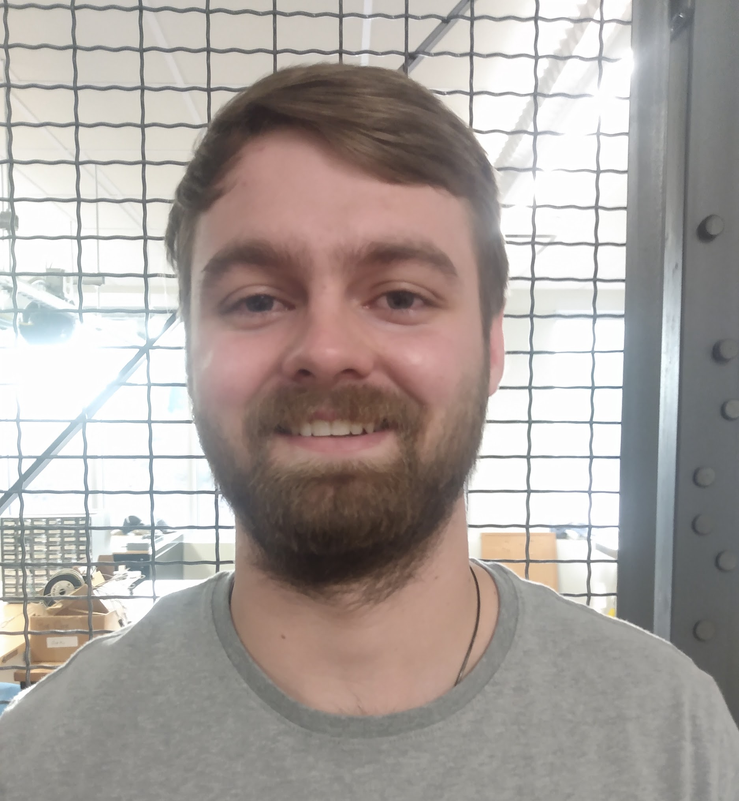
General Dynamics Site Weather
and Power Recorder (SWAPR)
Final Project Presentation
ANTHONY GALDI, LUKE MCGOWAN, BRENDAN SMITH, BRYCE VEGH
April 21st, 2021
Notes:
Hello, I am Luke McGowan and my teammates are Anthony Galdi, Brendan Smith, and Bryce Vegh, and we are Oscillation 300. Today we will be presenting our final project presentation for our capstone project which is the Site Weather and Power Recorder device, abbreviated by SWAPR, for General Dynamics.

Slide 2

Project Introduction:
Our Client:
General Dynamics was our client. They use new technologies and systems to provide support to civil government, defense, intelligence and cybersecurity customers. General Dynamics assists the U.S. Coast Guard with search and rescue operations through Rescue 21.
Description of the project:
The Site Weather and Power Recorder (SWAPR) is a device capable of measuring weather conditions and power transmissions at a remote facility. The facility is part of General Dynamics Rescue 21 system.
Motivation:
Our goal was to to prevent our client from having to send technicians out to the site. Our device will provide the technicians the information they need without having to manually get the measurements. The relevant measurements that the technicians need is measuring the VHF radio output in order to determine if the radio is transmitting properly and also the immediate local weather conditions.
Brendan Smith
Notes:
To begin our presentation. I will provide a summary of the project and motivation as well as introduce our client. Our client for this project was General Dynamics, they are a company that uses technology to provide support for many government and defense organizations, and one of those groups is the United States Coast Guard. Because they work with the Coast Guard, General Dynamics uses special equipment for search and rescue operations. This is where our device fits in. Our device is called the Site Weather and Power Recorder, or SWPAR, and it functions as the name implies. It measures power transmissions and various weather conditions at a remote site and then records the data. The reason General Dynamics needs this device is that the location where the device will be installed is very isolated. This means it can be time-consuming and expensive for a technician to manually check on the equipment. What our device does is eliminate the need to send someone to inspect the site. The relevant data that technicians need to verify if the station is operating correctly can be provided via the SWAPR, that data includes radio power transmissions as well as the following weather conditions: temperature, humidity, rain intensity, wind speed, and wind direction. The final design consists of an Arduino, a laptop, Hamshield Mini, attenuators, and weather sensors that are used to gather the data. A program on the laptop uploads the data to a server, where it is then accessible to the technicians. Our device will be part of General Dynamics and the Coast Guards Rescue 21 program. This program uses remote state-of-the-art systems to find sailors in distress as well as save lives. By utilizing these stations and systems, the coast guard can quickly and effectively locate sailors.

Slide 3
Most Important Requirements
1. Record sensed data from the weather station
Requirement: sense humidity, temperature, wind speed, wind direction, and if rain is present.
Result: requirement exceeded
2. Record sensed data from power station
Requirement: sense if power is being transmitted from a radio to the station and an optional requirement of measuring the transmitted power in dBm’s.
Result: requirement exceeded
3. Output data to the laptop and store on a file
Requirement: send and store the sensed data as JSON variables to a text file using a Python program
Result: requirement met
4. Weather resistant devices/materials for outside components
Requirement: encase all exterior components in weather resistant materials
Results: requirement met
5. All components of the design must be hardwired
Requirement: No wireless communication, including Bluetooth or Wi-Fi, can be used. All connections must be hardwired.
Results: requirement met
Luke McGowan
Notes:
This slide focuses on the most important requirements for our device. The first important requirement is that the weather station must sense humidity, temperature, wind speed, wind direction, and if rain is present. Our device not only met this requirement by successful sensing all of theses weather conditions, but it exceeded it by meeting some of the optional requirements such as measuring the amount of rain in increments, like light rain, moderate rain, heavy rain, etcetera… and by sensing wind direction with accuracy to the eight principal winds instead of only the four cardinal directions.
The second important requirement is for the power station to scan certain frequencies and sense if power is being transmitted from the radio to the station, which our device did successfully. An optional requirements was for the device to measure the transmitted power in dBm’s, which our device also achieved, which is why we exceeded this requirement.
The third requirement was to output all of the sensed data to a text file on our laptop, which acted as a server in our implementation. We successfully stored all of the data onto a text file using a Python program, so this requirement was met.
The fourth requirement was to ensure that our entire device was weather resistant, since a portion of our project is intended to be placed outside and would be exposed to harsh weather conditions. We encased all vulnerable exterior components in weatherproof junction boxes and used strain relief connectors to further weatherproof the system to ensure that this requirement was met.
The last requirement was that all connections had to be hardwired to ensure that the device was as secure as possible, since this device is intended to be used with the Coast Guard, security is a top priority. To meet this requirement, we ensured that no wireless communications of any kind were used.

Slide 4
Prototyping
Prototype #1 Rain Sensor: This prototype used reading from a variable resistor whose values fluctuated between 0-1024 based on the resistors position, which acted as a placeholder for the chosen Rain Sensor LM393 our team intended to use, since the LM393 used the same output method except on a much larger scale. The prototype successfully showed the team the varying nature of this sensor.
Prototype #2 Temperature/ Humidity Sensor: This prototype was able to utilize the DHT11 Temperature and Humidity Sensor in conjunction with an Arduino MEGA to test the immediate surrounding area for said values. The main issue in getting the prototype working was finding the proper libraries as well as modifying the code, but proved to be successful by demonstration day. As a result, the final project adopted this exact sensor and code.
Prototype #3 RF Signal Filter: The prototype for the RF signal filter was not done using any hardware, but instead utilized a circuit simulation software where we created a Band Pass Filter that intended to later build once proven successful in said simulations. Undesired frequencies that lie outside our intended 140-172 MHz range were successfully filtered out modifying the well known Sallen-Key filter circuit. Although this prototyping was a success, it was not used in the final design as our chosen Software Defined Radio was able to filter on it’s own.
Prototype #4 Recording and Processing Station: This prototype’s was created in order to simulate the final stage of the entire system: logging all our collected data into a text file onto a laptop. A python script is used to do the final conversion from Arduino IDE data received in the COM port to the text file log. The prototype specifically used two simple analog voltage inputs as place holders for the two different expected station data and was a success, which lead to easy integration of the real version down the line.
Anthony Galdi
Notes:
This slide discusses the Prototyping phase of the SWAPR project. This prototyping was conducting in the early stages of our project and as a result that, some prototypes were able to utilize the specific sensor or part we intended to use in the final design while others were built using our best educated guess on how that function would be implemented.
Going into it, the first listed prototype is the Rain Sensor. The situation was that our team knew we would be using the LM393 Rain Sensor, but since we did not have it on hand during this design phase, we decided to use a variable resistor to act in its place due to it being similar in its data output resistance value. This was a successful prototype as it showed our team the expected high-varying nature of the resistance value output that our microprocessor would expect to be reading.
The second prototype was done using the specific sensor we intended to use in the final design, since we did have it on hand. We simply set up our DHT11 Temperature and Humidity Sensor in conjunction with an Arduino Mega and once running properly we were able to see the values indicating the nearby temperature and humidity conditions. This was a large success as it showed us exactly what to expect when this sensor was implemented to the final design.
The 3rd Prototype is the RF signal Filter, which was for the Power Recording station portion of the project. This particular prototype used a software simulation and a Sallen-Key Filter whose job was to act as a bandpass filter that would cut out any frequencies that went above or below our desired 140-172 MHz range. Although the results of this simulation were a success, the circuit itself was never implemented to the final design as we ended up selecting a Software Defined Radio that was able to the job without it.
Finally, the fourth prototype was created to act as the final stage of our project that was intended to take the collected data from the Arduino and log it on a laptop so it could be read at anytime by the user. Two analog voltages with varying input acted in place of the expected data, while the data was then sent to and logged on a nearby laptop that acted as our clients' servers. This was also a success and was significantly valuable as it was directly implemented into our final design.

Slide 5
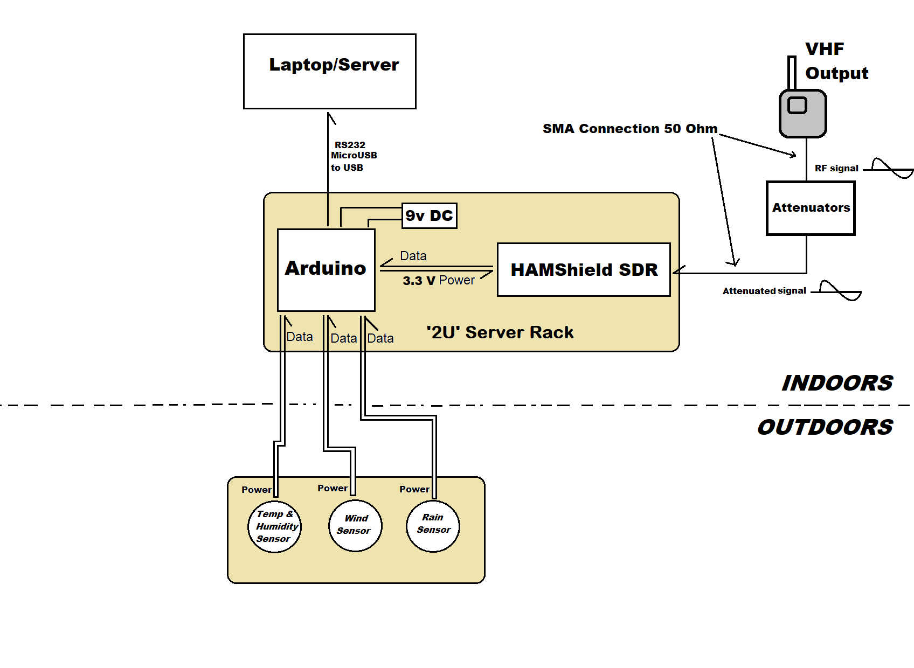
System Architecture
Laptop acting as a stand in for our clients server, which receives all collected data from the microcontroller and logs it in regular intervals (top)
Handheld Radio outputting aVHF output signal in the 140-172 Mhz range intended to be read by our system (far right)
Outdoor weather station collecting various sensor data to determine weather conditions (bottom)
‘2U’ Server Rack housing the Software Defined Radio and the Arduino microcontroller acting as the brain of the system that organizes our data (center)
Anthony Galdi
Notes:
This is overview of our projects entire system architecture, with descriptions of the major components of our final design alongside an image of the full project as well.
Looking at the image, the far right shows that our design includes a handheld radio that is outputting a VHF signal which is followed by a set of attenuators to safely pass the signal on to the power recording station located indoors on the ‘2U’ server rack.
On the bottom, we can see the weather station which consists of multiple sensors that despite being housed together, all are individually passing their data directly to the microprocessor. It is important to note that the weather station is intended to be placed outdoors while the rest of the project will be located indoors.
The Arduino microcontroller and Software defined Radio are located in the center of the image on the previously mentioned server rack. The microcontrollers job is to collect data from the SDR as well as the weather station.
The top of the image shows the final destination of our data, the laptop, which is acting as the substitute for our client's server. The Arduino microprocessor will be sending the collected data to this laptop where our team then uses a python script and JSON variables to accurately log the collected data on a regular interval.

Slide 6
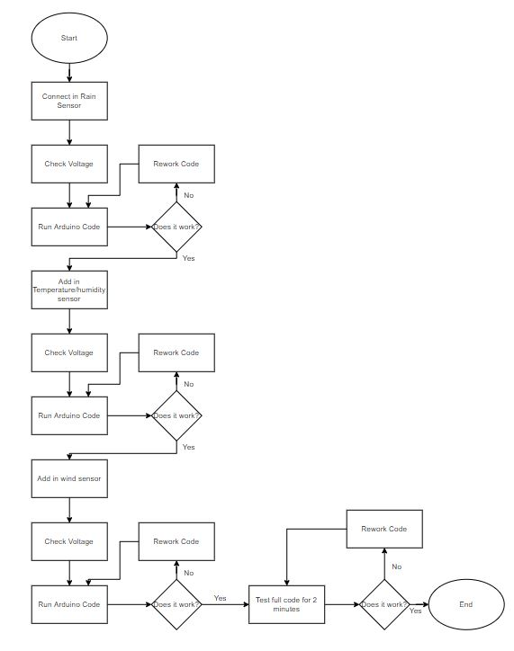
Most Significant Testing Results
At the end of the testing phase, all tests conducted were found to be successful
The weather station’s integration testing made us aware of an error causing the temperature/humidity sensor to malfunction, which was promptly fixed.
Testing the full weather station made it apparent that interrupts for anemometer caused the other sensors to return null values.
Bryce Vegh
Notes:
The next slide is going to be the most significant testing results.
So, starting off the main point that our team wants to make clear from this slide is that our team was able to correct any errors that may have been present in our initial design. What I mean by this is that in our testing, each test we ran was able to be successful by the end of the testing phase by either debugging the code for errors or fixing mistakes within the circuit for the full weather station.
The full weather station integration testing was the most significant testing result because it showed our team that we had an error within our Arduino code that we had written. Before I get to explaining what that error is though, I want to go over the image that is on the right. This image is the flowchart that we used to run and complete the full weather station integration testing. So, looking at the image, the first step was to wire in the rain sensor to the Arduino while it is hooked up to the computer and to check the voltage at the rain sensor to make sure that the sensor is receiving enough power to function. Once that was done, the code would be run to check if the rain sensor was working as intended. If the rain sensor was working as intended, then the temperature/humidity sensor would be wired into the Arduino along with the rain sensor or if there was an issue then the code and circuit would be reworked looking for errors. After the temperature/humidity sensor was wired in, the voltage would be checked at both sensors to verify that they were receiving enough power to function. Which would lead to the code being run to verify the sensors were working as intended, if they were not working as intended then the code and circuit would be reworked looking for any errors. But, if they worked as intended then the last sensor which is the wind sensor would be wired into the Arduino along side of the rain and temperature/humidity sensor. Which would lead to the final voltage check at each of the sensors to verify that each sensor was receiving enough power to function. Then, the code would be run to verify that each sensor was working as intended if the sensors were not working as intended then the code and circuit would be reworked looking for any error that might have been made. Once there were no errors, the test moved to the final stage of running the code constantly for two minutes to make sure that no errors accrue when the code would be run for an extended period of time.
With the structure of the full weather station integration test being explained, now I will talk about how this structure allowed our team to easily troubleshoot the error we ran into while testing. The structure of the test allowed us to realize that we had an error with the full weather station when the last sensor, the wind sensor, was added into the circuit. After a few minutes of troubleshooting, we realized that it was because of the wind speed function and how it used an interrupt, this interrupt was causing all the other sensors values to output as null. The interrupt was shutting off the ability of the other sensors to function and provide their data to the Arduino, this issue was corrected by moving the interrupt to the wind speed’s function and detaching the interrupt at the end of the wind speed function.
In conclusion, the full weather station integration testing was the most significant testing results because it was the one test where we ran into a big issue that was causing our outputted data to become corrupted.

Slide 7
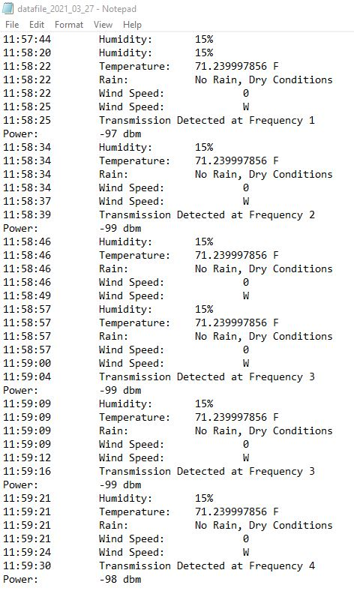
Analysis of Results
Each individual unit test for the weather sensors was successful due to prototyping and early white box testing during development
Weather station integration test initially failed, but the issue was resolved and the test was then successful
The unit test for the power recording station was successful as the Hamshield Mini recorded transmission power in dBm’s
Our project meets or exceeds all of the current requirements from our client and also meets a few of the optional requirements.
Luke McGowan
Notes:
This slide is an analysis of our results. Our team is very happy with the results of our device as all tests were successful in the end. Each individual unit test for the weather sensors was successful without any issues, which we attribute to our prototyping and early white box testing during the development of our device, which helped to debug any issues early on.
When we integrated the entire weather station, we ran into only one issue, which was that an interrupt in the wind sensor code was causing the temperature/humidity sensor to malfunction. This issue was easily solved through debugging, and then the integrated weather station successfully passed testing.
The unit test for the power recording station was also successful as the Hamshield Mini detected when power was being transmitted and recorded this power in dBm’s, which was an optional requirement.
At completion, our device meets all required requirements and even meets a few of the optional requirements.
On the right of this slide, our final results are shown. This is what the text file looks like after all of the data has been sensed and sent to the laptop via the Python program. Each data type is clearly displayed with a time stamp, so the client can see the current conditions as well as how the weather is changing over time and also allows them to see any past radio transmissions and at what power they were transmitting.

Slide 8
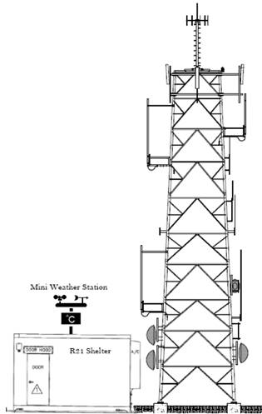
Summary of Technical challenges
Figuring out a way for our SWAPR device to measure the power of the radio transmission.
Integrating the code for all three of the weather station sensors so it would be able to function as a single module.
Integrating the code for both of the weather station and power station be one functioning device.
Writing the Python program to take in the data from the Arduino and be able to create a text file to be able to write the Arduino’s data to the file with a timestamp.
Coming up with a way to not mixed up the data that is coming from both the Weather station and the Power station when being sent over the COM port.
Bryce Vegh
Notes:
The next slide is going to be Summary of Technical Challenges
The first technical challenge that our team faced was figuring out a way to design our device to be able to measure the power of the radio transmission that would be in the range of 140MHz to 172 MHz.
The second technical challenge that we faced was figuring out a smooth and easy way for us to integrate all three of the weather station sensors. Which this integration would be both hardware integration and software integration. What I mean by this is that we had to make sure that these sensors could all be wired off the same power supply that was coming from the Arduino and that each of the sensor’s code could be integrated together to create a single code that would be run.
The third technical challenge that we faced was figuring out a way for us to integrate the weather station and power station into one functional device. Which this integration would also be both hardware integration and software integration. Meaning that we had to make sure that these two stations could be wired off the same power supply that was coming from the Arduino and that each of the station’s code could be integrated together to create the final Arduino code that would be run for the device.
The fourth technical challenge that we faced was for our team to develop a Python program that would take in the data that the Arduino was sending across the COM port and create a text file to storage that data in for later use. This Python program needed to be able to write the data to the text file with the time that the data was collected, the name of the sensor that the data was coming from, and lastly the data that was collected.
The last technical challenge our team faced was how to keep track of what data was being sent across the COM port. Meaning that we had to figure out a way to 100% guarantee that none of the data that was being written to the text file was mixed up and written with the wrong sensor name.
In conclusion, the two most difficult technical challenges were figuring out a way to measure the power from the radio transmission and figuring out a way to stop data from being mixed up when it was being sent over the COM port. These were the most difficult challenges because these were the areas were where our team did not have a lot of experience in and we had to do a lot of research to understand how to go about solve these technical challenges.

Slide 9
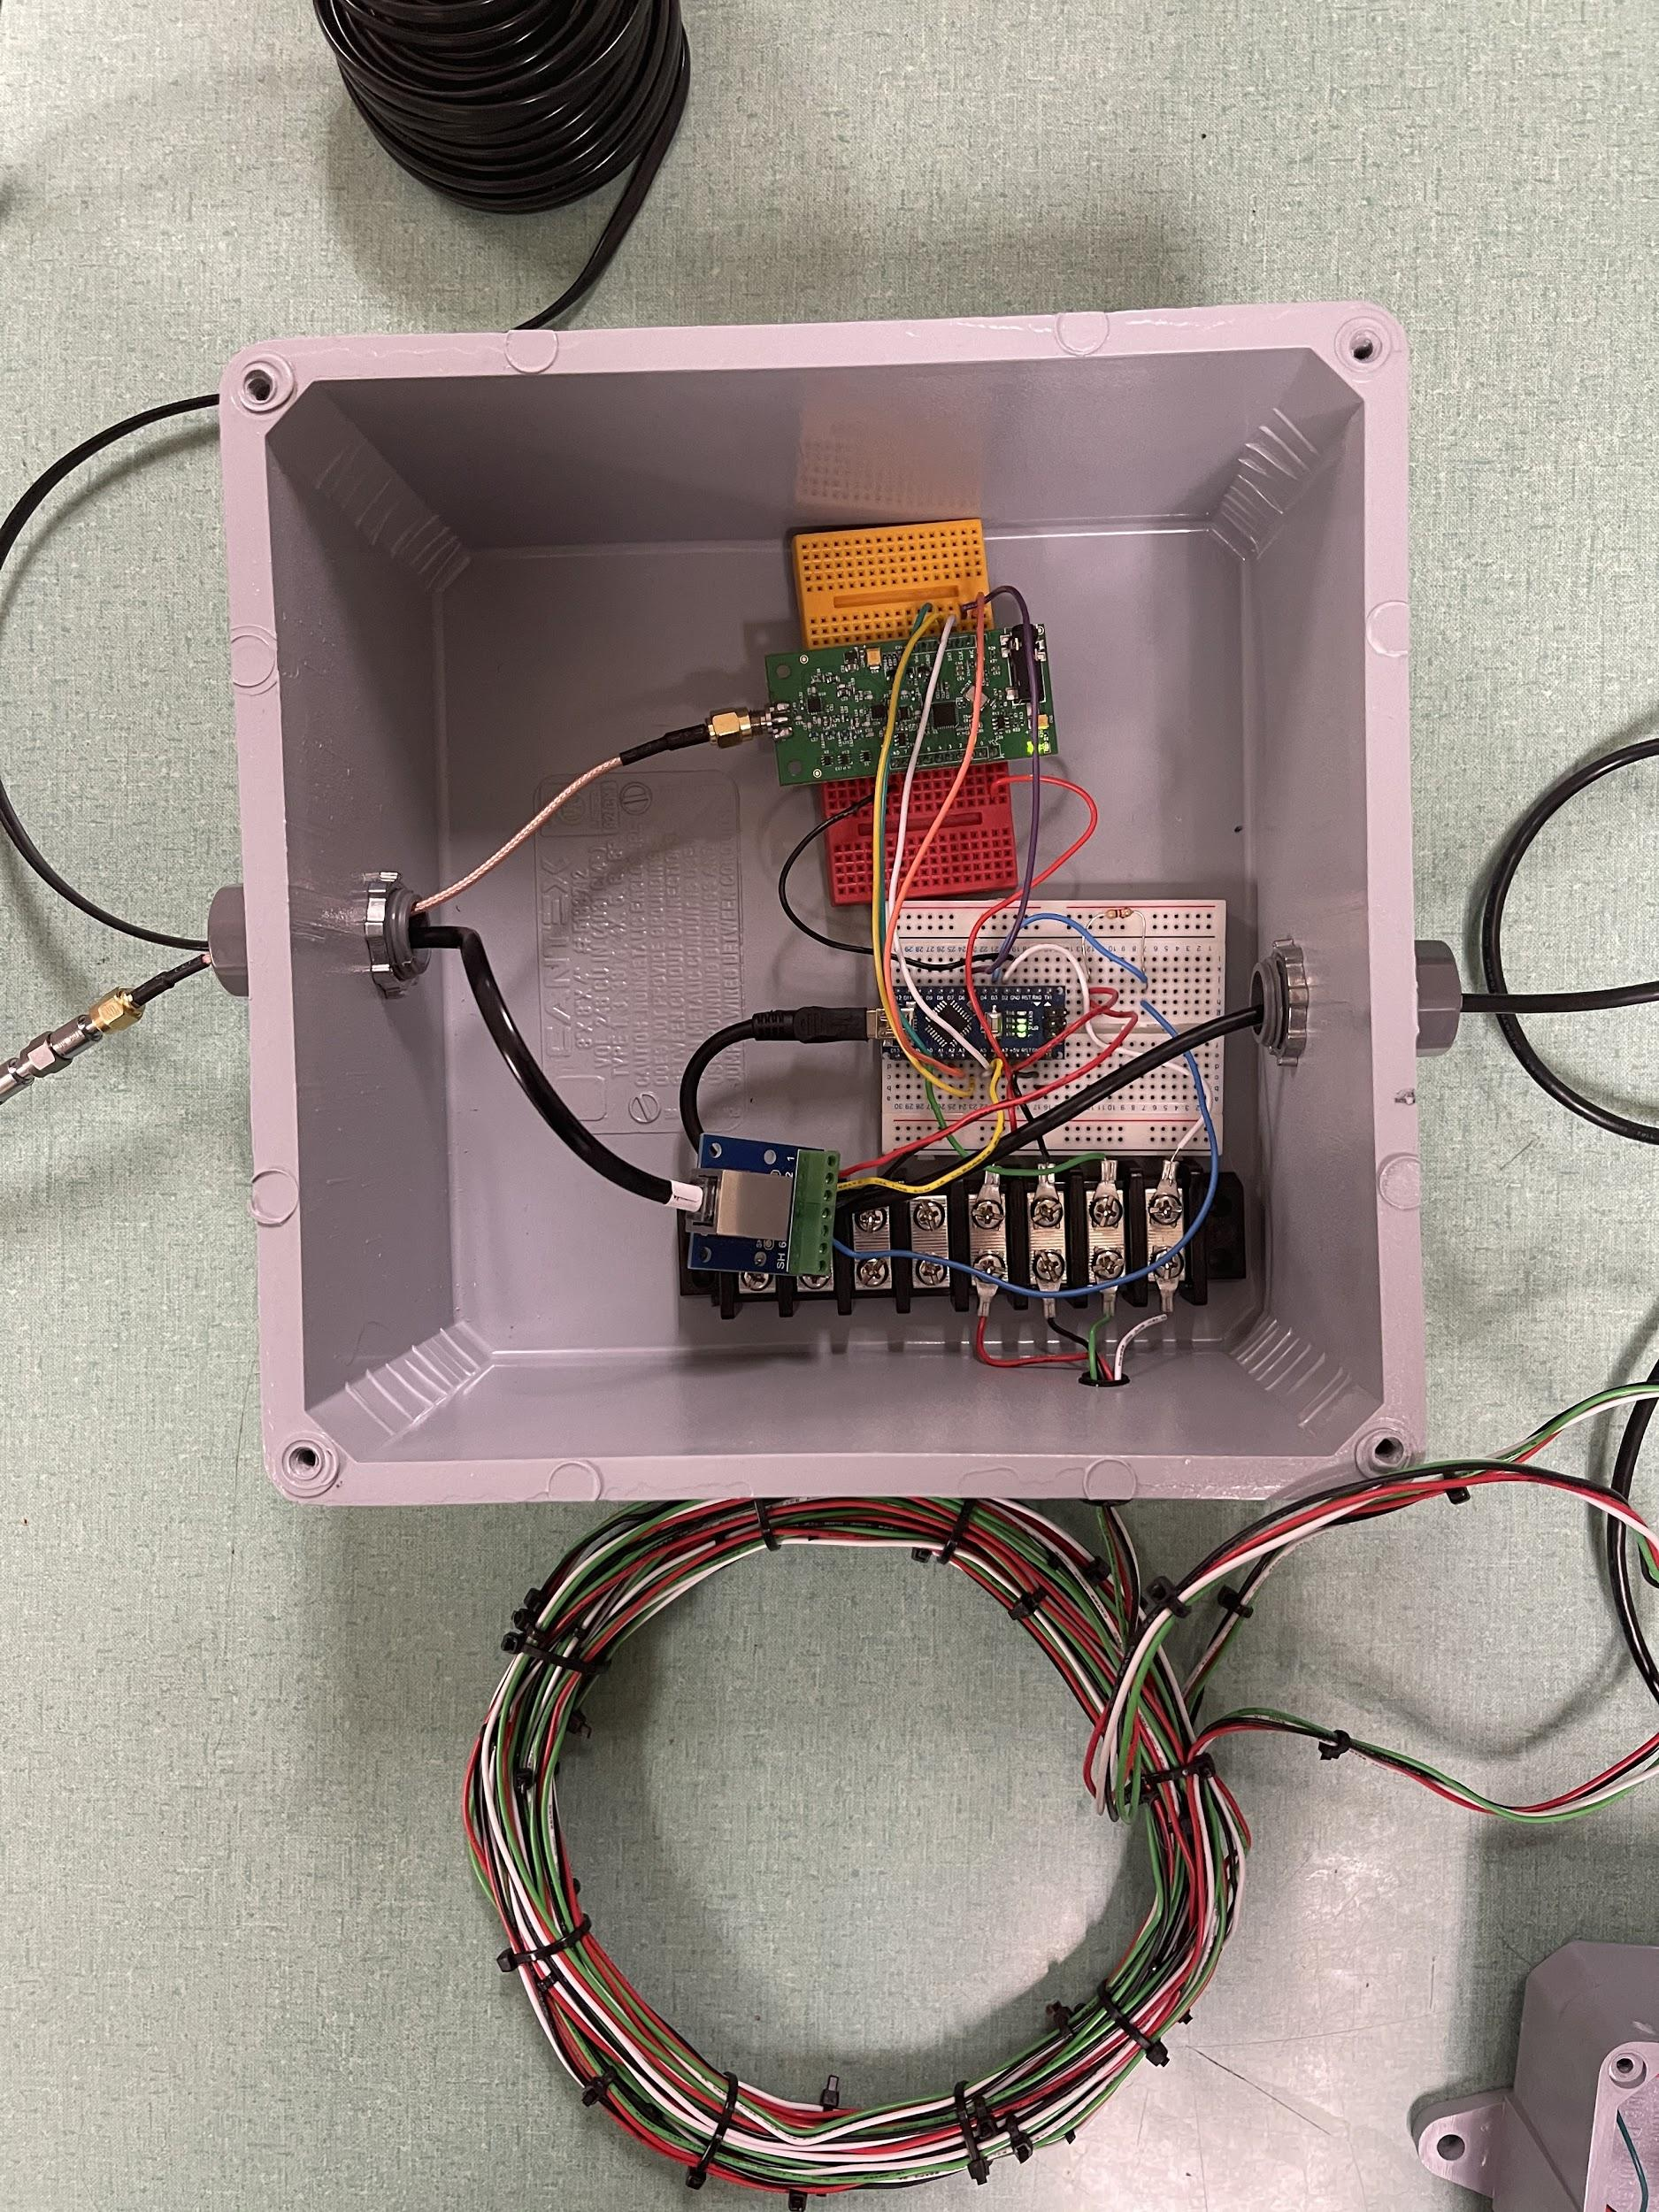
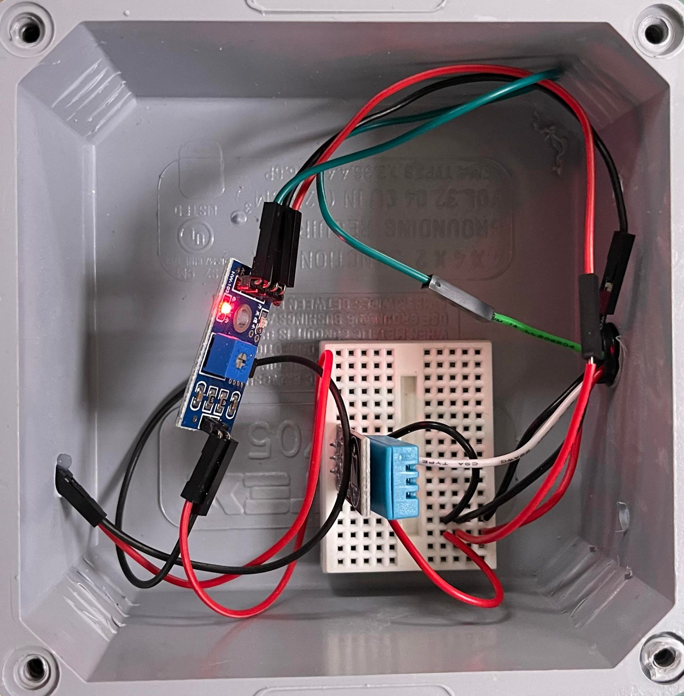
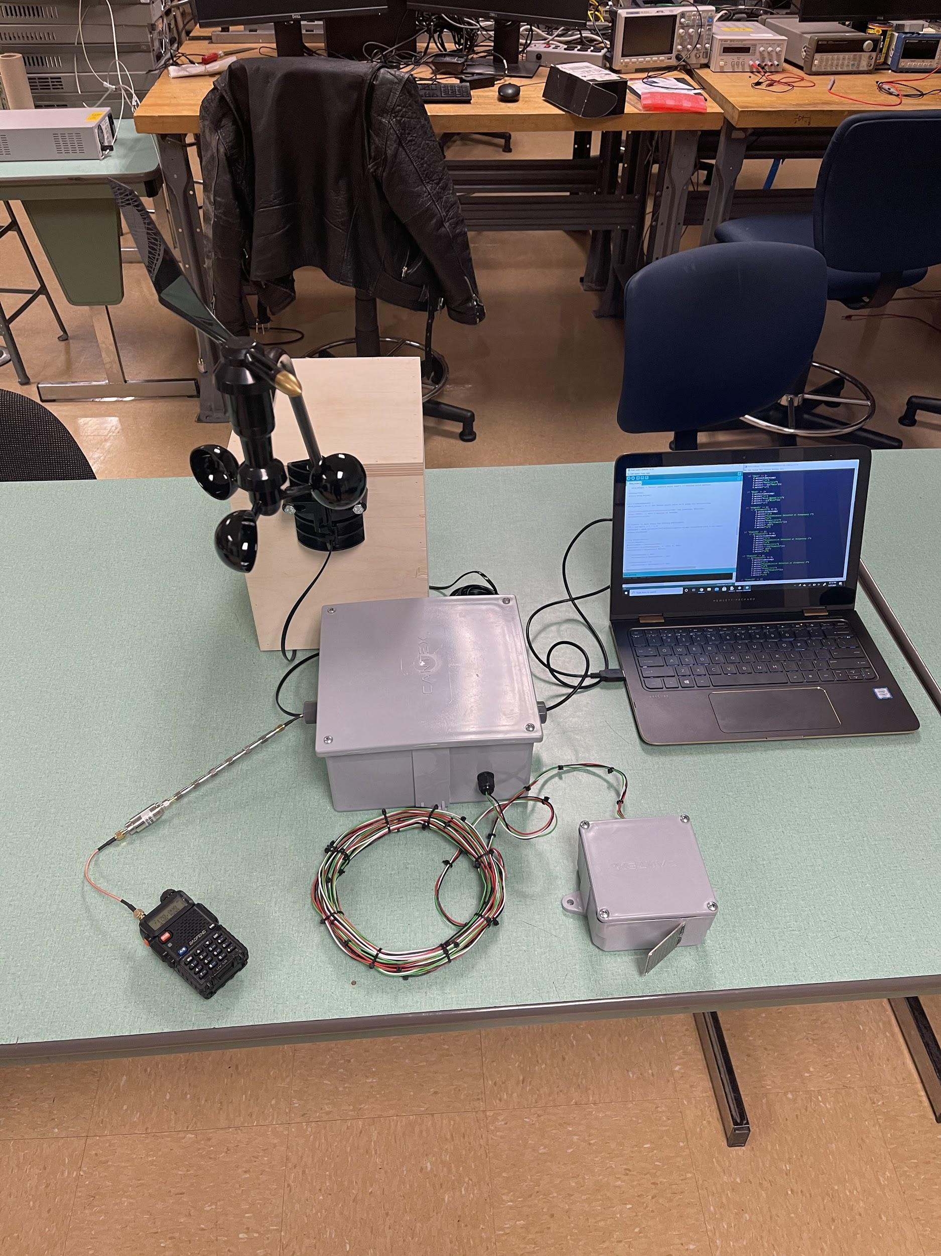

Conclusion & Final Product pictures/video
The SWAPR device was successful and performs as we expected. All of the requirements that we had for the project have been met. We were able to complete our Capstone project successfully by using the Engineering Design Process. We identified the issue and developed our requirements with the aid of our client, professor and GTA.
We then researched prior works to develop and thorough understanding of our project. We then prototyped the devices we researched before we started testing. Once all the modules were tested, we integrated the entire project and performed integration testing.
Brendan Smith
Notes:
In conclusion, we are very proud to say we completed our device. All the major components meet the requirements we set at the beginning of the project. It records sensed data from the weather station and even fulfilled some of the optional requirements for the weather station such as displaying 8 different wind directions. The device also meets and exceeds the requirement for measuring the output from power stations. It can sense if power is being transmitted from a radio as well as measuring the transmitted power in dBms, which was an optional requirement. The device also saves the data in a text file, which was another one of our main requirements. And lastly, we made sure all the outdoor components were weather-resistant and we hard wired the device. We made these requirements with the help of our client and used them to guide us during the project. This was just the first step in the engineering design process. Once we had our requirements, we began researching prior works to see what other engineers had done to solve similar problems. When we had gathered as much relevant information as we needed, we began the prototyping phase. We used what we had learned from researching to create prototypes which we were able to test. Once prototyping was completed, we began work on the final design and the final testing. We are happy with how much we were able to accomplish with this project, and finally, we would all like to thank our client Amir, our GTA Mahsa, and our professor Dr. S.

