Slide 1

Low Cost Platform
for Electric Drive Experimentations
Ali Muqeem
Ali Alfadhli
Ahmad Alfaresi
Salman Alajmi
Client: Dr. Venkata Yaramasu

Slide 2

Client:
Dr. Venkata Yaramasu
  Assistant Professor
  Research interests: Wind and photovoltaic energy,
high power converters, model predictive control.
GTA: Han Peng
Salman Alajmi

Slide 3
Introduction:
dSPACE is an expensive platform that is being used in Electric Drives courses.
By using this platform along with the lab equipment, the students are able perform lab experiments.
This platform is supported with MATLAB Simulink and dSPACE Control Desk.
There is a cheaper alternative for this platform, which is the Arduino board.
Our task is to perform the dSPACE lab experiments and convert these experiments into the Arduino board by using MATLAB Simulink.
Ali Muqeem

Slide 4
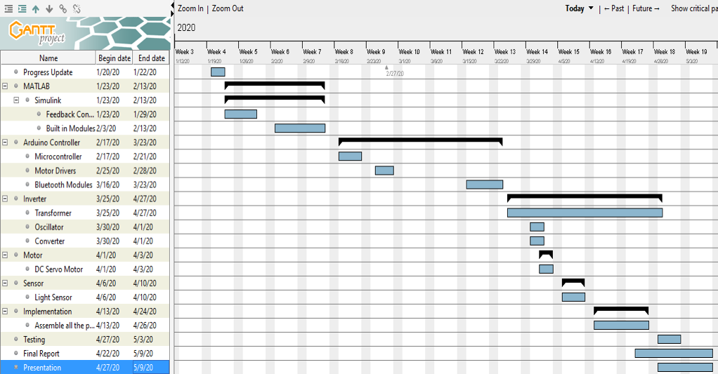
Schedule Overview:
Ahmad Alfaresi

Slide 5
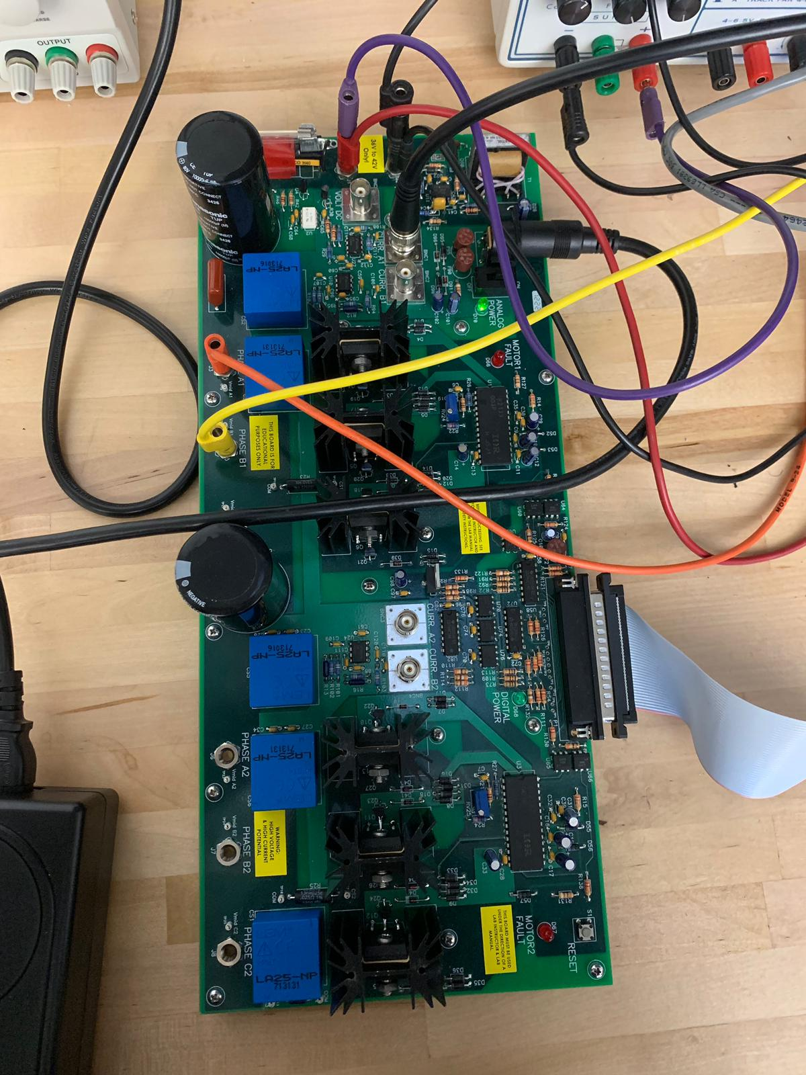
Responsibilities of Ali Muqeem:
Current measurement:
  Measured current for both Arduino and dSPACE by using BNC cables.
  The current for the Arduino board is measured by using pins.
  Used a Converter for direct current comparison between the Arduino and dSPACE
Wire Soldering
  Double solder on a 15 pin encoder connector.
  The idea of the soldering is to make a direct comparison between the two platforms.
Arduino blocks testing:
  The Arduino has a support package for MATLAB Simulink.
  Testing the blocks had to be done with the Arduino.
  Arduino starter kit

Slide 6
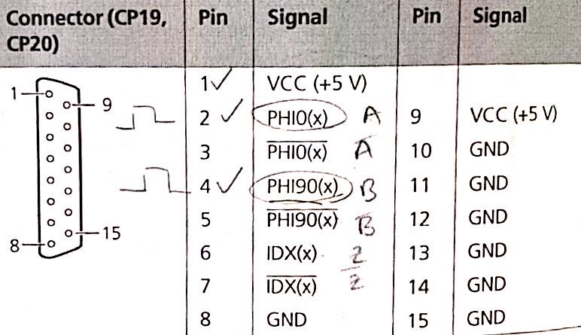
Responsibilities of Ali Alfadhli:
Speed measurement:
  Measured speed in dSPACE based experiments to compare it with Arduino labs.
  Used 15-Pin encoder cable.
  Researched the data sheets for the encoder to get the correct functions.
Modeling the Simulink design for Arduino:
  Converting dSPACE Simulink Blocks to Arduino.
  Arduino support package for MATLAB Simulink.
Modify the Arduino code inside the blocks:
  Will be next task.
  The code inside some of the blocks need to be modified.
  Making the system more stable.

Slide 7
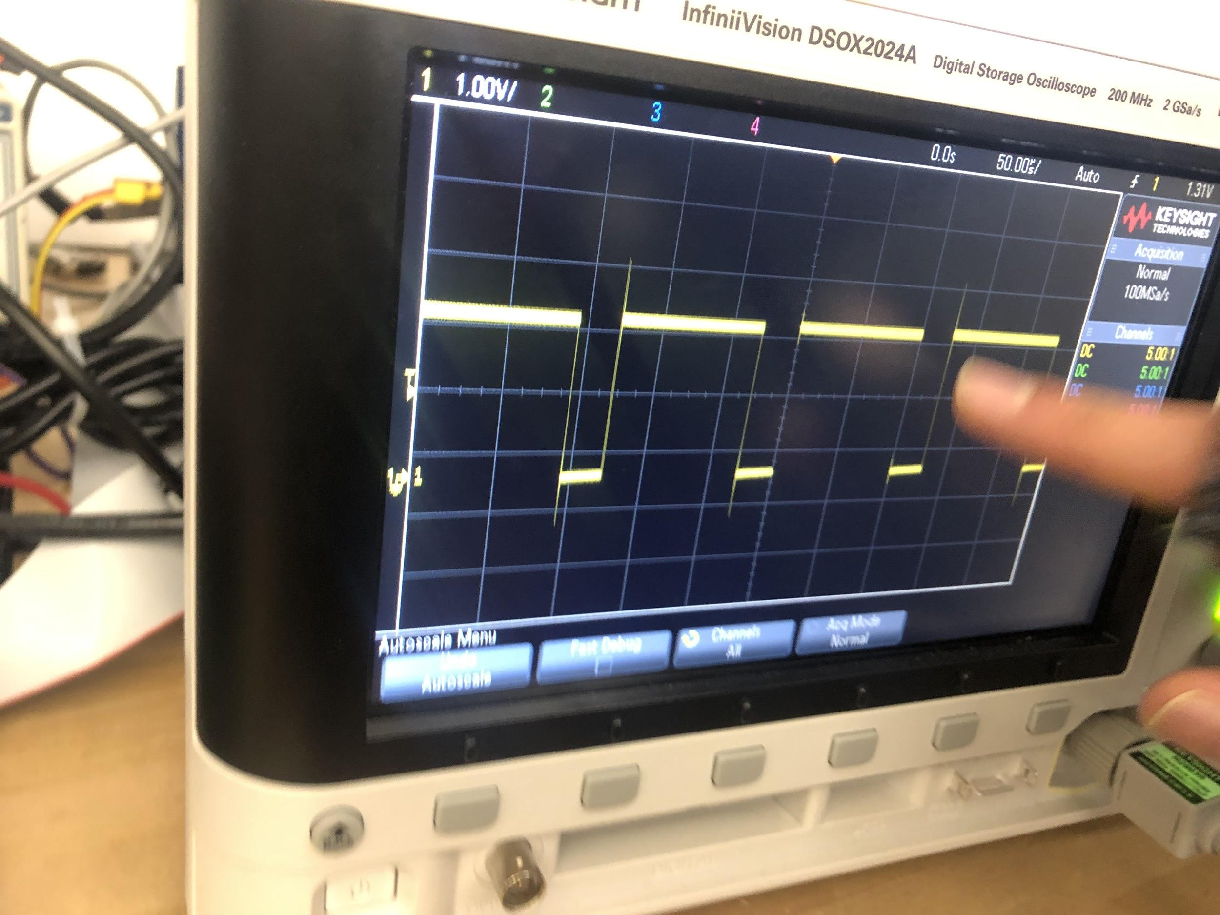
Responsibilities of Salman Alajmi:
Collecting data from dSPACE labs:
  Using equations from the lab manual to get the correct measurement.
  Comparing the Arduino results to dSPACE experiments and try to get the most accurate results.
Sending 5V PWM signal:
  Using the Arduino PWM pins to send the signal.
  The Oscilloscope will display the signal in discrete.
  We have two ways to measure the PWM:
    PWM generators block.
    Arduino PWM pin blocks.

Slide 8
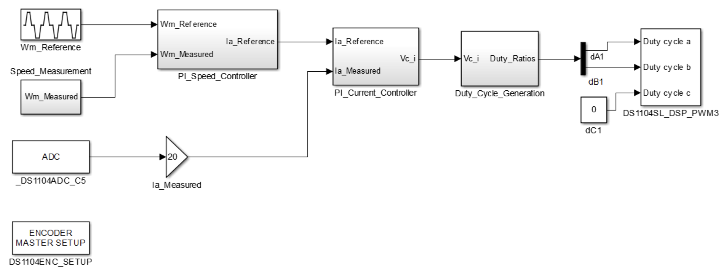
Responsibilities of Ahmad Alfaresi:
Running the dSPACE experiments:
  Taking parts in the dSPACE labs, running the experiments, and take measurements.
  Test lab 1, lab2 and lab3 for dSPACE and the data and compare it with Arduino labs.
Wire Connections:
  Connecting the Arduino wires with the right pins.
  The Arduino pins numbers has to match the code.
Research:
  Search for solutions for Simulink errors.
  Search for codes that can measure speed and PWM signal.
  Check datasheets of the Arduino Mega and Due.

Slide 9
Conclusion:
Current Project Status:
  The team is still working on converting the labs to the Arduino.
  We designed the Simulink model for Arduino labs, but we want to make it more accurate.
Future Tasks:
  The team will work on testing all the dSPACE labs on Arduino.
  We will design a new better inverter board with smaller components.
Challenges:
  We will try the fix the codes inside the Simulink blocks to make the system operate better.
  Work on the duty cycles to make sure that the motor runs properly for each lab.
Ahmad Alfaresi

