Slide 1
Motorized Tricycle
Mohammed Allahyani, Khalid Alghamdi, Yu Sun, James Sigler
Notes:
James, All

Slide 2
Outline
Introduction
Problem Definition
Problem Overview
Possible Applications
Possible Solutions
Recap
Conclusions and Future Work
Notes:
James

Slide 3
Introduction
Name of project: Motorized Tricycle
Client: Dr. Jane Scott
Faculty mentor: Dr. Kyle N. Winfree

Slide 4
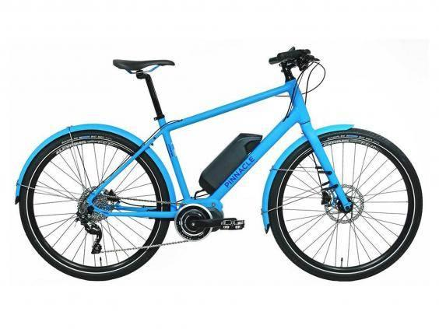
Problem Definition
The highest trending search on Ebay
The highest selling electric vehicle worldwide
Notes:
Electric bike” was the highest trending search on eBay during May 2016
(95,529 Views and 108,734 clicks as of 25th May 2016)
e-bikes are the highest selling electric vehicle worldwide with 35 million unit sales forecast for 2016.
In first days, we thought this project will be simple as the picture showing how this system seem simple. It’s just perfect KIT (Battery, Motor, Display) give you the level you want of assistance.

Slide 5
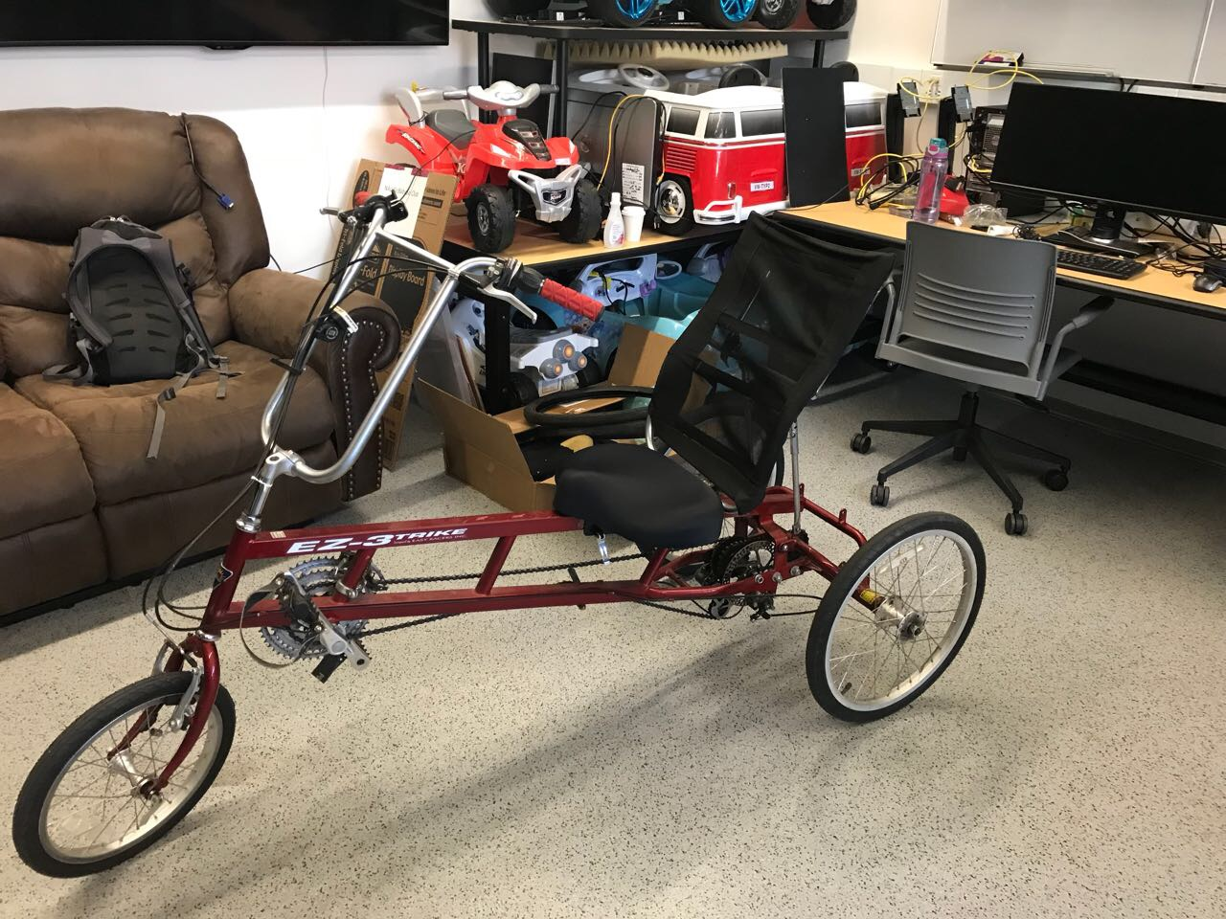
Problem Definition
Convert a tricycle to a pedal-assisted tricycle
This project is designed for
A client with a heart condition
Could be used by anyone
Notes:
But! The problem bigger and complex more than what we thought about it.
We have to find:
the right battery to provide the right energy.
The right motor to provide the right power and torque.
The right controller to control *********

Slide 6
Problem Definition
Constraints
The range of a fully charged system should be 10 miles
The user can pedal at the same time as the power assist is on
Two levels of assist
Maximum weight is 225 lbs
Maximum speed is 15mph
Regenerative braking system
Instrumentation and display
Weatherproof
Notes:
the range of a fully charged system should be 10 miles.
the user can pedal at the same time as the power assist is on.
Thats mean this system provide 50% assistance
two levels of assist
1. When the user Cycling Uphill.
2. When the user Cycling in flat road.
maximum weight is 225 lbs.
Include all tricycle parts and user
regenerative braking system.
Gives the bicycle resistance when the tricycle downhill and recharge the battery
Instrumentation and display.
Allow the user to chose modes and give him information (speed, battery level, navigation)
Weatherproof.
Protect the tricycle from rain and snow.

Slide 7
Problem Overview
The history of E-bikes
How E-bikes work
Motor
Battery
Controller
Notes:
the range of a fully charged system should be 10 miles.
the user can pedal at the same time as the power assist is on.
Thats mean this system provide 50% assistance
two levels of assist
1. When the user Cycling Uphill.
2. When the user Cycling in flat road.
maximum weight is 225 lbs.
Include all tricycle parts and user
regenerative braking system.
Gives the bicycle resistance when the tricycle downhill and recharge the battery
Instrumentation and display.
Allow the user to chose modes and give him information (speed, battery level, navigation)
Weatherproof.
Protect the tricycle from rain and snow.

Slide 8
Problem Applications
Technology Used
GPS
Track distance
Locate bike
Heart Rate Potential
Built into grips
3rd party components
Notes:
the range of a fully charged system should be 10 miles.
the user can pedal at the same time as the power assist is on.
Thats mean this system provide 50% assistance
two levels of assist
1. When the user Cycling Uphill.
2. When the user Cycling in flat road.
maximum weight is 225 lbs.
Include all tricycle parts and user
regenerative braking system.
Gives the bicycle resistance when the tricycle downhill and recharge the battery
Instrumentation and display.
Allow the user to chose modes and give him information (speed, battery level, navigation)
Weatherproof.
Protect the tricycle from rain and snow.

Slide 9
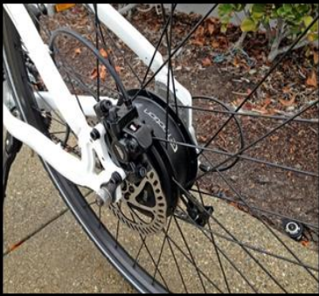
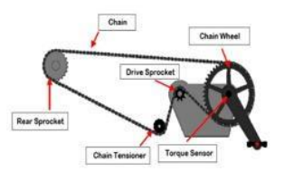
Possible Solutions
The user can pedal at the same time as the power assist is on- we will design a electric drive system
Battery
Cadence sensor（includes a magnet）
Torque sensor (connected to top of the chain)
Controller
Motor(Hub drive motor & Crank drive motor)

Slide 10
Possible Solutions
Regenerative braking system-How the system works
Hold the hand brake->
Drive system open->
Gearbox gear meshes with gear on wheel shaft->
The kinetic energy of the wheel drives the generator to generate electricity(When the generator works, the brake effect on the wheels will generate at the same time)

Slide 11
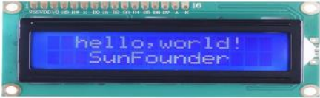
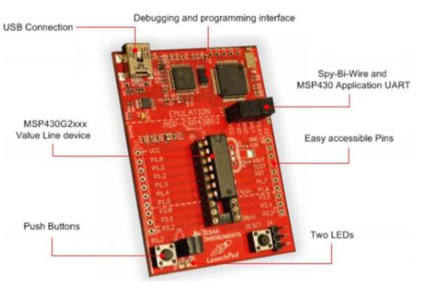
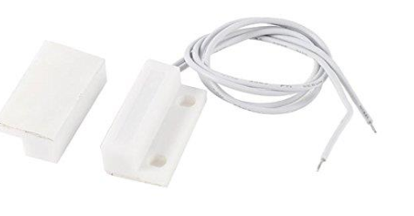
Possible Solutions
Instrumentation and display
Sensor- detect the rotate speed of wheels
Single chip - receive and process the information from sensor and transmit the result to LCD
LCD- displays speed of bicycle in miles per hour and residual electricity

Slide 12
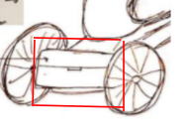
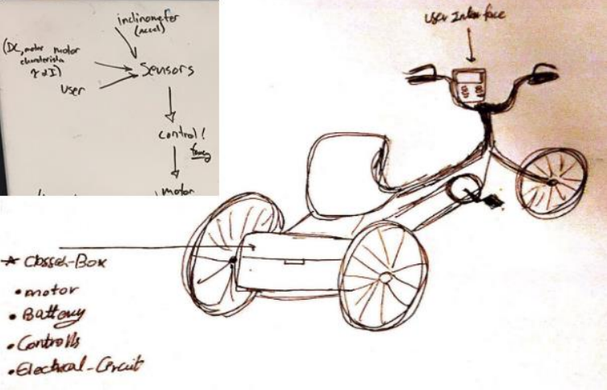
Possible Solutions
Weatherproof
There is a closed box on the back of the trike. All the electrical components(motor, battery, controller, and, etc.) on the bike will be covered.

Slide 13
Recap
Converting a tricycle to a pedal assisted bicycle
Calculate the rider's torque to provide “smart assist”
Extra hill help
Automatic speed reduction
Adding training modes to the GUI
Interval
Trainer
Notes:
James

Slide 14
Conclusions and Future Work
Read and plot data from ride around NAU
Determine average heart rate
Determine amount of assistance needed
Research and order parts
Battery
Torque Sensor
Motor
Controller
Display
Begin working on prototype
Integrating
Creating GUI
Notes:
James

Slide 15
Thank You
More info visit https://www.cefns.nau.edu/capstone/projects/EE/2018/MotorizedTrike/

Slide 16
References
[1] M. Balmer, “History of Pedal-Assisted Bicycles”, Electric Bike Association, 2016. [Online]
[2] J. Turner, “Understanding Electric Bike Motors with Jim Turner of Optibike,” 2014. [Online]. Available: https://www.youtube.com/watch?v=KL7tTUZCFDs. [Accessed: 01-Oct-2017].
[3] J. D. Goodman, “An Electric Boost for Bicyclists,” New York Times, Jan. 2010.
[4] Bill Cummings, “Why Don’t More E Bikes Use Regenerative Braking?,” Evelo, 2017. [Online]. Available: https://www.evelo.com/bikes-use-regenerative-braking/. [Accessed: 05-Oct-2017].
[5] Hook slide: http://www.ebikeclass.com/buying-guides/facts-electric-bikes/

