Slide 1
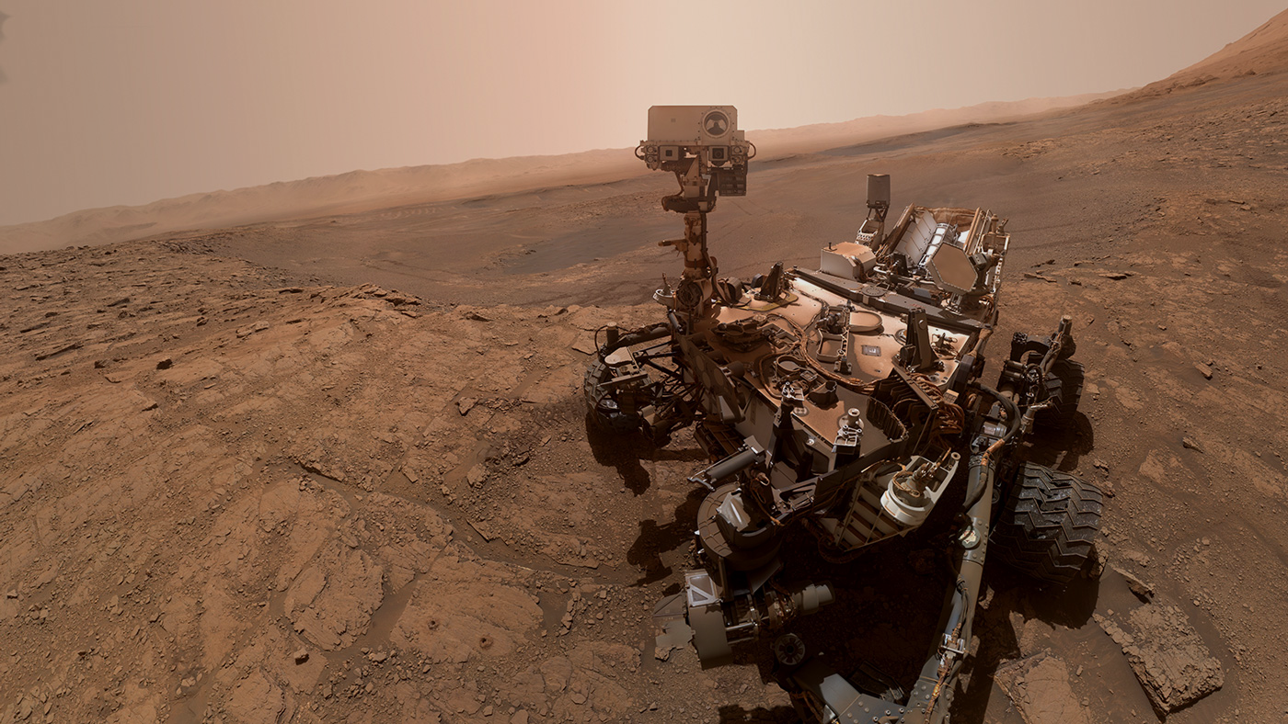




ArtemiS3
An intelligent search tool for AWS S3 buckets.
Sponsored by: Trent Hare. USGS Cartographer.
1
Notes:
Introduction
List off names of each team member
This open-source project is sponsored by the USGS Astrogeology Science Center
Working with our client, Trent Hare, and NASA to make their S3 buckets searchable

Slide 2
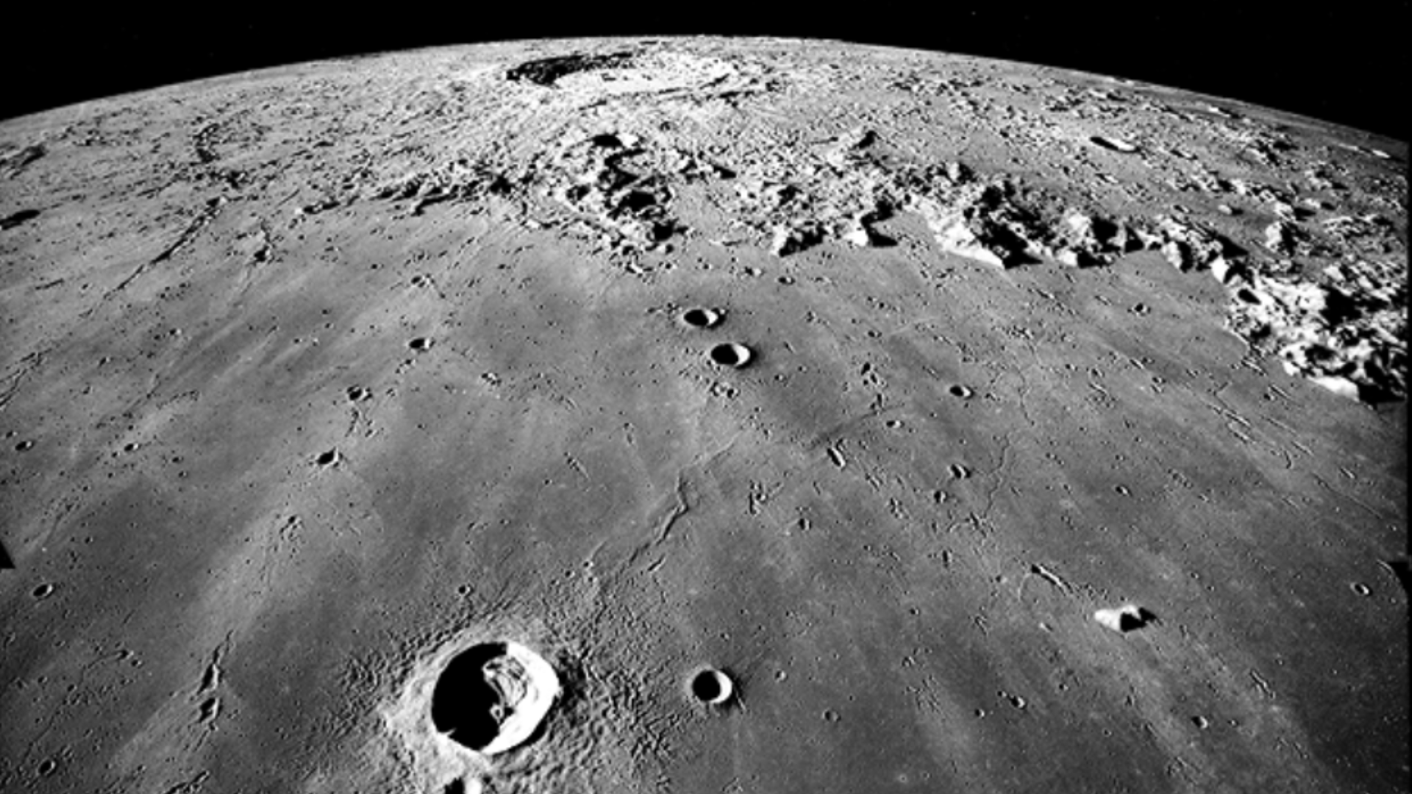
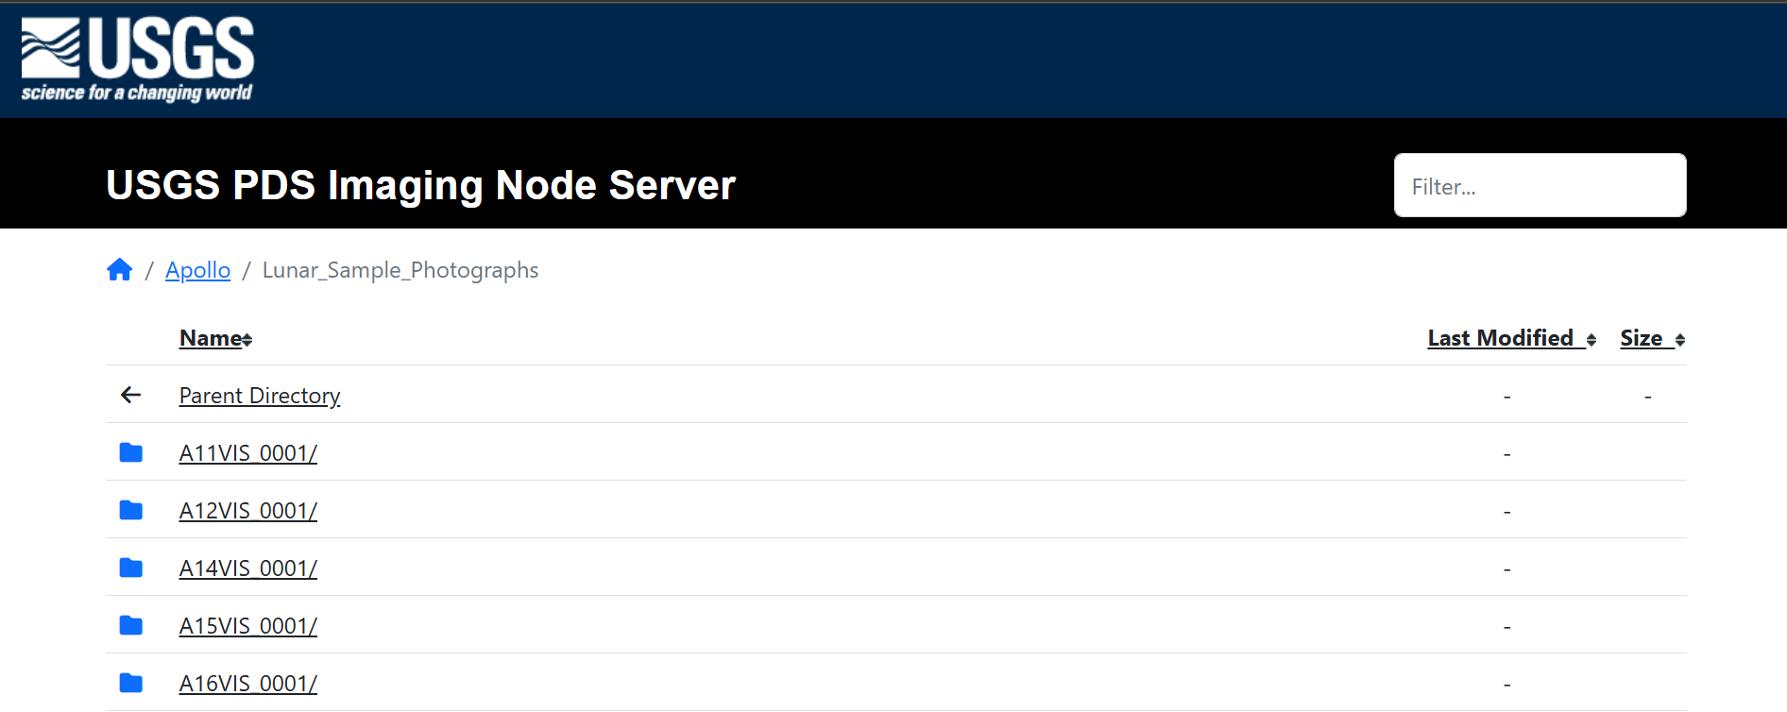
NASA’s Data is Growing Faster than Scientists Can Navigate It
2
Notes:
NASA and the USGS release TBs of mission data
Datasets power scientific discoveries worldwide
Problem:
Accessing this data means digging through massive AWS S3 buckets
Clicking folder by folder with no search bar,
no indexing,
and no efficient method to find data
Trent shared current solution (on screen):
Zero search capability,
forcing researchers to waste hours locating mission data

Slide 3
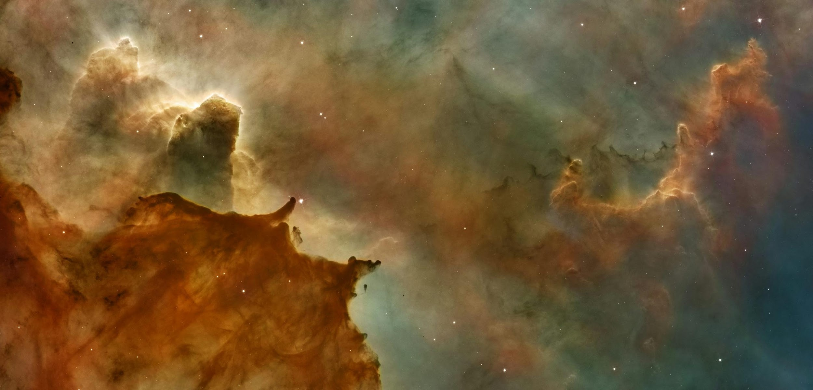

Slow Data Access = Slow Science
Thousands of objects per bucket.
No full-text or metadata search.
Slows down research, delays publications,
And creates friction for scientists, students, and NASA teams.
3
Notes:
Imagine trying to understand Mars geology,
But spending more time hunting for the right image file than analyzing it
With thousands of objects per bucket and inconsistent metadata, important information gets buried
This slows down research,
delays publications,
and creates unnecessary barriers for the global scientific community relying on NASA data

Slide 4
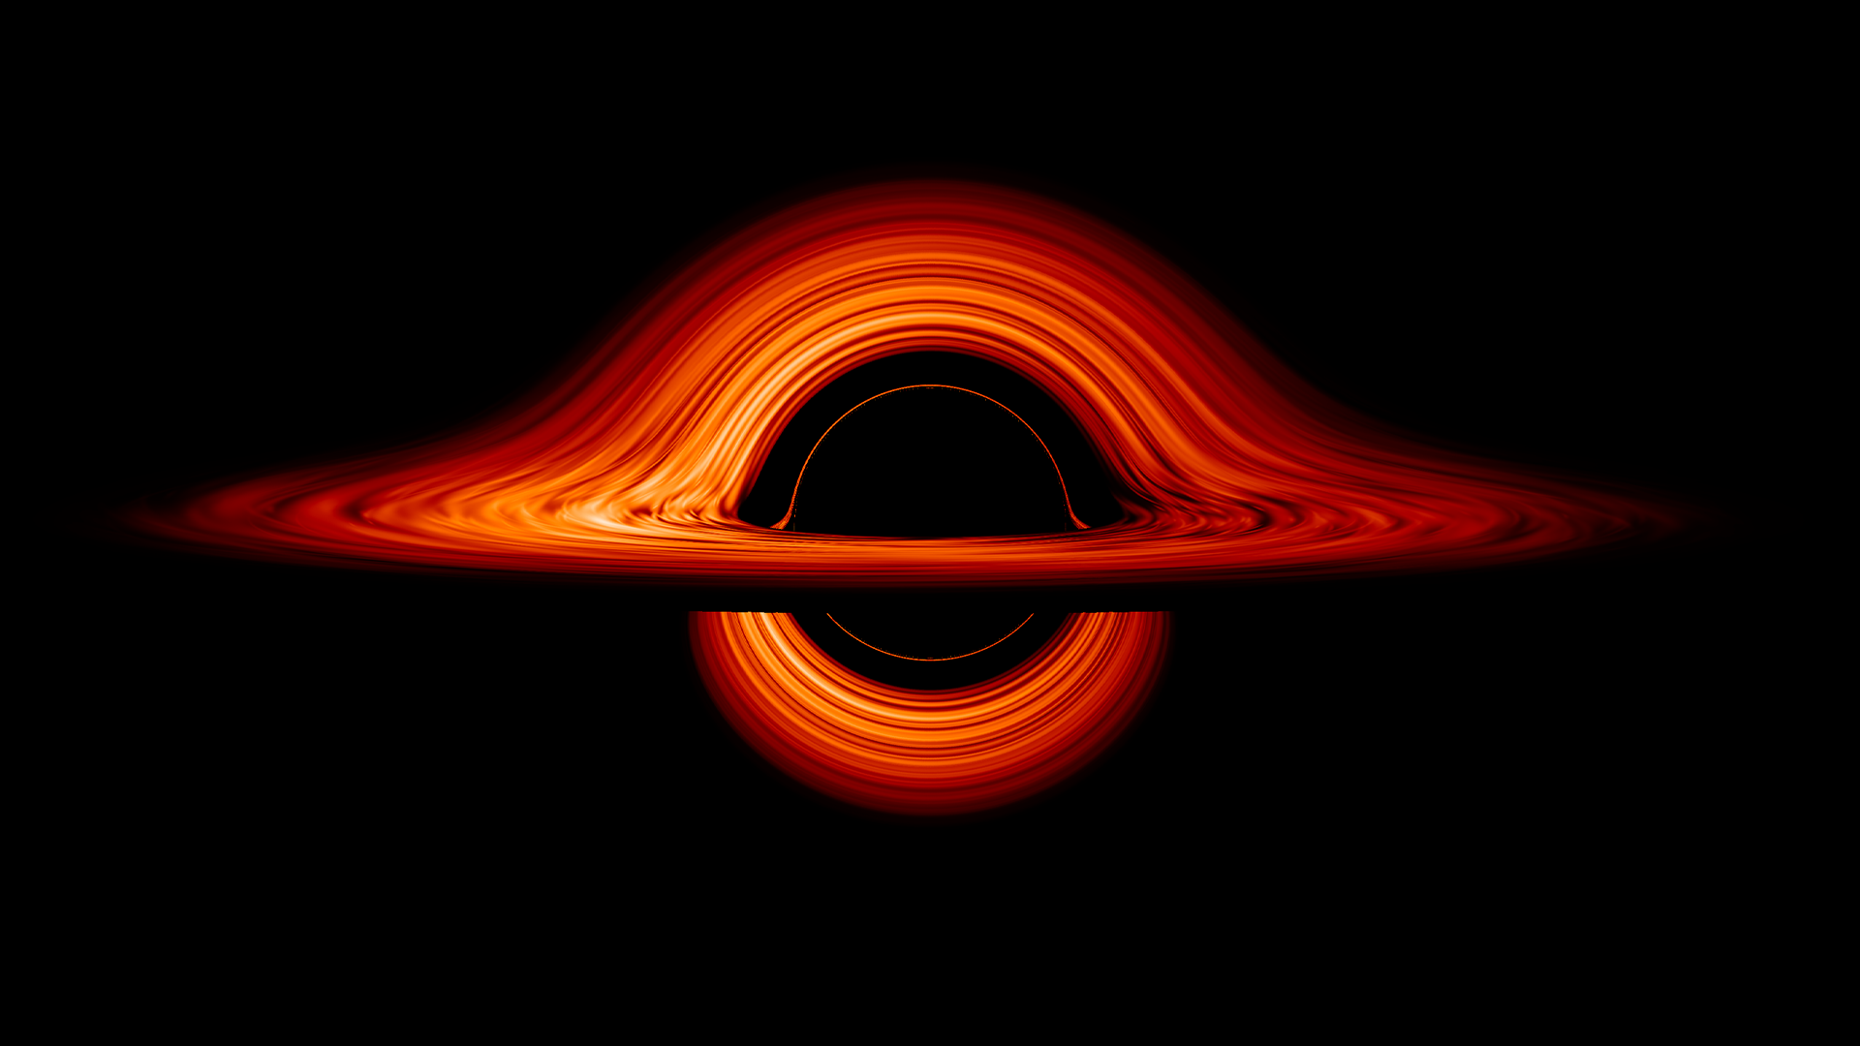
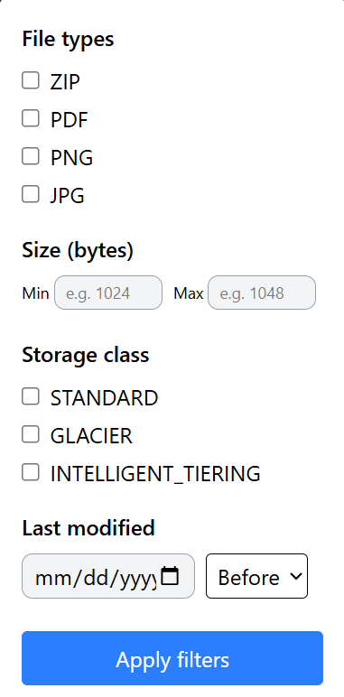


Index. Search. Visualize. Discover.
Full-text and metadata search.
Instant filtering by type, size, and date.
File previews + metadata insights.
User tagging and collaboration.
4
Notes:
That’s why we’re building ArtemiS3:
an intelligent search platform purpose-built for AWS S3 buckets that host NASA and USGS mission data.
ArtemiS3 indexes public S3 buckets, extracts metadata automatically, and gives researchers an intuitive dashboard to
search,
filter,
preview,
and tag mission files instantly

Slide 5
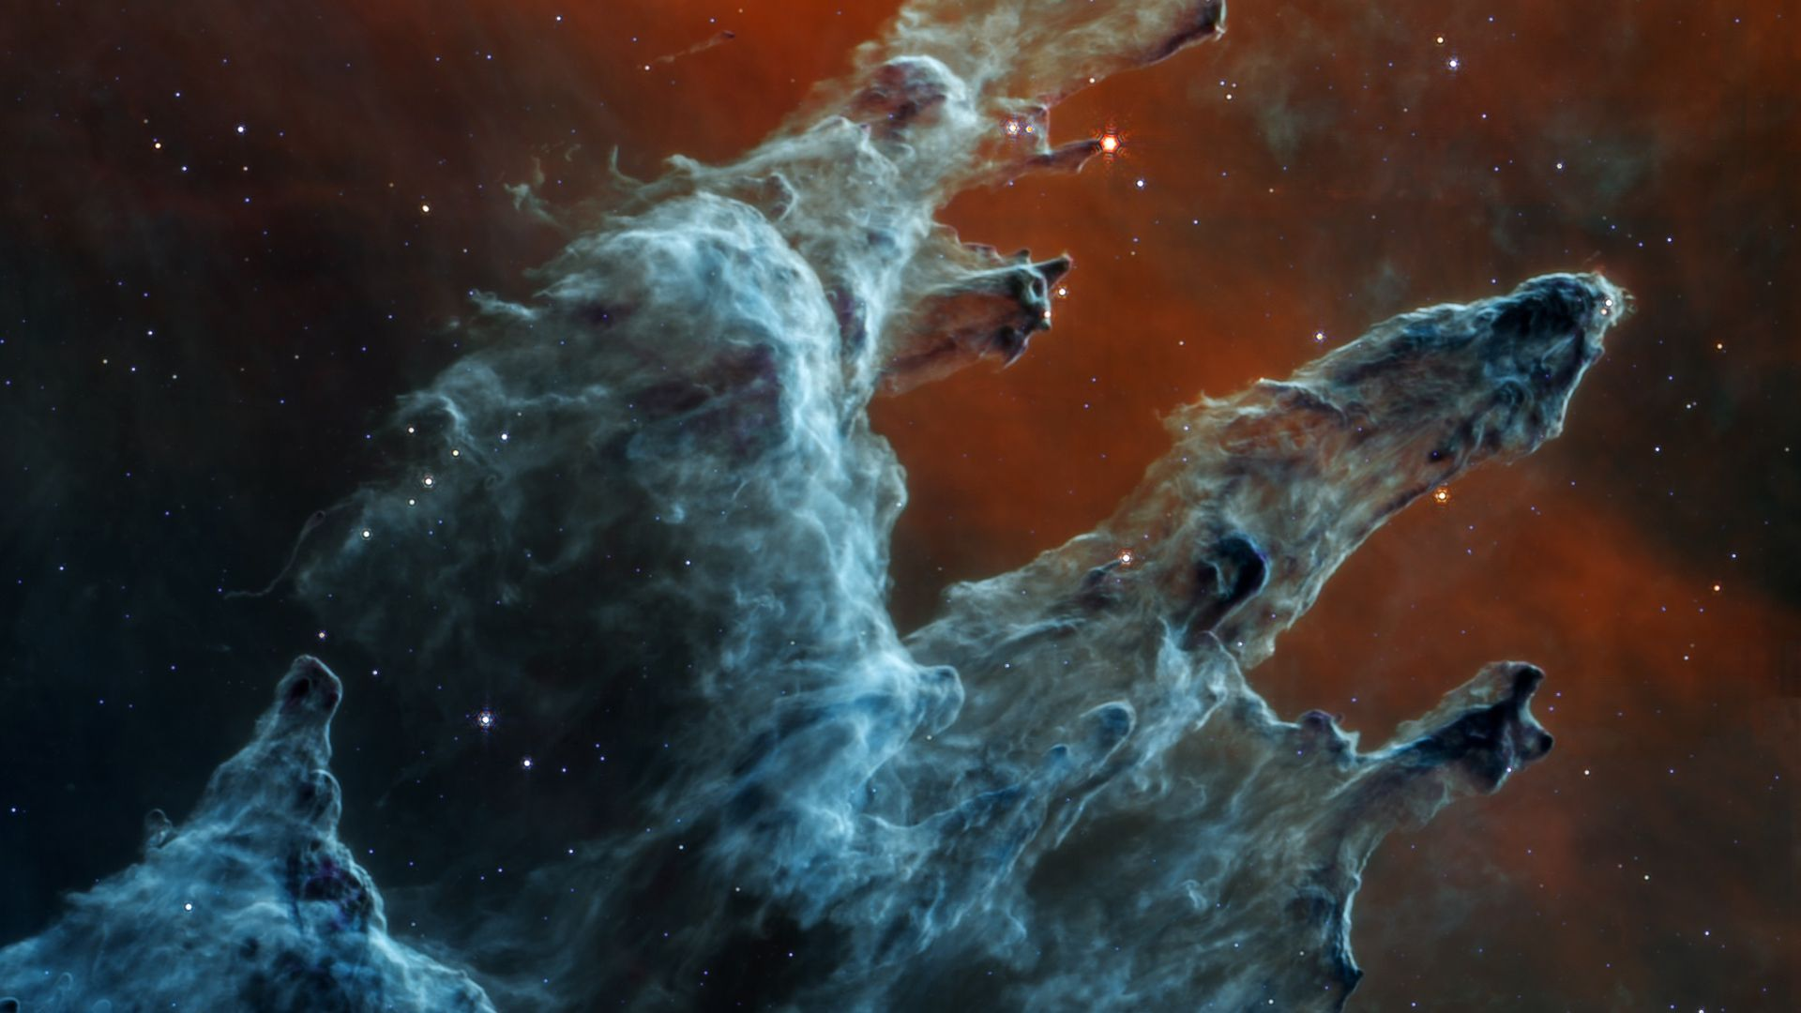
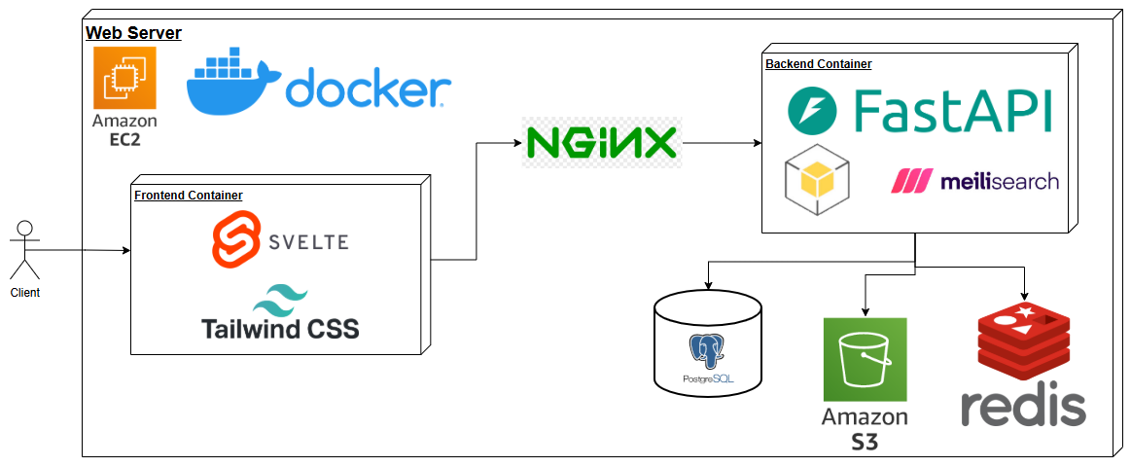
Modern, Fast, and Fully Open-Source
Svelte + TailwindCSS Frontend
Meilisearch
FastAPI Backend
PostgreSQL Tags
Boto3 S3 API
Docker on AWS EC2
5
Notes:
ArtemiS3 delivers fast
full-text and metadata search,
collaborative tagging,
and visualization
All packaged into a clean, lightweight interface designed for performance and accessibility.
This is made possible using a modern stack of tools such as FastAPI, Meilisearch, Svelte, PostgreSQL, and Boto3
The frontend user interface in made with Svelte and Tailwindcss making it fast, stylish, and lightweight
This is where the user can:
Enter search queries
Apply filters
Sort, preview, and download results
It interfaces with the backend API through an NGINX reverse proxy for security and load balancing
The backend is implemented with FastAPI, making it responsive and reliable
It interfaces directly with Amazon S3 through Boto3, allowing easy access to the stored data
Our search engine of choice, Meilisearch, is locally hosted on a docker container and interfaces directly with the backend
Which allows for automatically indexeing s3 objects for lighting fast full-text search
Additional data such as file tags are stored on postgreSQL and responses are cached with redis
Lastly the entire system is dockerized to ensure system independence and redeployability
When combined, these systems work together to make ArtemiS3 a comprehensive solution that accelerates and enhances the user experience with data access

Slide 6
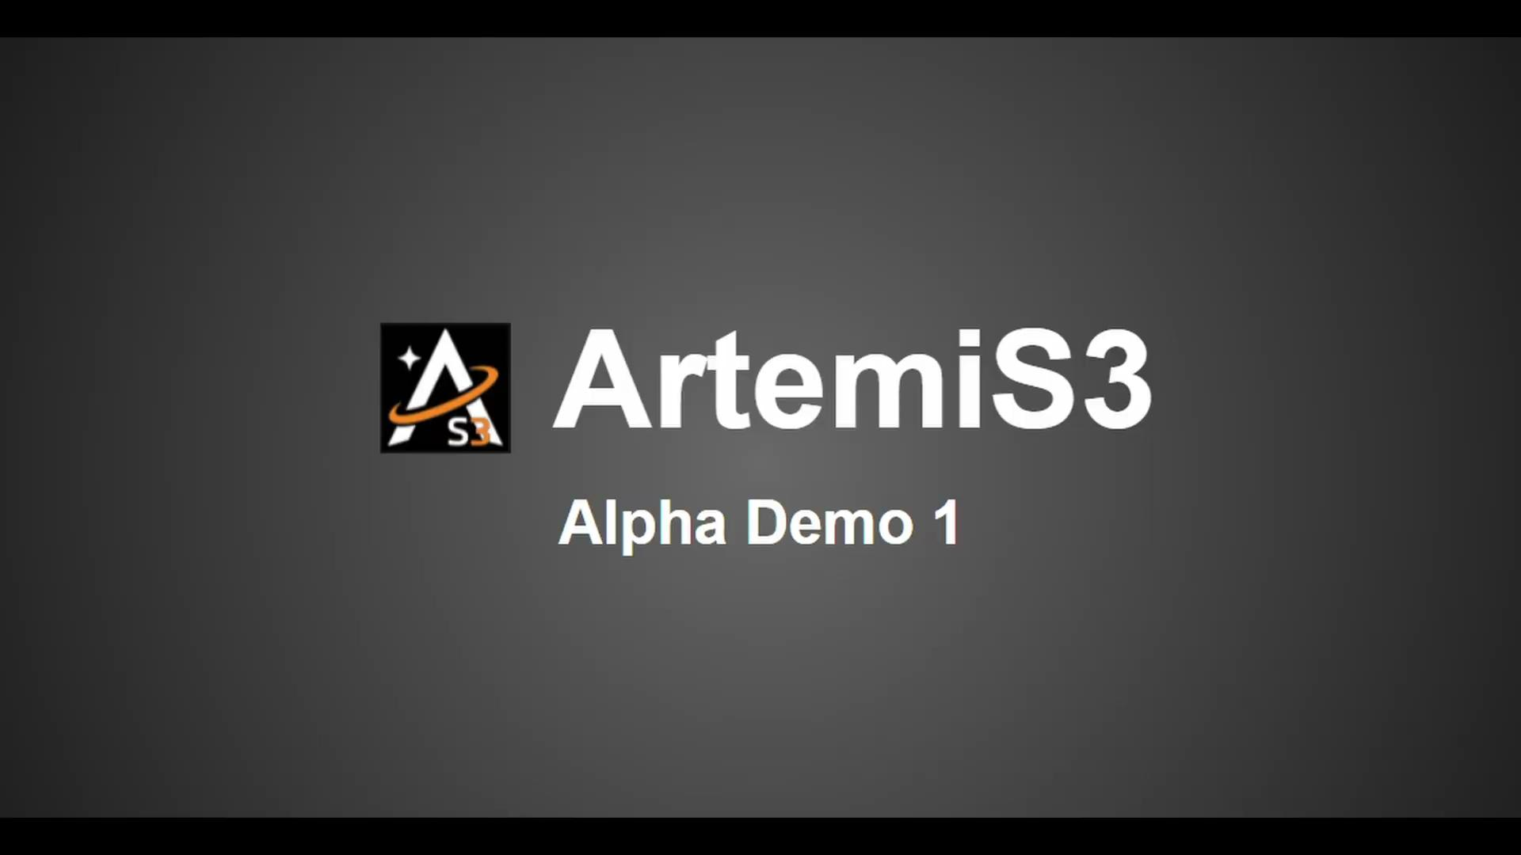

Slide 7
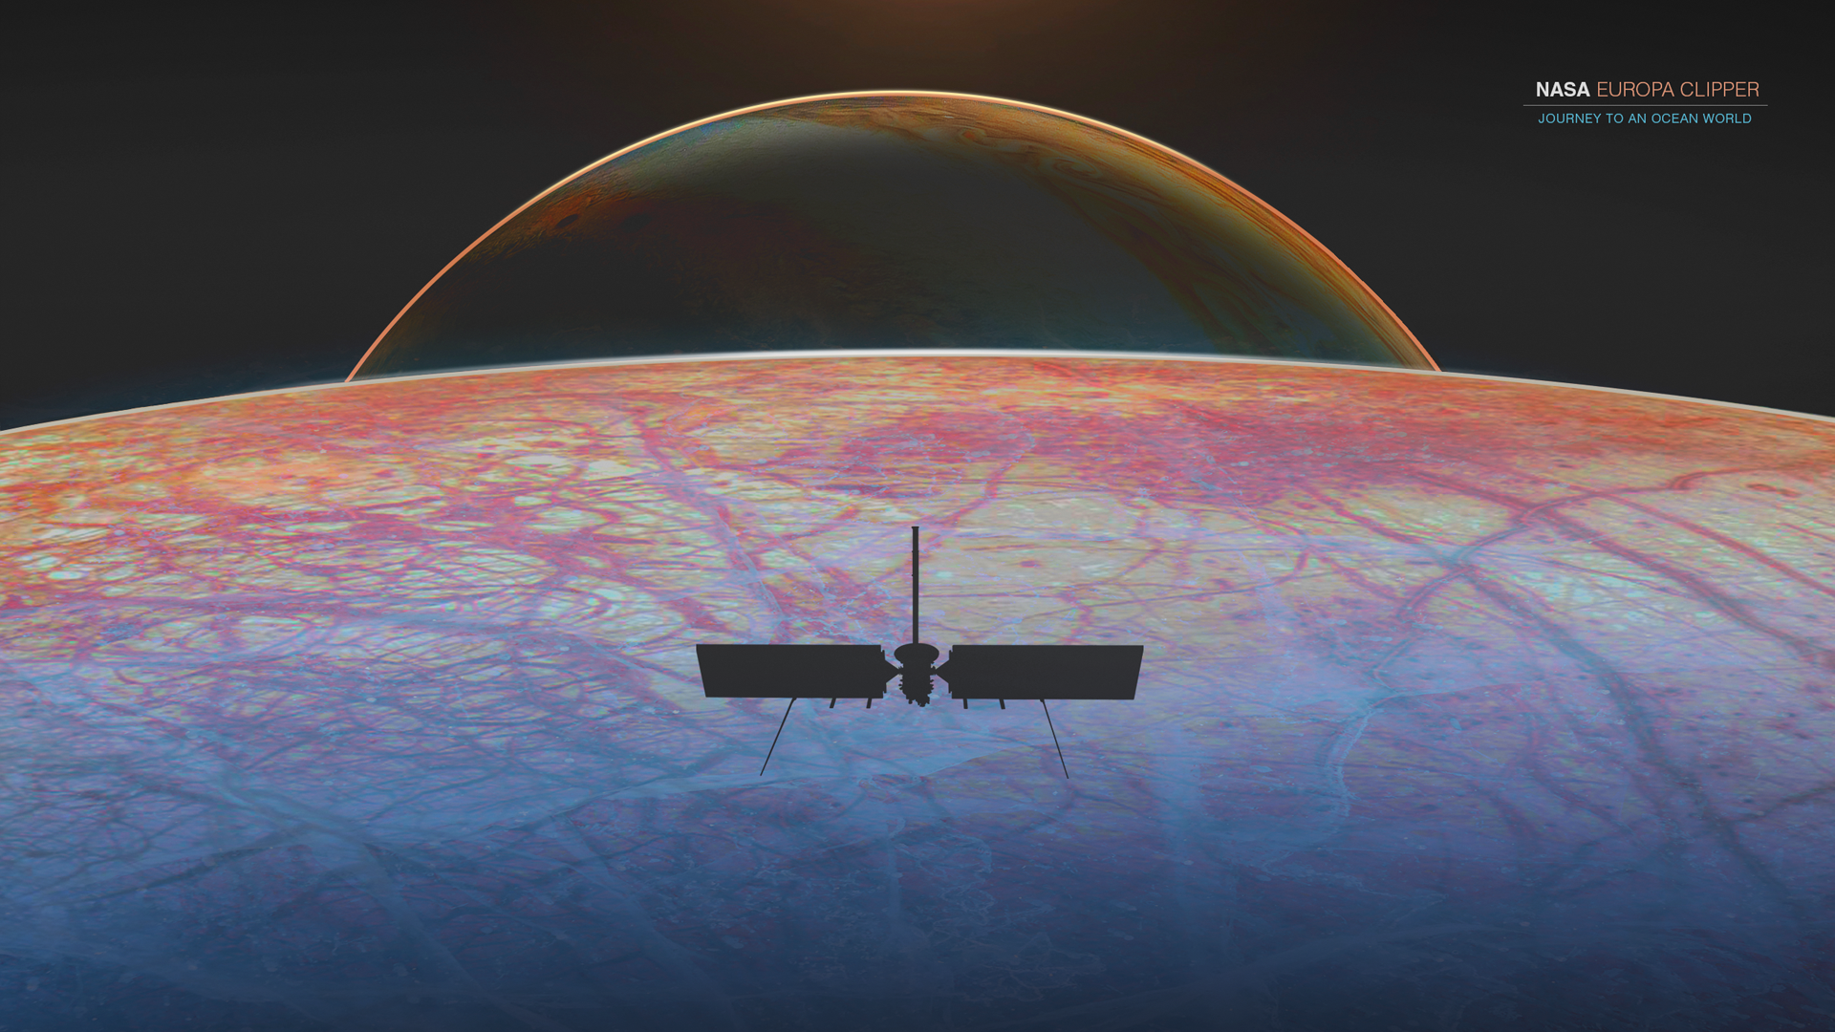
Challenges & Resolutions
Index performance with Meilisearch
Fixed with parallelization
Allowing users to sort by name, file size, or last modified date.
Updated Meilisearch’s “sortableAttributes” field
Added file, size and last modified date to the filter
Potential future problem regarding memory when deploying on EC2 Instance
Large indexes could easily exhaust resources
Notes:
One challenge we encountered was indexing performance with Meilisearch.
As bucket size increased, indexing time became a bottleneck. We addressed this by introducing parallelization in the indexing process, which significantly improved index time
Another challenge was enabling sorting by name, file size, and last modified date.
To implement this, we updated Meilisearch’s sortableAttributes configuration and ensured those fields were properly included in our filter logic.
Looking ahead now, a potential challenge is memory usage when deploying on our EC2 instance.
Large indexes could easily exhaust available resources
Would only be discovered one the project is handed over to the client

Slide 8
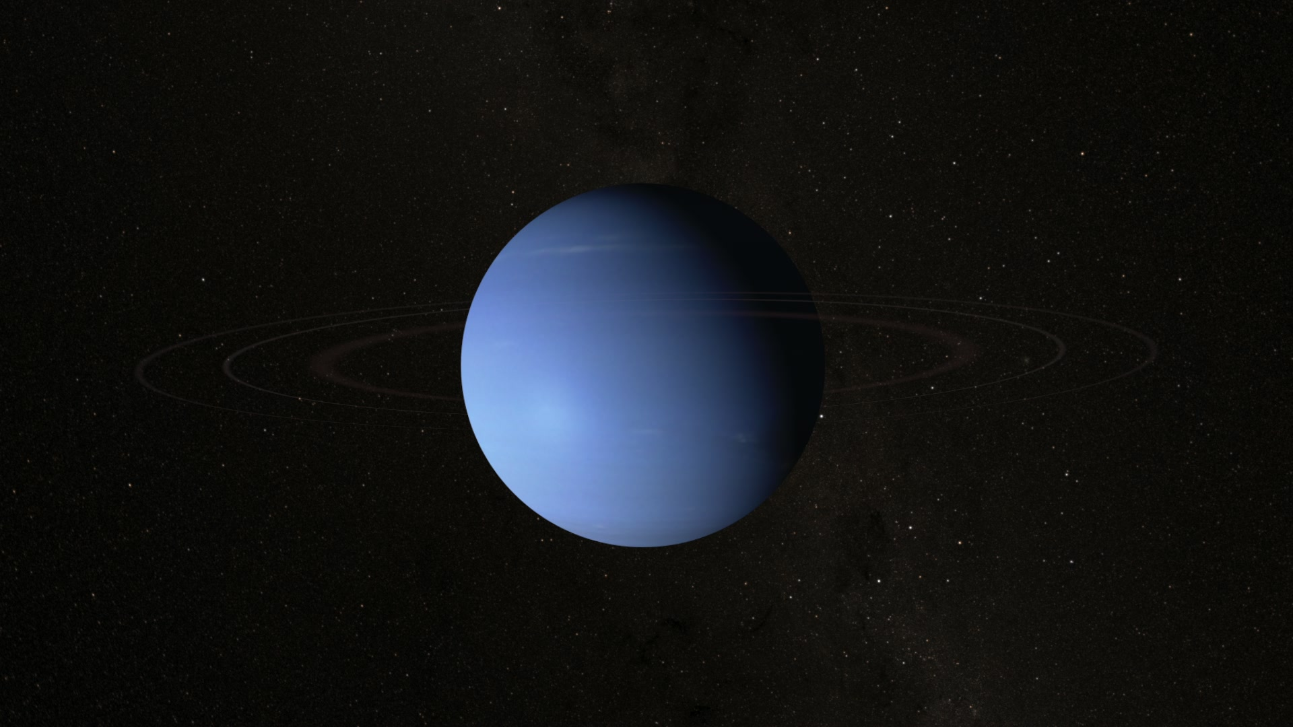
Current Schedule
ArtemiS3's core functionality is fully operational
Search, sort, filter, and indexing
Frontend and backend are connected
Next Phase:
Frontend/UI polish and user testing
Improving performance where possible
Notes:
Right now, ArtemiS3’s core functionality is fully operational
Search, sorting, filtering, and indexing are all working end-to-end, and the frontend and backend are fully integrated and communicating
Moving into the next phase, our focus shifts to refinement.
We’ll be polishing the frontend and overall user experience, conducting user testing to gather feedback, and optimizing performance wherever possible

Slide 9
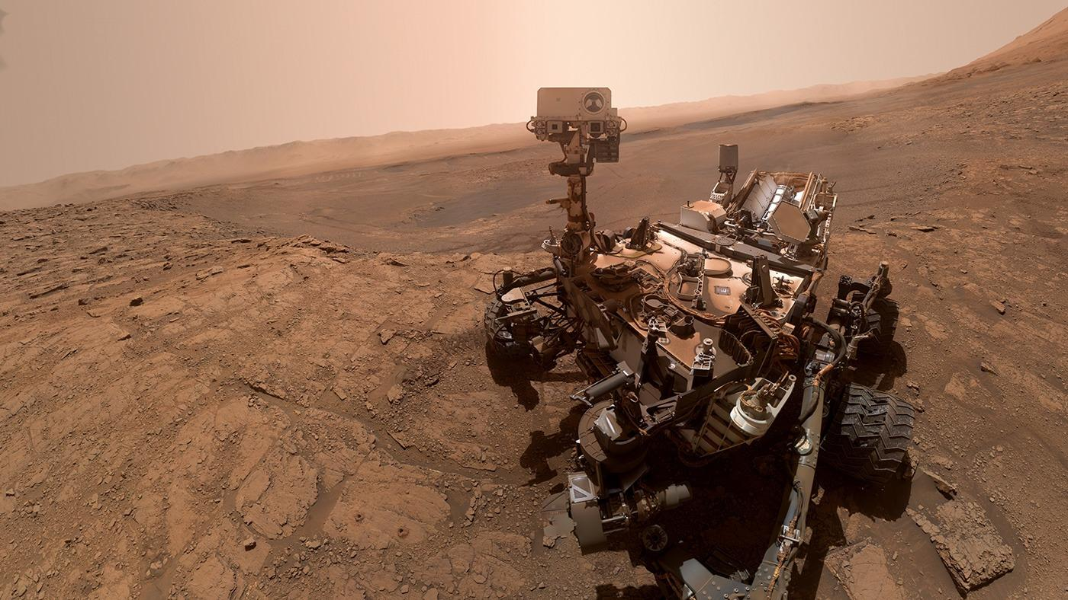








Jeffrey Hoelzel Jr
Architect
jmh2338@nau.edu
Joseph Laity
Team Lead
jbl265@nau.edu
Samuel Bodenheimer
Release Manager
swb79@nau.edu
Travian Lenox
Software Lead
tjl379@nau.edu
Thank you
ArtemiS3
*This presentation includes publicly accessible content provided by NASA and the United States Geological Survey (USGS). All such materials are used in accordance with their public use guidelines.
Notes:
ArtemiS3 transforms static S3 storage into a fast, secure, and intelligent search platform for NASA mission data.
With core functionality implemented and Alpha milestones in progress, we are confident in our design and ready to move into refinement, testing, and final deployment.
Overall, ArtemiS3 is built with impact, scalability, and long-term value in mind
Thank you!

