Slide 1

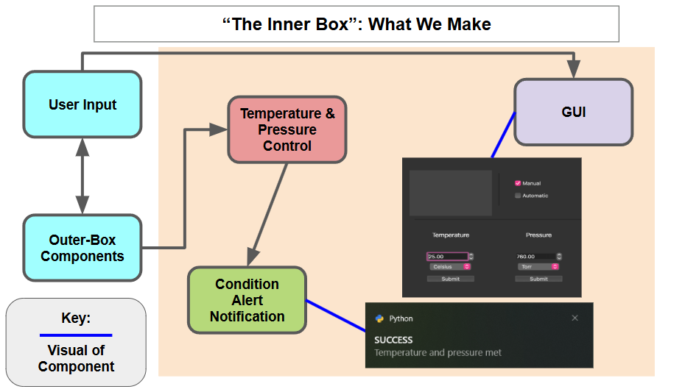
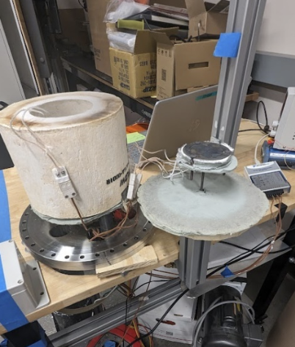
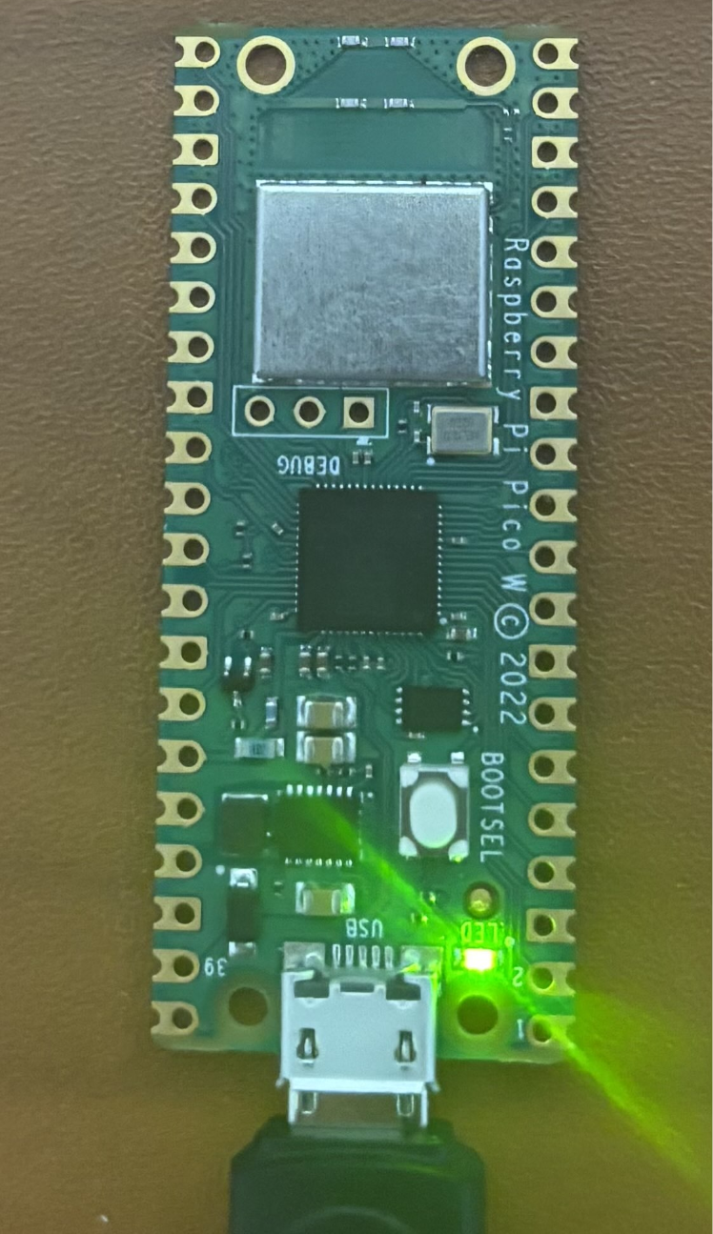
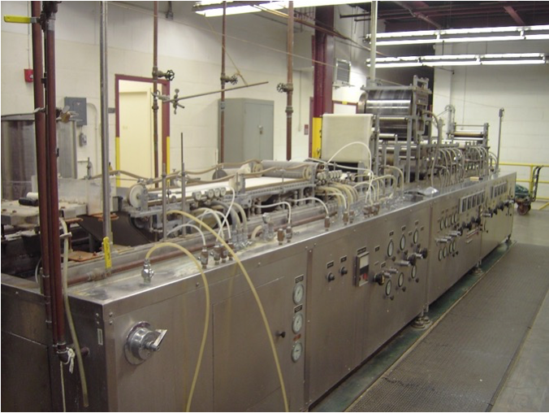
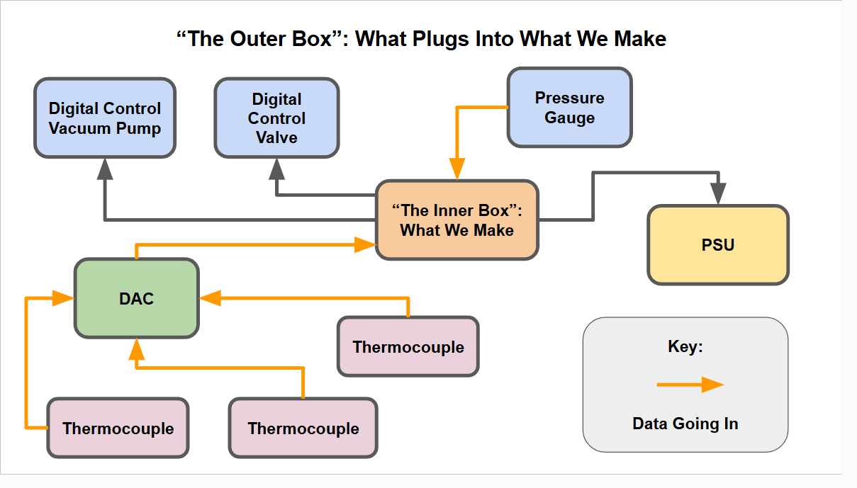
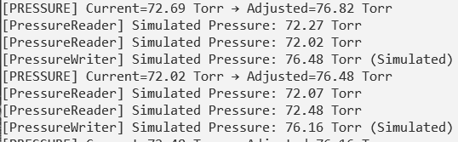
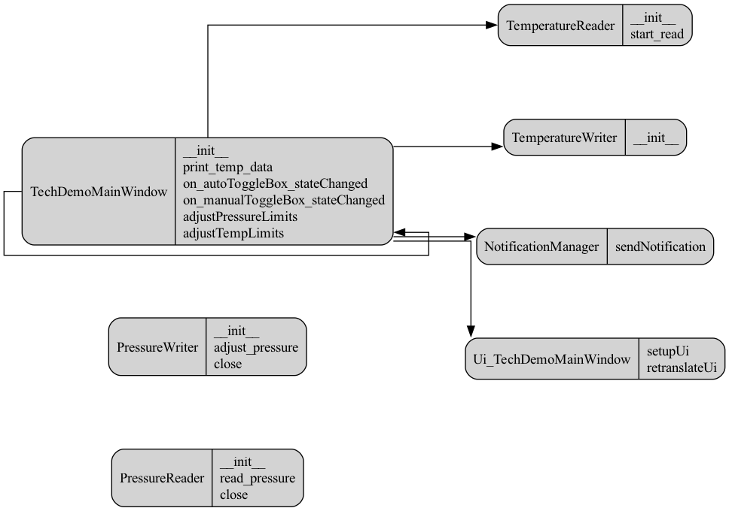
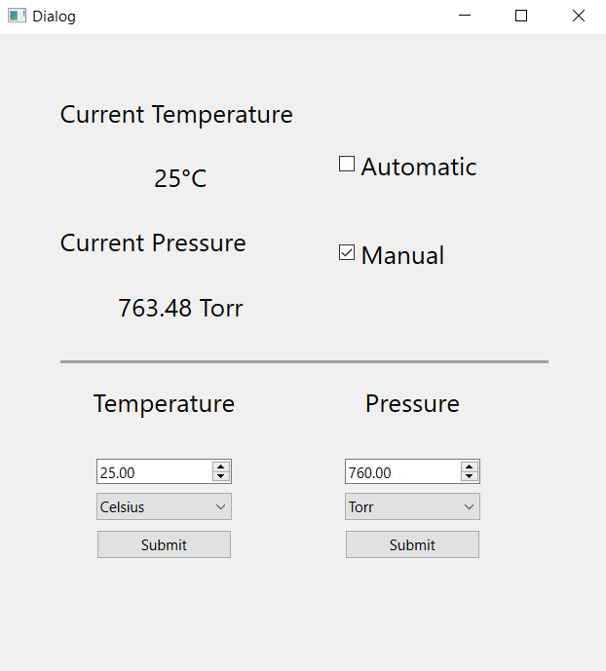

ThermoGen: Automating for HeetShield
Gareth Carew, Kameron Napier, Olivia Vester
Overview
Methods
Testing
ThermoGen is a senior capstone project working with the client HeetShield. The purpose of this project was to automate the process used by HeetShield that tests their thermal materials in order to reduce the amount of time the test operator needs to spend testing.
This is the basic internal design of our software system.
Unit testing for the pressure module includes reading the pressure as well as responses to valve commands.
Unit testing for the temperature module includes converting temperature to voltage, reading the voltage, and writing the voltage.
User testing includes three stages that will encompass iterative steps to meet client requirements and needs
Fig. 2
Fig. 4
Fig. 5
This is the outline for the hardware design that plugs into our software system.
Fig. 3
Fig. 1
Architecture
Conclusion
Results
ThermoGen provides accurate, automated control of temperature and pressure for thermal insulation material testing. By removing manual adjustments, it ensures consistent test conditions, saves time, and improves precision in thermal analysis. The system offers a reliable and efficient solution for HeetShield’s testing.
Fig. 7
Automated control of both temperature and pressure within a thermal diffusivity testing environment.
By using a power supply and valve the system achieves a user specified environment without manual input which significantly improves accuracy and speed in material testing.
Fig. 6
Fig. 8
Acknowledgments
Sponsor: Steve Miller, HeetShield, CS486 Professor: Isaac Shaffer, Mentor: Jeevana Kalapala
Figures provided by HeetShield and ThermoGen 2025

