Slide 1
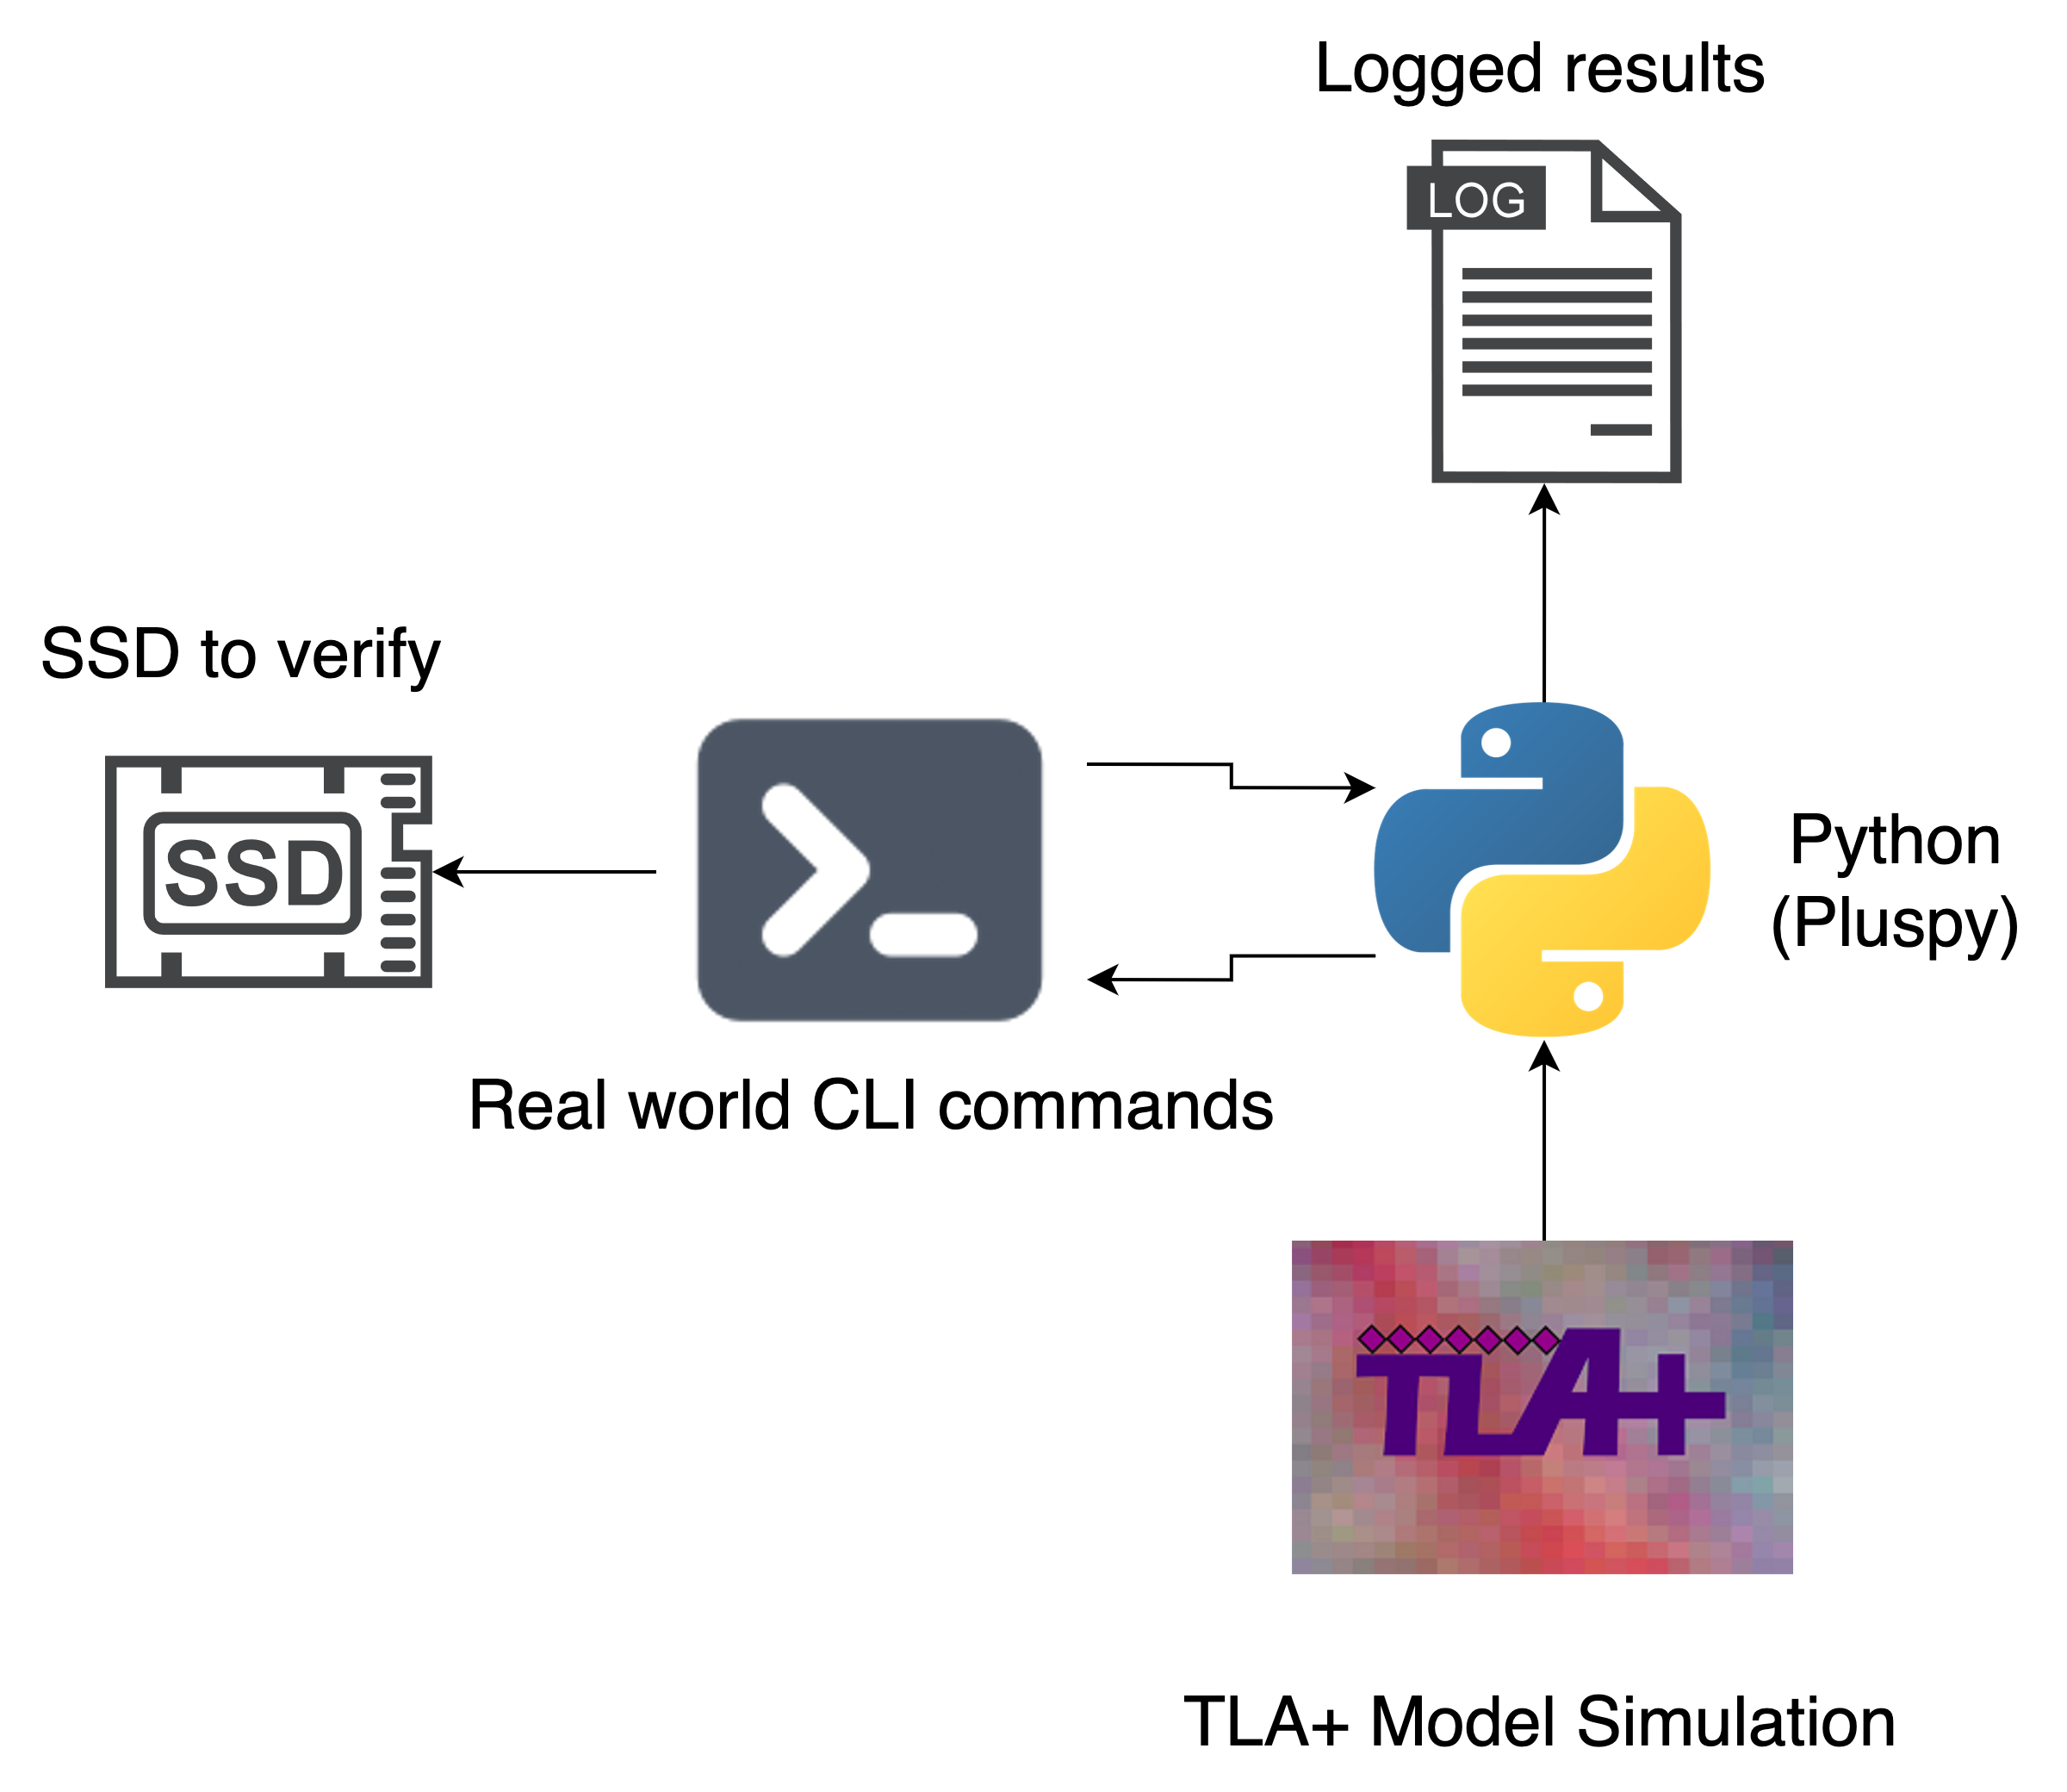
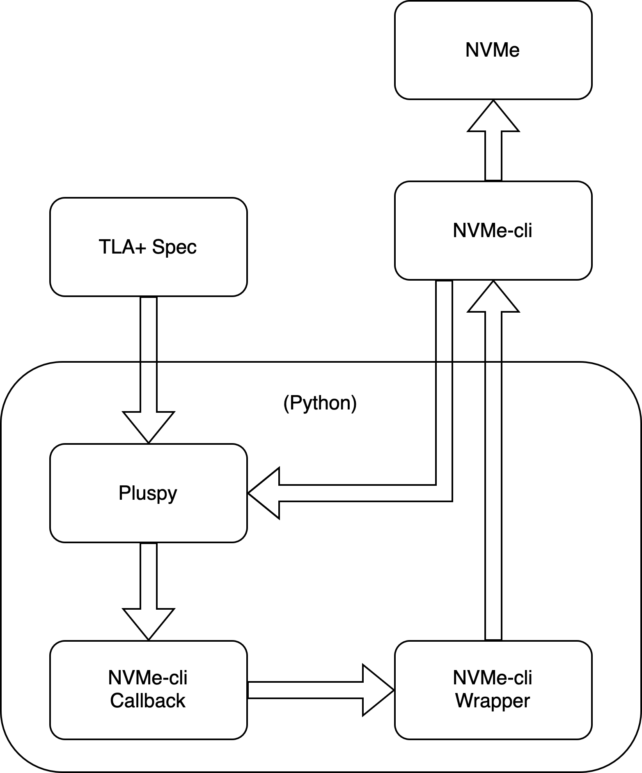
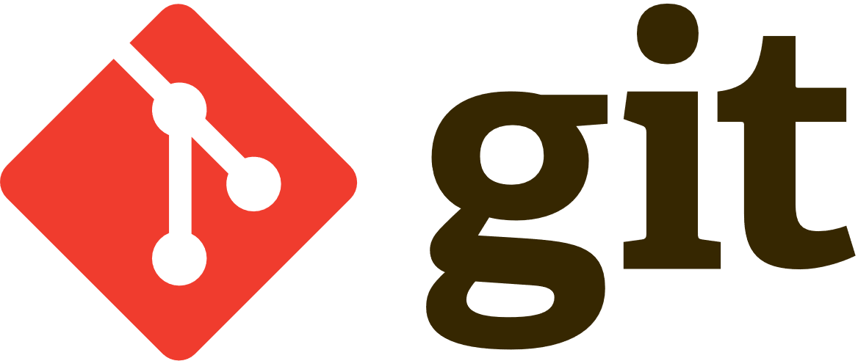

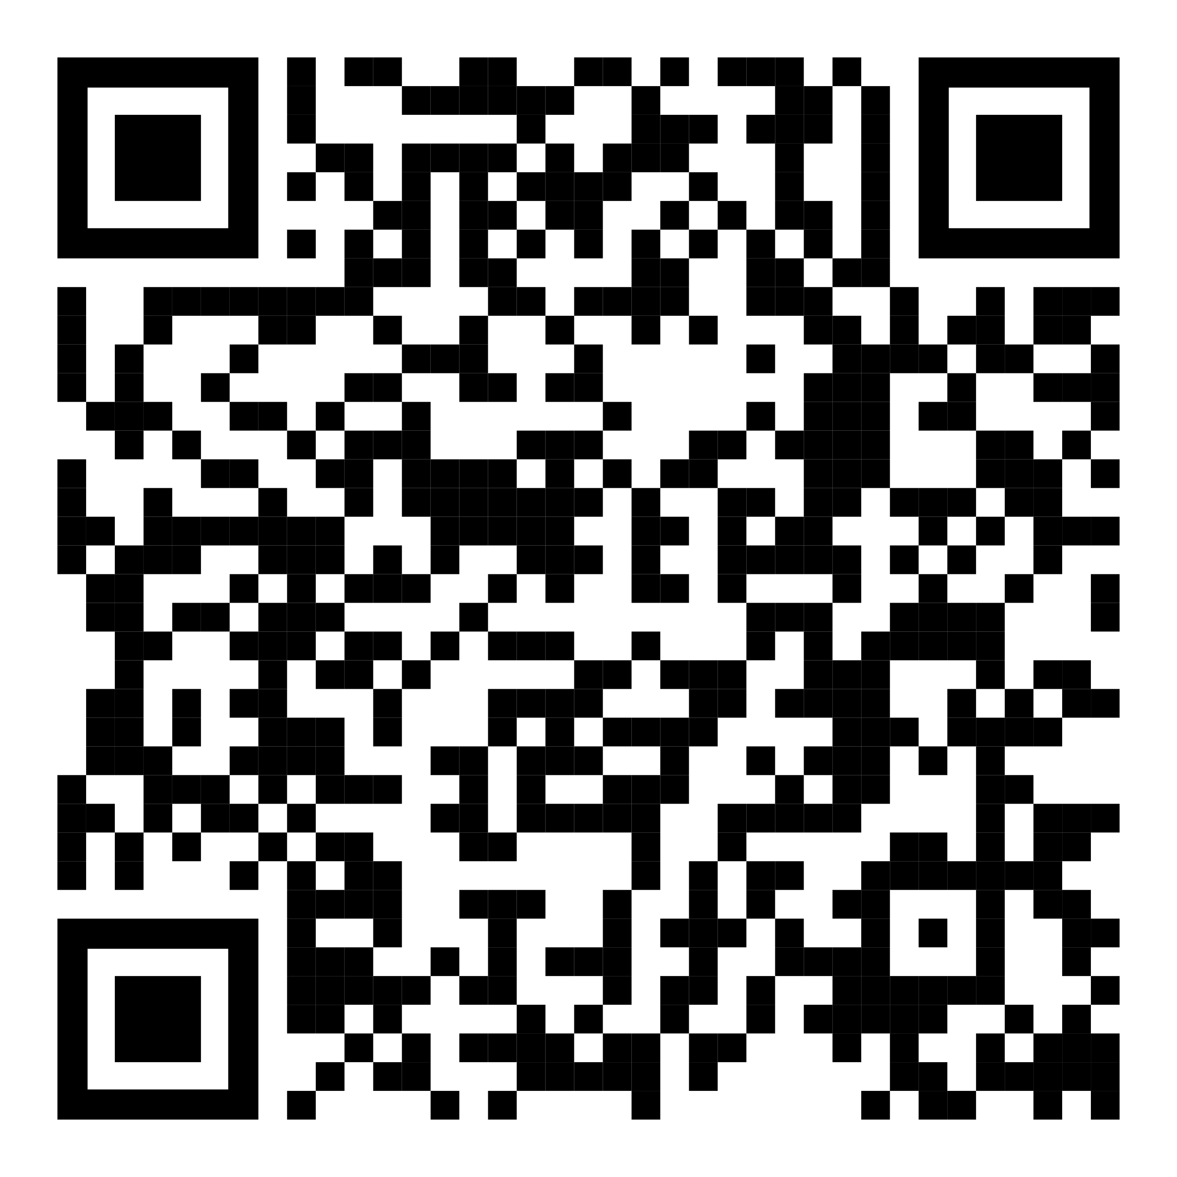


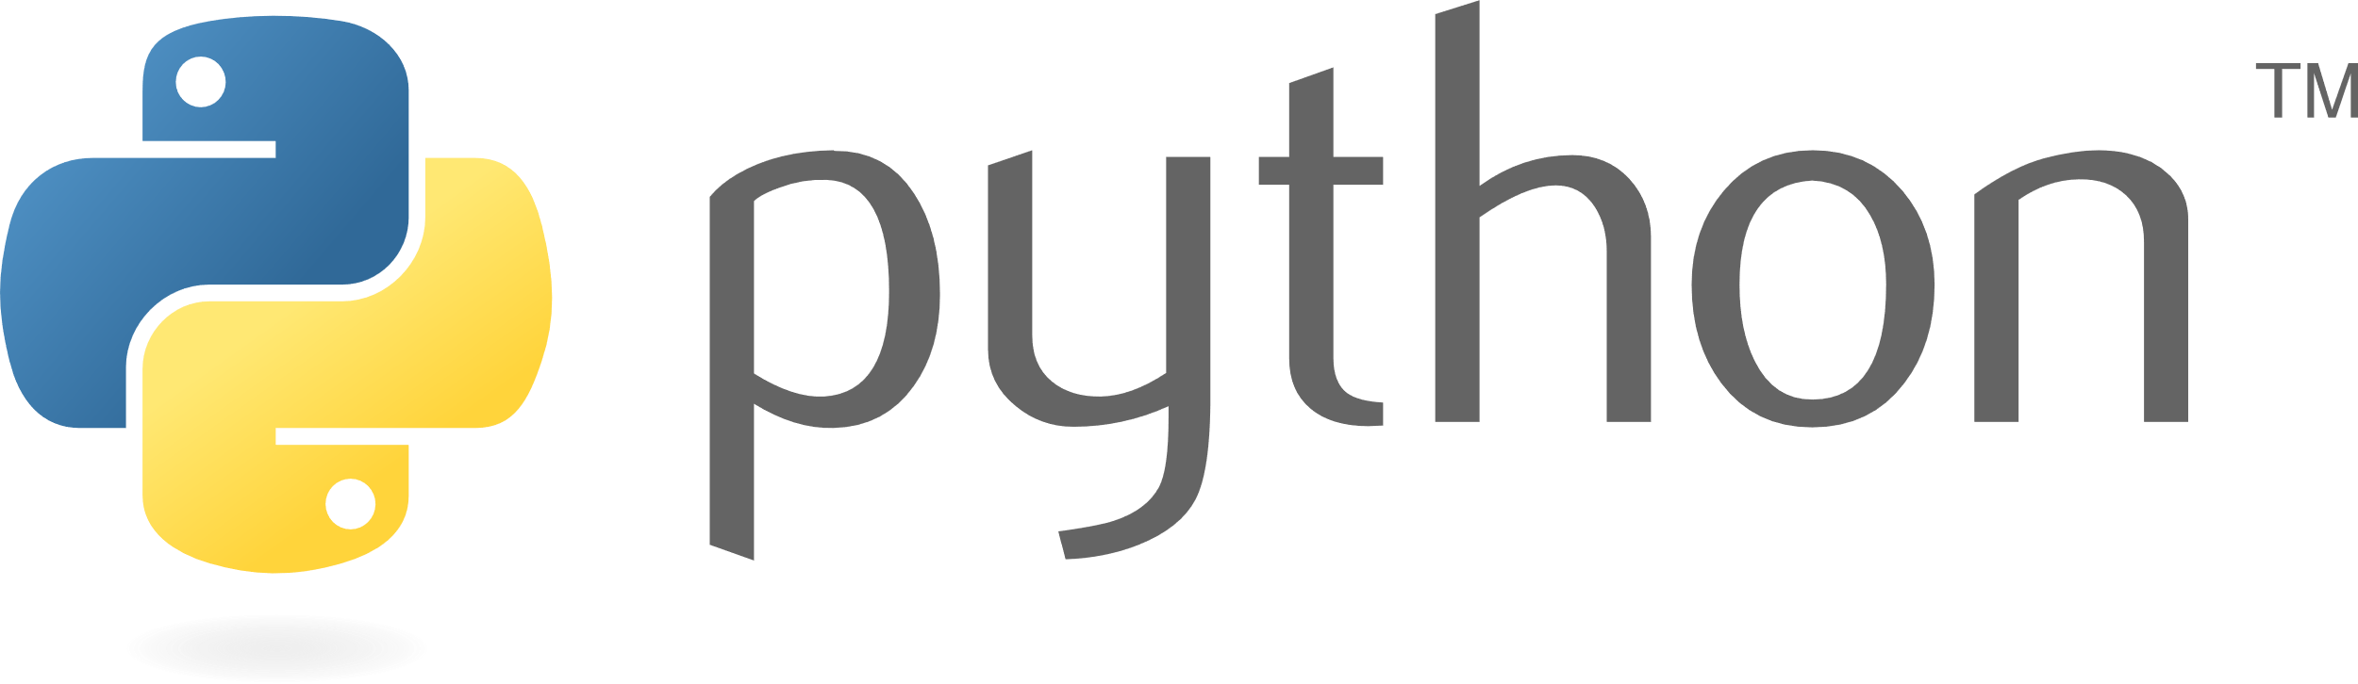
Validating NVMe using TLA+ and Python
Generative Testing of NVMe using TLA+ Model-Simulation
Carter Kaess, Charles(Chas) Diaz, Connor Aiton, Charles Descamps
Solution
NAU School of Informatics, Computing, and Cyber Systems
NVMe-CLI is a tool we use to send commands to an SSD.
A Python script connects to NVMe-CLI and runs tests using a TLA+ file and a random seed.
The TLA+ file contains predefined tests, and the seed selects tests randomly.
This approach allows extra test during idle time, helping find SSD errors.
Introduction
The need for fast solid-state storage is growing as computers become faster.
Applications demand quick storage solutions to keep up with performance requirements.
Storage drives are improving in speed, but testing processes have not kept pace.
Exploring additional testing options during downtime can help identify obscure bugs or specific violations.
Program Flow
Motivation
Long-term storage, like NVMe drives, is crucial for saving files, media, and running applications smoothly
NVMe drives power modern computing but must be rigorously tested to prevent data loss
Traditional tests exhaust quickly, causing idle time and wasted computing resources
We’re developing a brute force approach to maximize testing, finding more bugs and edge cases
Technologies
Scan for website

