Slide 1

Facilitating Communication Between
Local Governments and Non-Profit Service Providers
Team 12 HelloWorldByMe
Notes:
Elizabeth - Hello everyone! We are Team HelloWorldByMe, and for our project, we designed a way to facilitate communication between local governments and non-profit service providers.

Slide 2
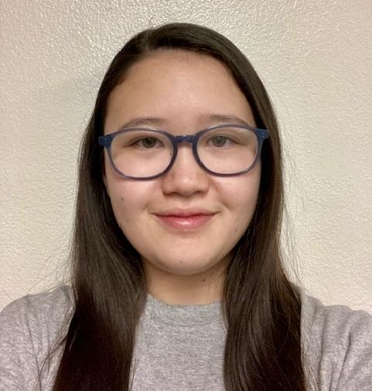



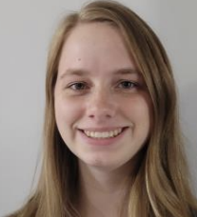

Meet The Team
Elizabeth Knight
Team Lead
Client Communicator
Full Stack
Jessica Maldonado Olivas
Release Manager
Frontend
Savannah Chappus
Mentor
Joey Banaszak
Database Architect
Backend
Samantha Madderom
Recorder
Backend
Brian Donnelly
Mentor
Notes:
Elizabeth - Before we get started, we would like to introduce ourselves! My name is Elizabeth Knight, and I’m the team lead, client communicator, and full-stack developer…. [Insert rest of team’s introductions.] Our two mentors are Savannah and Brian. Now that you’ve all met the team, we would love to introduce the person who is behind this project… our client, Kevin Daily

Slide 3
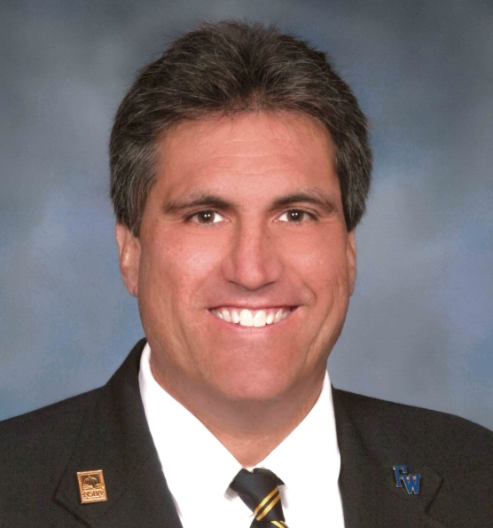
Our Client
Kevin Daily, President at EKA Labs
Creator of WorldByMe: a role-based education model
Client Need: Build a platform that supports secure collaboration and role-based access between multiple service organizations
Notes:
Elizabeth - Kevin is the president of his own start-up, EKA Labs, and creator of an education role-based model, WorldByMe. After spending his own time helping the Tucson community, he came to us with a goal in mind: to build a secure platform that allows multiple non-profit organizations to come together to support individuals needing shelter, food, and more.

Slide 4
The Problem:
According to the City of Tucson’s 2023 Point in Time Count Report, despite there being 1,066 available shelter and supportive housing beds, there was still over 1,504 individuals experiencing unsheltered homelessness.
Service providers are working hard, but are working in silos, limiting effective help for the community.
Disconnected organizations = no shared client history
Clients usually need multiple services
Delays + miscommunication = missed opportunities to help
Kevin’s vision is to connect local service providers through a centralized, secure platform that streamlines the current workflow and reduces inefficiencies
Notes:
Elizabeth - The biggest issue that the city of Tucson faces that Kevin wants to resolve is not just the resource quantity, but the lack of coordination providing these resources. Many service providers are working hard, but independently, leading to duplicated information, fragmented client progress, and allows clients to be left behind in the current system. Kevin’s vision involves bringing these services together in one secure environment, where information can be responsibly shared, and allows support to be coordinated in real-time.

Slide 5
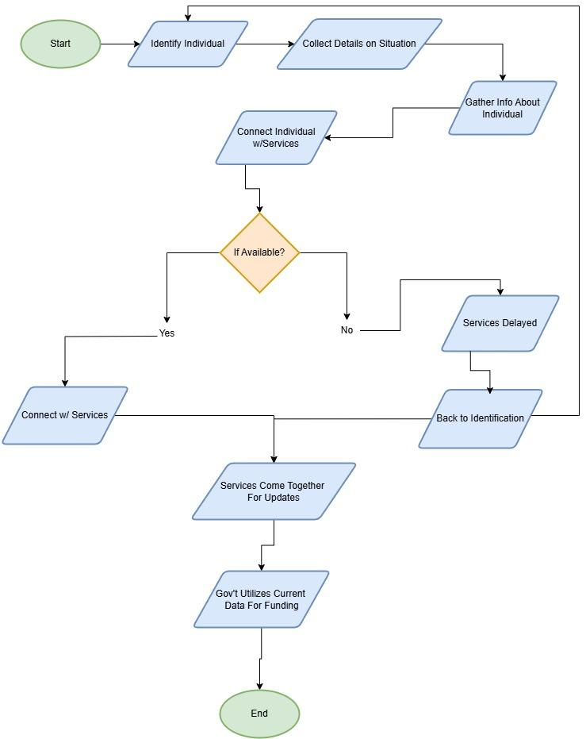
Current Workflow for Service Providers
Connecting individuals to services heavily depends on local availability
Individuals that utilize multiple services are often lost or delayed in the workflow
Appropriate government funding isn’t possible from inaccurate data and a 24-hr community health check
Notes:
Elizabeth - Currently, various service providers are doing their best to keep up with the high demands, but the system just isn’t made to allow collaboration efficiently. To connect individuals with the correct service providers they need, availability is important. Without a shared system, it is extremely easy for a client’s journey towards recovery to be fragmented. And when that data isn’t captured accurately, it not only impacts the individual but also the funding and resources available to the whole community.
Now I’m handing it off to Samantha to talk about our newly developed solution.

Slide 6
Our Solution
A web application that will serve as a centralized, secure platform that will allow:
Multiple organizations/entities to have their own workspace
Service providers to work together to help people with multiple service needs
Respectful access and accountability
Key Features:
Robust multi-organization messaging
Role-based access control
Shared access to information and resources
Accurate, real-time data for proper funding and research
Notes:
Samantha
Our solution is a web application that will serve as a centralized, secure platform to will allow these service providers to connect more directly and consistently. They will be able to create their own organization on our platform, and broadcast what services they currently have available. In this way service providers can work together to provide a variety of service needs to the community. Our system also supports role based access, meaning individuals using the system will have access to the resources relevant to only them without having to be granted additional privileges.
Our solution also features a robust messaging system that enables cross organizational communication. Users can connect with others without needing specific contact details. For example, if a user doesn’t know the name, email, or number of the person they need to contact, but they do know their role, they can quickly search for that individual based on that role. Users may also send group messages to everyone with a given role.
Finally any information that is collected can be compiled and delivered to local governments for the purposes of funding and research. The funding these organizations receive is often based on the demographic information of the individuals they help, and with the current process only doing a headcount once a year, this information is often inaccurate and unreliable. Our solution helps alleviate this.

Slide 7
Why Don’t They Use Another Messaging Platform?
 | Our Platform | Discord/Teams | Email
Cross-Org Communication | Open and discoverable organizations | Private servers that rely on connections | Unable to form groups; must have right contact
Role-Based Access | Strict RBAC, easy to maintain | Has RBAC, hard to maintain unless settings is familiar to user | Non-existent
IRB/Data Protection | Designed for secure use | Not HIPAA and IRB compliant | Depends on system
Purpose | Developed for service coordination | Made for general communication | General communication
Notes:
Samantha
One question we’d like to address is why these organizations don’t simply use some other communication platform such as discord? There are several reasons.
First, our system presents open and discoverable organizations, while other systems rely on you already having the contacts or connections you need. With our system, organizations can connect instantly without needing to go through the process of getting an individual’s contact information.
Second, our system maintains role based access across all parts of the site. This makes it easy to maintain who has access to what. Other platforms have a concept of RBAC, but it’s harder to maintain, while our system manages all that behind the scenes.
Third, our system has been designed for secure use, ensuring that our client’s data is protected. Other systems just aren’t designed with this in mind.
Finally, our system has been created specifically for this use case. This means we can tailor our system to the needs of our client, instead of having to work through other platforms. There are many features, such as service matching, that other platforms don’t share.
Now that we’ve discussed the unique advantages of our system, let’s look at the key requirements that guided our development

Slide 8
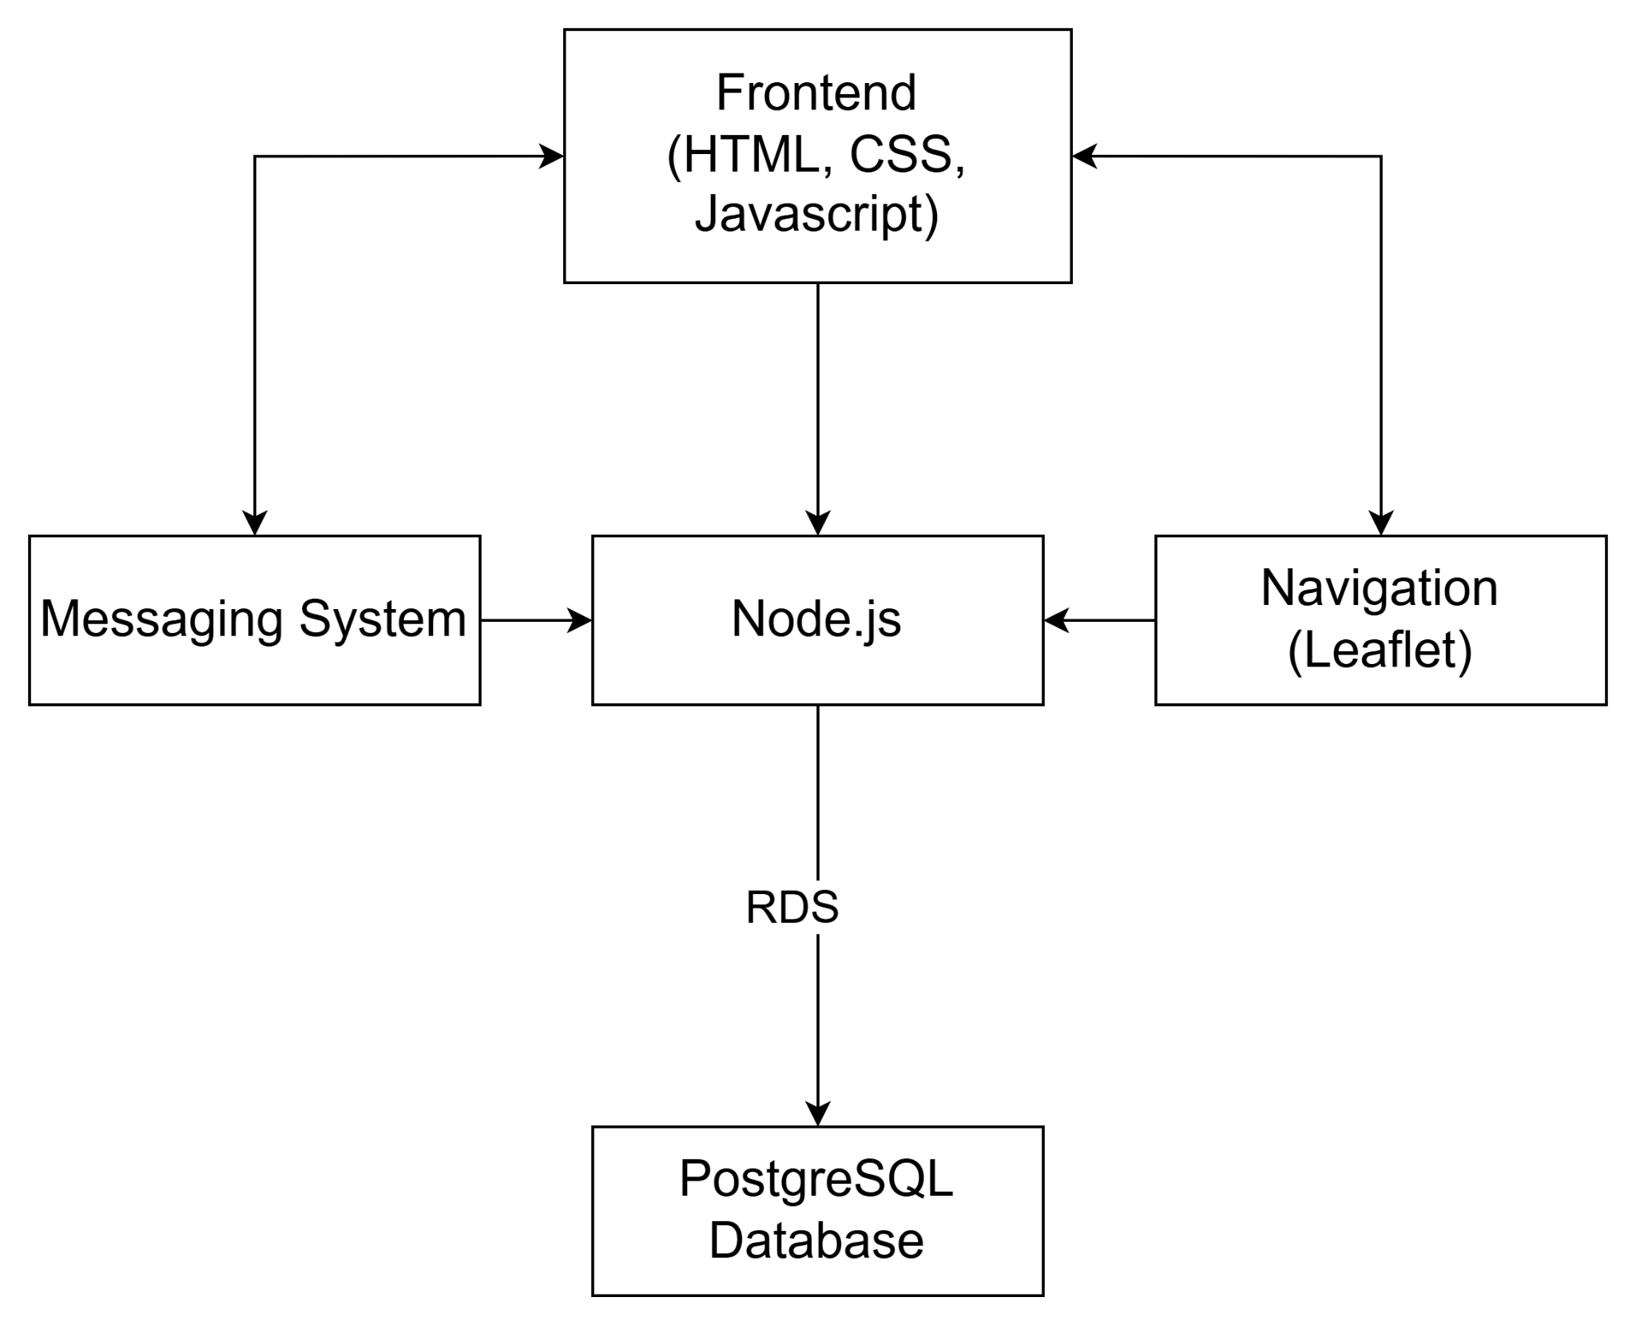
Key Requirements
Real-time database querying
Create/join organizations
Add new people to organizations
Cross-organization communication system
Store critical client data
Security
Notes:
Samantha
These are the major requirements for our project. We must be able to query the database in real time, create organizations, add employees, provide a method of communication, and store critical information in our database, all while maintaining security and protecting our client’s information.
We will now go into more detail about our implementation.

Slide 9
Architecture & Implementation

Slide 10
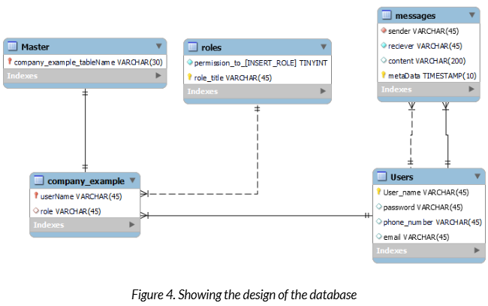

Database
PostgreSQL DB on AWS EC2 instance
Navigation
Data Objects
Notes:
Joey: Our database is hosted on an Amazon RDS instance through an EC2 server, with a postgreSQL engine. We chose postgres because it is a relational database which allows us to easily and effectively organize different tables. Our database stores information regarding role definitions, user information, what roles a user takes on, hashed passwords, entity information, message history, and more. The master table will act as a table of contents for a distributed system storing information about a particular company, allowing each company can have its own table in our database for a high degree of scalability. With each company having the capacity to store employee information, roles and the permissions associated with them and more.
The database is also be responsible for storing data objects associated with different users. This includes collected demographic information to be used for research purposes, and possibly government funding for organizations.
Now for our role based access control

Slide 11
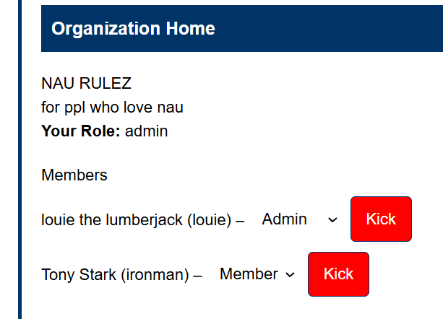
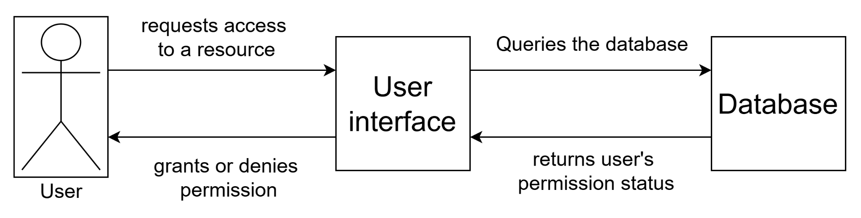
Role-Based Access Control
User’s role and permissions
  incorrect level of clearance = denied access
Login/logout auditing
Notes:
A major aspect of our project is our clients proprietary role based access system. Users have access to different actions and resources based on their assigned role or roles in the system. Our role based access feature is implemented through the database. Storing a user’s role and the permissions associated with it. Roles are be associated with user’s data, and will be checked before the system will allow a user to perform certain actions, or access certain resources. The database also has a table that specifies the roles and their level of access and if a user does not have the proper permissions, the system will simply not allow them to perform the action they were trying to perform.
We’ve also implemented a login/logout auditing feature which logs what users make what changes to their system while they are logged in to track changes. This is also hosted on our Amazon RDS database, and connects directly to the User interface.
Now back to Samantha with the messaging system

Slide 12
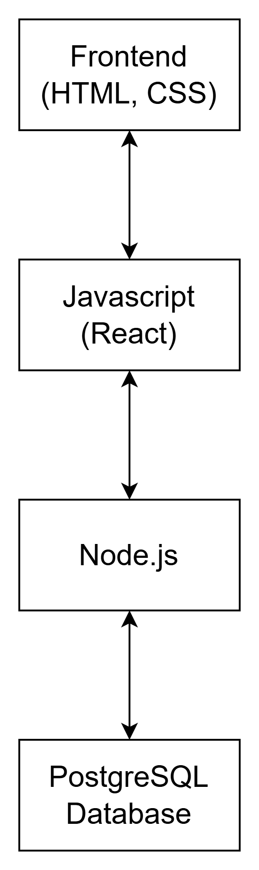
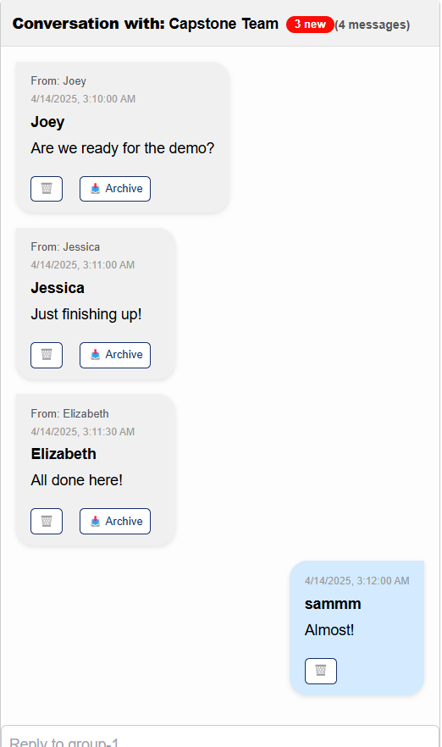
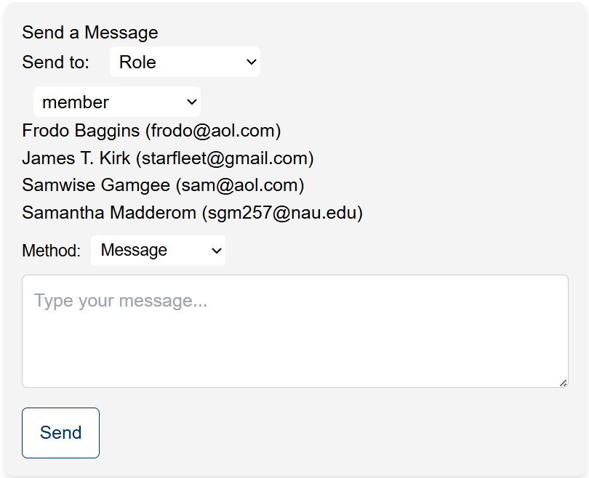
Messaging System
Role based messaging
Individual or group messages
Search by name or by role
Notes:
Samantha
Our solution features a messaging system which allows cross organization communication. This means that organizations can communicate with each other directly, and without the need for specific contacts. Our system uses node.js as the backend framework, and works by storing messages in the database, and retrieving them on the receiving end.
Because of our maintained role based system, users have the option to contact everyone with a given role in the system. You don’t need the individual contact information of everyone you want to reach, and this ensures that no one is left out by accident. When sending a message to an individual, or creating a custom group message, users can search for people by name or by role.
And now Elizabeth with talk about the navigation system of our platform

Slide 13
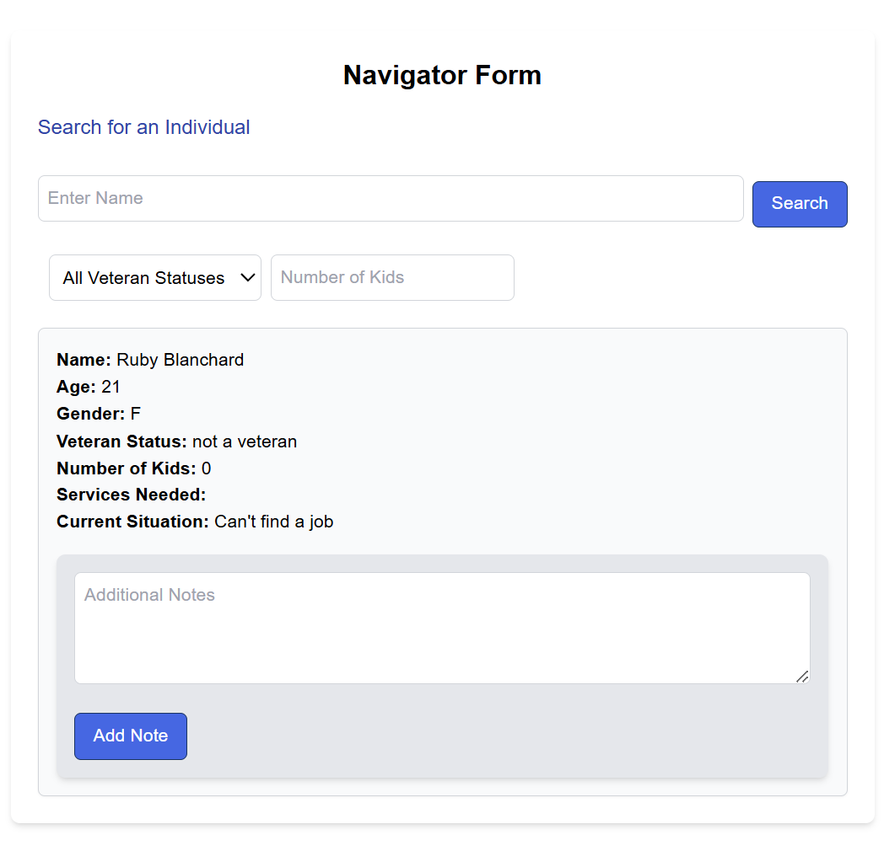
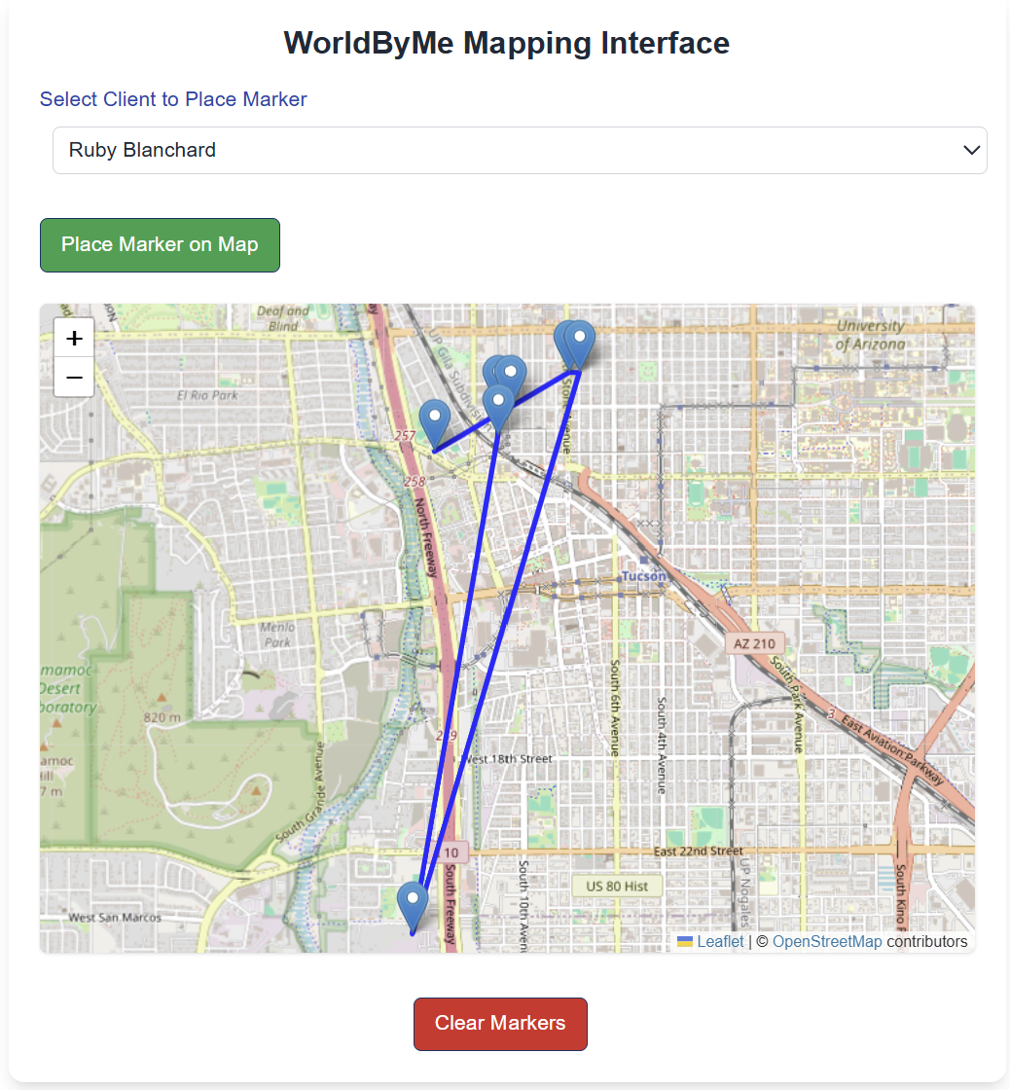
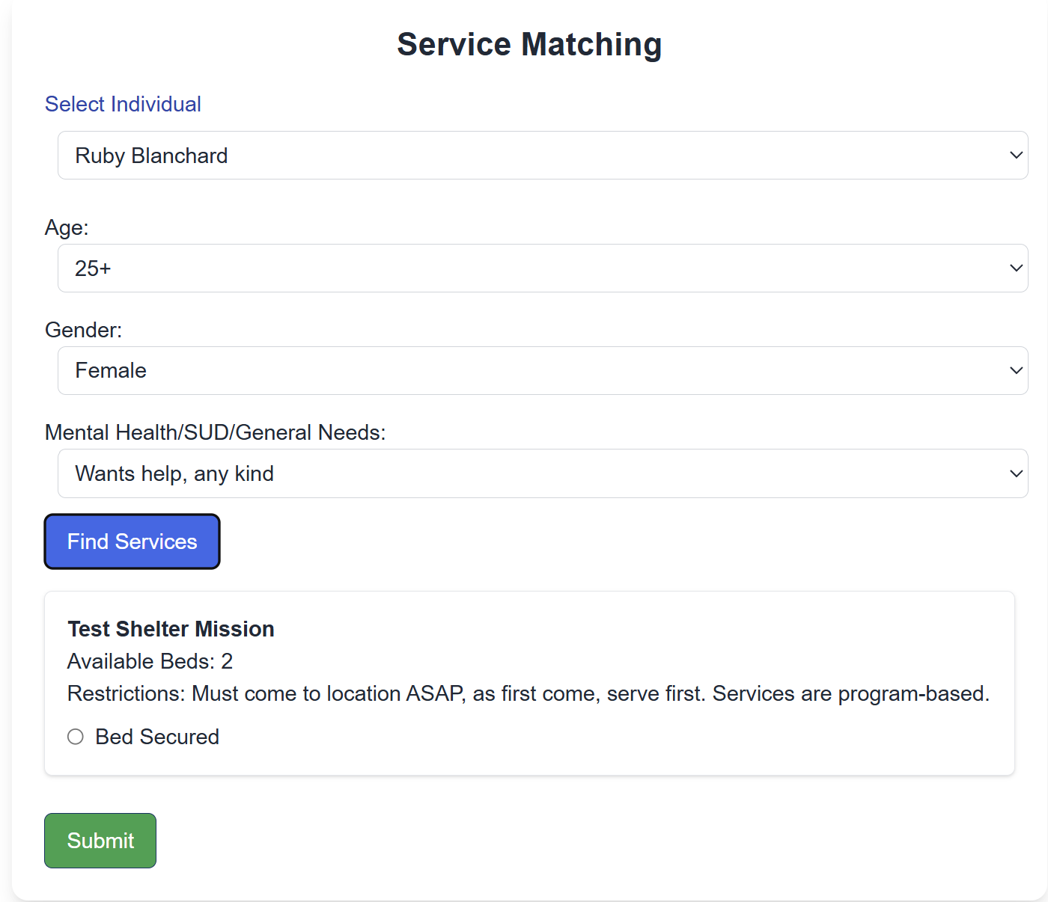
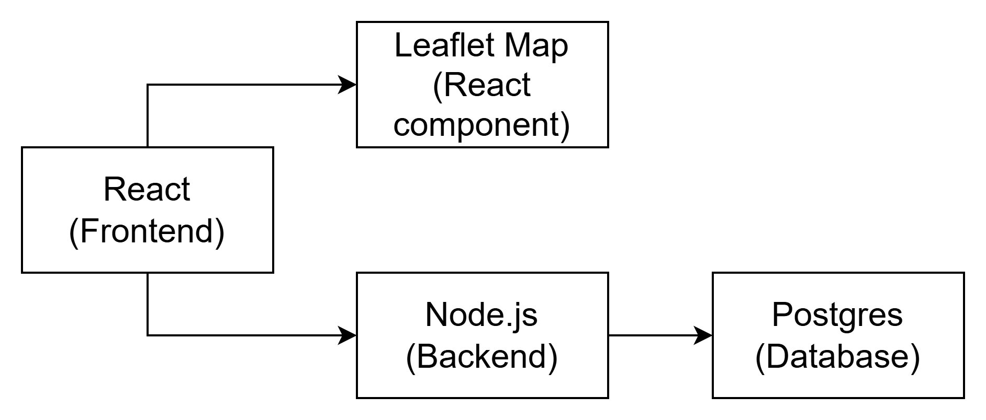
Navigation System
3 forms:
  Navigator
  mapping interface
  service matching
Client info: storage and retrieval
UI: React with Leaflet for mapping
Notes:
Elizabeth - Our custom-built Navigation System empowers volunteers called Navigators to engage directly with individuals in need, connecting them with vital services such as food, shelter, and more. This system will give navigators powerful tools that include:
On-the-spot data collection where basic client information is logged via a Navigator’s form.
A mapping interface that allows navigators to mark encounter locations and view them later.
Centralized database access that provide Real-time updates and retrieval of user info through a Node.js backend and Postgres database.
This system encourages strategic outreach by utilizing Filters and a dropdown list of existing users to simplify tracking, even when names are forgotten.

Slide 14
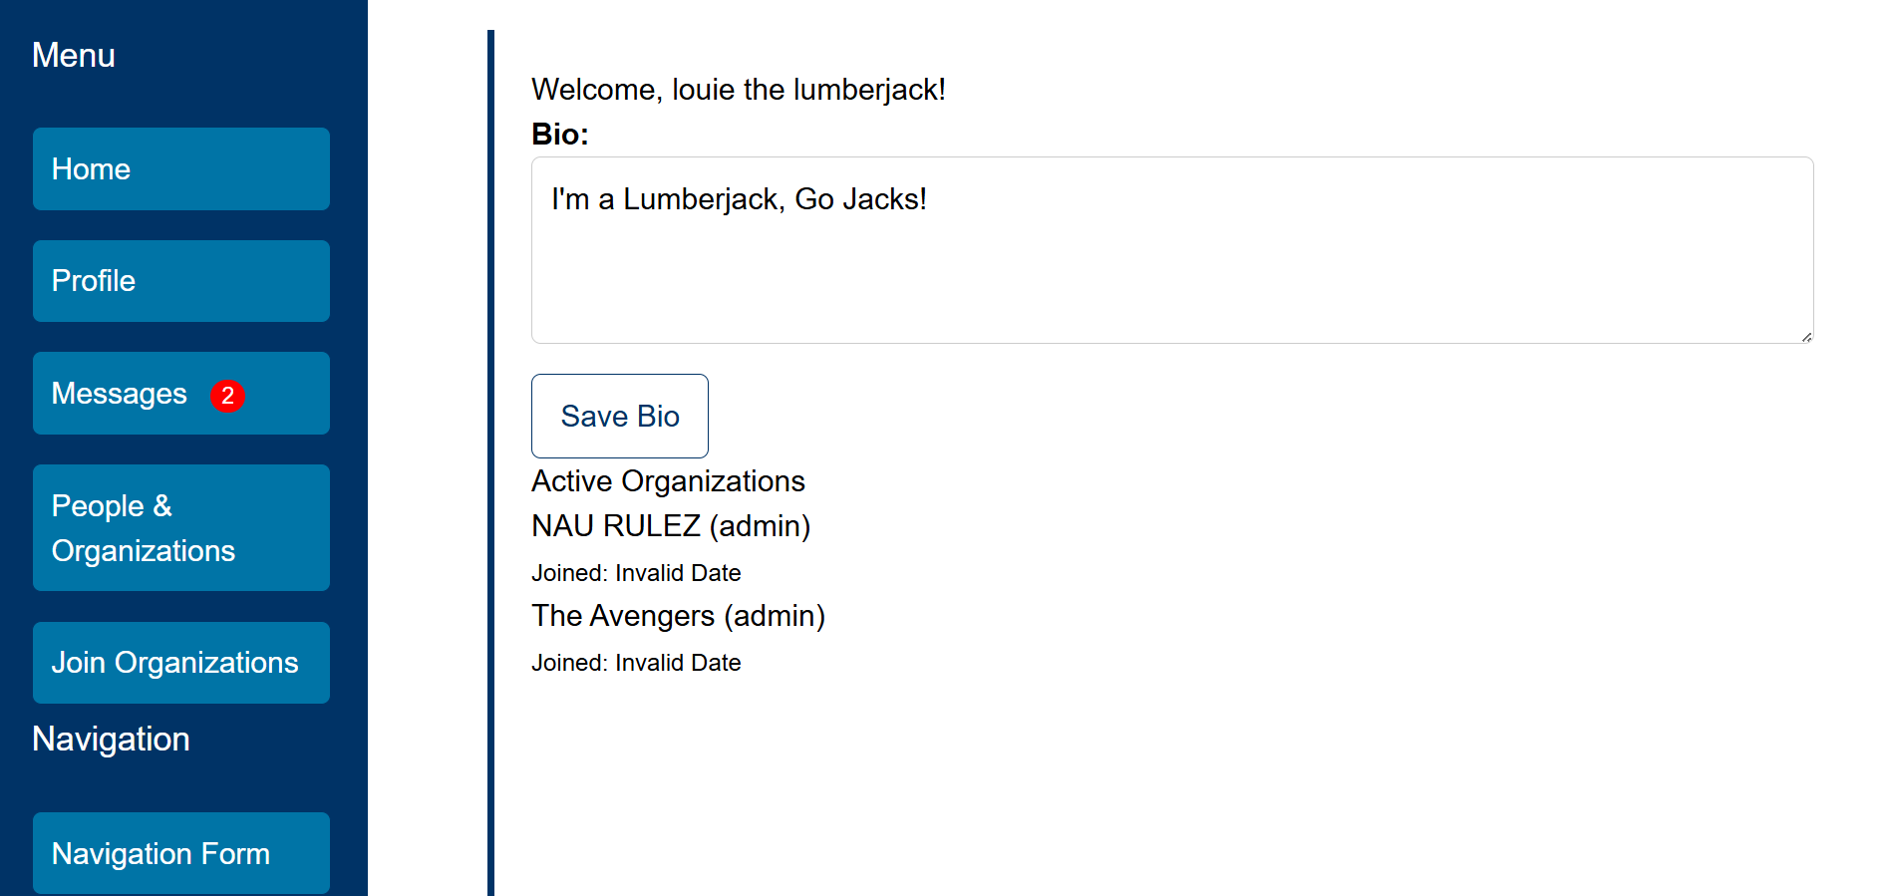
User Interface

Slide 15
Prototype
Review

Slide 16
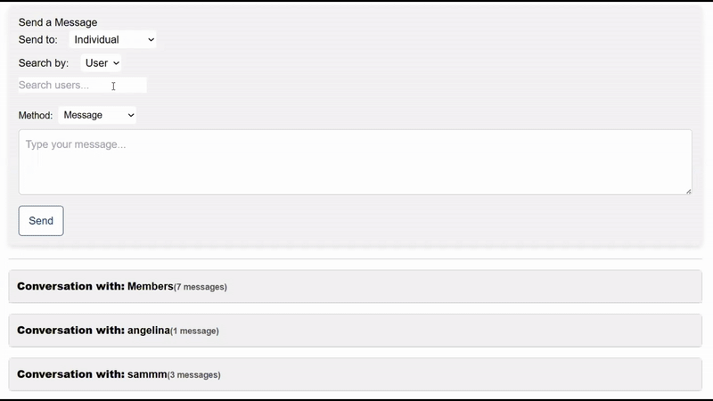
Messaging
Notes:
Samantha
In the top right you can see what it looks like to search for users by role. It simply lists everyone in the system with a particular role, from which users can select the individual, or individuals, they wish to send a message to.
Next to that on the top left you can see what it looks like to send a message based on role. Instead of a clickable list, it simply displays everyone the message will be sent to. If a user once had admin permissions, but later those permissions were revoked, they are removed from the chat. If a new user is given those role permissions, they are added to the chat, and can see the full chat history.
The bottom picture demonstrates searching by username. As you type in the name, it lists options you might be searching for that you can select from.

Slide 17
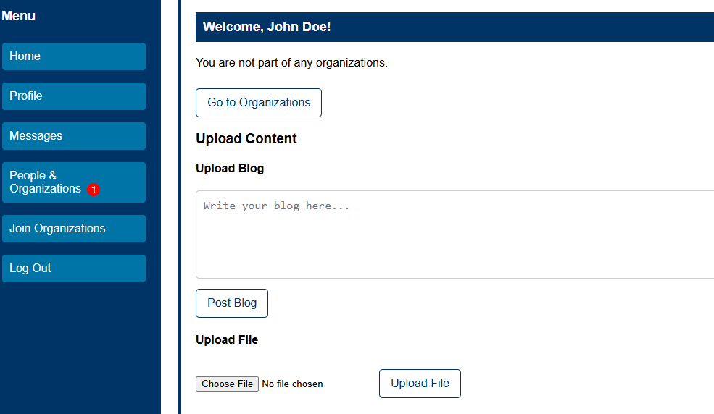
Main
Profile

Slide 18
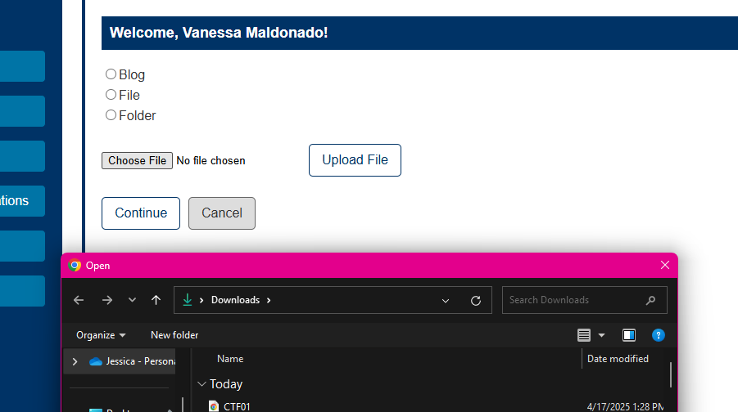
File
Upload

Slide 19
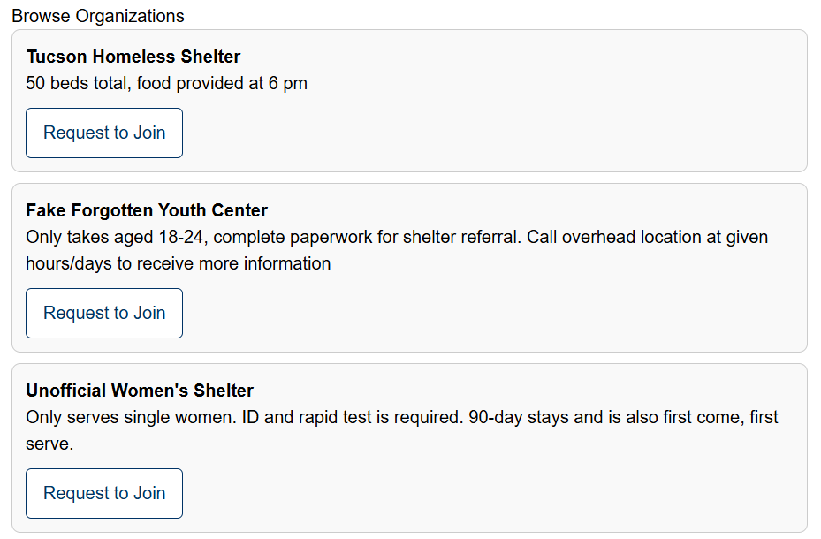
Browse
Organizations
To Join

Slide 20
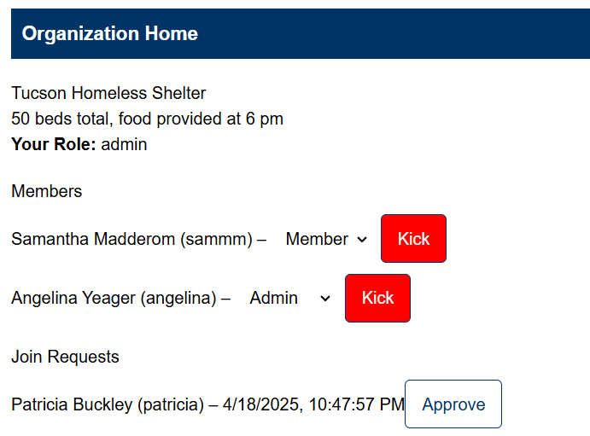
Organization Home

Slide 21
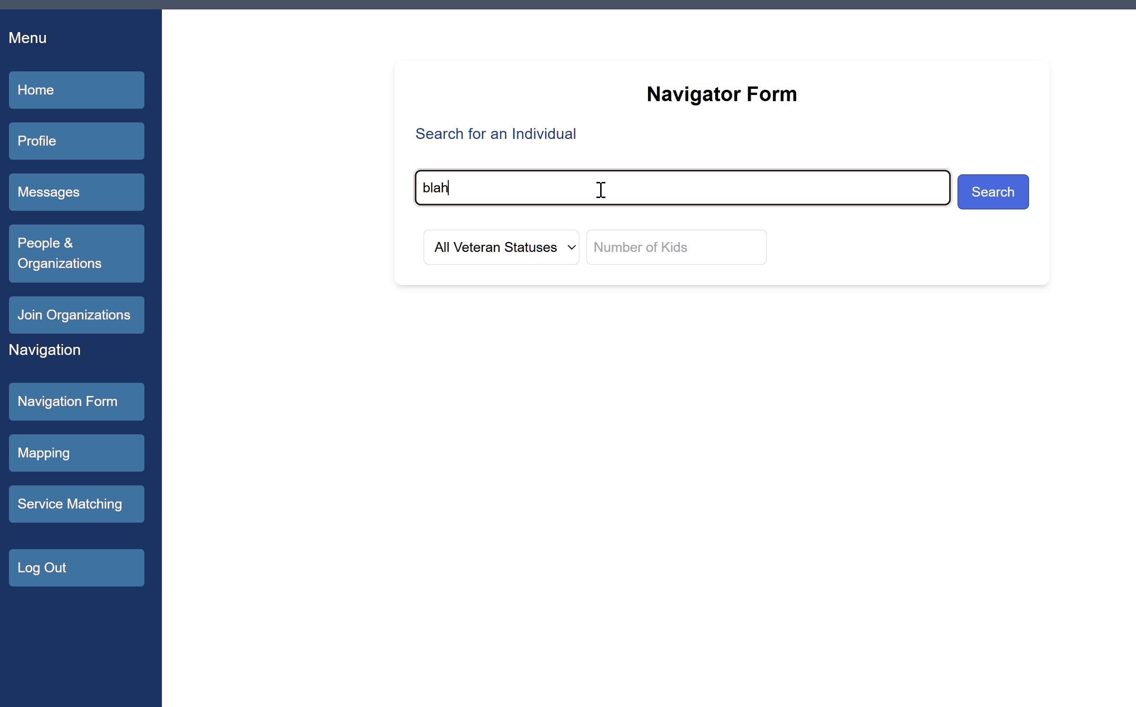
Navigation
Notes:
Elizabeth - The navigation system consists of a Navigator’s form, where demographic information is gathered, defining the individual in need as an end user of the service providers. If a user doesn’t exist the navigator will be prompted to create a new client. If not, the existing client will be displayed. If the navigator doesn’t remember the name of the 10th person they encountered, they can also utilize the veteran status and number of kids filter to narrow down the search. When the correct client is identified, they can be found within the mapping interfaces’ dropdown and when the ‘place marker’ button is pressed, the navigator will be able to add markers under the client’s name and as more markers are put on the map, they will be connected by polylines. If a navigator wants to clear the buttons when a client is finally situated with their providers, they can click the clear button. Additionally, there is a service matching page where there the necessary information should be filled out and on the click of the ‘find services’ button, a list of services will pop up and the navigator can select one and submit the request to create an official referral. Now im going to hand it off to jess to talk about challenges and resolutions.

Slide 22
Challenges & Resolutions
Multi-tech integrations made designing tests hard
Implemented integration testing
Changed security subnet and in/outbound rules to allow our connection
EC2 Instance Connection Issue
Steep Learning Curve with Unfamiliar Tools
Adapted to new tools

Slide 23

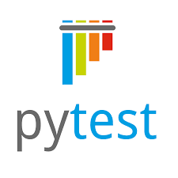
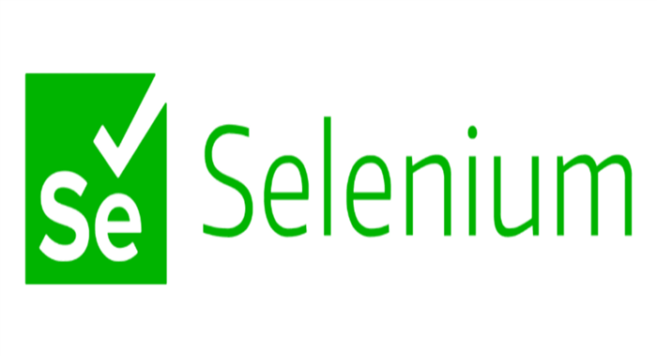
Testing
Unit testing (jest and pytest)
Integration testing (selenium)
User testing
Notes:
To ensure the quality and integrity of our product, we are conducting extensive testing of our code. Planning to reach 100% code coverage through unit tests, integration testing, and user testing. To complete our unit testing we are using pytest for our python aspects and jest for the javascript. We chose Selenium be used to conduct integration testing for our front end to ensuring that everything is working as intended, while fixing any problems with the code as they came up. Lastly, we had a small base of users help us tweak the alpha version of our product and we will be giving our client a beta version so that real navigators will be able to test out our software and give feedback to us. We are planning to have this all completed in the coming weeks, which leads us to our schedule.
We stayed fairly true to our original schedule with some setbacks leading us to take a longer time implementing some of the features of our system. In the coming weeks we are going to be extensively documenting our system for our client and then handing off a product that our client is happy with. But there are some aspects that we weren't able to implement this semester which leads to our future work.

Slide 24
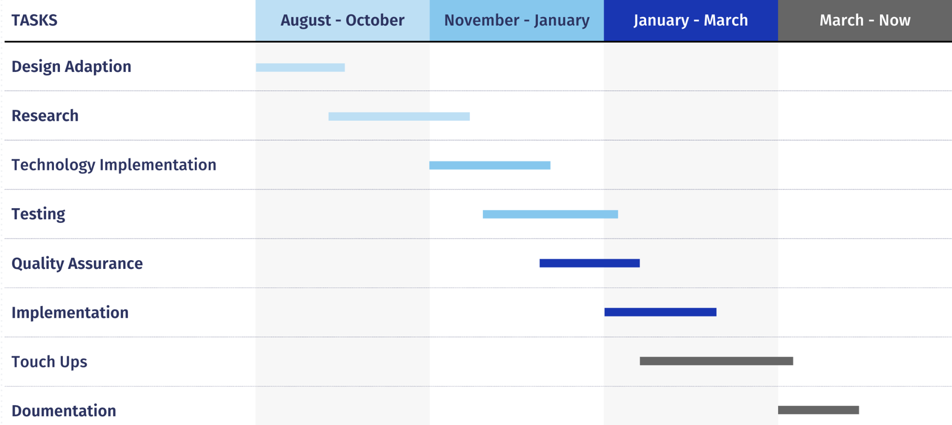

Slide 25
Future Work
Sending file attachments through the messaging
Adding text and email messaging options
Dynamic roles, allowing organizations to create their own roles with defined permissions

Slide 26
Conclusion
We developed the start of a web application that centralizes connections between local service providers and organizations. It enhances workflows, communication, and long-term scalability.
Streamlines workflows and improves operational efficiency
Provides a secure, scalable platform for multiple organizations

Slide 27
Thank You!
Notes:
Thank the sponsor, etc. make sure to invite people to our poster section

