Slide 1

Design Review 3:
Team 12 HelloWorldByMe
Facilitating Communication Between
Local Governments and Non-Profit Service Providers
Notes:
Hello everyone! We are Team HelloWorldByMe and our project focuses on facilitating communication between local governments and non-profit service providers

Slide 2
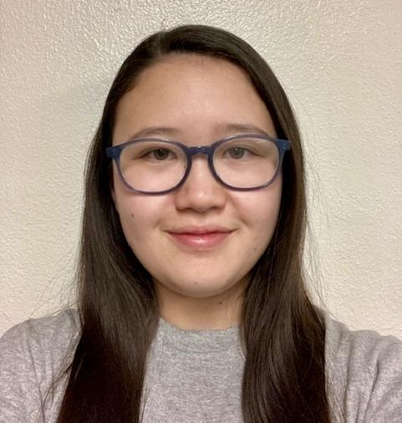


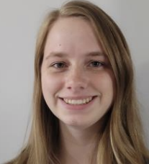



The Team
Elizabeth Knight
Team Lead
Client Communicator
Coder
Joey Banaszak
Architect
Coder
Jessica Maldonado Olivas
Release Manager
Coder
Samantha Madderom
Recorder
Coder
Kevin Daily
Client
Savannah Chappus
Mentor
Brian Donnelly
Mentor
Notes:
Before we get started, we would love to reintroduce ourselves! My name is Elizabeth Knight and I’m the team lead, client communicator, full stack coder
On the bottom right is our 2 mentors: Savannah and Brian and on the bottom left is our client, Kevin Daily. Kevin is the president of EKA Labs and the creator of the role-based education model, WorldByMe.

Slide 3
Understanding the Problem
Tucson is facing increasing rates of homelessness, leading to major inefficiencies in how services for substance disorders and improving mental health are coordinated.
Current Challenges:
Inconsistent communication b/w providers
Vague updates on client status
Delayed assistance that limits long-term impacts
Notes:
With Kevin working in the public service sector, he came to us to help him resolve an issue that is way bigger than software, as the city of Tucson and beyond are experiencing high homelessness rates. Despite services being available to those with no proper shelter, local service providers are facing a lack of communication, vague updates, and ineffective assistance.

Slide 4
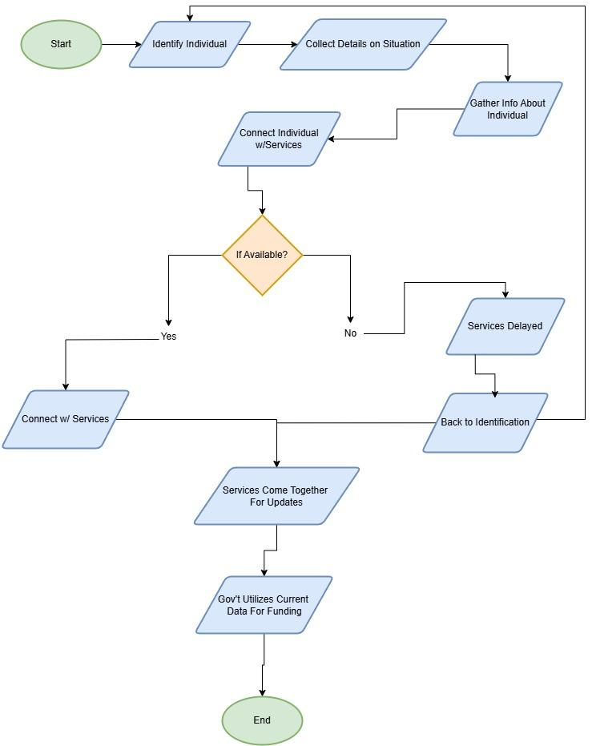
Current Workflow
Current Flaws:
Individuals have to rely on nearby service providers having availability
When services give updates on their progress with clients, it is very minimal
Appropriate government funding is not possible from a one-day-a-year community health check
Notes:
Looking deeper into the current workflow, we can see that it starts by identifying and connecting with an individual through a navigator, a volunteer working for a service provider, and then leads to trying to connect the individual in need with local services.
From there, helping people becomes heavily reliant on the availability of these services, which could easily lead to a waiting game of being discovered again.
Whether an individual gets help or not, the cycle moves on with local services getting together once a month to give vague updates on their progress with current clients and their availabilities.
Finally, local governments gather data from the local service providers and conduct a 1-day community check to determine funding.
One of the biggest issues with this one-day data collection is that it often doesn’t accurately reflect the help people in need receive.
Now I’m handing it off to Samantha to talk about the solution

Slide 5

Our Solution
Robust messaging crossing company boundaries
Role based access control
Shared access to information and resources
Data for research and better funding procurement
Notes:
Our solution starts with improving communication. As Elizabeth mentioned, a major issue is the lack of coordination between service providers and local governments. We’ll implement a role-based communication system, allowing users to interact based on shared roles and access only the resources relevant to them.
We’ll also create a database to store information about organizations, employees, and users. As nonprofits engage with individuals, they can collect and, if permitted, share data across organizations. This helps broaden access to services and improves coordination.
Finally, collected data can be shared with local governments and investors to support research and funding. Unlike the current system, which relies on outdated annual data, our solution enables more accurate and timely reporting.
Our solution begins with communication. As Elizabeth mentioned, one of the biggest problems currently is a lack of communication between these service providers and the local governments. We will create a robust communication system that will allow for intercompany communication based on common roles within the system. Role based access is yet another important component of our solution. Users will only have access to resources associated with their given role or roles within the system.
Our solution includes a database to store all the information regarding entities, employees, and users. As these nonprofits interact with people on the streets, they will be able to collect information about them and their habits. If the company allows it, this information can be shared across organizations. The organizations can also broadcast what services they have available to others. The result is that one individual has access to more resources than they would with just a single organization.
Finally, this information can be condensed and delivered to local governments and investors to increase research and funding. Funding is often based on the demographic information on the people they typically help, and with the current system only doing a single search every year, the data is often outdated and inaccurate, leading to funding problems. Our solution provides a method to alleviate some of those issues.

Slide 6
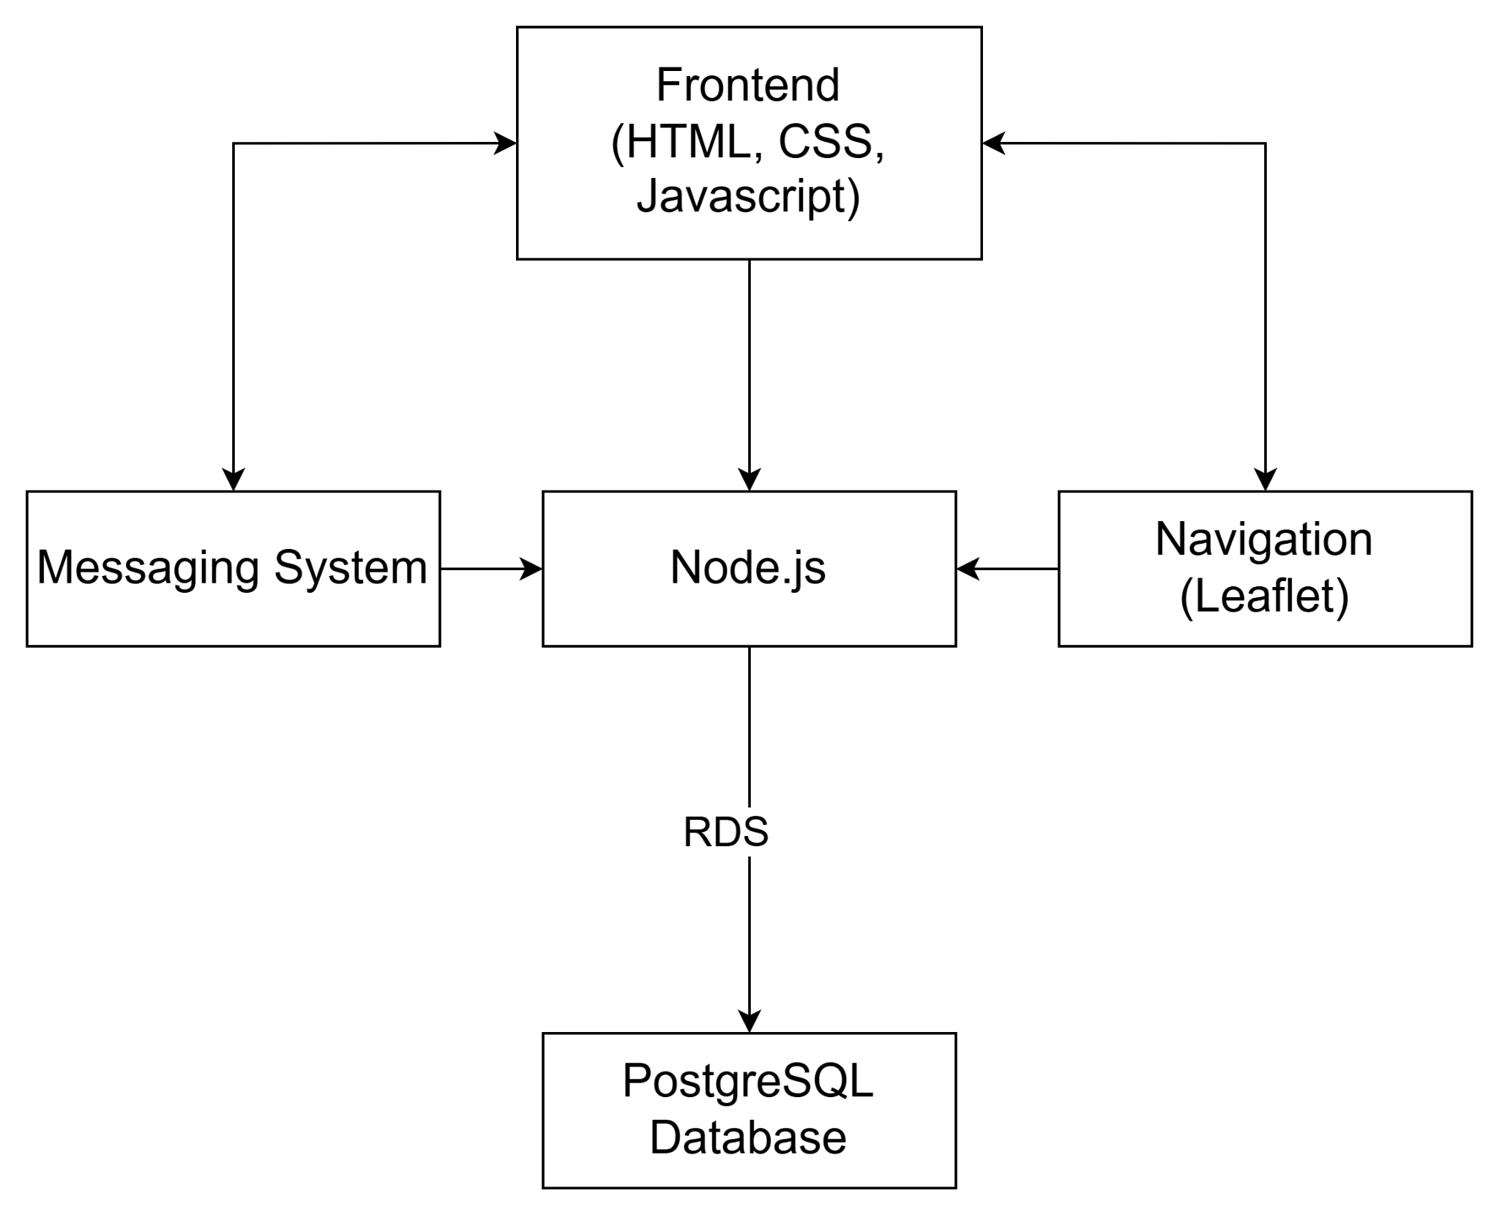
Implementation Requirements
Query the database in real-time
Create an organization
Add new employees to organizations
A system that fosters communication between employees across organizations
Store critical information on individuals in need
Security
Notes:
Samantha -> add requirements slide?
These are the major requirements for our project. We must be able to query the database in real time, create organizations, add employees, provide a method of communication, and store critical information in our database, all while maintaining security and protecting our client’s information.
We will now go into more detail about our implementation.

Slide 7
Implementation Details
Notes:
Now to get into some details of our implementation

Slide 8
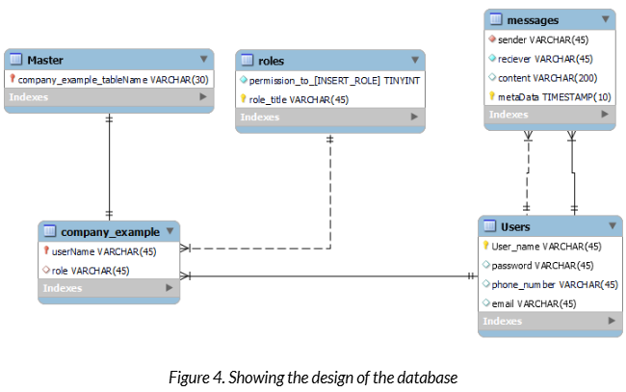
Database
Database
Navigation information
Data objects
Notes:
Hosted on amazon RDS instance through EC2 server, postgres engine
Postgres because it will better organize tables
Holds role definitions, user information: (username(s), hashed passwords), message history, and more
Master table
Scalability
Store data objects
Used for research or funding
Role based access control
Joey - Firstly, Our database is hosted on an Amazon RDS instance through an EC2 server, with a postgreSQL engine. We chose postgres because it is a relational database which allows us to easily and better organize different tables. It will store information regarding role definitions, user information, what roles a user takes on, hashed passwords, entity information, as well as message history. The master table will store information about a particular company, acting as a table of contents for a distributed system so that each company will have its own table in our database allowing for a high degree of scalability. With each company having the capacity to store employee information, roles and the permissions associated with them and more.
The database will also be responsible for storing data objects associated with different users. This will include collected demographic information to be used for research purposes, and possibly government funding for organizations.
Now for our role based access control

Slide 9
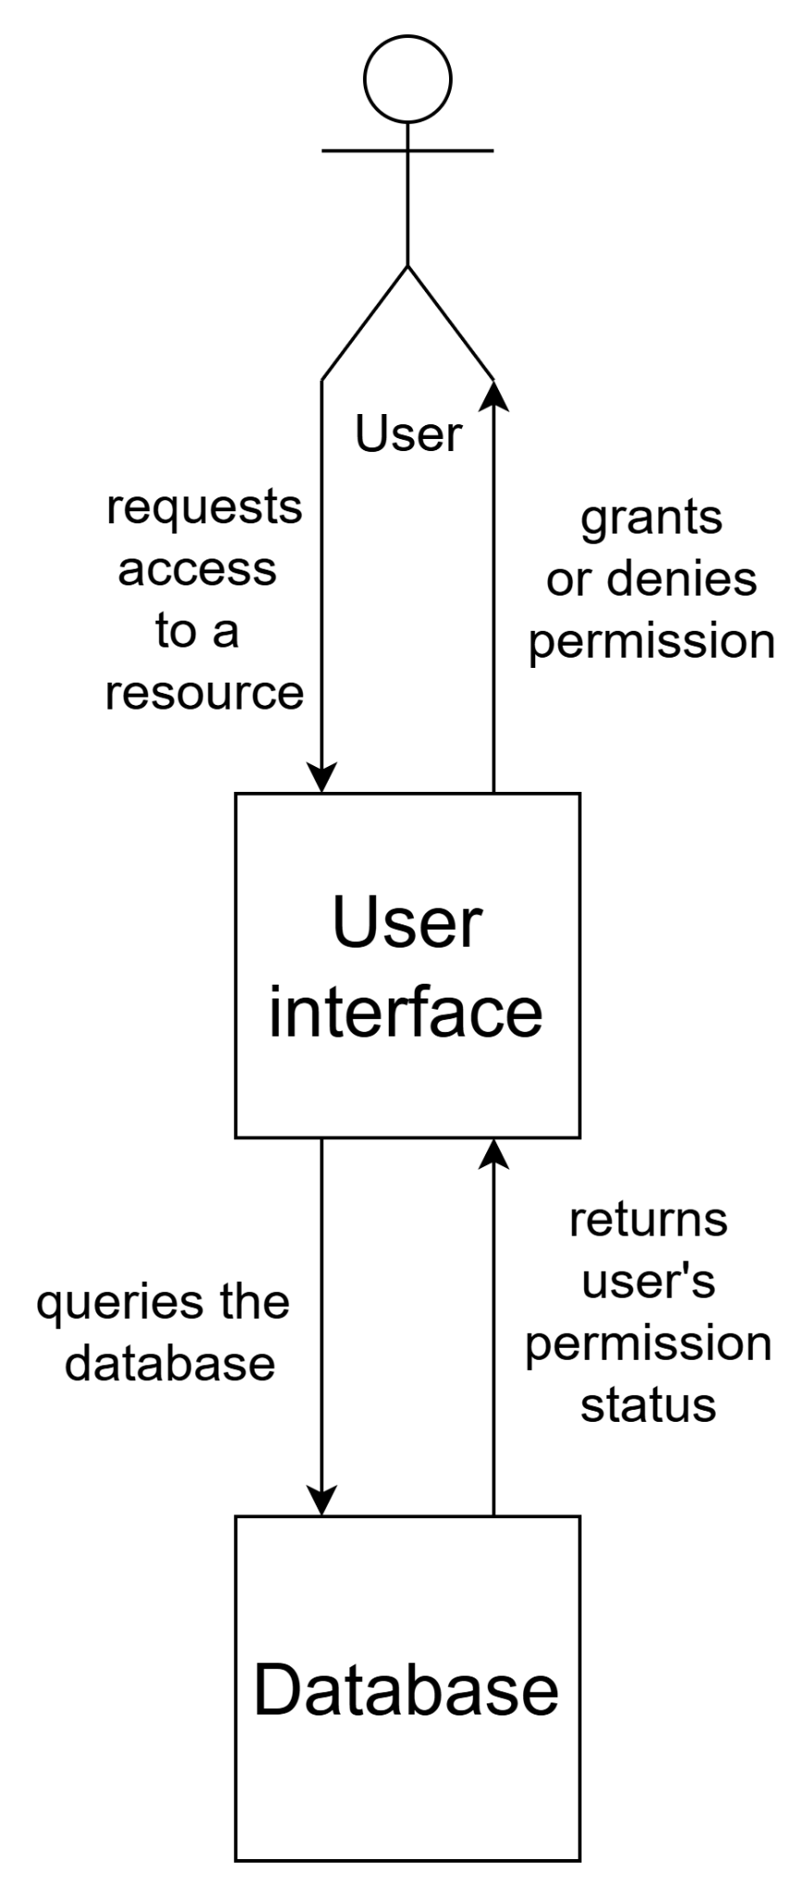
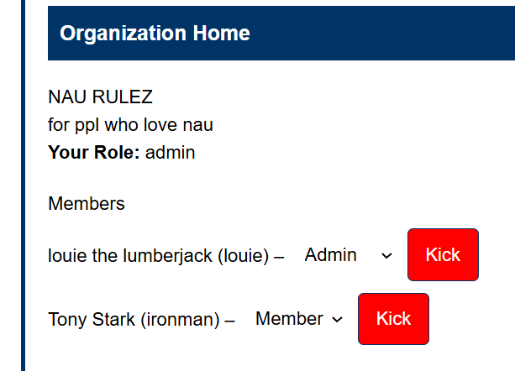
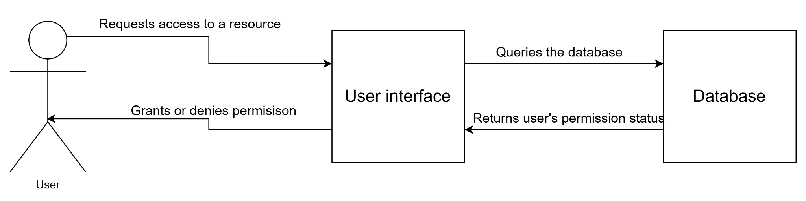
Role-Based Access Control
Role-Based Access Control (RBAC)
Login/logout auditing
Notes:
Proprietary role based system
Implemented through database and connect to the UI
System checks for permissions
Certain actions or resources
login/logout auditing
Hosted on RDS
Joey - A major aspect of our project is our clients proprietary role based access system. Users will have access to different actions and resources based on their assigned role or roles in the system. Our role based access feature will be implemented through the database. Storing a user’s role and the permissions associated with it. Roles will be associated with user’s data, and will be checked before the system will allow a user to perform certain actions, or access certain resources. The database will also have a table that specifies the roles and their level of access and if a user does not have the proper permissions, the system will simply not allow them to perform the action they were trying to perform.
We will also implement a login/logout auditing feature will will log which users make what changes to their system while they are logged in to track changes in the system. This will be hosted on our Amazon RDS database, and will connect to the User interface.
Now back to Samantha with the messaging system

Slide 10
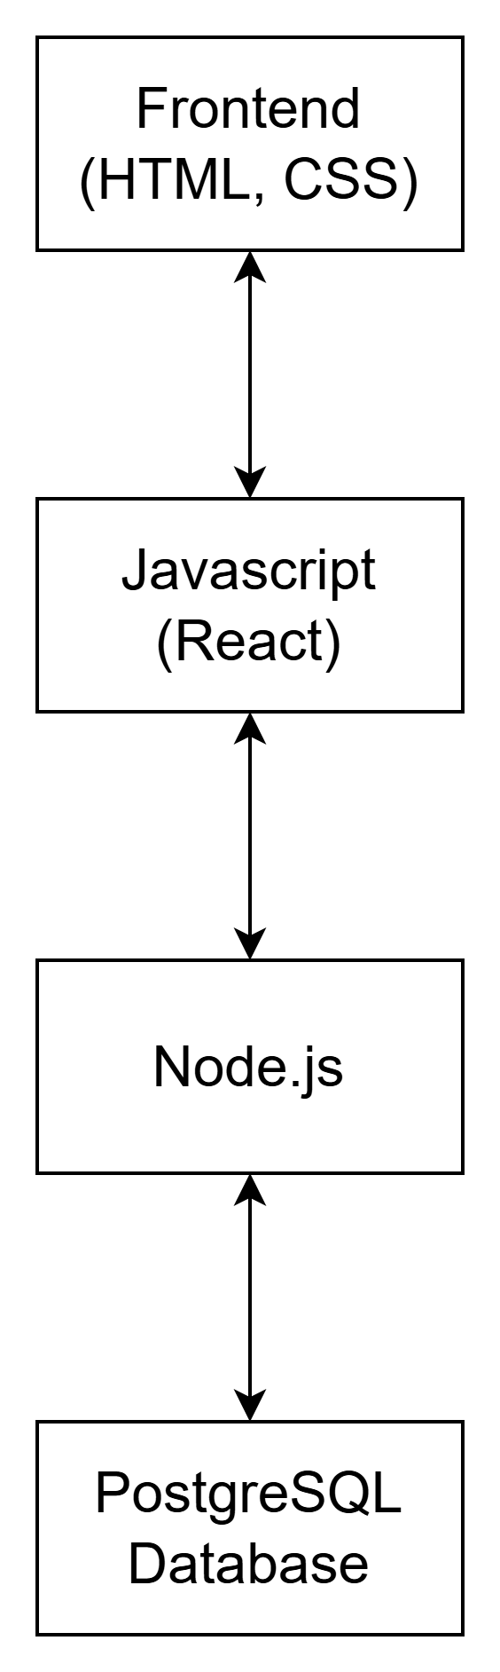
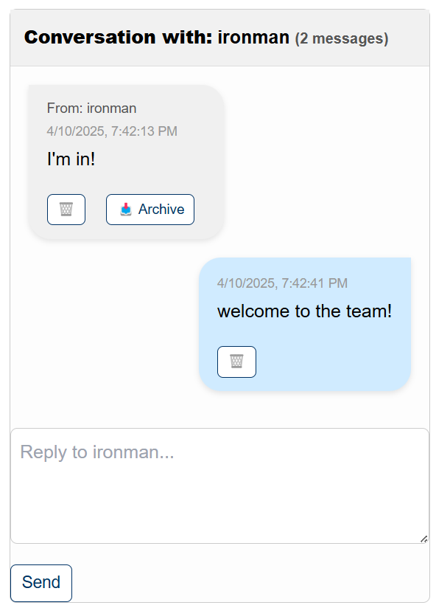
Messaging System
Send messages based on role
Delete messages
Create multiple message chains
Notes:
Samantha
Our solution features a messaging system to facilitate cross entity communication. Users will be able to contact each other based on their assigned roles, including those with the same roles that belong to different entities. In this way, different companies can communicate with the right people easily. They will also be able to communicate with specific individuals if they so desire.
We had to restructure some elements of our project so our system now uses node.js as the backend framework. Our messaging system works by storing messages in the database, and retrieving them on the receiving end. Users will be able to message others based on their name or their role. They are able to delete messages or archive them. They also have the option to send a message via email or text, as well as using the website.

Slide 11
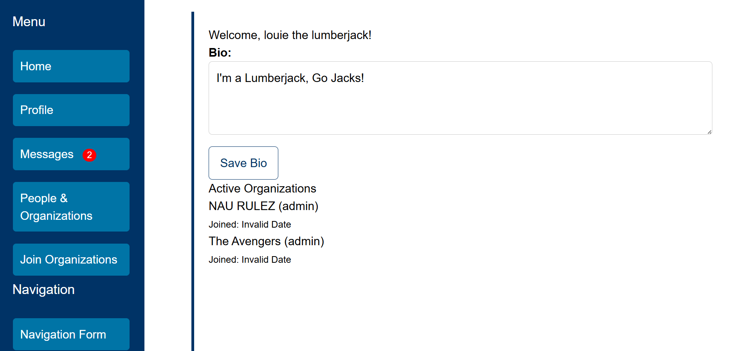
User Interface
Notes:
Finally, we will have an interactive and easy to use UI that connects everything together. The user interface is made using HTML, CSS, and Javascript. We use the React library to manage the UI components and HTTP requests. Through the UI, users will be able to edit data objects, send messages to other users,

Slide 12

Prototype & Product Review - Organizations and Messaging
Notes:
Samantha
Demo
Sign up
Log in
Adding bio
Join organization
Create organization
Kicking someone out of an organization
sending/receiving a message
Adding someone via navigation mapping page
Log out
Use cases
Creating an account as a new user
Logging in
Adding a bio
Join an organization
Create an organization
Someone else joins that organization
Approve them
Kick them out
Send a message to a user
Receive a response
Adding a user via nav mapping page
Log out
THIS IS THE MEAT! You’ve worked hard all semester to get a nice beta prototype up...the audience is surely dying to see what you’ve done. If you haven’t chosen to insert a walk-through of your prototype earlier on (e.g., as part of an extended solution vision) then this is the time to show it off. Warning: Live demos are dangerous! If something breaks or the network goes down, you’re sunk. On the other hand, for some products, it’s the cool dynamic aspects that are the most impressive. Ask yourself whether the live visual flow is critically important/impressive for your product. If not, a series of well-chosen screenshots to present and discuss are probably a better bet.
In any case, your goal of the demo is to convince the audience that you have elegantly satisfied the requirements with a solution that will address the client’s problem. This means: focusing your screenshot and discussion on those aspects of the product that clearly address the problems the client needs solved. Again, a great way to organize such a demo walkthrough is by coming back to the usage cases that you (hopefully) introduced earlier: set up a scenario of a user wanting to do whatever it is they need to do, then walk through them using your application to do so. This is *way* better than just giving a random walk through various features of your application! It clearly indicates how your application nicely solves the user problems you outlined in your intro.

Slide 13
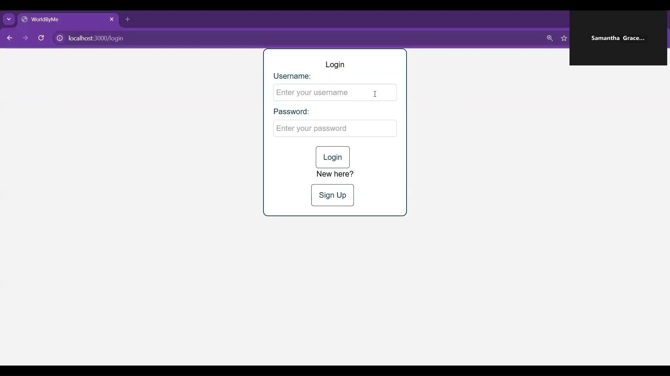
Prototype & Product Review - Navigation and Service Matching
Notes:
Samantha
Demo
Sign up
Log in
Adding bio
Join organization
Create organization
Kicking someone out of an organization
sending/receiving a message
Adding someone via navigation mapping page
Log out
Use cases
Creating an account as a new user
Logging in
Adding a bio
Join an organization
Create an organization
Someone else joins that organization
Approve them
Kick them out
Send a message to a user
Receive a response
Adding a user via nav mapping page
Log out
THIS IS THE MEAT! You’ve worked hard all semester to get a nice beta prototype up...the audience is surely dying to see what you’ve done. If you haven’t chosen to insert a walk-through of your prototype earlier on (e.g., as part of an extended solution vision) then this is the time to show it off. Warning: Live demos are dangerous! If something breaks or the network goes down, you’re sunk. On the other hand, for some products, it’s the cool dynamic aspects that are the most impressive. Ask yourself whether the live visual flow is critically important/impressive for your product. If not, a series of well-chosen screenshots to present and discuss are probably a better bet.
In any case, your goal of the demo is to convince the audience that you have elegantly satisfied the requirements with a solution that will address the client’s problem. This means: focusing your screenshot and discussion on those aspects of the product that clearly address the problems the client needs solved. Again, a great way to organize such a demo walkthrough is by coming back to the usage cases that you (hopefully) introduced earlier: set up a scenario of a user wanting to do whatever it is they need to do, then walk through them using your application to do so. This is *way* better than just giving a random walk through various features of your application! It clearly indicates how your application nicely solves the user problems you outlined in your intro.

Slide 14
Challenges & Resolutions
Integrated Technologies
Testing Plans
EC2 Instances
Blocked Server Instances
Learning curve
(Nginx, React, Postgres)
New Technologies
Notes:
Note that if any challenges that are currently facing and haven’t solved

Slide 15
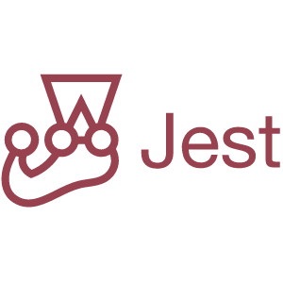
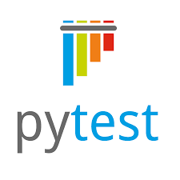
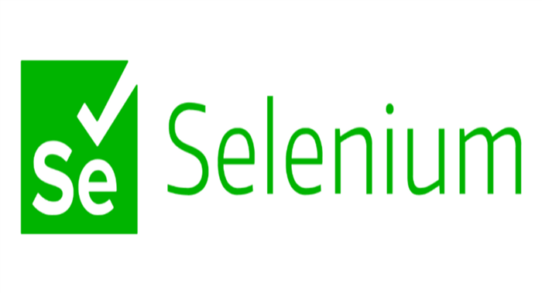
Testing Plan
Notes:
Joey:
To ensure the quality and integrity of our product, we will be conducting extensive testing of our code. Planning to reach 100% code coverage through unit tests, integration testing, and user testing. To complete our unit testing we will be using pytest for our python aspects and jest for the javascript. Selenium will then be used to conduct integration testing for our front end to ensure that everything is working as intended, and fixing any problems with the code as they arise. Lastly, we will have a small base of users help us tweak the alpha version of our product and then we will be giving our client a beta version so that real navigators will be able to test out our software and give feedback to us. We are planning to have this all implemented in the coming weeks, which leads us to our schedule.
Plan to fix problems as they arise
Will use pytest and Jest to test back end functionality
Will use selenium to test front end functionality

Slide 16
Our Schedule
April
April
May
Final Mock Ups
Testing & Validation
Demo Ready/User Guide
Finalize the finishing touches to prepare for user testing
Start Final Testing
Finish Up last touches
Notes:
Make sure to spend time with detail about what has happened and what has yet to happen

Slide 17
Conclusion
Thank you for listening!
Any questions?
Notes:
Need a full conclusion slide

Slide 18
Thanks!
Do you have any questions?
youremail@freepik.com
+91 620 421 838
yourcompany.com
Please keep this slide for attribution

