Slide 1

Alyssa Ortiz, Andrew Ortega, Tyler Chapp, Payton Watts

Slide 2
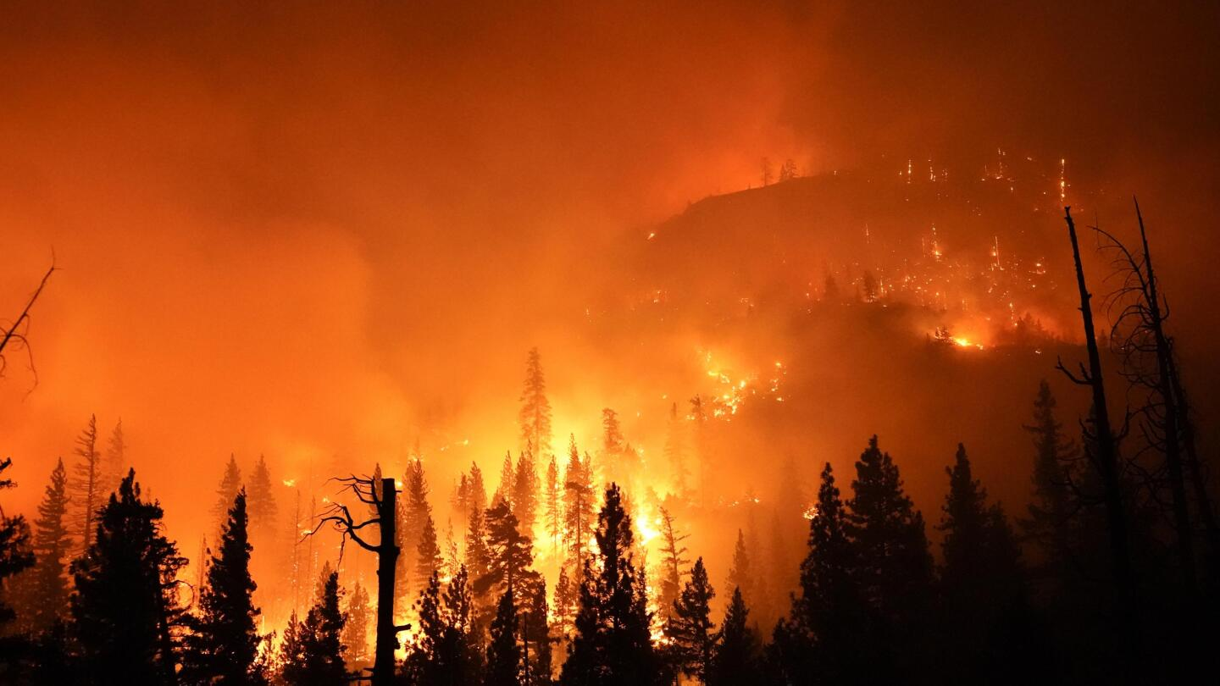
Big Picture
Climate change
Wildfires
Birds indicate the health of an ecosystem
Prediction tool
Notes:
Hook audience:
If you live in Flagstaff, nature is a part of everyday life. The pines swaying in the wind, a deer crossing the road, a crow swooping from tree to tree. But if you’ve lived here long enough, you know how it can all be changed in an instant by fire and weather. What we want to know better is how animals, in particular birds, in environments such as ours, react to these events.

Slide 3



Clients
USDA Forest Service researchers
NAU SICCS researchers
Study change in forests ecosystems
Have collected and analyzed data for over ten years
Notes:
Our clients are the USDA and United States Forest Service, in tandem with NAU SICCS researchers. The USDA and Forest Service both are government organizations; the USDA focuses on agriculture, while the Forest Service monitors and protects our forests.
An example of their activities can be seen in the various research stations these organizations have across the country dedicated to studying changes in local environments.
Our clients have over 10 years of collected data on birds, and how wildfires impact them.

Slide 4
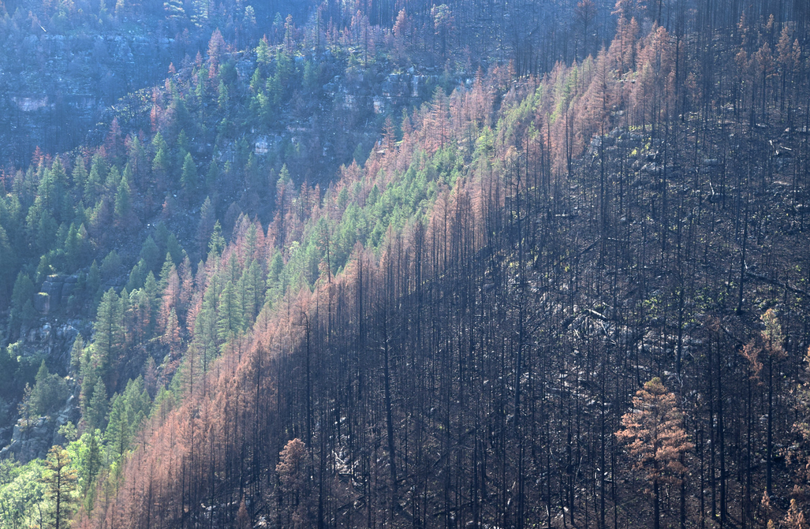
Problem
No large scale tools exist
Limited data analysis
Raw data is difficult to parse
Data trends will help make forest management decisions
Notes:
The problem is, a large scale tool to analyze all this data does not exist.
They need to be able to easily see larger trends, in an easy to digest format that anyone can understand
Seeing general bird trends will be advantageous when deciding how to take care of an area (lead into next slide)

Slide 5
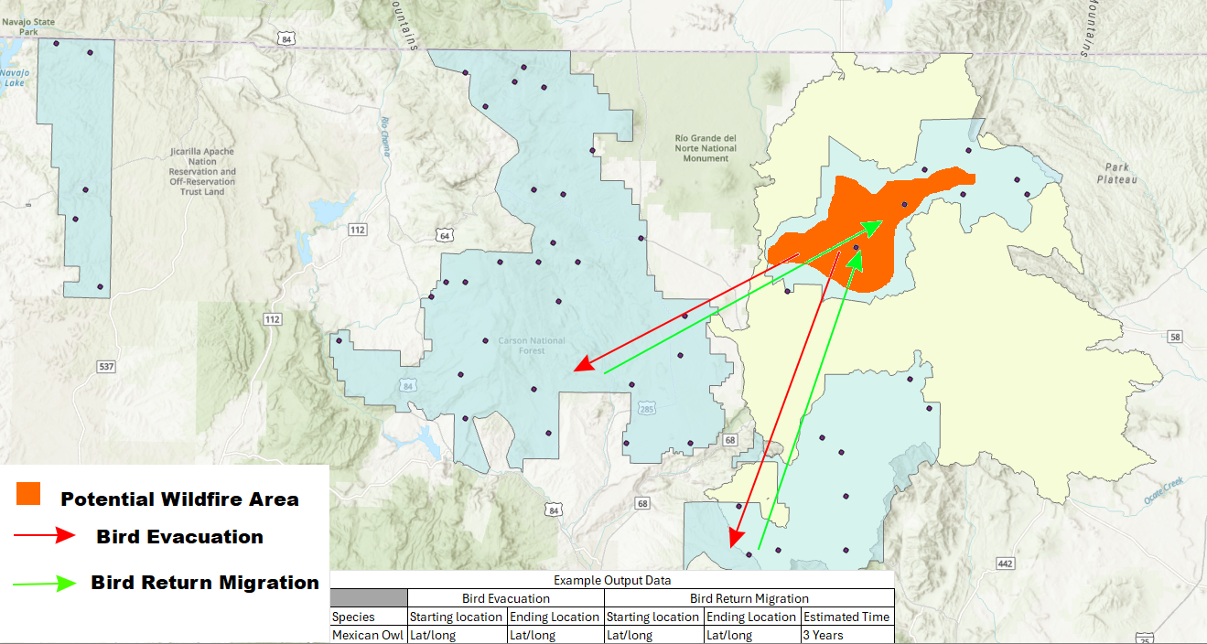
Solution
Create a user friendly visualization tool
Making predictions based on years of data
Officials can estimate ecosystem recovery after wildfire
Notes:
For the solution, we will develop a user-friendly visualization tool designed to help forest service managers estimate ecosystem recovery after wildfires.
Using years of collected data, this tool will provide users with deep insight into forest regrowth, bird migration patterns, and overall ecosystem health
following wildfires, controlled burns, and other forest service management activities.
This allows forest service managers to get a deeper understanding of the long term effects of their actions and assist with making informed decisions for the future.

Slide 6




Plan for Development
Regular communication with clients
Generating map overlays
Data integration
Scalability and performance
Folium and Leaflet in tandem with open source maps or GIS software we can access, and Bootstrap for frontend
Notes:
Regular communication with clients, meetings for things that cannot be resolved with an email

Slide 7

Conclusion
Thank you for your time!
We hope you look forward to hearing more about our project soon!
Notes:
In summary, our project will analyze the data collected by our clients in order to create a tool that allows a simple and easy way to view and predict general wildlife trends in response to wildfires and other disasters.

