Slide 1

Introduction
Our team is composed of Alyssa Ortiz, Payton Watts, Andrew Ortega, and Tyler Chapp
Our client:
  USDA Forest Service researchers
  NAU SICCS researchers
Mentor: Scott Larocca
The main focus of this project are birds and the way that fires impacts their recovery.
  The way that birds react after a fire gives also an important signifier of how the overall ecosystem reacts as well.

Slide 2


Problem Statement
Clients: USDA, United States Forest Service, NAU SICCS researchers
  Provide valuable data analysis for Western United States Forestry Management Stations
Clients currently produce and distribute all data + analysis
Research stations need to be able to view data on their own
Notes:
Our clients are the USDA and United States Forest Service, in tandem with NAU SICCS researchers.
They provide valuable data analysis for Western United States Forestry Management Stations
All Stations must go through a single point to receive user-friendly analysis for over 10 years of collected data- our clients
Seeing general bird trends will be advantageous when deciding how to take care of an area
These research stations need to be able to easily see larger trends on their own, in an easy to digest format that anyone can understand
Each research station should be able to view the collected data on their own, and be able to understand the results in order to increase individual efficiency and free up our clients to work on other important projects, rather than dedicating lots of time to relaying information back and forth.

Slide 3
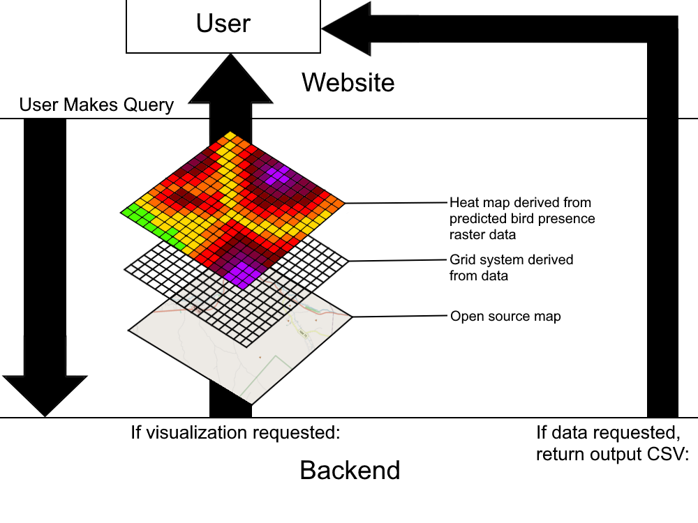
Solution Overview
Essentially, we want to be able to create a web-based system that allows users to query the database for bird presence prediction data, receiving it either as data, a heat map, or both.
Key features:
  Ease of access- users need an easy way to retrieve data/maps.
  Clear visualization- heat maps and data files must be able to clearly visualize what the user wishes to show to forest managers and other officials.

Slide 4
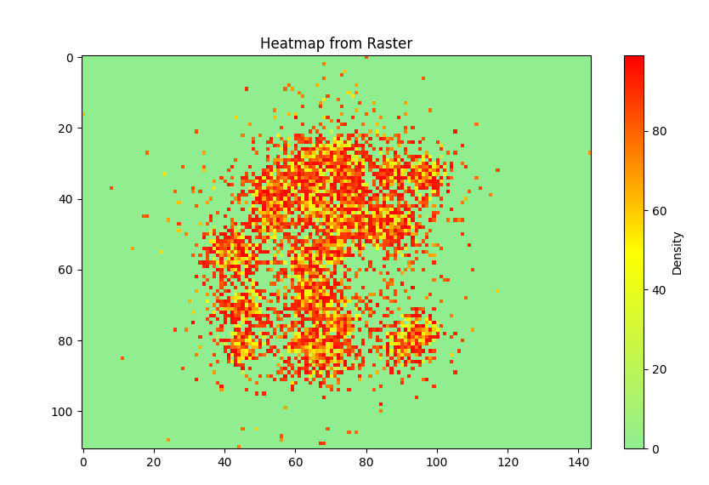
Key Requirements
User-Friendly Interface
Exportable Results
Data Querying and Filtering
Data Visualization
Convert raw data to Raster
Convert Raster to web-based, interactive map
Display data as Heatmap
Notes:
We worked closely with clients, with regular meetings and feedback to gather requirements.
This approach allowed us to understand the practical and technical needs of our end users, laying a solid foundation for the system.
From these discussions we identified 4 key requirements:
FireFlight’s interface must be intuitive and easy for non-technical users to navigate and use.
FS Managers need a reliable option to export results in CSV format for further research and analysis.
Efficient data querying and filtering are essential to providing users fast, relevant insights tailored to their needs.
The system must display complex bird and wildfire data clearly, allowing users to understand and analyze trends without feeling overwhelmed.
Let’s take a closer look at Data Visualization and how it breaks down into specific sub-requirements:
We convert raw datasets from CSV into raster format to structure the data in a way that aligns with grid-based mapping.
This raster data is transformed into interactive maps using Python and the Folium library, which is ideal for creating web-based visualizations.
We then display the data as a heatmap, which use color gradients to highlight patterns like the likelihood of bird presence across regions.
While requirements may evolve, the strong baseline we’ve developed ensures that FireFlight can handle large datasets and provide a responsive, scalable experience.
By addressing user experience, visualization, data querying, and exportable results, FireFlight is positioned to meet the needs of our clients and their end-users.

Slide 5

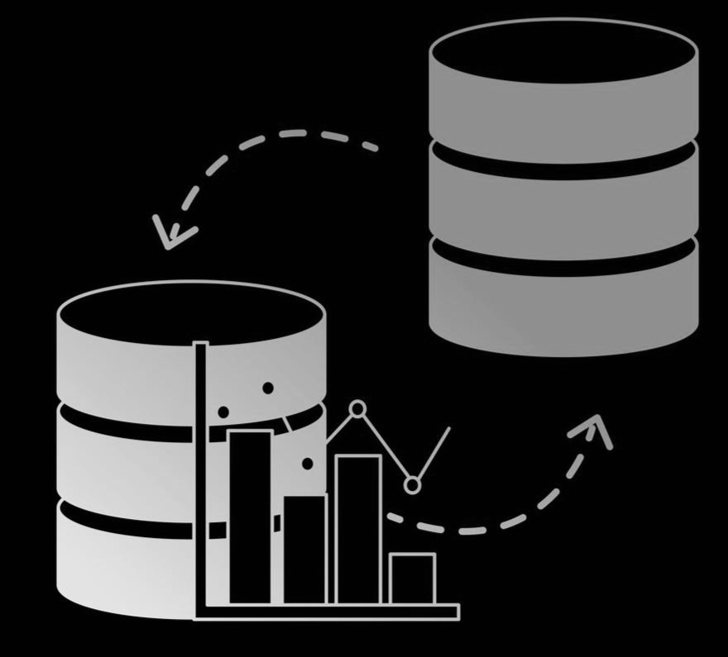

Risks and Strategies
Main Concerns:
  Maintainability
  Transfer of Ownership
  Updating Data
Strategies:
  3rd-party Hosting (AWS)
  Separate Database
Notes:
The main concerns when developing our project are the overall maintainability, transfer of ownership to the clients after we are finished with the project, and finding a way to update the data we are using, as we are unable to connect to the clients database.
The strategies we are using to help mitigate these risks are using a 3-d party hosting service to ease our transfer, and a separate database which we will maintain and update

Slide 6
Feasibility
Requirements:
  Transferable hosting service
  Reliable Front-End
  Accurate mapping software
Solution:
  Amazon Web Services
  Django
  Folium & Raster.io
Notes:
For the overall feasibility of our project, we have several key requirements: a transferable hosting service, which I just mentioned, a reliable and user friendly front end, and accurate mapping software.
Our solution for these requirements are to use Amazon Web Services for hosting our project, enabling an easier transfer to our clients later on.
We are using Django for our web framework, as it has been proven to be reliable and trustworthy.
For our mapping software, we are using the python library Folium with Rasterio to generate maps from our data.

Slide 7
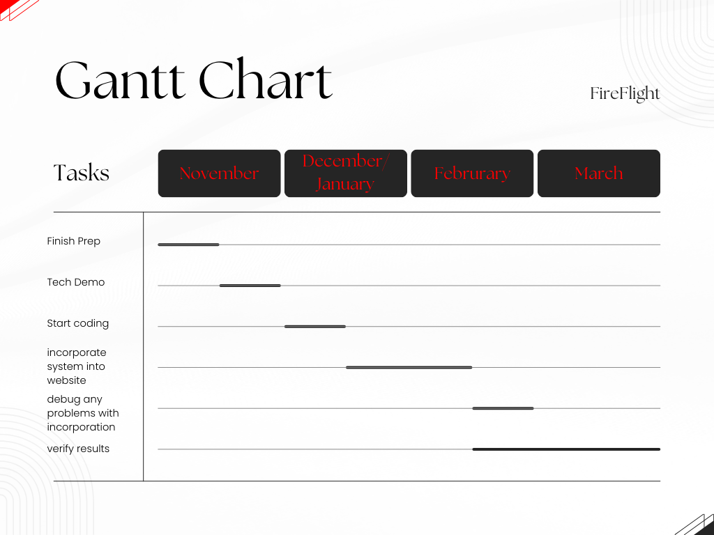
Schedule

Slide 8
Conclusion
Fires are harmful and can impact wildlife populations
We need a tool to help predict their population recovery as a result of fires
Our system will be able to help make said predictions
We are confident that we can deliver such a useful tool

