Slide 1

Team 4 “Cyber Recon”
Zachary Garza, Sean Weston,
Jared Kagie, Christian Butler
Mentor: Karthik Srivathsan Sekar
Client: HighViz Security LLC
Notes:
Charles
Use our logo colors

Slide 2

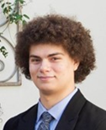



Meet the Team
Zachary Garza
Sean Weston
Christian Butler
Jared Kagie
Team Lead / QA
Debugging & Logging
Machine Learning Lead
Testing
Computer Science major with strengths in programming, teamwork, and leadership.
Software Engineering major skilled in development and project collaboration.
Computer Science major with a Cybersecurity minor and interest in AI and research.
Software Engineering major focused on coding, problem solving, and technical growth.
Notes:
Explain how the business works and how it would go about testing/validating nvme ssds
Chas
SSD PCIe speeds has been rapidly growing, between the last two generations the speed have almost doubled.
This is a great thing for everyone. It means faster boot times for a computer and faster times program load times.
However, with each new generation there comes the challenges of developing new products.
There is a lot of development that is needed for each new SSD and along with that comes a lot of testing to make sure that the ssds are actually working properly.
Explain what is deficient about current testing/validation process
Charles D.
Talk about file management being faster.
This leads to faster file loading and saving.
Since SSDs are getting faster, this leads to less stability.
With this, there is a need for better and thorough testing.

Slide 3

What Matters
Cybersecurity is a Growing Need
Cybersecurity is a growing concern in today’s technological world
Applications and websites need to be secure
Nowadays, over 6.04 billion people are connected to the internet[1]
The security of individuals is no longer a suggestion, it’s a requirement
[1] https://www.statista.com/statistics/617136/digital-population-worldwide/
Notes:
Explain how the business works and how it would go about testing/validating nvme ssds
Chas
SSD PCIe speeds has been rapidly growing, between the last two generations the speed have almost doubled.
This is a great thing for everyone. It means faster boot times for a computer and faster times program load times.
However, with each new generation there comes the challenges of developing new products.
There is a lot of development that is needed for each new SSD and along with that comes a lot of testing to make sure that the ssds are actually working properly.
Explain what is deficient about current testing/validation process
Charles D.
Talk about file management being faster.
This leads to faster file loading and saving.
Since SSDs are getting faster, this leads to less stability.
With this, there is a need for better and thorough testing.

Slide 4
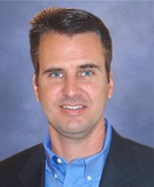
Our Client
Rick Belisle is the CEO and co-founder of the company with over 25 years of experience.
Had training from the Army in cyber-warfare and created the first defense unit
Other co-founders include Greg Johnson, Scott Miles, and Marty Sells
To identify vulnerabilities, our client uses a program called Nessus
Notes:
Explain how the business works and how it would go about testing/validating nvme ssds
Chas
SSD PCIe speeds has been rapidly growing, between the last two generations the speed have almost doubled.
This is a great thing for everyone. It means faster boot times for a computer and faster times program load times.
However, with each new generation there comes the challenges of developing new products.
There is a lot of development that is needed for each new SSD and along with that comes a lot of testing to make sure that the ssds are actually working properly.
Explain what is deficient about current testing/validation process
Charles D.
Talk about file management being faster.
This leads to faster file loading and saving.
Since SSDs are getting faster, this leads to less stability.
With this, there is a need for better and thorough testing.

Slide 5
The Problem
Cybersecurity Vulnerability Analysis is Tedious
Our client uses Nessus to scan for vulnerabilities
When new, unknown vulnerabilities are detected, it takes hours to research
Severity scores need to be adjusted
Time NEEDS to be saved
[1] https://www.statista.com/statistics/617136/digital-population-worldwide/
Notes:
Explain how the business works and how it would go about testing/validating nvme ssds
Chas
SSD PCIe speeds has been rapidly growing, between the last two generations the speed have almost doubled.
This is a great thing for everyone. It means faster boot times for a computer and faster times program load times.
However, with each new generation there comes the challenges of developing new products.
There is a lot of development that is needed for each new SSD and along with that comes a lot of testing to make sure that the ssds are actually working properly.
Explain what is deficient about current testing/validation process
Charles D.
Talk about file management being faster.
This leads to faster file loading and saving.
Since SSDs are getting faster, this leads to less stability.
With this, there is a need for better and thorough testing.

Slide 6



Requirements Review
Classify vulnerabilities as Lower / Keep / Raise.
Run Nessus scans → generate enriched reports.
Include lookups from NVD, GitHub PoCs, and CVE data.
Apply HighViz internal severity mappings.
[1] https://www.statista.com/statistics/617136/digital-population-worldwide/
Notes:
Explain how the business works and how it would go about testing/validating nvme ssds
Chas
SSD PCIe speeds has been rapidly growing, between the last two generations the speed have almost doubled.
This is a great thing for everyone. It means faster boot times for a computer and faster times program load times.
However, with each new generation there comes the challenges of developing new products.
There is a lot of development that is needed for each new SSD and along with that comes a lot of testing to make sure that the ssds are actually working properly.
Explain what is deficient about current testing/validation process
Charles D.
Talk about file management being faster.
This leads to faster file loading and saving.
Since SSDs are getting faster, this leads to less stability.
With this, there is a need for better and thorough testing.

Slide 7
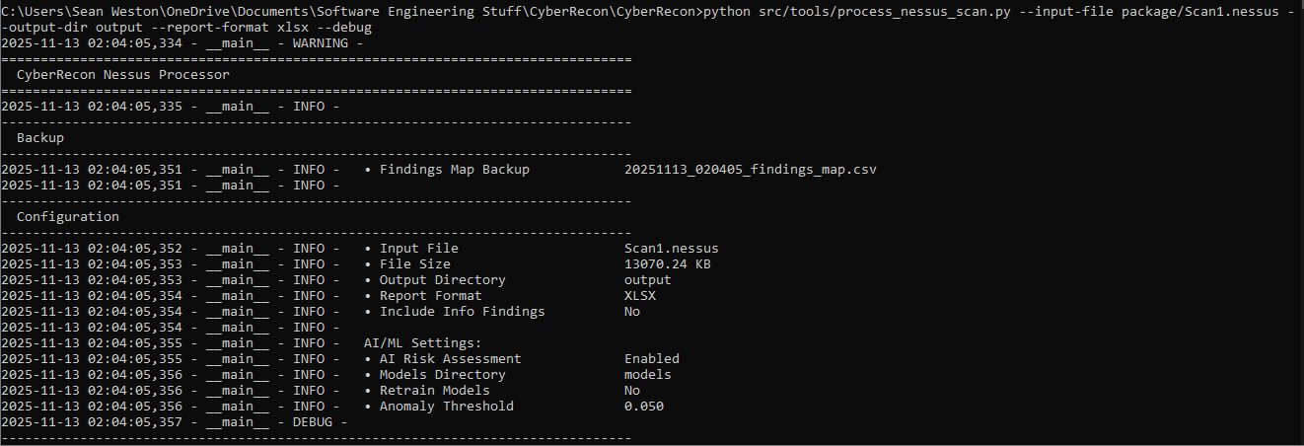
Our Solution
An intelligent vulnerability processing system that integrates AI/ML capabilities directly into the existing Nessus workflow
Fully Integrated command line interface for easy use and simplification
Real-time threat intelligence enrichment

Slide 8
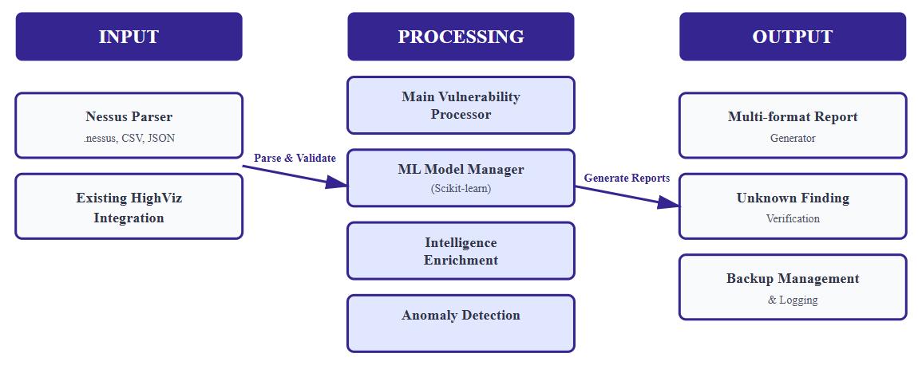
Implementation Details
Three layers to the design:
Input
Nessus Parser
Existing HighViz Integration
Processing
Main Vulnerability Processor
ML Model Manager (Scikit-learn)
Intelligence Enrichment
Anomaly Detection
Output
Multi-format report generator
Unknown Finding verification
Backup Management/Logging

Slide 9
Implementation Details
Vulnerability Processor
Main workflow of the system
Manages AI learning feedback
AI Risk Assessor
Severity Prediction
Anomaly detection on unknown finding
EPSS, NVD, KEV, and PoC GitHub
Findings Mapper
Automatic backup system
Integrated using existing HighViz Mapping file

Slide 10
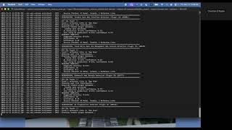
Product Demo

Slide 11
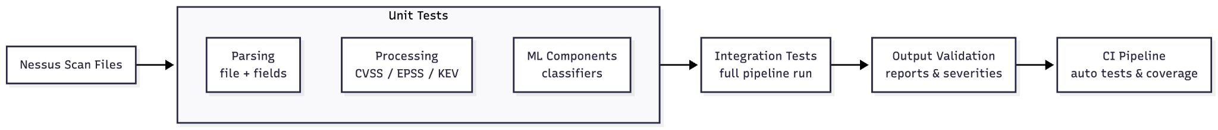
Testing Plan
Unit Testing
Test each module
Including our modified library
Integration Testing
Test the module interactions
Make sure they work as intended
Usability Testing
Hand off the platform to the engineers to try out
Get feedback from the engineer

Slide 12
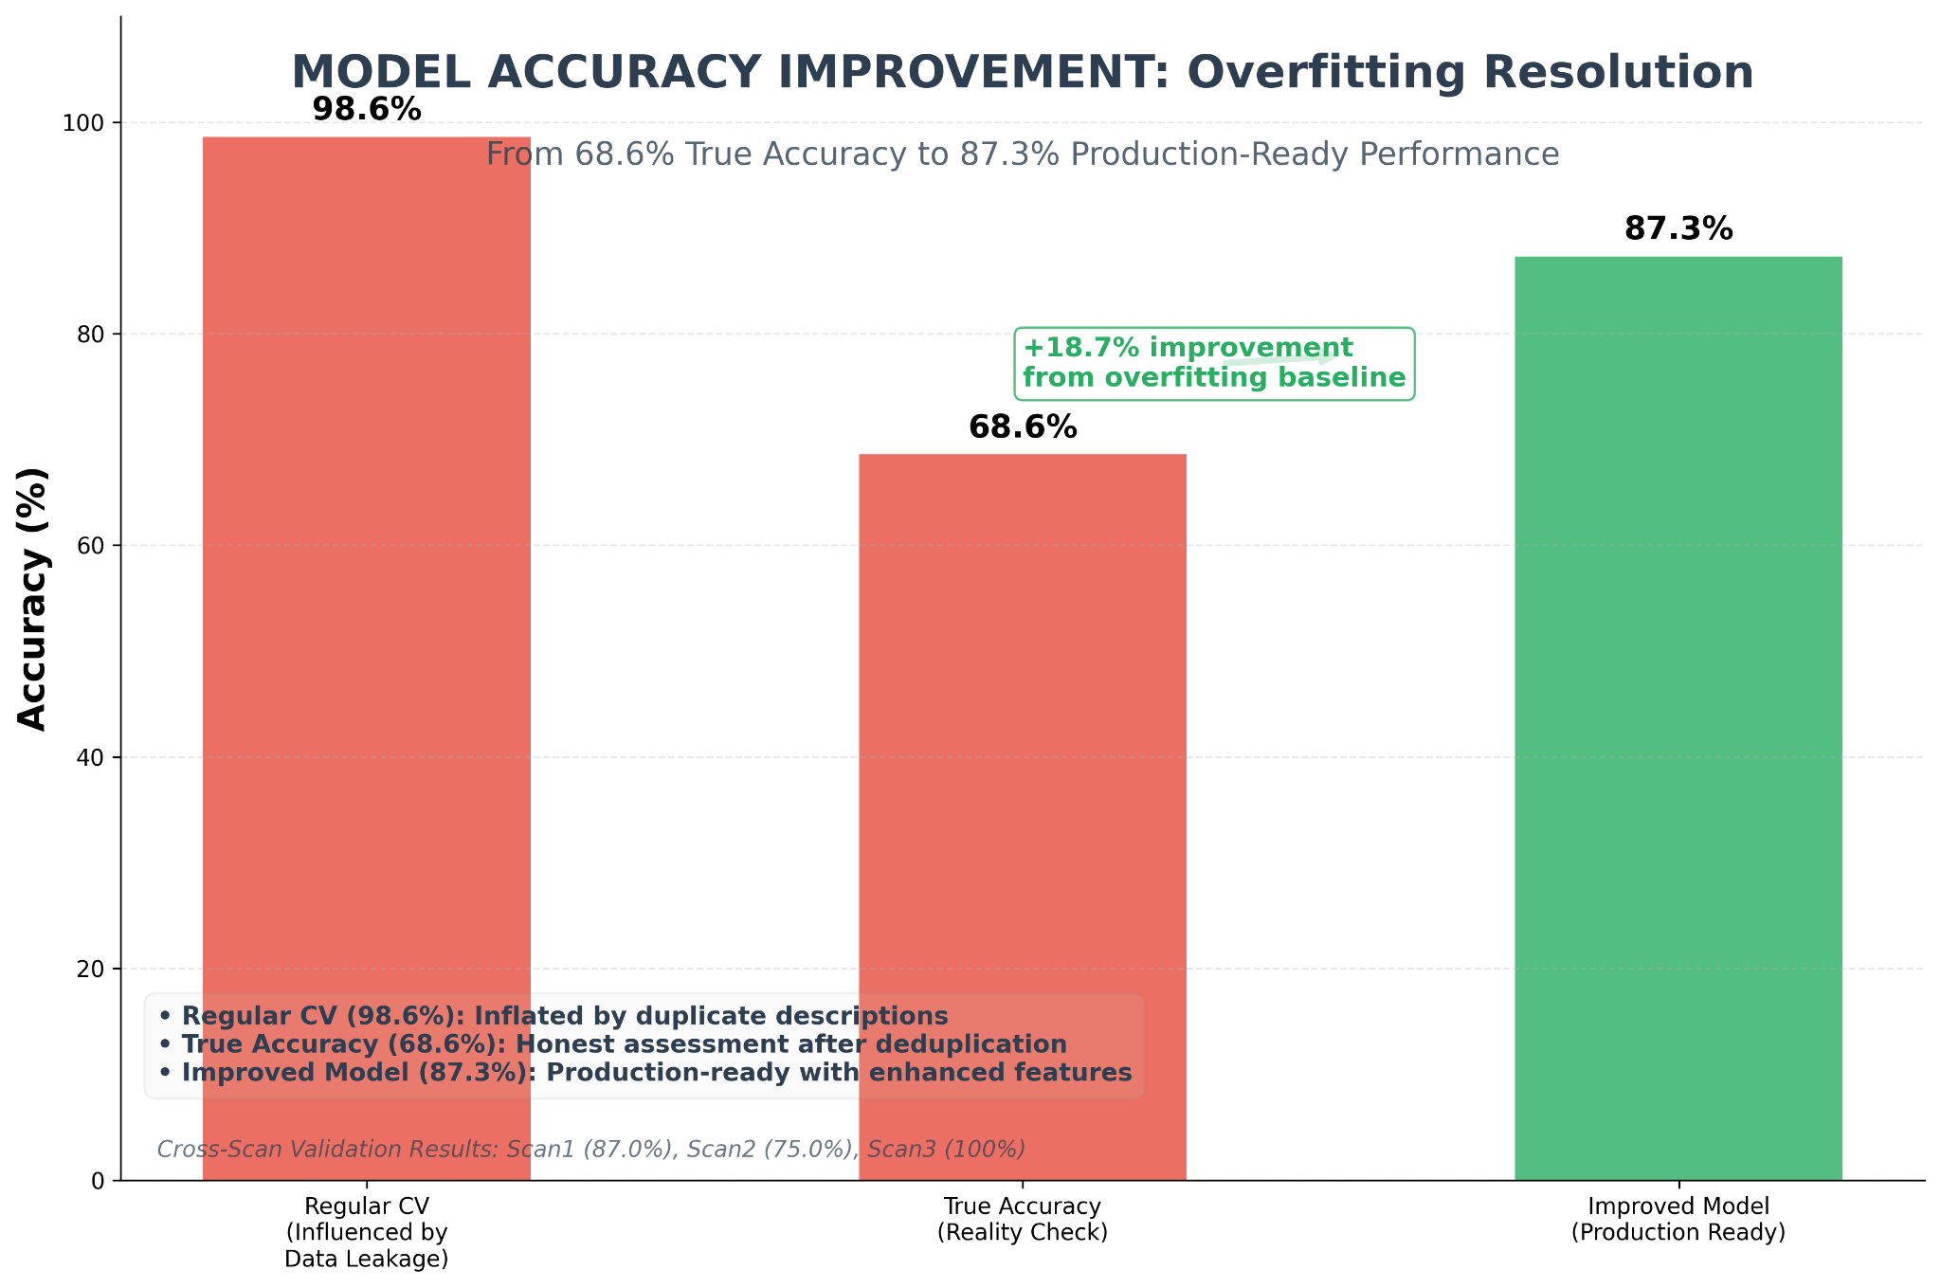
Challenges & Resolutions
Challenge – Overfitting
Duplicate PluginIDs/descriptions caused data leakage.
Inflated accuracy (98.6%) that wasn’t real.
Fix
Deduplicated by PluginID + description.
Added vulnerability categories to improve generalization.

Slide 13
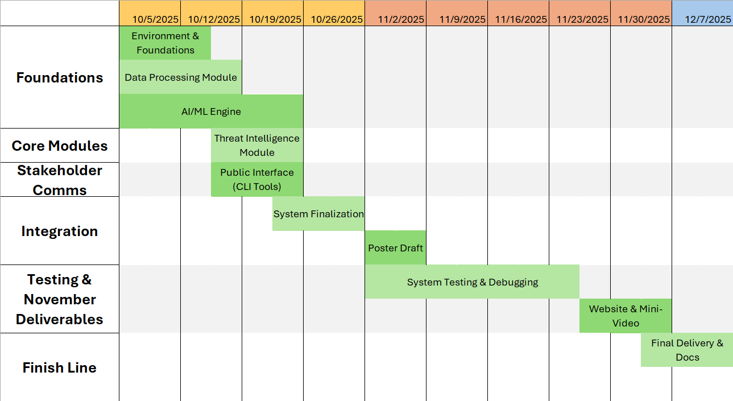
Schedule
Development Schedule

Slide 14
Conclusion
Before Our Solution
Researching new vulnerabilities takes too long
Reports are delayed until all vulnerabilities are checked
Bugs can’t be fixed quickly
After Our Solution
Accurate classifications of unknown vulnerabilities are found faster
Entire scans can be analyzed in minutes
System can be retrained as needed
More time for HighViz to do business
Going Forward
Ensuring results are as accurate as possible
Final documentation and deliverables

Slide 15

Thank You!

