Slide 1

Design Review 2
Team Sponsor: HighViz Security LLC
Team Mentor: Karthik Srivathsan Sekar
CyberRecon

Slide 2




Meet the team
Zachary Garza
Software Engineering major skilled in development and project collaboration.
Computer Science major with a Cybersecurity minor and interest in AI and research.
Software Engineering major focused on coding, problem solving, and technical growth.
Computer Science major with strengths in programming, teamwork, and leadership.
Sean Weston
Christian Butler
Jared Kagie
Team Lead
CyberRecon

Slide 3
CyberRecon
Domain and Market Importance
Cybersecurity Industry is critical in protecting organizations from the rapidly evolving digital threats (Exploits, Vulnerabilities, Cyberattacks)
60% of small businesses close within 6 months of a cyberattack
In the U.S. alone, the average cost of a data breach is $9.44 million
Organizations lack internal security teams and rely on third-party analysts
Demand for AI-driven vulnerability management continues to rise

Slide 4
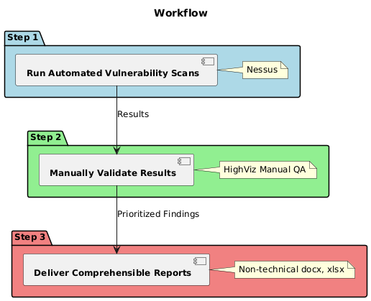
CyberRecon
Client and Current Workflow
Client: HighViz Security, a third-party cybersecurity threat analyst service provider
Specializes in vulnerability discovery and documentation using vulnerability scanning tools such as Nessus
They value the locality of their workflow due to data sensitivity and protection
Current Workflow:
Run automated vulnerability scans
Manually validate results and prioritize accordingly
Deliver comprehensible reports to clients

Slide 5
CyberRecon
Problem Statement
Manual vulnerability analysis is inefficient, error-prone, and most importantly time-consuming
Some Specifics:
Excessive amount of time spent filtering, verifying, and prioritizing vulnerabilities
  Scans generate false positives and irrelevant data
Human error leads to missed or misclassified risks
Slower threat response time and reduction of productivity
Proposed Solution:
A CLI tool that handles vulnerability sorting and classifying with an AI-driven approach

Slide 6
CyberRecon
What are these terms?
Nessus: A vulnerability scanner that identifies security vulnerabilities in devices, applications, and network resources.
CVE: Common Vulnerabilities and Exposures.
A public list of known security flaws, each with a unique ID.
KEV: Known Exploited Vulnerabilities.
A catalog maintained by CISA (Cybersecurity and Infrastructure Security Agency) that lists vulnerabilities that have been actively exploited.
EPSS: Exploit Prediction Scoring System.
A data-driven model that estimates the probability of a software vulnerability being exploited in the wild within the next 30 days.

Slide 7
CyberRecon
Solution Overview
We will solve this problem by automating the manual work required to analyze the nessus scans using AI.
Using existing vulnerability classifications, both public and from HighViz, our AI can generate a vulnerability score that more accurately represents the severity of the vulnerability
This allows for the identification of false positives, false negatives, as well as
determining which vulnerabilities are severe threats and which
vulnerabilities are of little threat
This solution would be greatly beneficial to HighViz
Faster analysis times, which lead more clients seen per day
Less human error, creating more accurate reports
Allows employees to focus on real threats

Slide 8
CyberRecon
Requirements Recap
Takes Nessus CSV/JSON files as input
  Nessus files are inputted, then converted to CSV/JSON and stored into an SQLite DB
Use data from CVE/KEV/EPSS datasets
  CVE data is taken from these datasets and added to the input of the AI/ML engine
Generate a prioritized risk report
  Should contain a composite score, anomaly rating, risk tier, etc.
Process records in a reasonable time frame
  Can go through 10,000 records in ~2 minutes
Runs natively on macOS 13+
  Should run without issue on a MacBook Pro
Functions entirely offline, excluding updating datasets
  All functionality should work without a connection to the internet

Slide 9
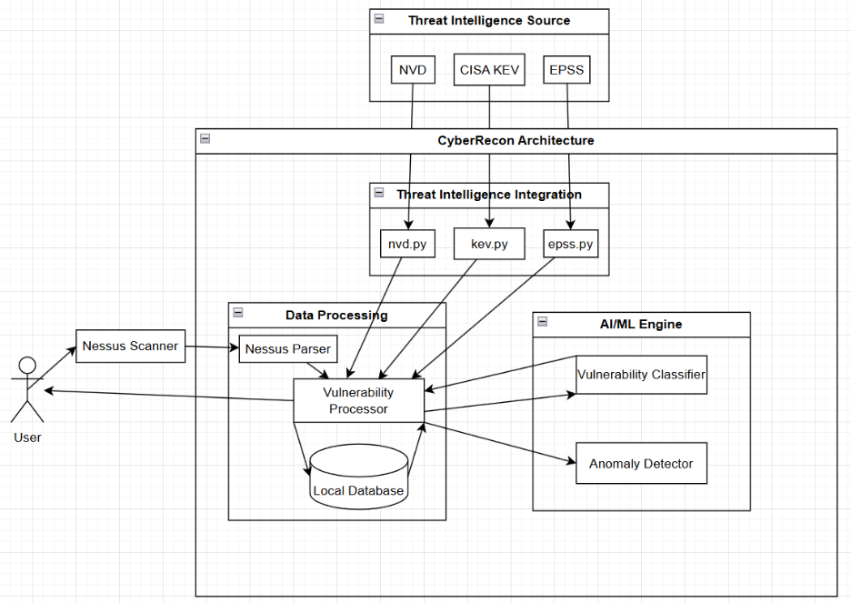
CyberRecon
High Level Architecture
Tech Explanation
SQLite, Scikit-Learn, Pandas, NumPy
Local, no login needed
Easy, flexible ML tools
Data handling, integration
1
NVD, KEV, & EPSS Databases
CVE metadata & CVSS scores
Known exploited vulnerabilities
Probability of future exploitation
2
Random Forest and Isolation Forest
3
Detects anomalies in CVE data
Predicts expected CVE scores
Notes:
Sqlite allows for easy access to data without requiring login information. More importantly, Sqlite operates locally, which perfectly fits our use case. Scikit-Learn is simple to use and provides many routes to accomplish our goals. Pandas and NumPy both provide powerful ways of representing data, and they both integrate very well with Scikit-Learn.
These databases provide various insights into CVEs, with NVD providing CVE metadata and CVSS scoring info, KEV supplying vulnerabilities with confirmed real-world exploitations, and EPSS providing scores outlining the probability of a CVE’s future exploitation. While other datasets exist, these provide enough information that we can gain a full picture of these CVEs
Isolation Forest is used for detecting anomalies in data, making it a great fit for finding CVEs with scores that don’t match the data provided by our Threat Intelligence Integration. Random Forest works on prediction based on inputs, allowing NVD, KEV and EPSS data to be used to predict what the scores should be for a given vulnerability. Additionally, Random Forest is resistant to overfitting, allowing it to better identify threats it hasn’t seen. It also performs well with raw data and can handle large datasets without much loss of performance

Slide 10
CyberRecon
Implementation Overview
Nessus Parsing
SQLite Schema
Training/Validation
Testing
Scoring Algorithm
Intel Sync
Logging
CLI/UI
Notes:
Nessus Parsing - Adopted from HighViz
SQLite Schema - 3 Tables, Nessus, HighViz Map (previous entries and pre-existing knowledge), HighViz Findings.
Training: on HVMap data
Testing: Make model is benefitting from the training data.
Scoring Algorithm - KEV: 35% CVSS: 25% AI: 20% EPSS: 20%
Intel Sync - Gets a list of epss, kev, and nvd so it’s available offline
Logging - ability to log so it’s well kept

Slide 11
Caching & Data Management
CyberRecon
Local Database Storage: SQLite3-based caching
Automated Update System: 24-hour update interval for threat intelligence data
Backup System: Automatic backups to data/backups before updates
Manifest Tracking: JSON manifest files tracks data versions and checksums
Cached Content:
KEV Data: CISA Known Exploited Vulnerabilities ( JSON format )
EPSS Scores: Exploit Prediction Scoring System ( CSV.GZ format )
NVD Data: National Vulnerability Database CVE details
Trained Models: ML models ( .joblib, .pkl files )

Slide 12
Public Intelligence Fetch
CyberRecon
KEV (Known Exploited Vulnerabilities)
Updates Daily
Purpose: Identifies actively exploited CVEs in the wild
Mandatory override: KEV CVEs forced to critical severity
EPSS (Exploit Prediction Scoring System)
Updates Daily
Format: Gzipped CSV
Purpose: Provides probability of exploitation in the next 30 days
NVD (National Vulnerability Database)
Rate Limit of 5 requests per 30 seconds
Purpose: Detailed CVE metadata and CVSS scores
API Key Support: Optional key for higher rate limits

Slide 13
Training, Validation & Testing
CyberRecon
Training Data Sources
CVSS-based training (Bootstrap method)
  Uses CVSS >7.0 as “high-risk” label
  Trains on vulnerability descriptions & solutions
Export Knowledge Training
  Uses HighViz expert input
Feature Engineering
Text Features: TF-IDF vectorization
  One-word and two-word from descriptions
  Stop word removal and normalization
Numerical Features:
  CVSS Scores
  Anomaly scores from Isolation Forest

Slide 14
CyberRecon
Key Challenges and Resolution
Integrating AI/ML Models into the Processing Pipeline
Balancing Performance and Model Accuracy
Maintaining Continuous Learning Without Model Drift
Nessus data isn’t ready for the Model to observe, as it needs to be formatted.
Pre-processing Module
Due to the Model being run locally, this can cause obvious slowdowns
Cache
Training models with new data risks overfitting and inconsistent accuracy
Validation
Create a module before processing that allows easy and efficient training off data
Incorporate a caching system and function parameters without compromising accuracy
Establish retraining rules and performance checks to keep the model accurate
Notes:
Integrating AI/ML Models into the Processing Pipeline
During implementation, we faced challenges connecting the AI classifiers and anomaly detectors with the Nessus parsing system without disrupting existing data structures. The issue arose because raw scan data required transformation before the models could interpret it. We solved this by developing a standardized preprocessing module that converts parsed output into a uniform, ML-ready format, ensuring compatibility across the entire workflow.
Balancing Performance and Model Accuracy in Local Environments
Running hybrid AI models (Random Forest and Isolation Forest) locally on M2 hardware caused noticeable slowdowns during large-scale scans. To address this, we optimized the pipeline by implementing caching for model files, using batch-based processing, and adjusting parameters like max_features and n_estimators for efficiency without compromising predictive accuracy.
Maintaining Continuous Learning Without Model Drift
One ongoing challenge is retraining models on tester feedback while avoiding overfitting or performance degradation. Our current solution involves automated retraining thresholds and validation scripts that benchmark new models against prior versions. However, we’re still refining the feedback pipeline to ensure consistent quality and interpretability across retraining cycles.

Slide 15
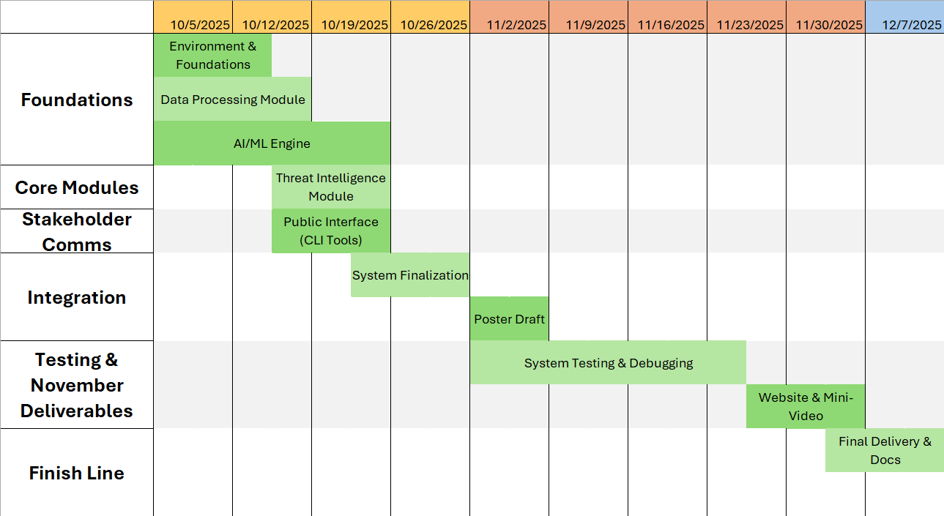
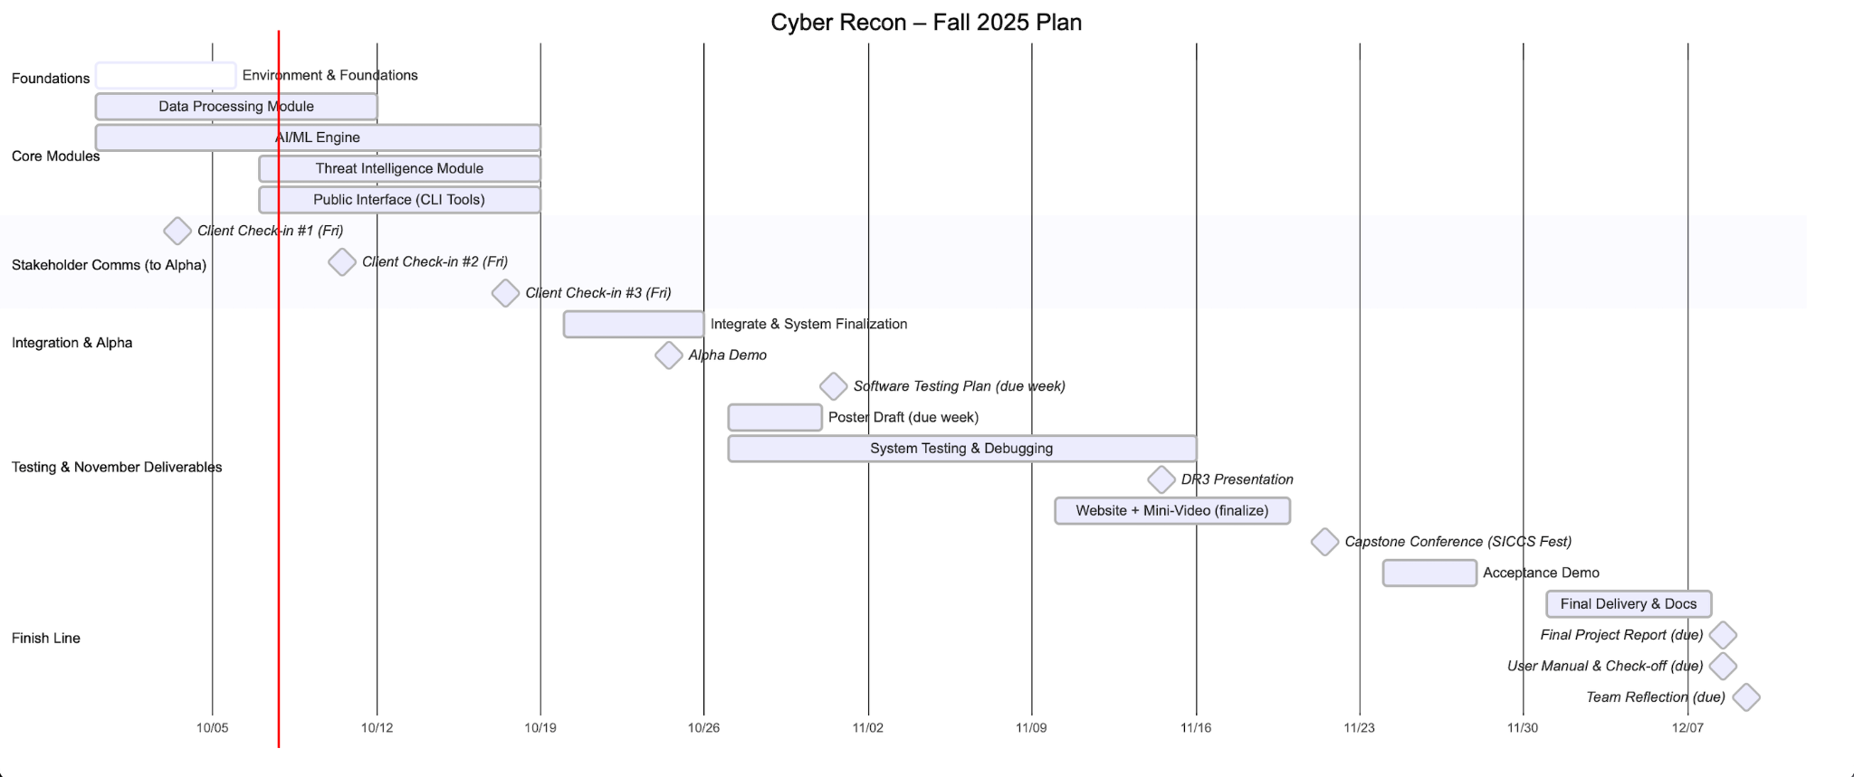
CyberRecon
Current Status and Schedule
An overview of the rest of our semester and project.

Slide 16
CyberRecon
Impact and Values
Empower Small Businesses
Accelerate Security Teams
1
2
Reduces the cost and expertise barrier to running effective vulnerability scans, lowering the risk of devastating breaches that can shut down a business.
Security analysts spend less time sifting through false positives and irrelevant results, freeing them to focus on real, exploitable risks.
Strengthen Risk-Based Decision Making
Privacy-First, Scalable Architecture
3
4
Helps clients and HighViz Security allocate limited resources to the most urgent threats instead of reacting to raw scanner output.
Offers a secure, scalable platform that fits both small teams and growing organizations, aligning with HighViz’s trust and compliance values.

Slide 17
CyberRecon
Conclusion
Delivering Security Value
Transforms raw Nessus scan data
Accurate risk scoring
Empowering HighViz and Clients
Reduces time and effort for manual triage
Enables small and mid-sized organizations to strengthen their analysis
Designed for Trust and Scalability
Privacy-first architecture
Modular design supports future growth & integration
Ready for Deployment
Fully tested and documented
Provides a foundation for continued enhancement

Slide 18
CyberRecon
Any Questions?
Ask Away!

Slide 19
Thank you
CyberRecon

