Slide 1

Cyber Recon
Team : Zachary Garza, Christian butler, jared kagie, sean weston
Mentor: Veerendernath Surendernath Komala
Client: HighViz Security

Slide 2
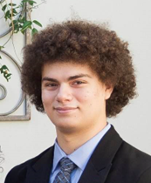
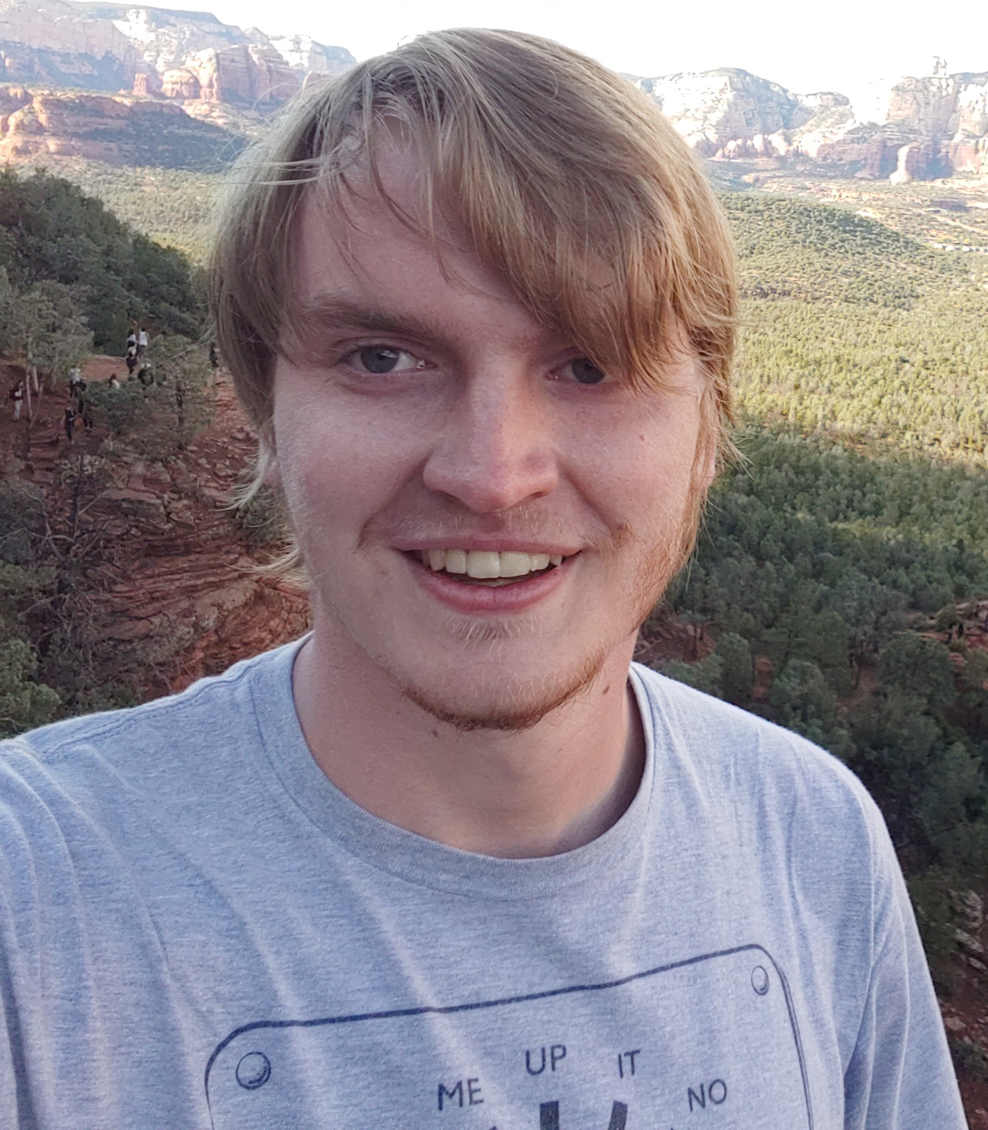

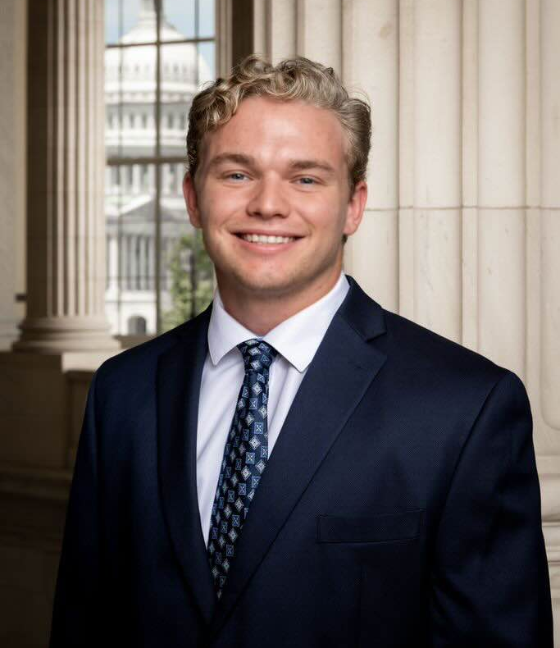
Our Team
Zachary Garza
Jared Kagie
Sean Weston
Christian Butler
Computer Science Major
Team Lead
Software Engineering Major
Recorder
Software Engineering Major
UI/UX Designer
Computer Science Major (Cybersecurity Minor)
Release Manager

Slide 3

HighViz Security
Rick Belisle is the CEO and co-founder of the company with over 25 years of experience.
Had training from the Army in cyber-warfare and created the first defense unit
Other co-founders include Greag Johnson, Scott Miles, and Marty Sells

Slide 4
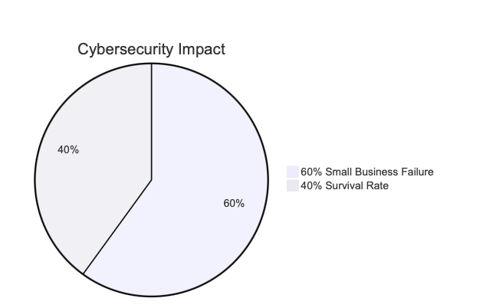
Introduction & Industry Overview
Cybersecurity Crisis:
  60% of small businesses fail within six months after a cyberattack.
  Average cost of a data breach in the U.S.: $9.44 million.
Market Demand:
  Increasing reliance on third-party cybersecurity firms.
Client Overview:
  HighViz Security specializes in vulnerability detection using Nessus.
https://www.inc.com/joe-galvin/60-percent-of-small-businesses-fold-within-6-months-of-a-cyber-attack-heres-how-to-protect-yourself.html

Slide 5
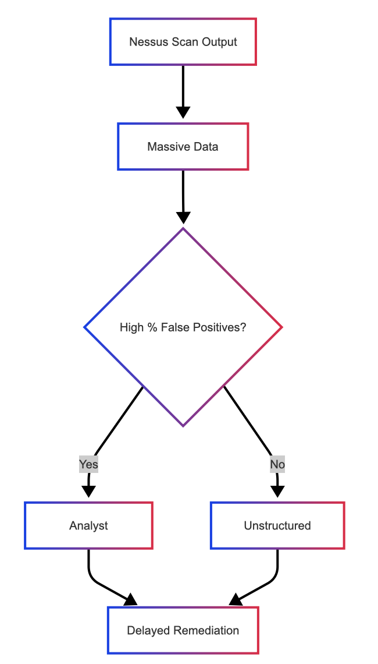
Problem Statement
Current Workflow Issues:
  Nessus scan outputs contain thousands of entries.
  High false positives and irrelevant data overwhelm analysts.
  Manual review is time-consuming and error-prone.
Impact:
  Delayed decision-making.
  Resource strain and risk of overlooking critical threats.

Slide 6
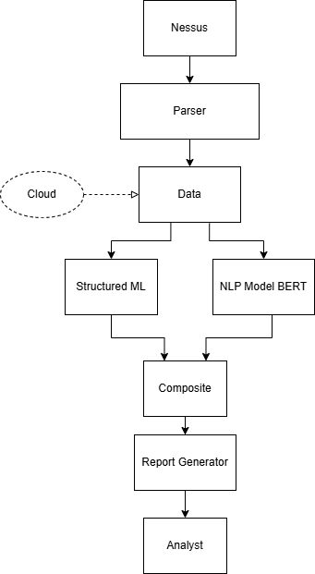
Solution Overview
Our Hybrid AI Approach:
  Uses NLP (fine-tuned BERT) plus structured ML (Random Forest/XGBoost).
  Enriches vulnerability data with external threat intelligence (CVE, KEV, EPSS).
Key Benefits:
  Local execution on Apple M2 hardware ensures speed and data privacy.
  Outputs prioritized, actionable reports for faster remediation.
  Scalable through secure cloud collaboration if needed.
Requirement Acquisition:
  Weekly team meetings
  Client has given specific needs in documentation

Slide 7
Key Requirements
Functional:
  Parse & normalize Nessus CSV/JSON files.
  Enrich data using CVE/KEV/EPSS feeds.
  Generate prioritized risk reports.
Performance:
  Process 10,000 records in under 5 minutes.
  Model inference under 100 milliseconds per entry.
Environmental:​
  Native support on macOS 13+ (Apple M2).​
  Offline functionality with secure periodic feed updates.​

Slide 8
Risks & Feasibility
Key Risks:
  Model Bias & Misclassification
  Dependency Vulnerabilities
  Performance Bottlenecks
  Threat Feed Staleness
  Cloud Security Breach Risks
Mitigation:
  Human-in-the-loop feedback
  Regular security scans of dependencies
  Continuous profiling and load testing
  Automated feed updates and alerts
  Secure HTTPS with mutual authentication for cloud interactions

Slide 9
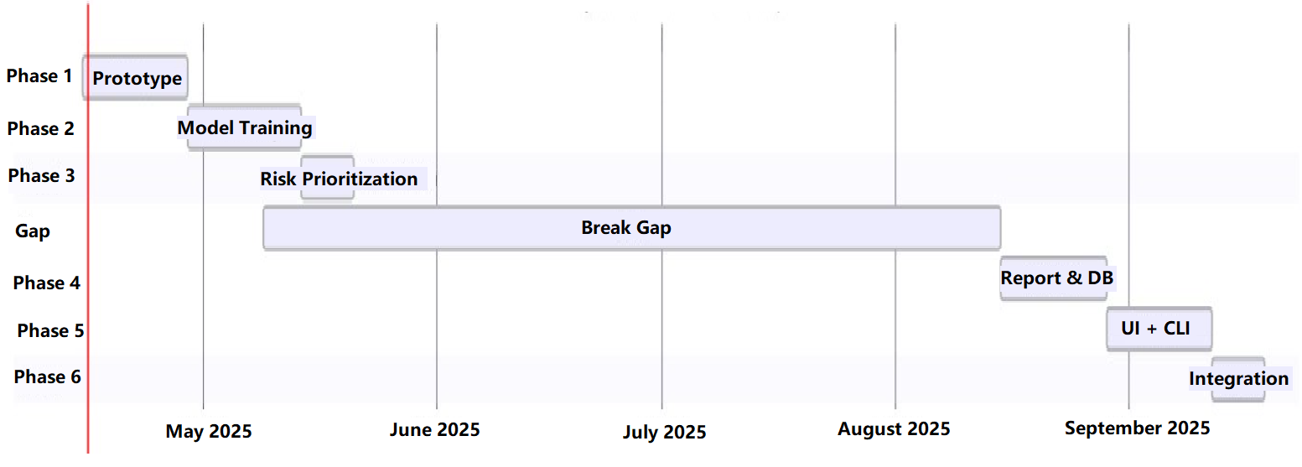
Project Plan & Schedule
Notes:
Milestones Overview:
Phase 1: Parser & Normalizer (Weeks 1–2)
Phase 2: Model Training (Weeks 3–5)
Phase 3: Risk Prioritization (Weeks 6–7)
Gap: (May 9 – August 15)
Phase 4: Report Generator & Local DB (Starting August 15, 14 days)
Phase 5: UI + CLI Finalization (14 days)
Phase 6: System Integration & Testing (7 days)

Slide 10
Conclusion and Next Steps
Recap:
Urgent cybersecurity need requiring automated vulnerability analysis.
Our hybrid AI solution addresses manual inefficiencies.
Comprehensive requirements and risk assessments have been established.
Next Steps:
Detailed design exploration and additional prototyping.
Continued risk assessment and iterative testing.
Preparation for the next phase of development.

