Slide 1
GeoKings
Design Review I
Team Members
Andrew Usvat
Zack Bryant
John Cardeccia
Jackson Brittain
Alex Poole
Client
United States Geological Survey (USGS)
Astrogeology Science Center

Slide 2

Big Picture
The universe extends over a radius of about 15 billion light years.
We want to increase space exploration.
Images and maps help increase exploration.
https://www.google.com/url?sa=i&url=https%3A%2F%2Fwww.freeiconspng.com%2Fimages%2Fearth-png&psig=AOvVaw1

Slide 3




Clients
usgs.gov
Amy Stamile Dr. Jay Laura Trent Hare
Software Developer Software Lead Cartographer

Slide 4
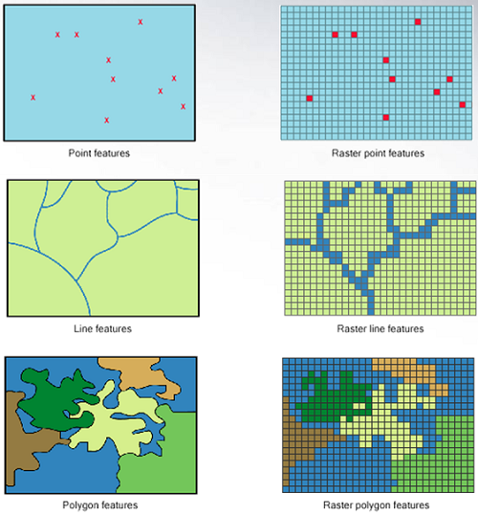
Problem
Vector Data Raster Data
The current application uses only raster data.
When implementing vector data, we have to update additional functionalities:
Rendering vector data
Updating the search query
Integrating vector stylizing
https://gsp.humboldt.edu/olm/Lessons/GIS/08%20Rasters/RasterToVector.html

Slide 5
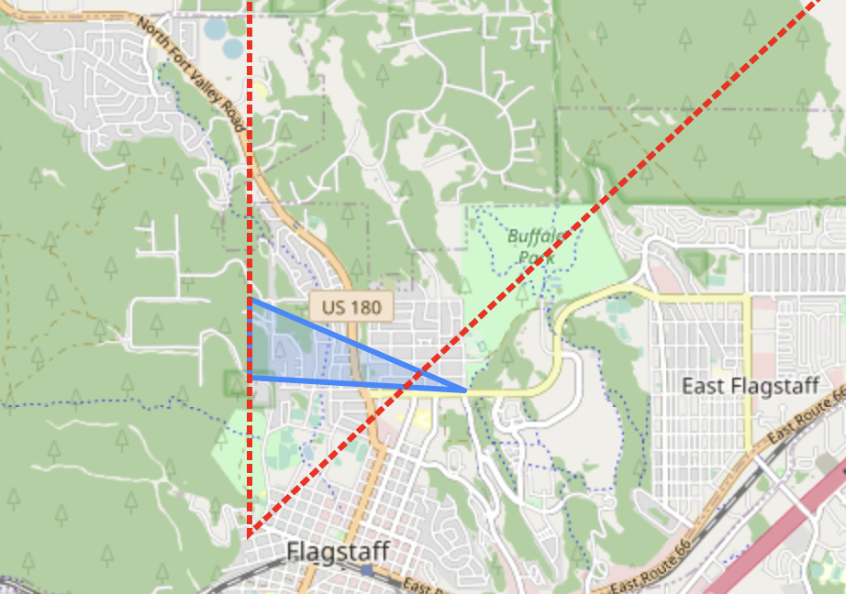
Solution
Integrating the the Vector API into GeoSTAC, and modifying the existing tools to work with the Pygeo API.
Using Leaflet to display vectors and Leaflet.SLD to style them
Creating compatibility with ElasticSearch and presenting using React
Default blue polygon vs stylized red lines from Leaflet.SLD

Slide 6
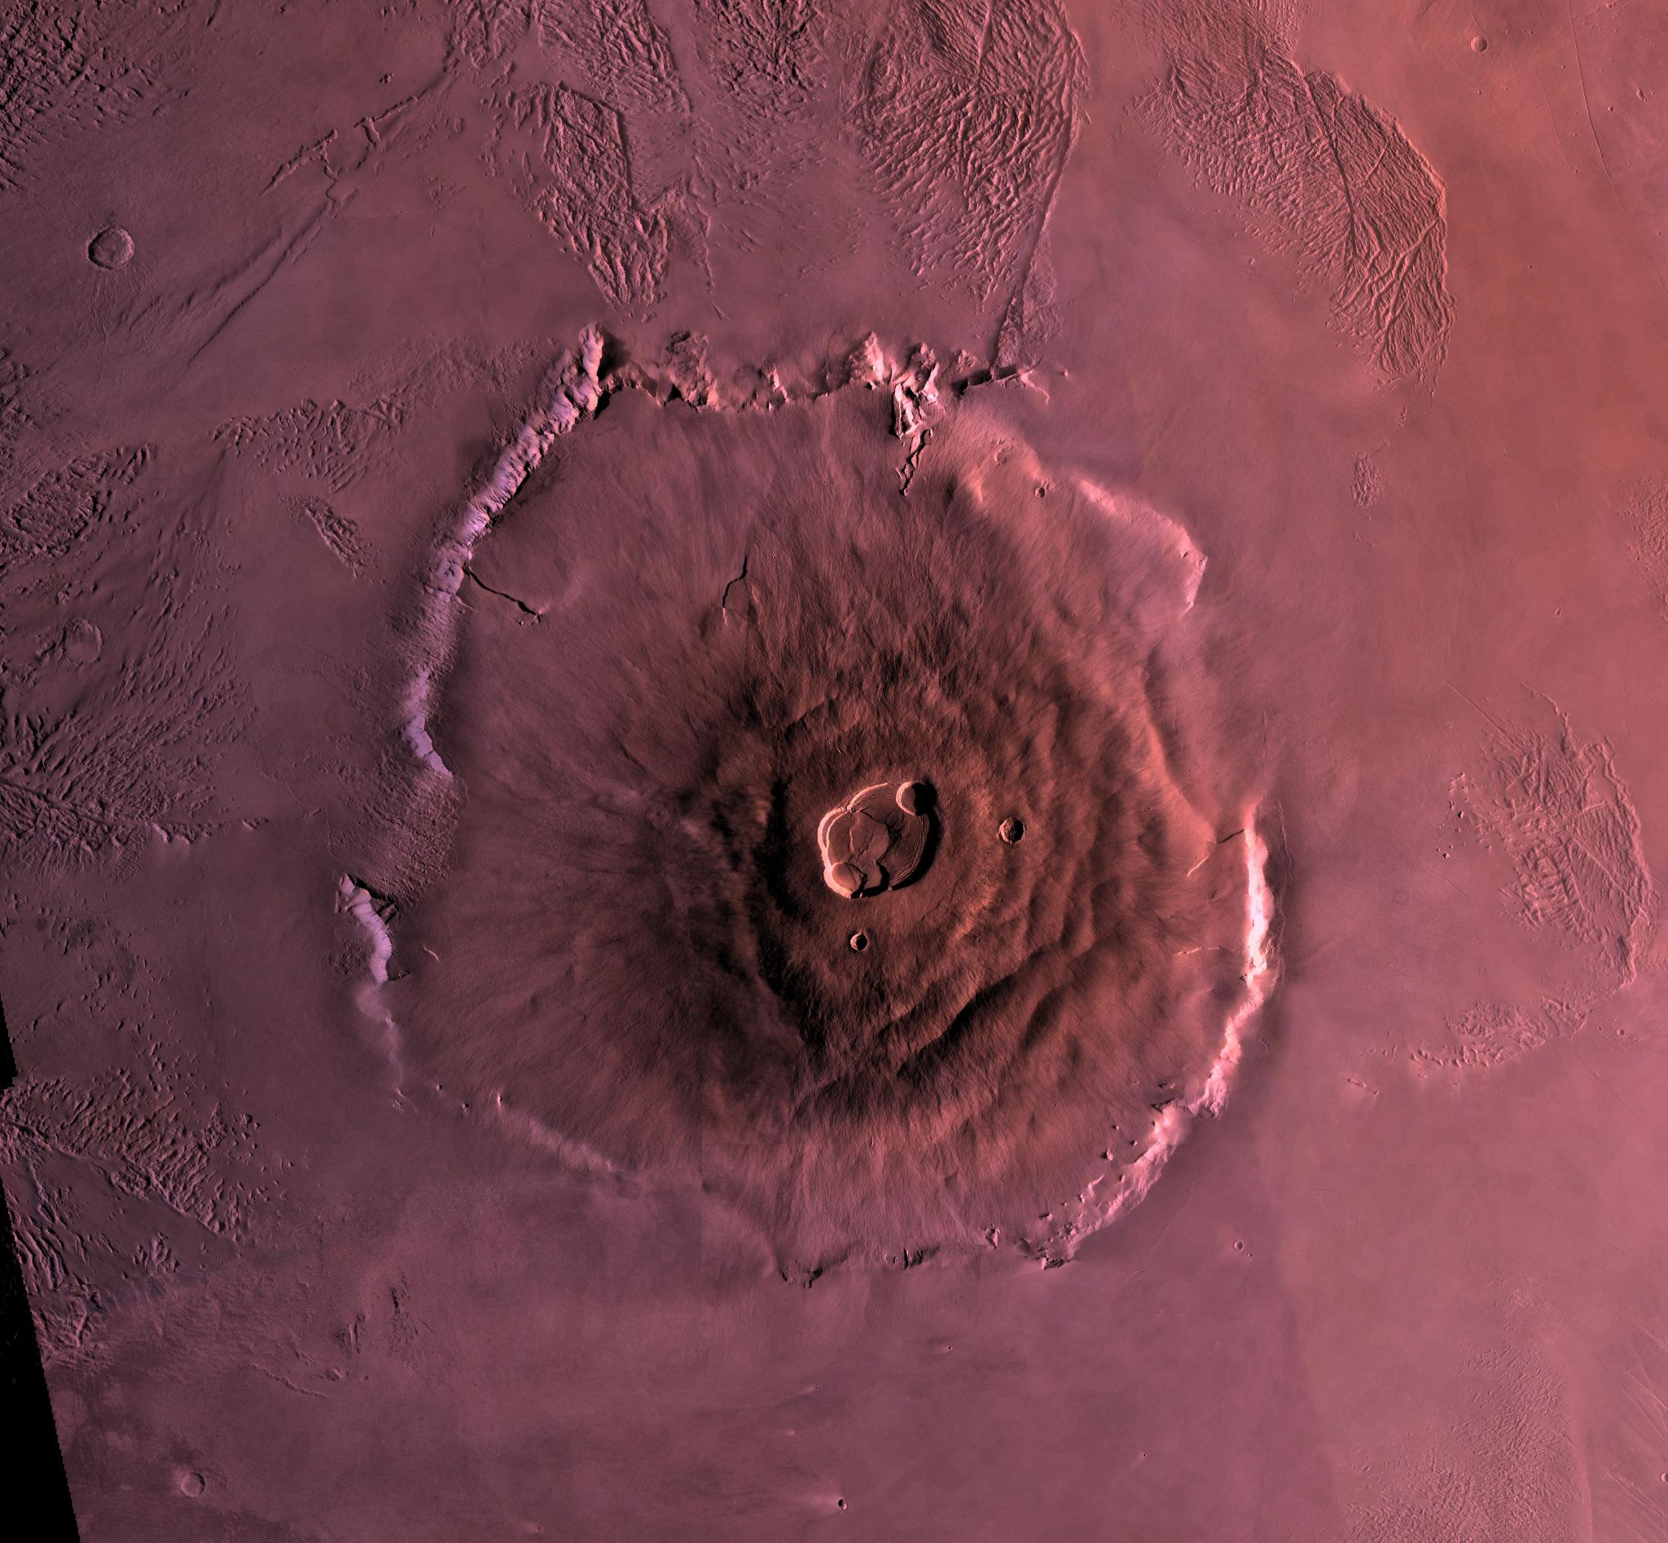
Requirements - Domain
View and select stylized vector data on a Leaflet rendered map.
Search for specific geologic features in the vector data.
*Olympus Mons, June 4, 1998, JPL

Slide 7
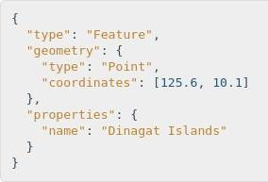
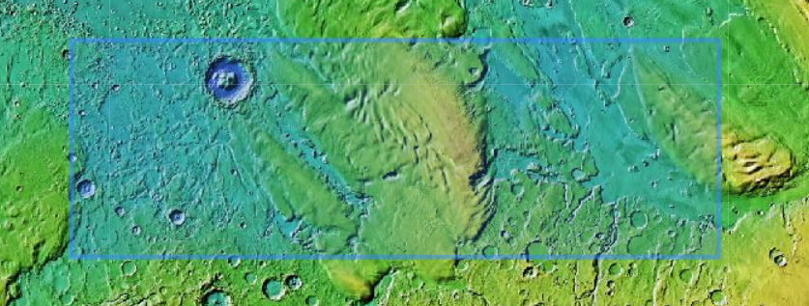
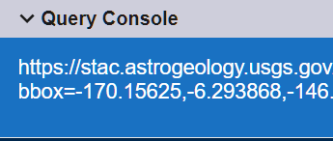
Requirements - Functional
Rendering
Stylizing
Searching
Access GeoJSON data through new Vector API.
Using SLD and SVG files to make the data useful.
Making the data accessible for the users.

Slide 8
Requirements - Performance
Data Accuracy
User Testing
Validating Data
Returned from the API.
Passed to SLD files.
Usability
Intuitive design for new and existing users.

Slide 9





Requirements - Environmental
Open Source Tools

Slide 10
Risks
Compatibility
Speed
Usage/cohesiveness

Slide 11
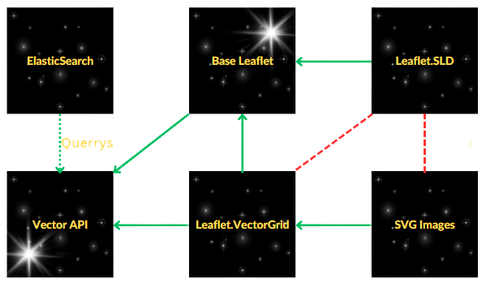
Feasibility
Query
Parser

Slide 12
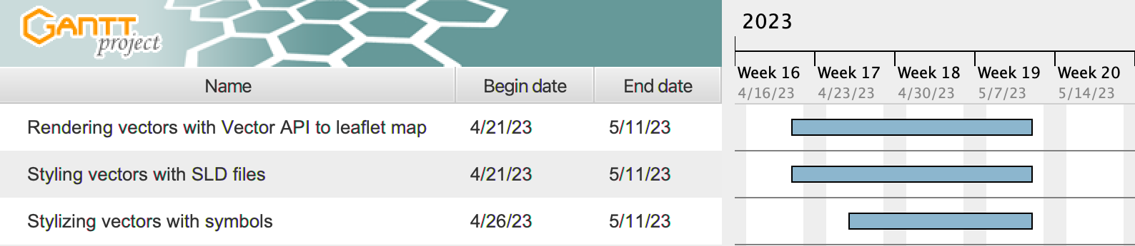
Schedule Through End of Semester

Slide 13
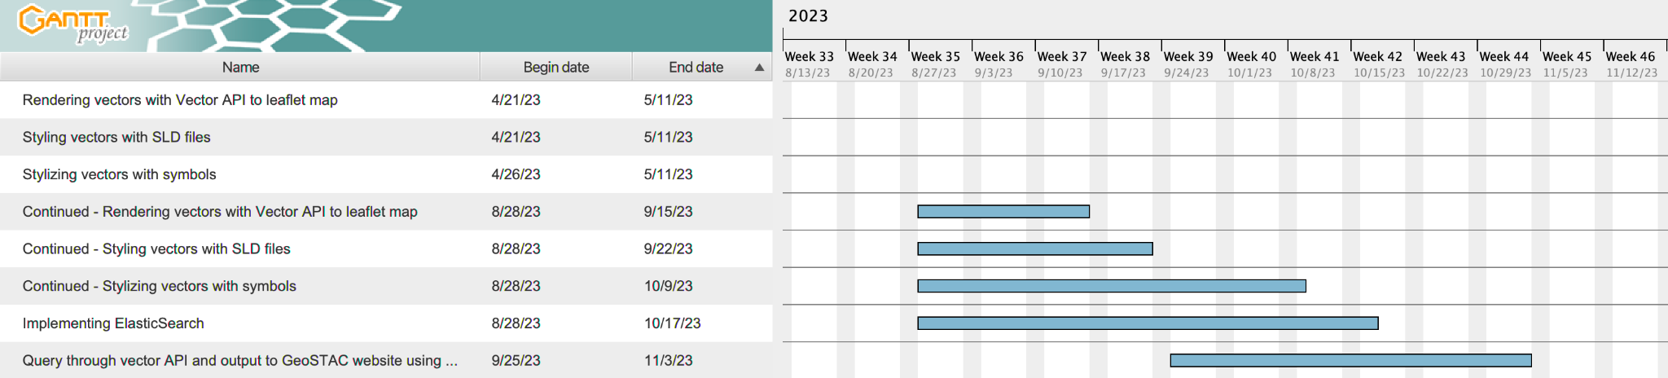
Schedule of Next Semester

Slide 14

Conclusion
Requirements discussed with clients
Functional Requirements:
Rendering, Stylizing, Searching
Performance Requirements:
Data Accuracy, User Testing
Environmental Requirements:
Javascript, Leaflet, React, Elasticsearch
Risks/Feasibility
Compatibility, Speed, and Usage/Cohesiveness

