Slide 1

Design Review 3
Team CareerNet
CARTER TAYLOR
Role: Team Lead, Customer Communicator
MCKENZIE CLARK
Role: Architect
RAN LI
Role : Release Manager
CS Faculty Mentor:
Han Peng
CARMEN MONTALVO
Role: Recorder
Notes:
CARMEN: Title, Problem Solution, key requirements
McKenzie: Architecture and Implementation overview
Ran: Problem, Challenges, Schedules (McKenzie will paste our most up to date schedule)
Carter: Conclusion

Slide 2
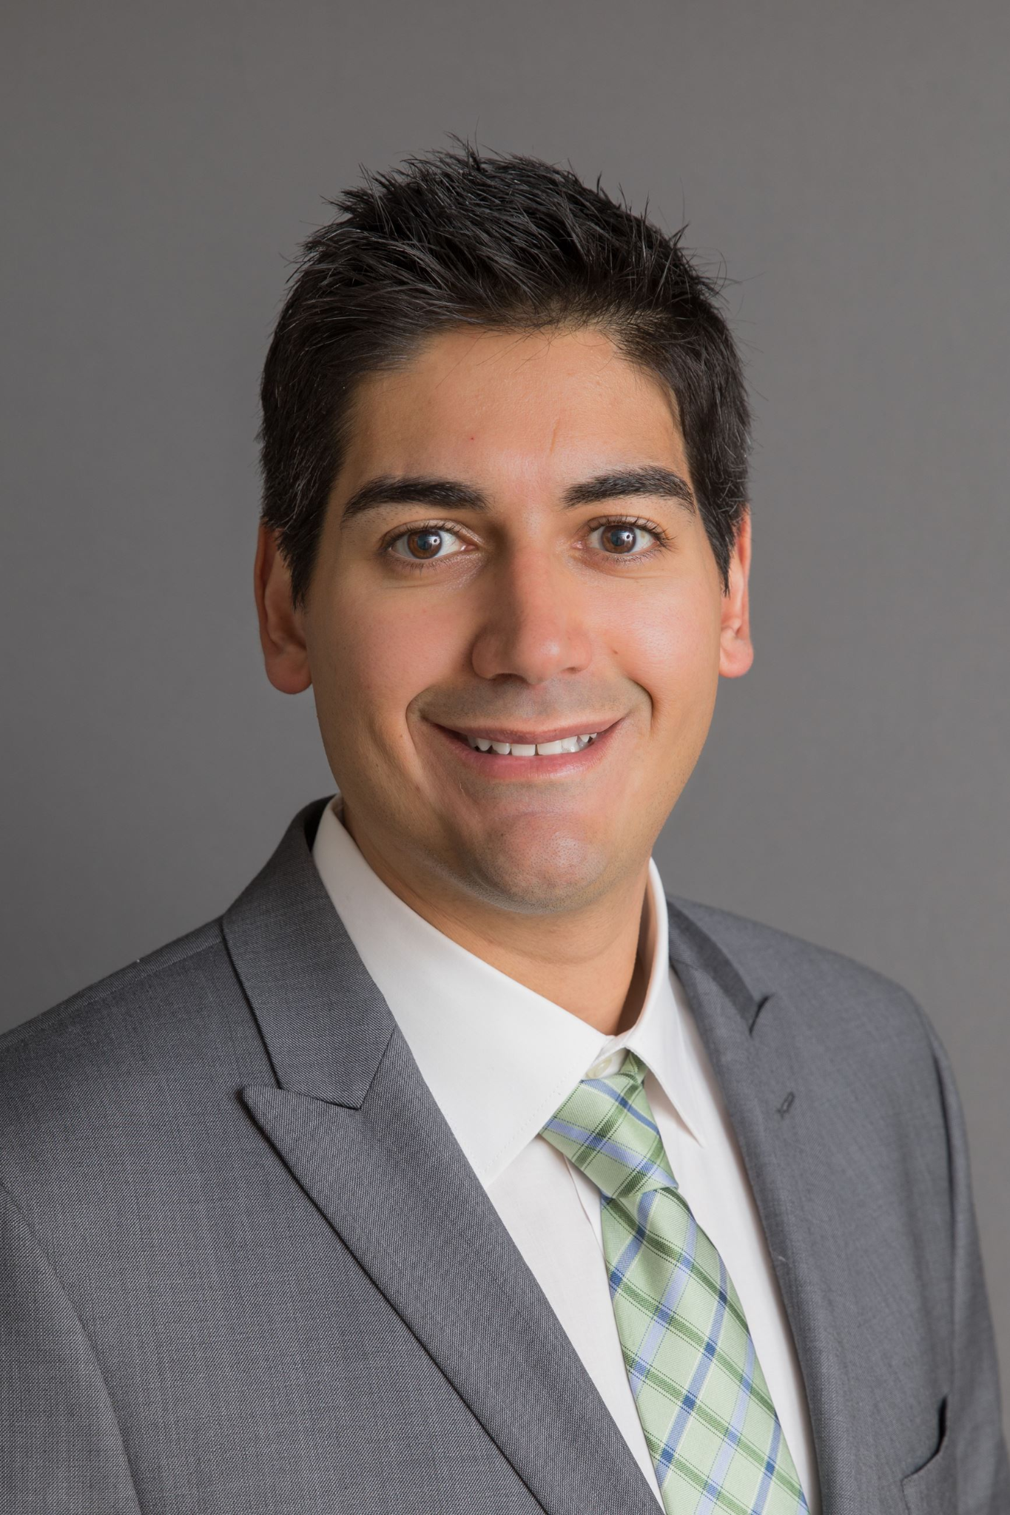
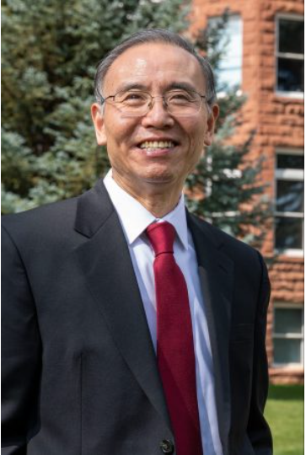
Clients
Mr. José R. Díaz Aquino, Program Director, CEIAS Career Development
Dr. Andy Wang, Dean and Professor
College of Engineering, Informatics, and Applied Sciences
José R. Díaz Aquino
Dr. Andy Wang
Notes:
hook

Slide 3
Workflow
Dean - head of a school or administration division in a university
Career Development Director - Directs and manages the university’s career services
Chairman of the Board - aids in defining the board’s responsibilities and setting the strategic direction for the institution
Faculty - professors and advisors
Goal: By 2026, all students should have external learning experiences (work in something related to their major outside of the classroom.
Dean
Career Development Director
Chairman
Students
Faculty
Notes:
talk about place of business (workflow)
talk about clients and involvement in the business
talk about goals as a business
maybe talk about the client's goal
Goal: By 2026 all students have external learning ( working on something related to major outside curriculum w/ examples)

Slide 4
Problem
Disconnect between the students and the clients
Timing of data collection
Lack of information on students career success outside of the classroom
No data visualization
Dean
Career Development Director
Chairman
Students
Faculty
Notes:
go into what is broken
what is bad and inefficient?
bullet point what is unsatisfactory
Not enough students are gaining degree specific experience before graduation
There is a disconnect between available resources
Unable to track if students are achieving career success outside school
How many of you want a job within 6 months of graduation? How many of you would have / or would like to have some time of internship experience before graduation? The goal we are currently looking for is that each and every student has at least one type of professional experience before graduation, and that 90% of students in CS have a job within 6 months of graduation
.Imagine you had the opportunity to see exactly which companies are most likely to hire NAU students. Program to allow the Deans to see where we could be doing better to alert the chairman's -> faculty -> students.

Slide 5
Solution
DATA RETRIEVAL
SECURE LOGIN
DATA VISUALIZATION
ACCESSIBILITY
Web Application
Dean
Career Development Director
Data retrieval, normalization, and storing
A secure login verification with user groups
Chairman
Students
Faculty
Easily filtered data graphs for users to examine
Easy user interface to find information at glance
Notes:
connect to bullected problems
graphic connecting students back to dean
segue to details

Slide 6
Key User Requirements Reminder
01
02
User Authentication
Efficient Student
Data Fetcher
03
04
Searchable
Student Profiles
Data Visualization
Only provide access for authorized users
Efficiently grab and store fetch Student data from Linkedin, and imported CSVs
Unique profiles for each stored student that shows notable professional milestones
Visualize and filter stored student data for analysis

Slide 7
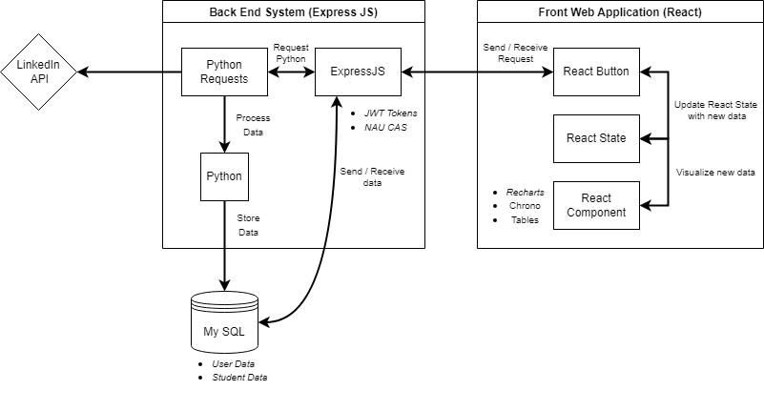
Architecture
Front Web Application
Data Visualization
Accessibility
Back End System
Data Retrieval
Secure Login

Slide 8
Prototype Review
User Login
Student Upload
Student Searching
Student Dashboard
Admin Settings

Slide 9
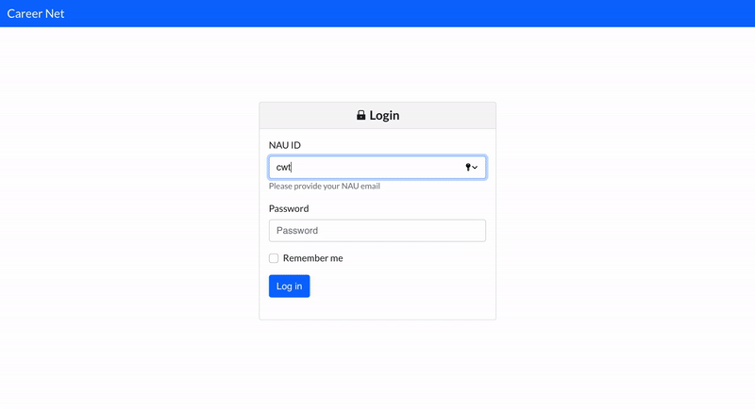
User Login
User Login
Login using provided user credentials
Passwords are hashed

Slide 10
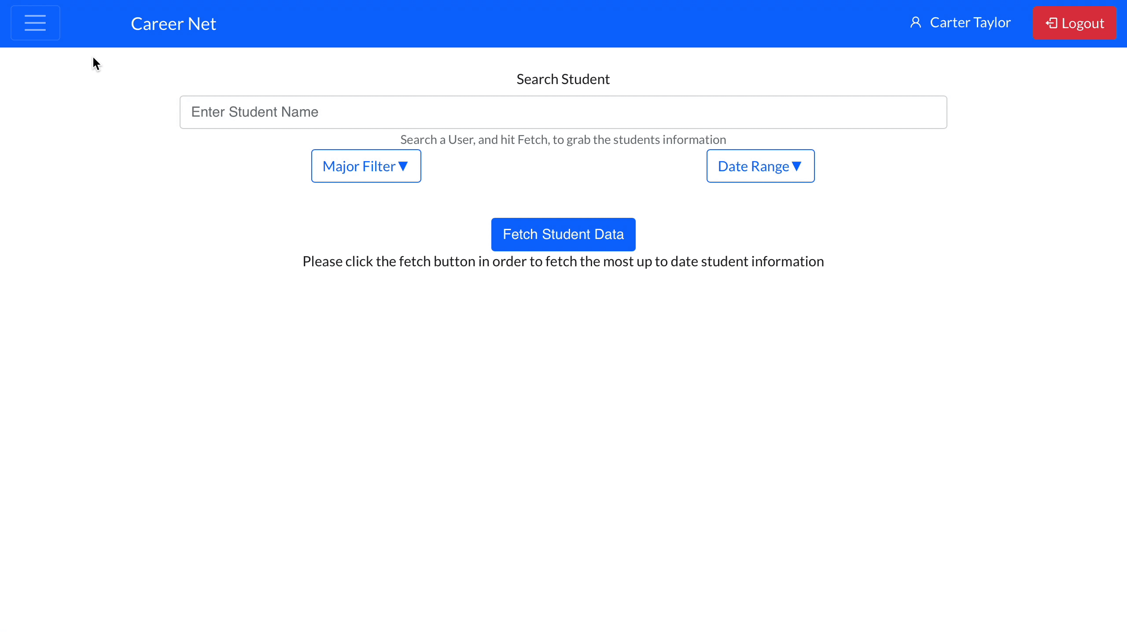
Student Upload
Student Dashboard
Upload new student info through CSV
Add new student milestones through CSV
Pull LinkedIn milestone from uploaded students

Slide 11
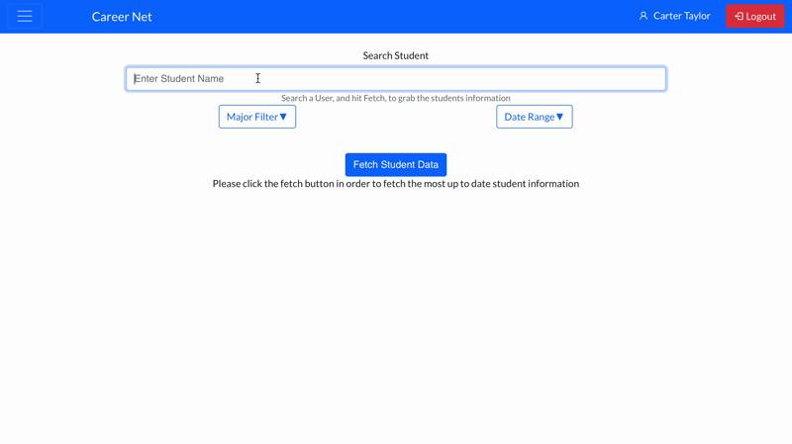
Student Searching
Student Milestones
Search by student name
Filter by major
View student timeline

Slide 12
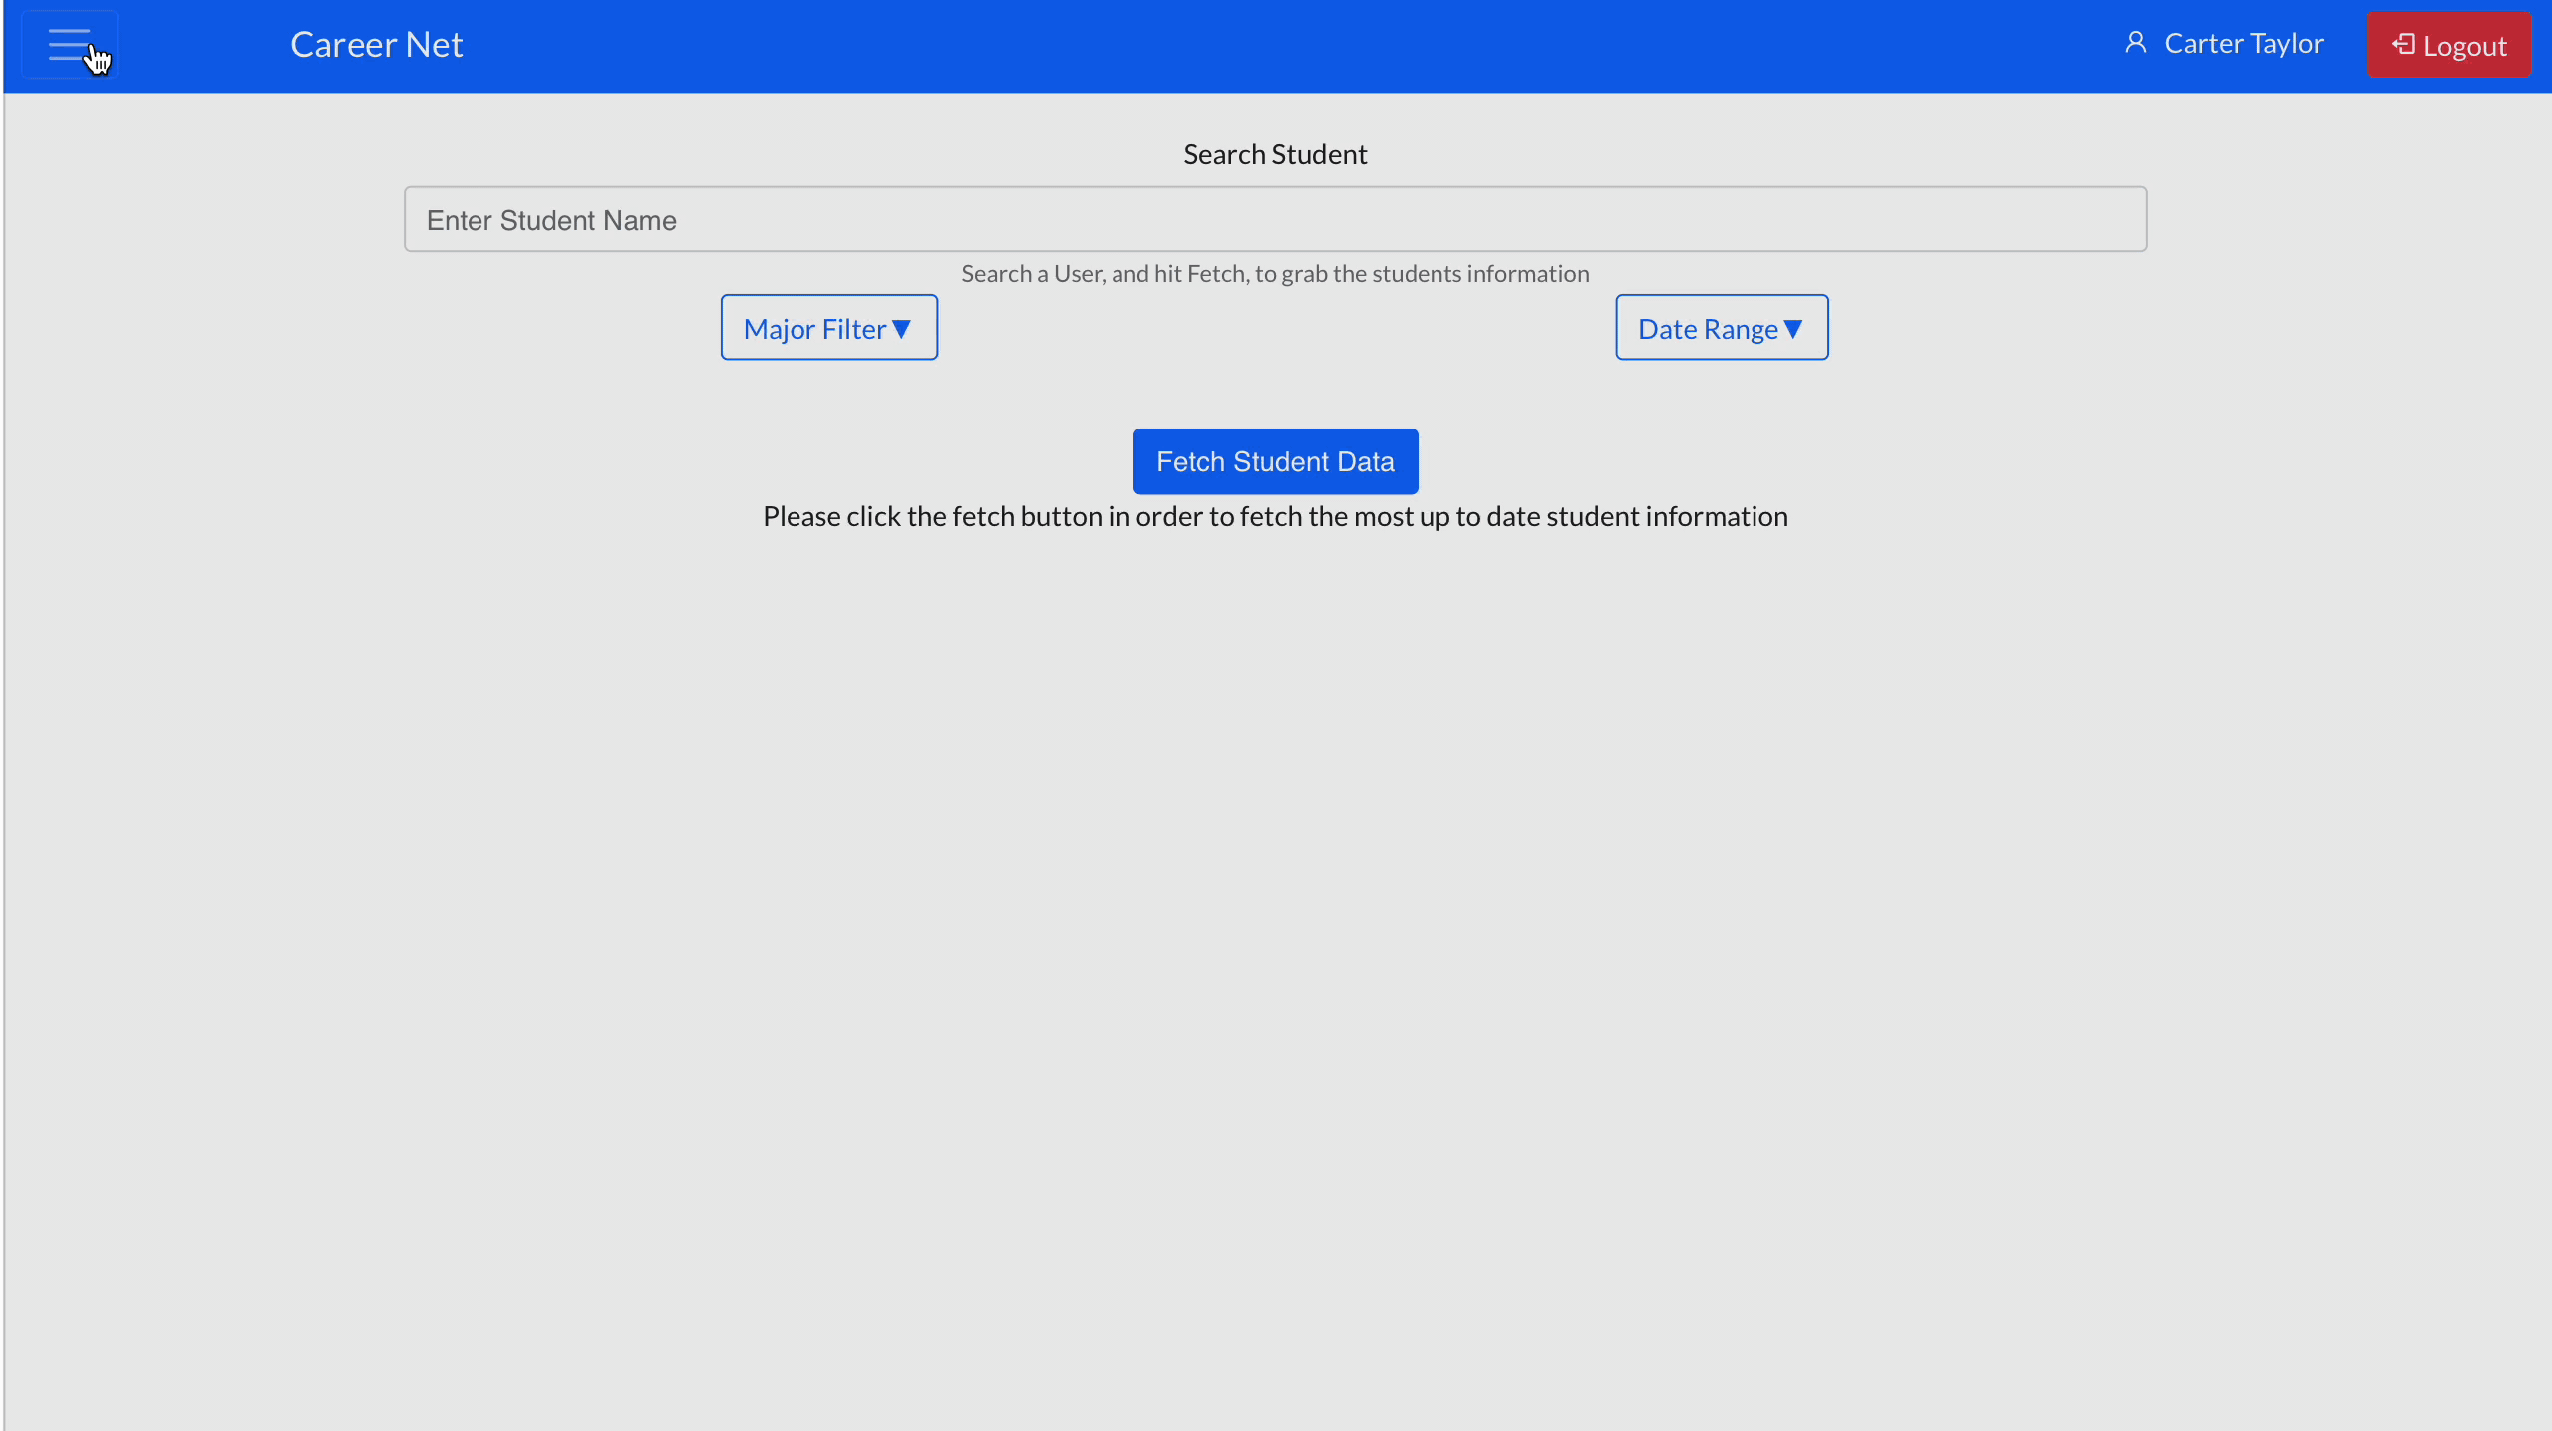
Student Dashboard
Student Dashboard
Choose different graph types
Create graphs based on student major
Filter data by different milestones (internship, full time job, etc…)

Slide 13
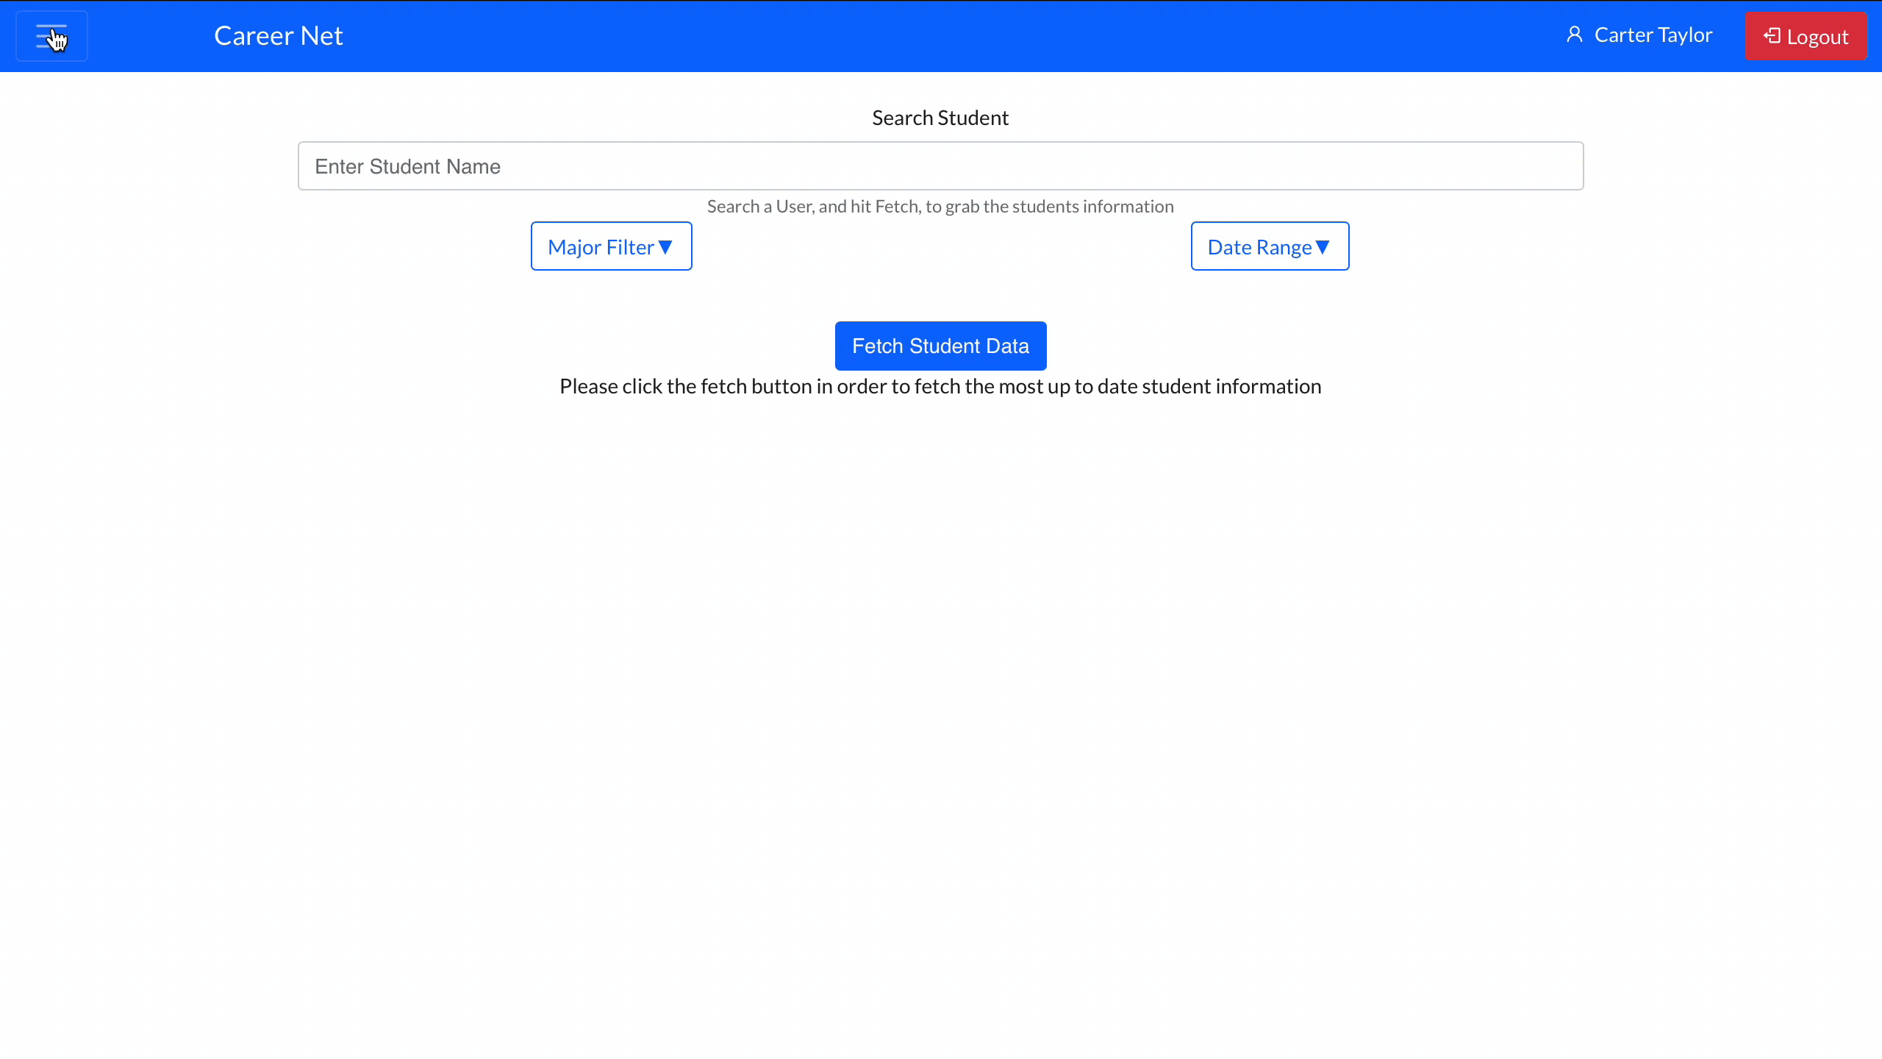
Admin Settings
Admin Settings
Add new users (faculty or admin)
Edit existing user permissions

Slide 14
Challenges
User Authentication
Data Visualization
Q

Slide 15
Solutions
Data Access
Performance Requirements
Back End Organization
Q
Host Server
Desktop Usability
Data Visualization
User Interface
Data Retrieval
User Authentication
Data Storage
Responsive User Interface
Quick Database Retrieval
Efficient Data Scraping

Slide 16
Unit
Testing
Integration Testing
Usability Testing
Individual functionality of:
Front-End
Back-End
Database
Combination of results for:
Front-End
Database
User interaction of:
Web Page Design
Element Quality
Page Modularity

Slide 17
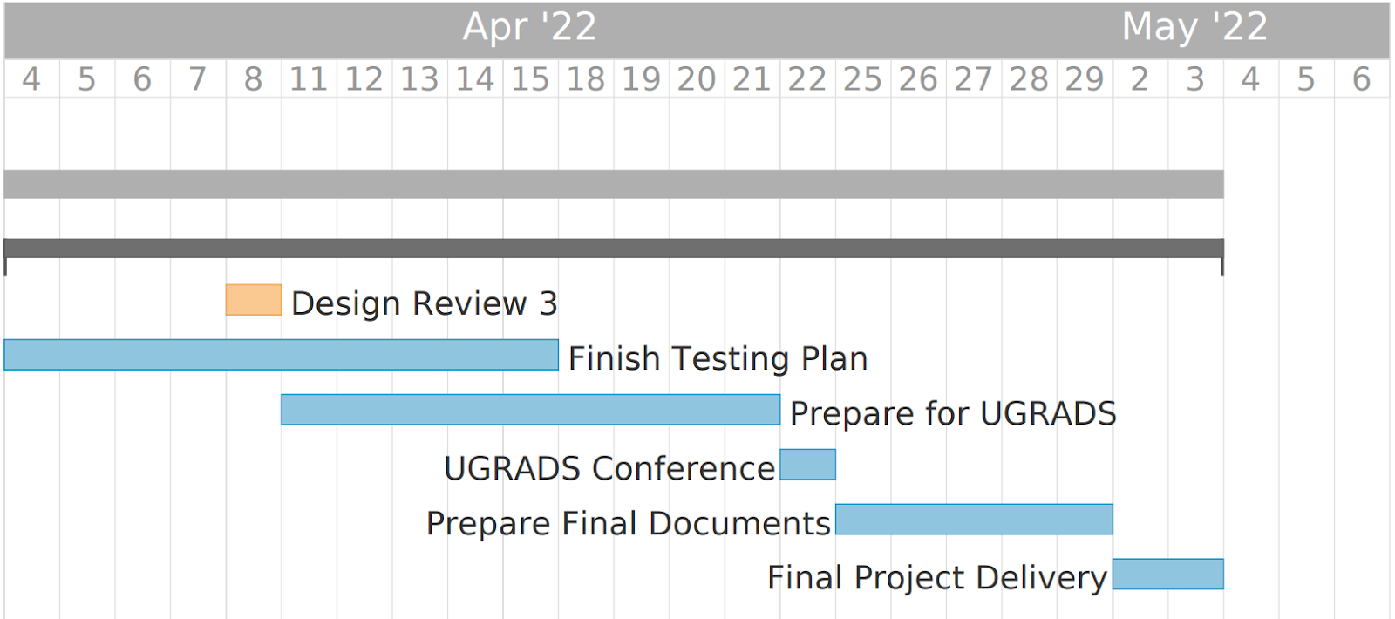
Schedule

Slide 18
Conclusion
01
Clients
02
Problem
03
Solution
Key Features
04
05
Product Impact
Dr. Andy Wang and Mr. José R. Díaz Aquino
Disconnect between student’s information and our clients
Web application that retrieves and organizes student information to be displayed to the client
Data Retrieval | Secure Login | Data Visualization | Accessibility
Implement actionable plans based on tracked student success

Slide 19
THANKS!

