Slide 1

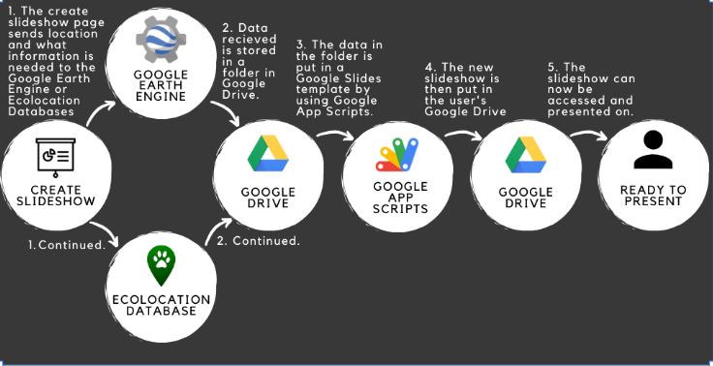





EnviroSlides: An Automated Environmental Presentation Creator
Samuel Prasse, Kaitlyn Grubb, Joshus Tenakhongva, Tyler Pehringer
Department of Computer Science, Northern Arizona University. Client: Dr. Chris Doughty and Andrew Abraham 86011
Motivation
We provide regionally specific environmental information in fun informative presentations that makes teachers work easier around the globe.
Education is a highly valued tool
Scholarly environmental data is nearly inaccessible
Earth-orbiting satellites and other technological advances have enabled scientists to see the big picture, collecting many different types of information about our planet and its climate on a global scale. This body of data, collected over many years, reveals the signals of a changing climate.
Solution Overview
Key Features
jjnj
Custom biodiversity and climate change slideshow presentations
Create presentations with locations and animals all over the world
Links and resources to motivate and encourage young people to combat climate change
Disease information and resources available on the website
Interactive games in presentations for young students
A browser based application
Automatically creates Google Slides presentations
Presentations on environmental information
Learning platform for K-12 students
Technologies
Architecture
Challenges
jjjjnj
Uploading website to AWS servers
  Had to update django framework
Incorrectly pulling info from Ecolocation database
  Adapted to changing format of the database
Database for animal photos was shutdown
  We developed an algorithm to pull the best quality photos of animals from the internet
Django
HTML5/ CSS
JavaScript
Python
VirtualBox
Google Drive API
Google Earth Engine API
Ecolocation Database
Testing
Unit Testing
  Testing data script input and output
  Testing website UI and interactables
  Testing server stability and functionality
Integration Testing
  Testing user input to script output
  Testing script output to slide generation input
Usability Testing
  Early moderated and in-person tests
  Usage of remote, unmoderated surveys
Outcome
Future Works
jjnj
Closes the gap between research and students
  Allows for learning about the environment to be easier for all kids
Adding more types of presentations and difficulties
  land use change, fire, precipitation
Adding more types of animals to our database
  avians, sea animals, insects
Gather in classroom feedback with each iteration
Notes:
Sam: Future Works, Key Features
Tyler: Architecture, Technologies, Challenges
Joshus: Testing, Motivation
Kaitlyn: Outcome, Solution overview

