Slide 1

Visualizing CO₂ Emissions
Clients: Prof. Kevin Gurney, Dr. Geoffrey Roest
Mentor: Scooter Nowak
Kiley Jacobs - Team Leader, Back-End Coder
Tung Nguyen - Recorder
Yisheng Wang - Front-End Coder
Zihang Shen - Front-End Coder

Slide 2
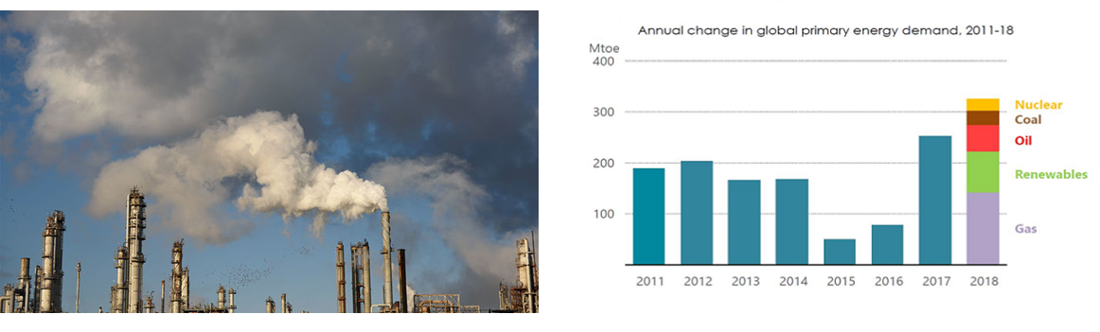
Introduction

Slide 3

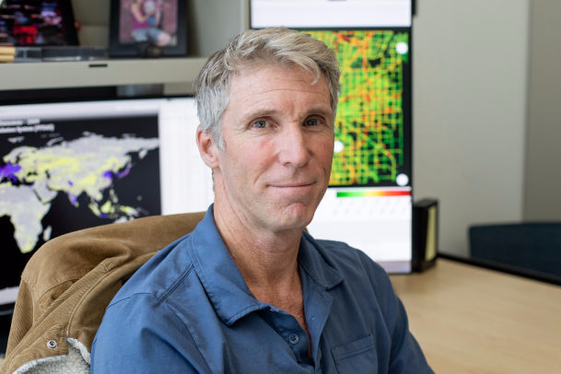

Our Clients
Professor Kevin Gurney
Researching in carbon cycle science
and climate science
Professor Kevin Gurney
Specializes in atmospheric science, ecology and public policy
25 years with UNCCFC
Doctor Geoffrey Roest
Postdoctoral Researcher

Slide 4
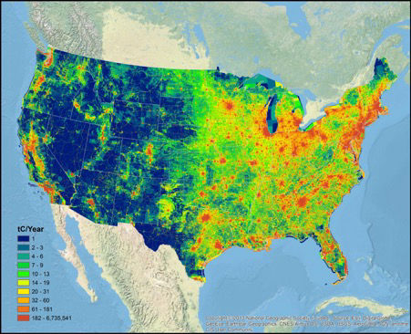
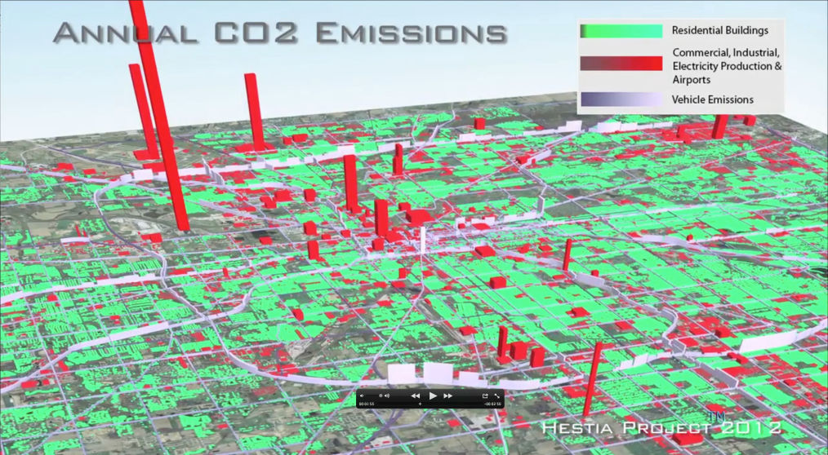
Our Clients’ Work

Slide 5
Problem Statement
Data are only available in technical formats
Hard to interpret
No user interaction

Slide 6
Solution Overview
A Web map application for CO2 emission in U.S.
  Time slider
  Zoom function
  Hide layers of information
  Search location
  Show the info. under the pointer
Notes:
· Zoom functions that allow users to focus on either the details of a particular region, or to gain a quick overview of a wider area
· Addition of text boxes to data points that show up when clicked to give a quick summary or description
· The ability to create layers of information that can be shown or hidden at the click of a button

Slide 7
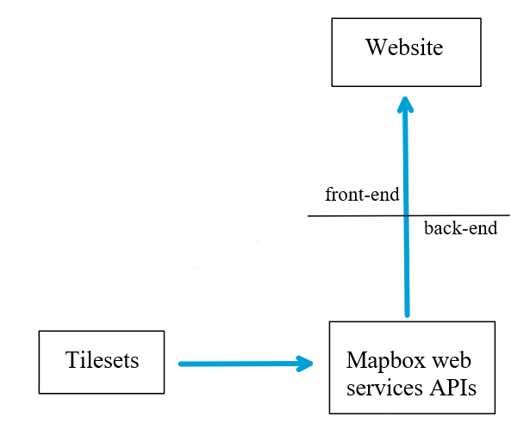
Solution Overview
Using Mapbox
  Access clients data directly
  Provide user interaction

Slide 8
Requirements Acquisition
Meet with clients
  discuss what they currently have
  what we can do with their data
  what they want most

Slide 9
User Level Requirements
View statistical information about a given section of map
Zoom in on areas
Change the time range of the shown emissions data
Change colors and transparency of map or map layers
View only certain kinds of emissions rather than all
Notes:
Kiley

Slide 10
Functional Requirements
Display CO2 Emissions data in the form of raster data
  Later use Vector data or even Hestia data
Able to change the data it is displaying
  Hopefully get this down to one hour intervals
Notes:
Kiley

Slide 11
Performance / Nonfunctional Requirements
With ideal internet the map should take ten seconds or less to load
The program should remove map data from memory once the data being shown changes
  This is vital when showing hour to hour data

Slide 12
Environmental / Client Constraints
Must use client data currently in the form of GeoTIFF data
  Can be possibly converted to other data formats
Must be integrated into the client’s website

Slide 13
Challenges
Figure out how to get the data on Mapbox framework
Learn how to use our tools
Embed the map onto client’s website

Slide 14


Risk and Feasibility
MEMORY LEAK
OPTIMIZING PERFORMANCE FOR REMOTE ACCESS
Likelihood: 3/5
High severity
Remove unused layers and data frames
Likelihood: 4/5
Medium severity
Use simplified versions of layers at smaller scale

Slide 15

Risk and Feasibility
MAINTAINING FLEXIBILITY & INTEGRITY
Likelihood: 4/5
Low severity
Keep our code organized and simplified

Slide 16
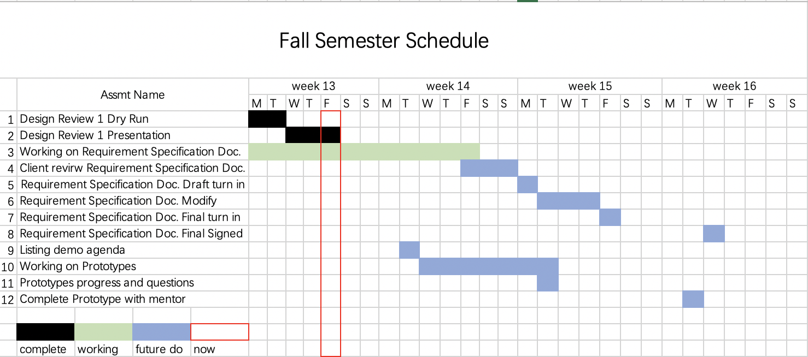
Schedule

Slide 17
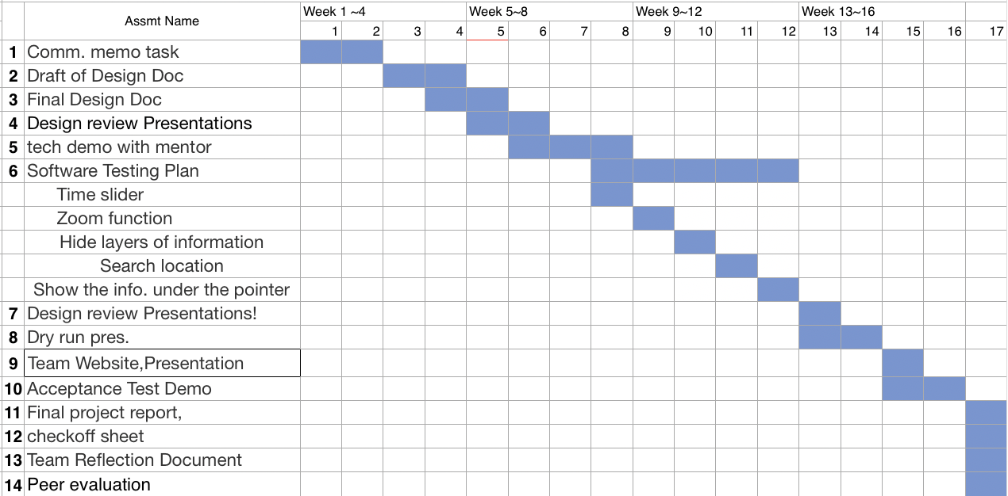
Schedule

Slide 18
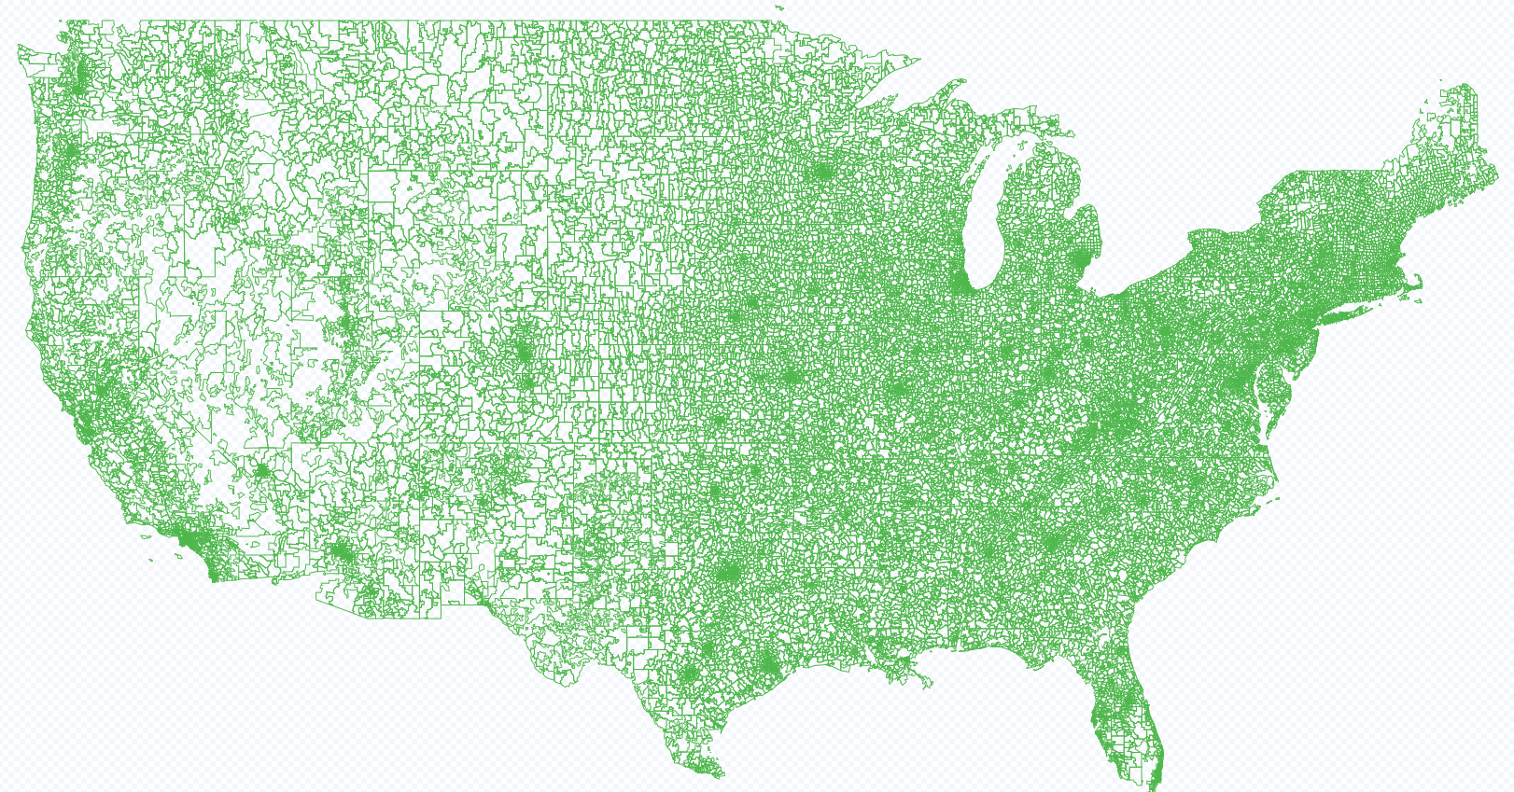
Conclusion
●Develop an interactive CO2 emission map of united states.
● Users will be able to interpret the map easily
●Mapbox is our solution to the project.
●Working on requirements doc and demo
Notes:
talk about issues clients are having, review solution, upcoming work

Slide 19
Questions?

