Slide 1

Mars 2020 Rover Dust Analysis for Drill
Team Hindsight

Slide 2
Introduction
Hunter Rainen - Team Lead, Documents/Research
Alexanderia Nelson - Release Manager, Documents/Research
Adam Paquette - Architect , Coder
Charles Beck - Recorder, Coder
Client: Iona Brockie NASA\JPL - Caltech
Faculty: Dr. Doerry
Mentor: Austin Sanders
Notes:
Time: < 1 minute
The usual. Begin by introducing yourselves briefly: Go through each team member’s name and role(s) on the project, as well as your team name, client, faculty mentor.

Slide 3

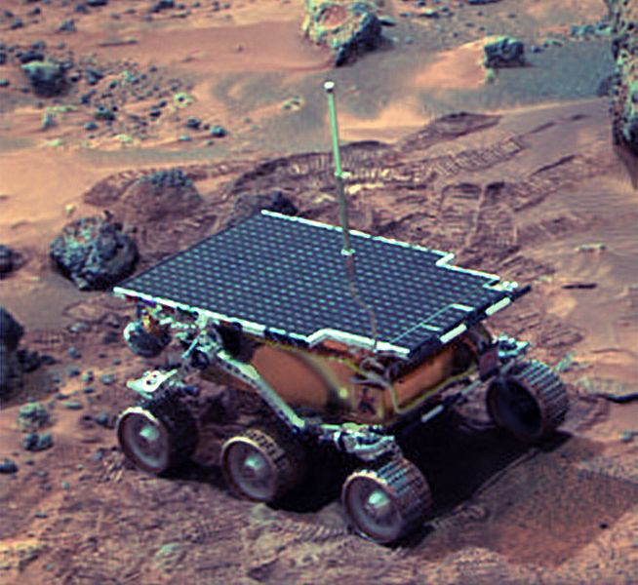
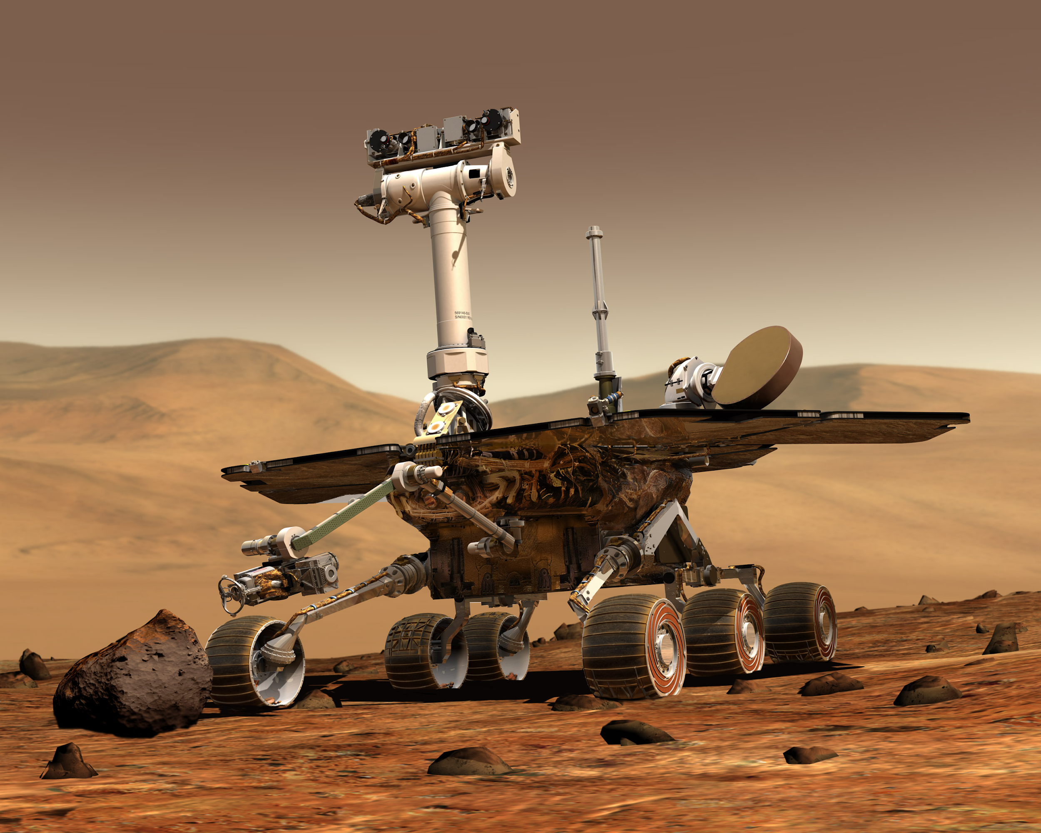
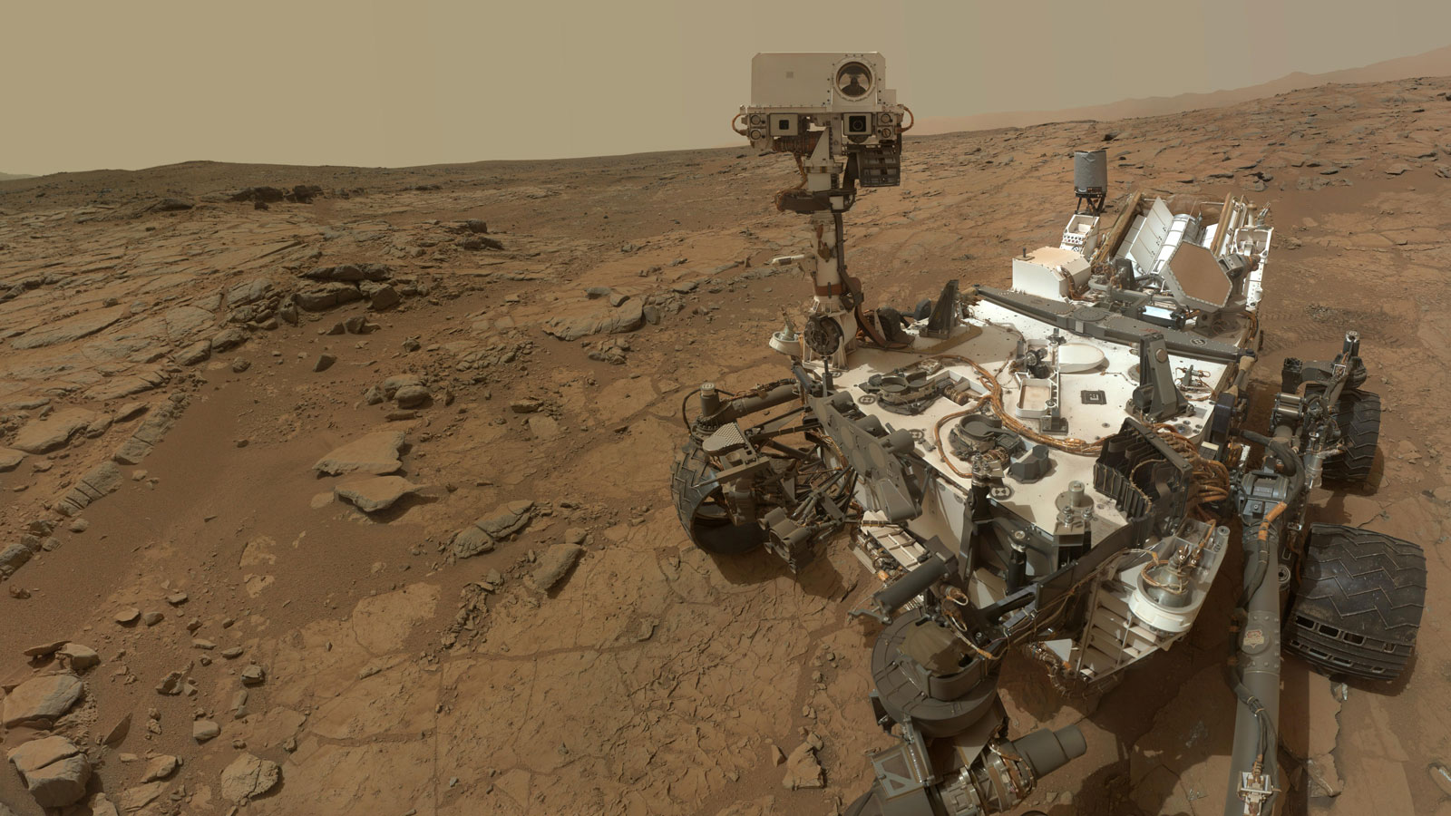
JPL’s Mission to Understand Mars
JPL is a federally funded NASA research and development center whose primary role is to construct and operate planetary robotic spacecraft. Mars is a good place to start looking for answers for a few reasons. JPL has sent many missions to Mars with the goal of looking for evidence that Mars once had the conditions necessary to support life.
Figure 1.0. Pathfinder
Figure 1.1. Spirit and Opportunity
Figure 1.2. Curiosity
Notes:
Time: 2-3 minutes, depending on domain complexity
Begin by talking about the overall business area that your client is in: introduce the area, explain briefly how it works, and try to give some motivating info on how big/active/important that sector is, e.g., how many people work in the area, how many people does it affect, how many use products like this, how much money is in it… anything of that sort that makes it clear that it’s avital problem. If it’s a complex area, graphics that help you explain processes, entites or process flows relevant to understanding how business in this sector works can help support you. THEN introduce your sponsor and the organization they’re attached to, and say how they and their organization contribute within the larger picture of the sector you intro’d. What do they produce, how does it fit into that larger sector, and what is the volume/importance/user base of their part? What is the process by which your client produces whatever data/product that they are producing?
Now are you ready to go on to describe the problem: what’s broken, why you were hired. This should be easy if you’ve already described the workflow/dynamics of how your client’s production/business process works: you then just have to explain what’s bad/inefficient about it. Describe the problem in overall terms briefly, then get down to bulleting out a few specific things that are not satisfactory. By the end of this, your audience should be really clear on what needs fixing.

Slide 4
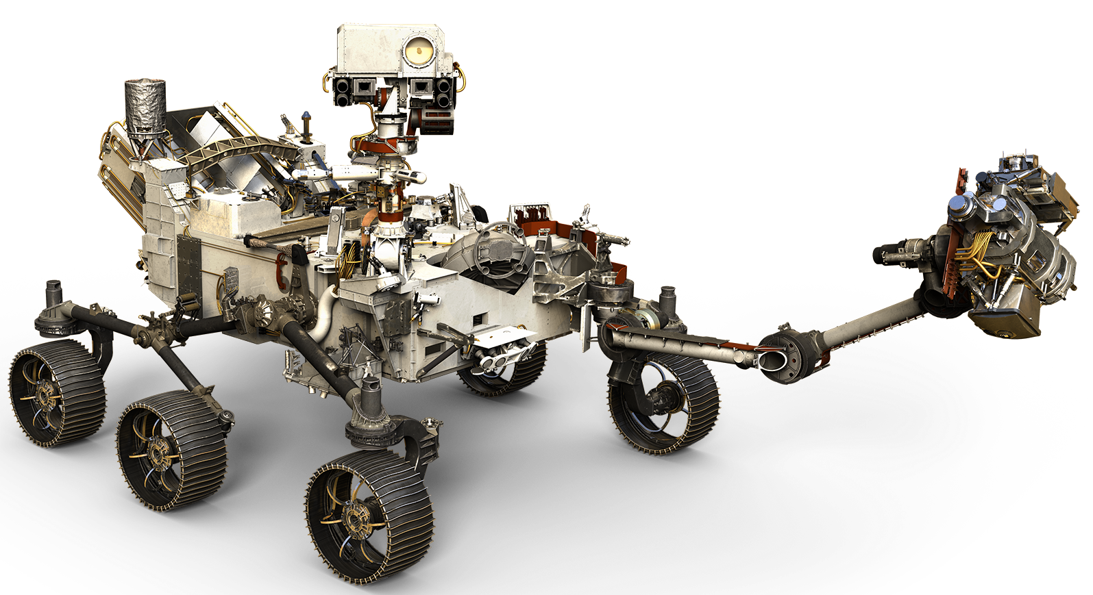
Mars 2020 (M2020)
The primary goal of JPL’s latest rover, M2020 will be to look for evidence of past life on Mars by analyzing and collecting samples of the Martian surface which will then be picked up, and returned to Earth by a future mission.
Figure 2.0. Mars 2020

Slide 5
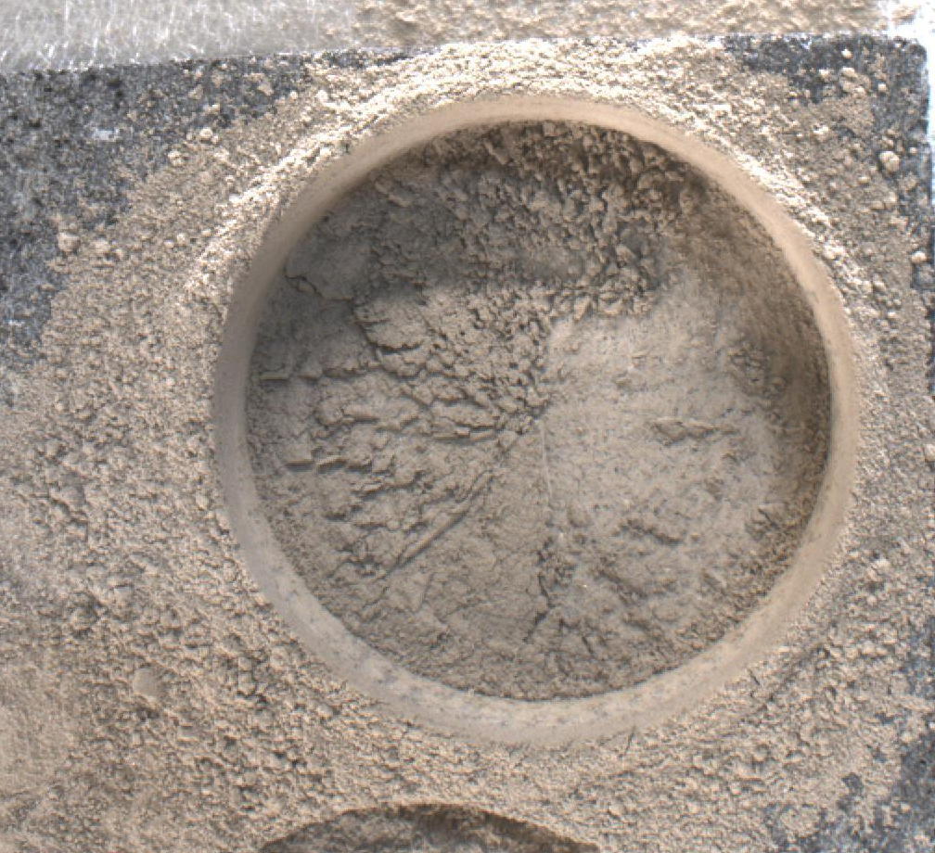
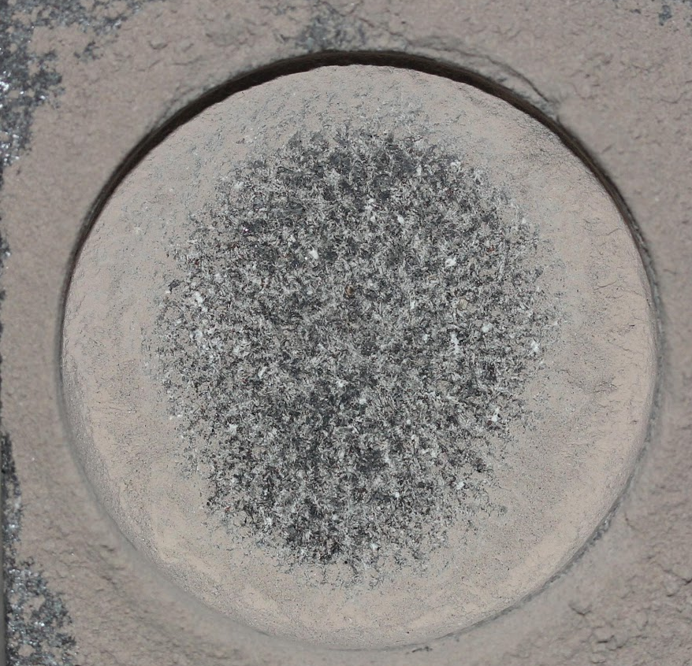
Challenge facing JPL
When the rover drills it creates dust that obscures the hole. JPL’s solution is to use compressed gas to blow dust out of the hole.
Figure 3.0. Before dust removal
Figure 3.1. After dust removal

Slide 6
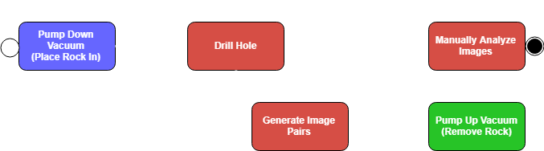

Why JPL’s testing method is a problem:
Slow
Inconsistent
Figure 4.0. JPL Testing process

Slide 7
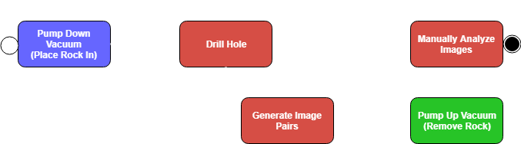
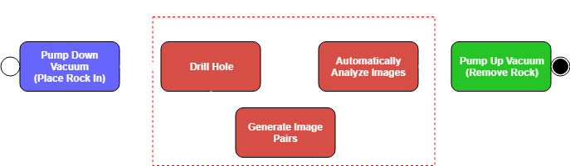
Solution Overview
Figure 5.0. Old process from JPL
Figure 5.1. New process from our solution

Slide 8
Our Solution
Our software includes the following to the process:
Faster :
No longer need to depressurize vacuum chamber
Image analysis speeds up to less than 5 minutes (from one hour) per image pair
More consistent:
For all images per rock type
Less prone to human error
Further improvements and flexibility
Can be parallelized
Algorithms added or changed

Slide 9
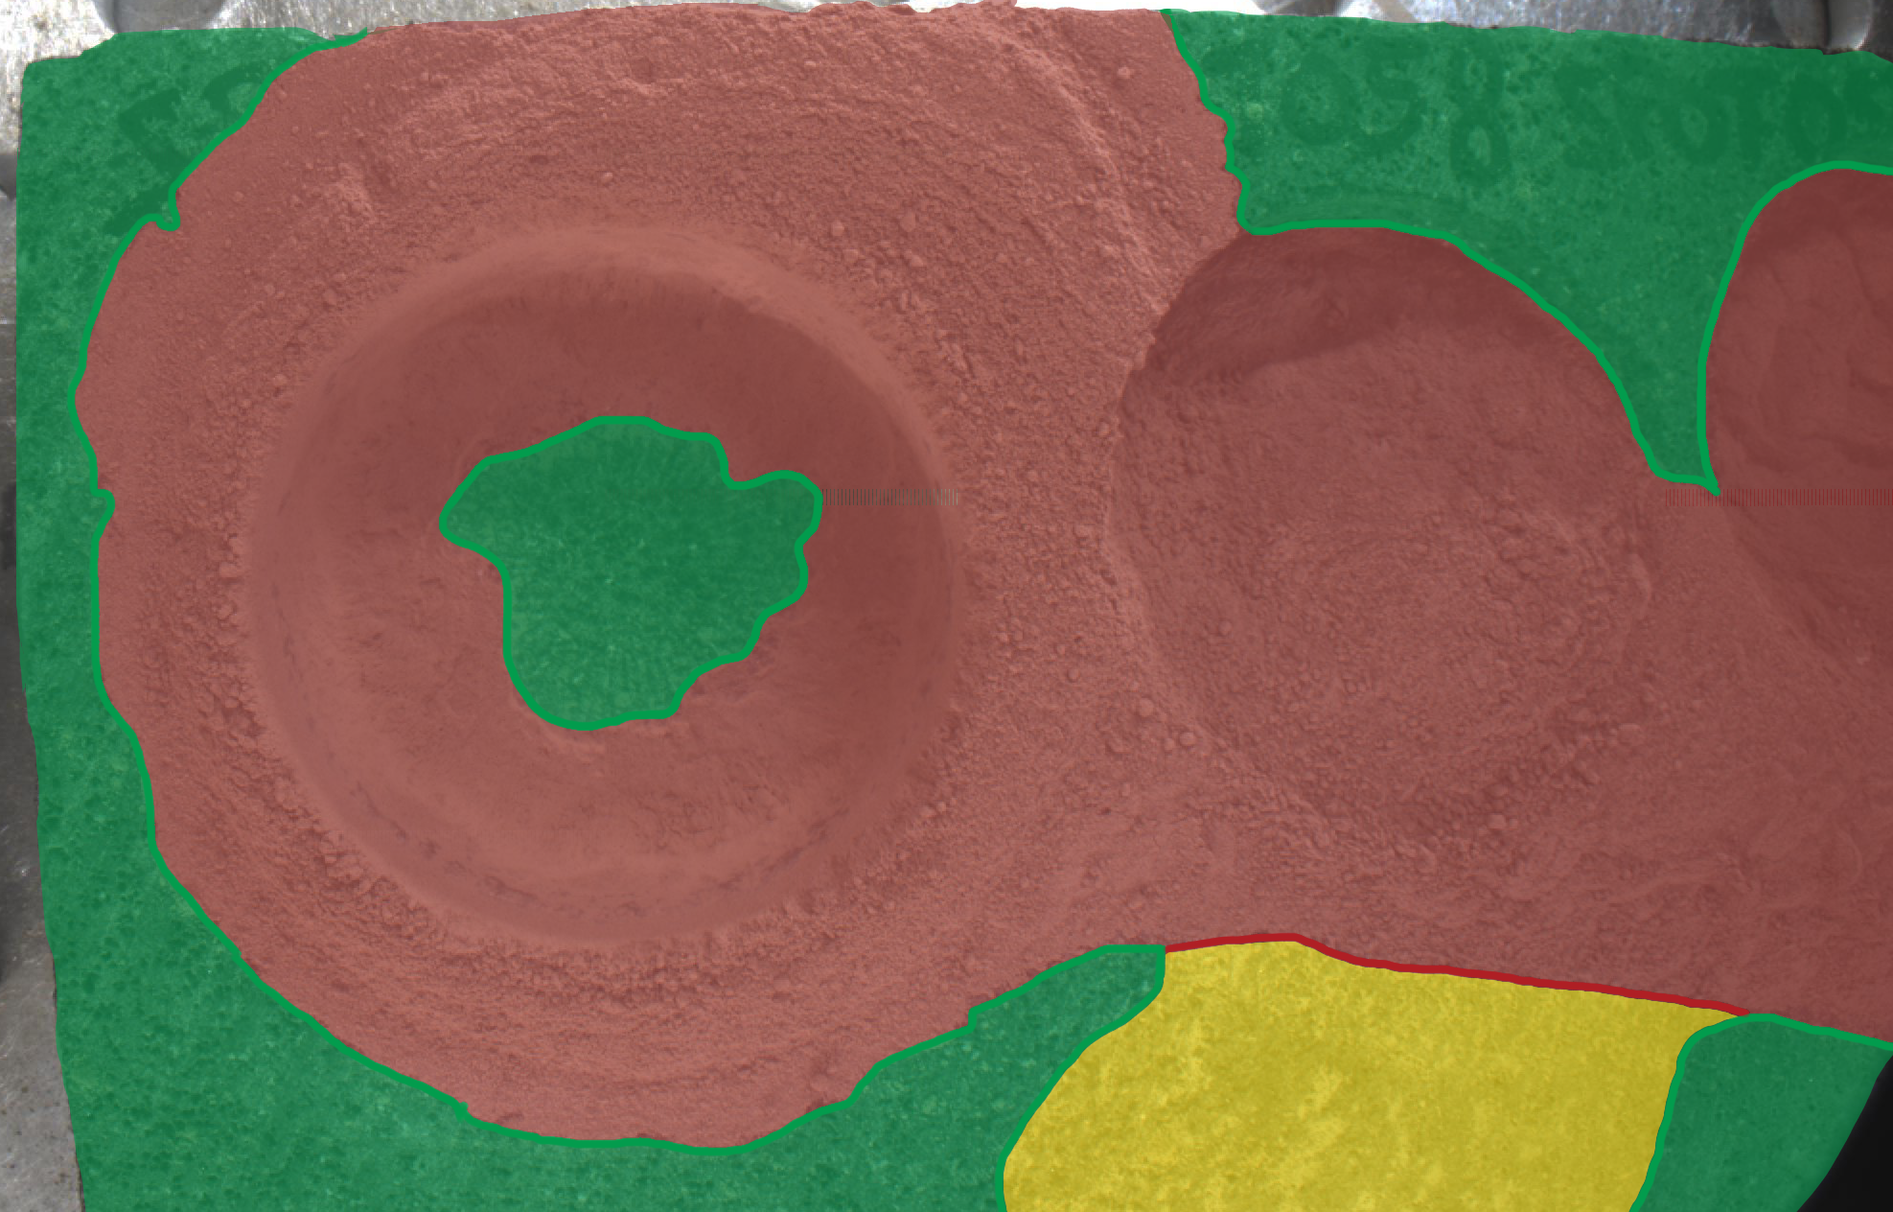
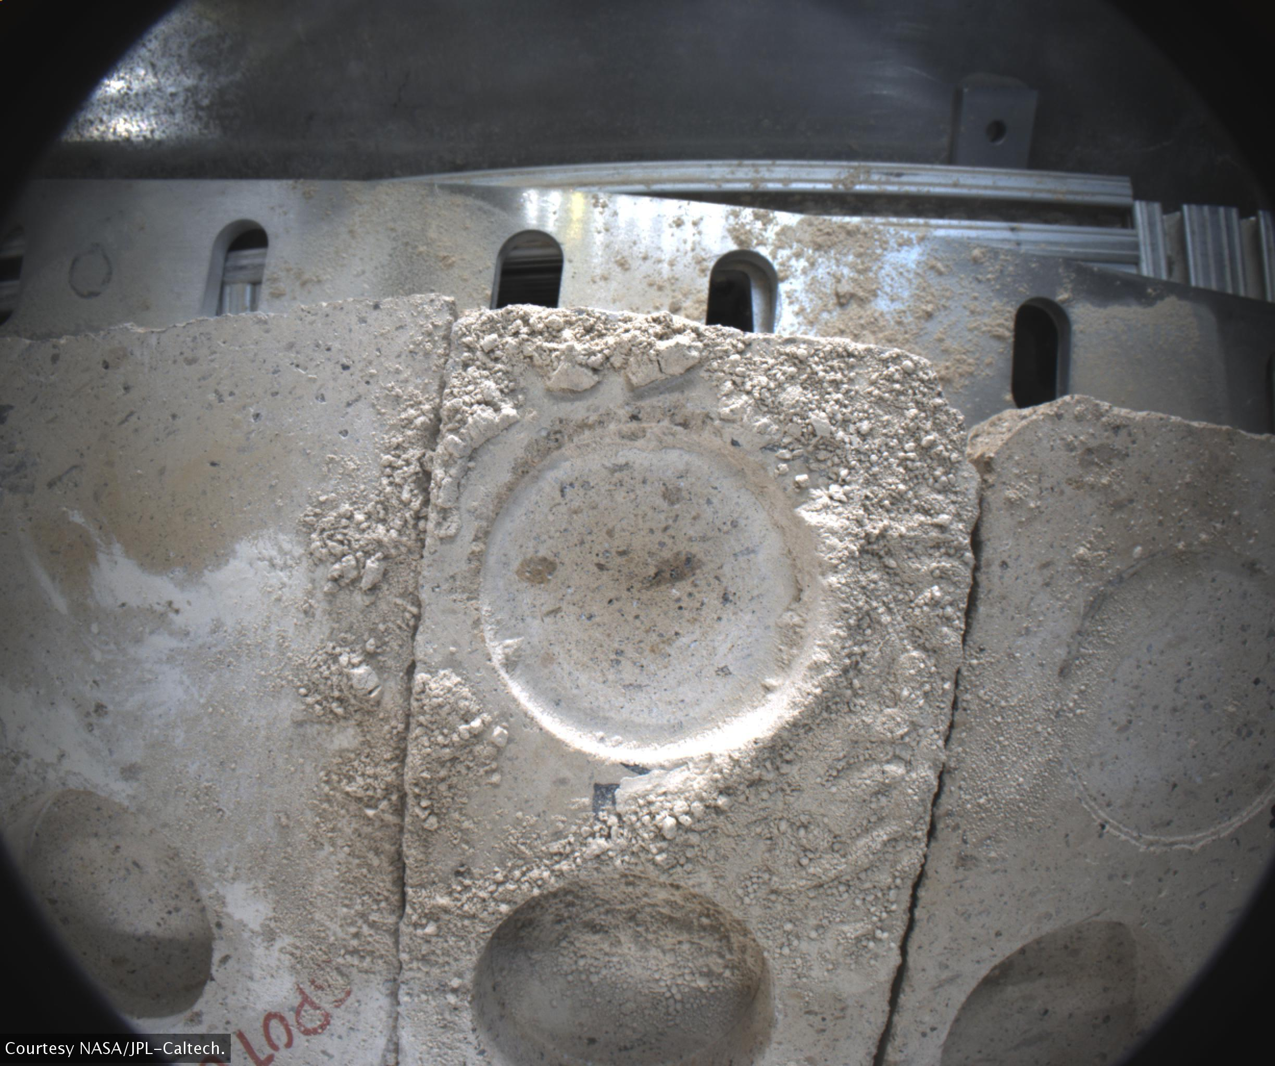
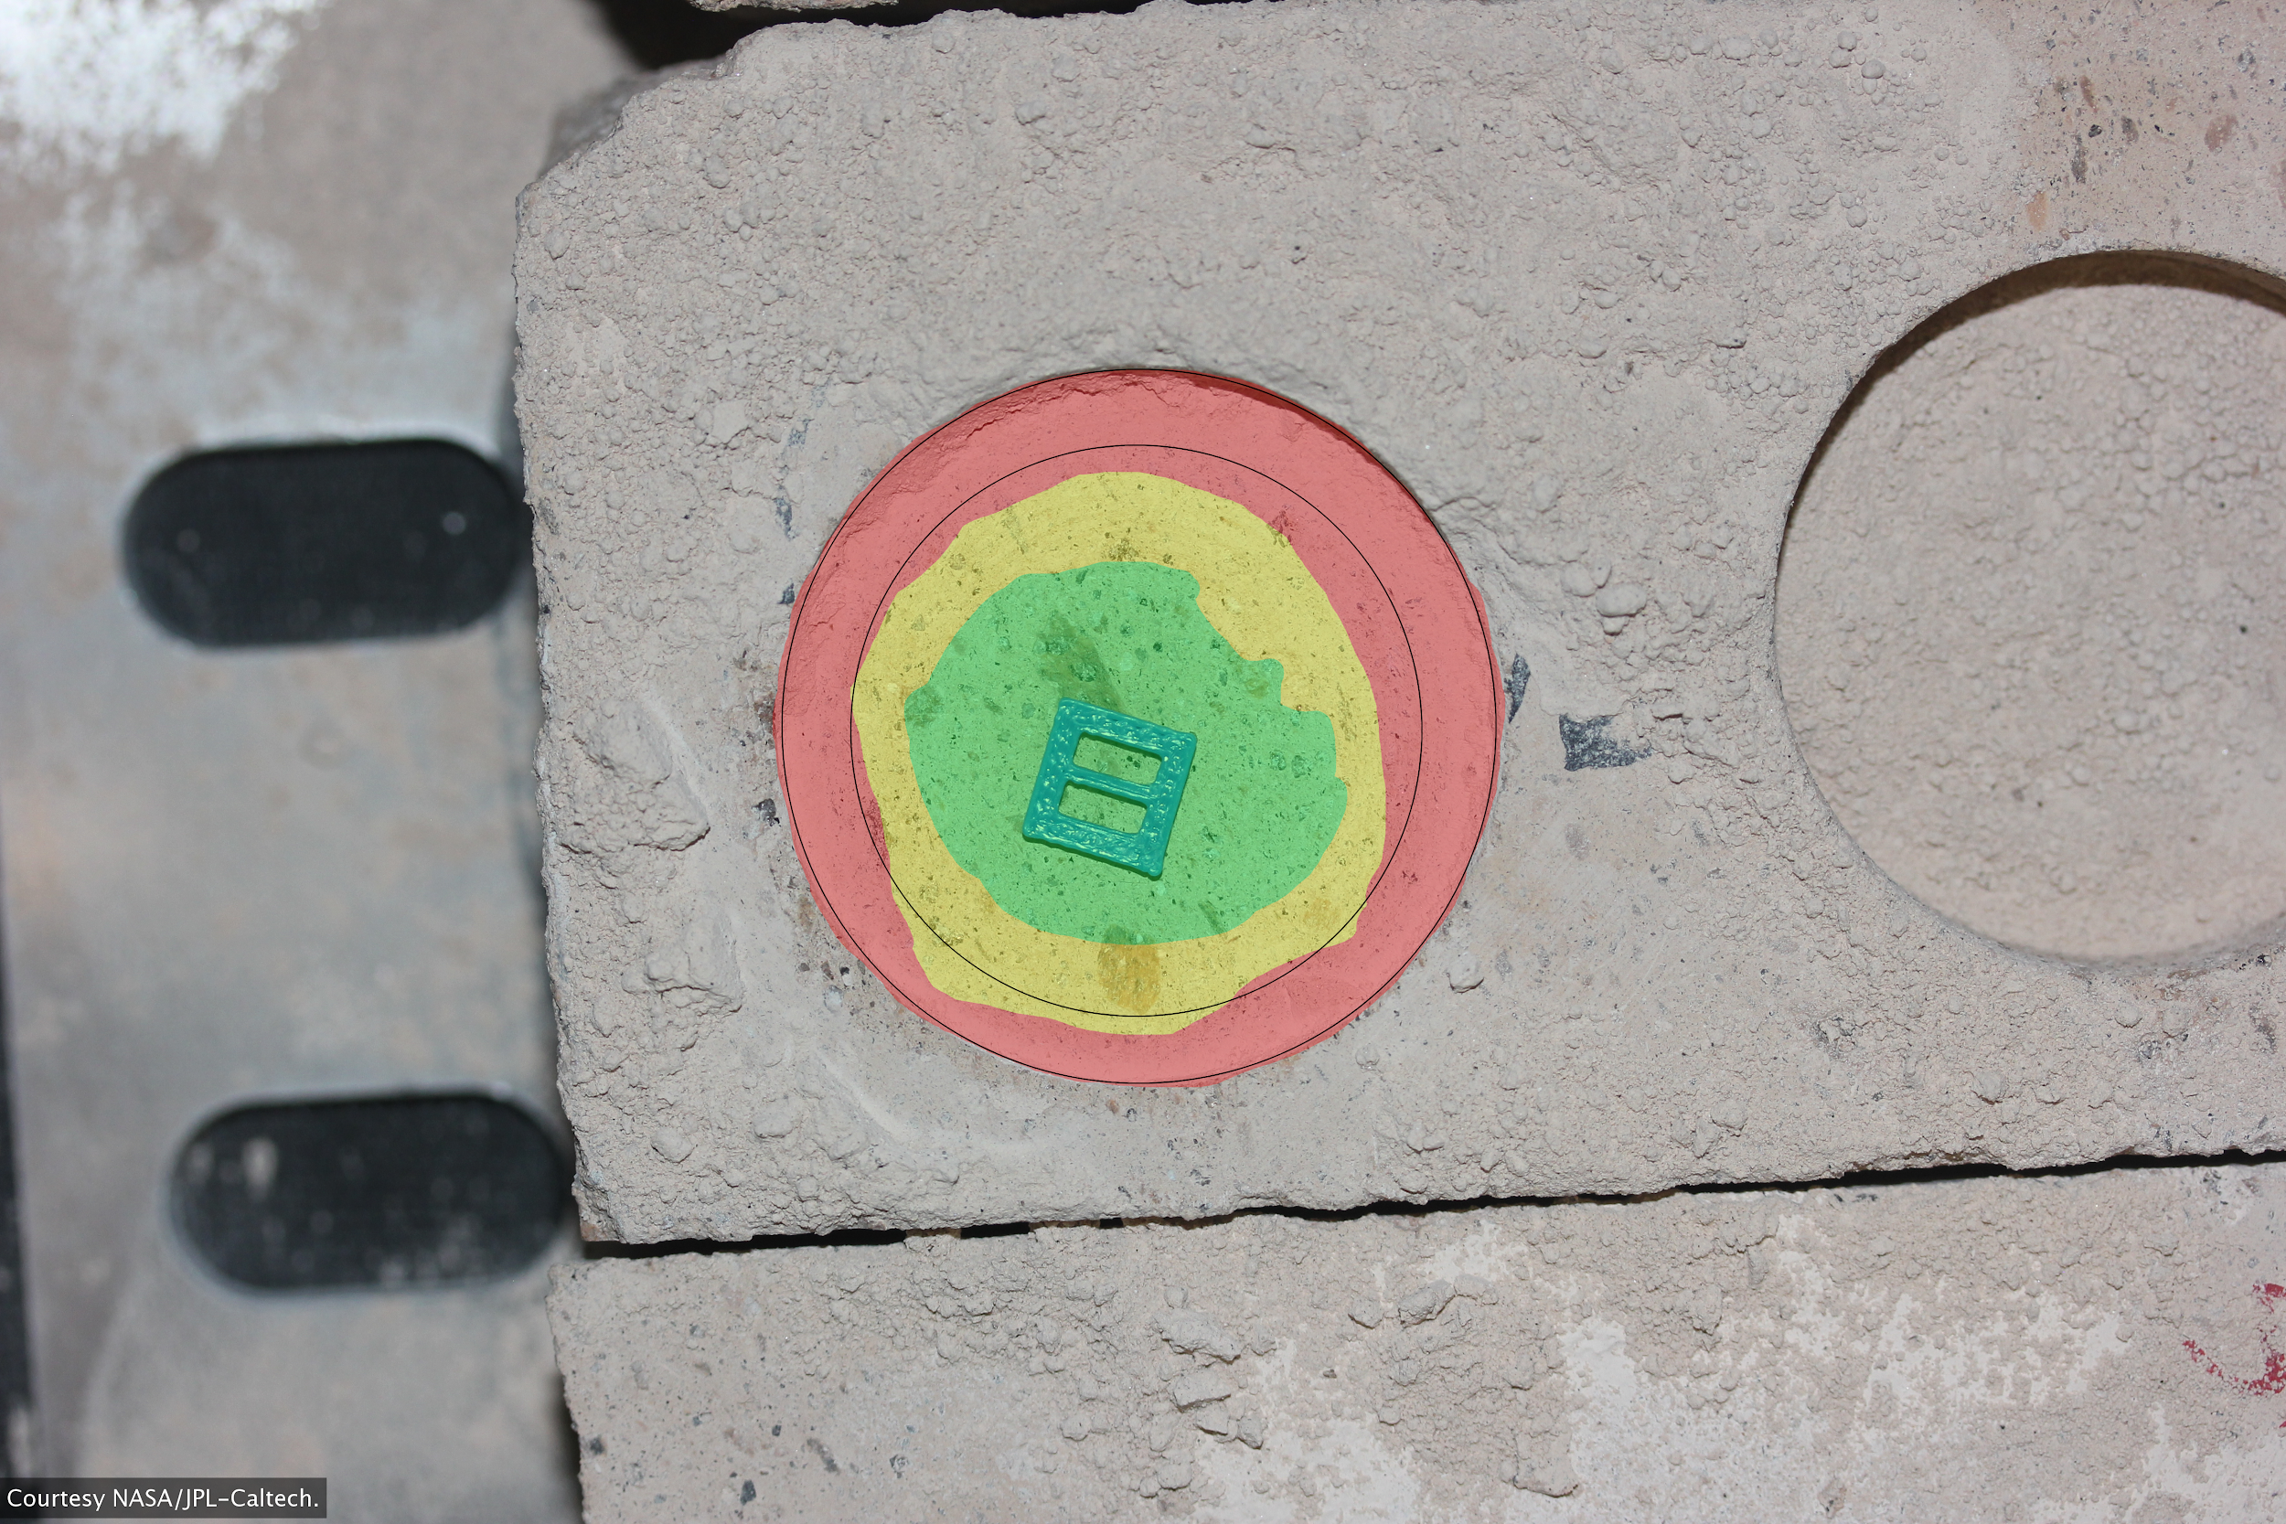
Requirements/Specs review
Functional
Handle batch of images
Analyze image(s) for dust
Mark areas of dust coverage
Be within 10% of JPL’s values
Non-Functional
Display percentage of areas cleared
Display after air blast and analyzed images in a GUI
Should take no longer than five minutes per image pair
AFTER
ANALYZED
Figure 6.0. Example abrasion analysis
Figure 6.1. Examples of after and JPL analyzed image
Notes:
Time: about 1 minute
Start with a brief review of your requirements: look at the requirements acquisition discussion you presented in the last DR, and condense that down to a slide of condensed key requirements, and walk through them to remind the audience of specific capabilities that you’d required for the product. Just helps to remind the audience what to look for in your implementation.

Slide 10
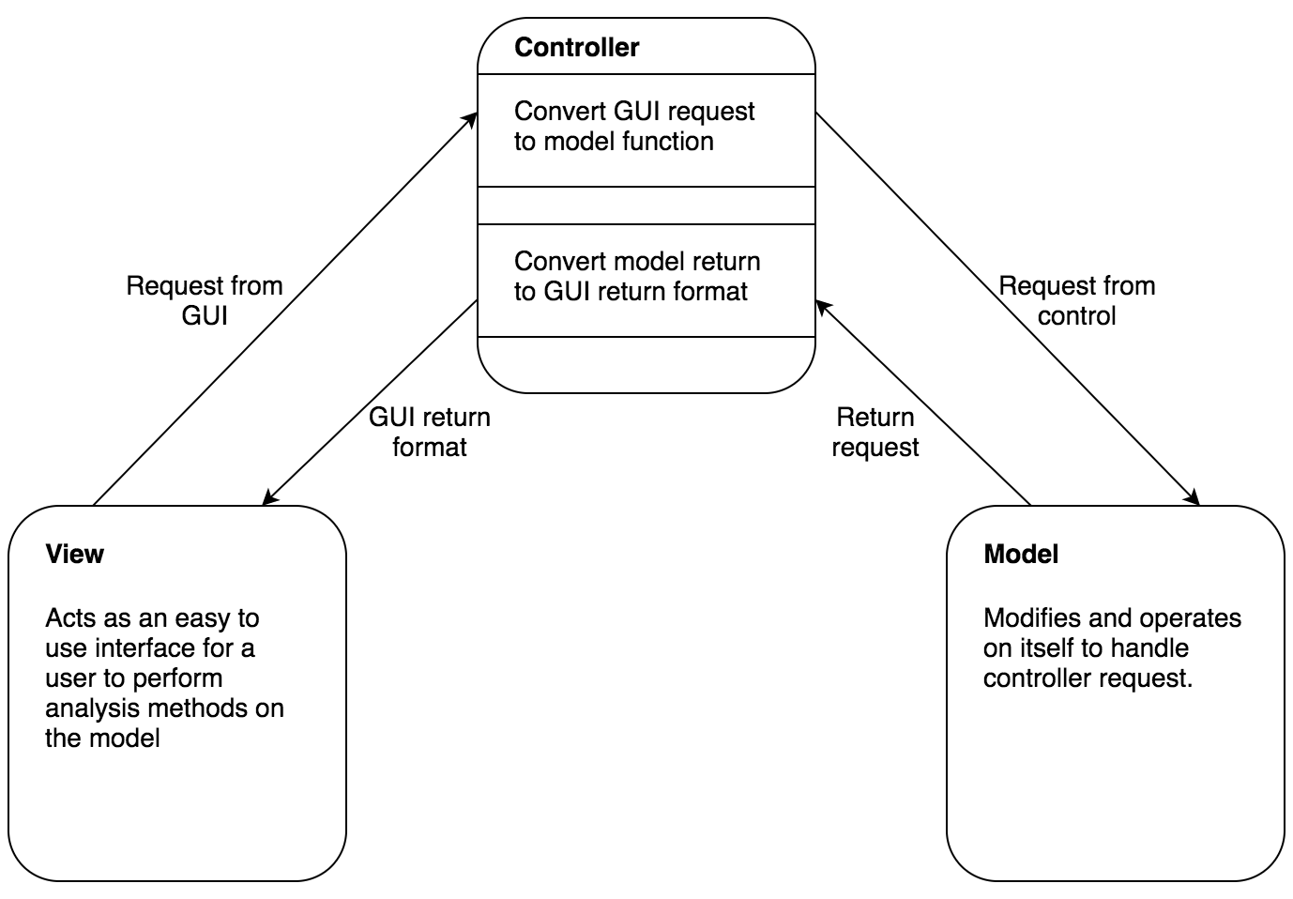
Architecture Overview
Model View Controller (MVC)
Graphical User Interface integration
Logic Separation
Parallel Development
Figure 7.0. High level architecture of the processing pipeline
Notes:
Time: about 1-2 minutes
Now go on to briefly review the logical architecture of your problem. Frameworks and tools used, overall models or design patterns expressed, and major functional elements in your implemented system. Graphics are highly useful here, as you just sketch out the main “high level functional elements” and walk through how they interact. So for a web app might have a front end (using some frameworks), a back end (using some langs/frameworks/DB), and a hosting solution. Walk through each of these pieces and talk about them briefly.

Slide 11
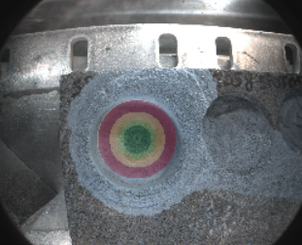
Implementation
Model:
Image
Communicates with Controller through return values
Uses third party libraries
Numpy
OpenCV
Figure 8.0. Before image data
Figure 8.1. After image data
Figure 8.2. Analyzed image data
Notes:
Time: 2 minutes
Now that everyone understands the overall approach and rough structure of your solution, it’s time to provide some implementation detail. This is just an update (and perhaps more evolved detail) on what you presented in introducing your software design plan in DR2. Give us a nice graphic showing what modules/classes/libraries that you wrote, briefly introducing what kinds of tasks each of them is responsible for. A nice way to bring this together is to follow up with a wlak-through of a common use case, tracing through how various steps/actions the user would be taking are passed between and handled by the various modules that you just introduced. Your goal is to give listeners a clear idea of how all of these individual modules that you’ve described work together to produce the overall external behavior required for the system in a clean and obvious way.

Slide 12
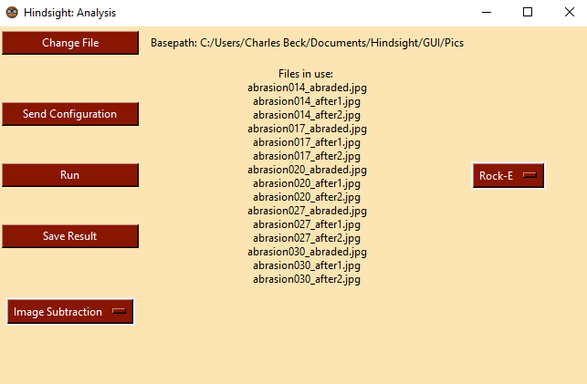

Implementation
View:
Window Class
Analysis Window Class
Communicates with Controller using Config Class
Uses tkinter
Figure 9.0. Window
Figure 9.1. Analysis Window
Notes:
Time: 2 minutes
Now that everyone understands the overall approach and rough structure of your solution, it’s time to provide some implementation detail. This is just an update (and perhaps more evolved detail) on what you presented in introducing your software design plan in DR2. Give us a nice graphic showing what modules/classes/libraries that you wrote, briefly introducing what kinds of tasks each of them is responsible for. A nice way to bring this together is to follow up with a wlak-through of a common use case, tracing through how various steps/actions the user would be taking are passed between and handled by the various modules that you just introduced. Your goal is to give listeners a clear idea of how all of these individual modules that you’ve described work together to produce the overall external behavior required for the system in a clean and obvious way.

Slide 13
Implementation
Controller:
Control Class
control_funcs
Sends returns from Model to View
Applys Config functions to Model
Uses Pandas Dataframe
Figure 10.0. Controller Pandas Dataframe
Notes:
Time: 2 minutes
Now that everyone understands the overall approach and rough structure of your solution, it’s time to provide some implementation detail. This is just an update (and perhaps more evolved detail) on what you presented in introducing your software design plan in DR2. Give us a nice graphic showing what modules/classes/libraries that you wrote, briefly introducing what kinds of tasks each of them is responsible for. A nice way to bring this together is to follow up with a wlak-through of a common use case, tracing through how various steps/actions the user would be taking are passed between and handled by the various modules that you just introduced. Your goal is to give listeners a clear idea of how all of these individual modules that you’ve described work together to produce the overall external behavior required for the system in a clean and obvious way.

Slide 14
Product Overview

Slide 15
Start

Slide 16
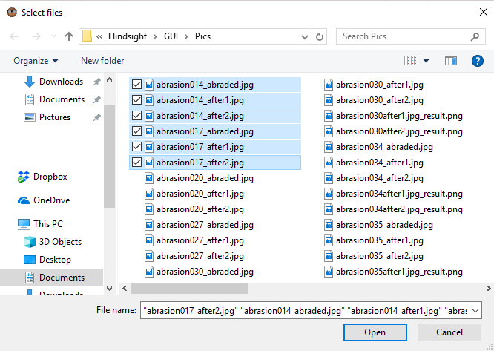
File Browser

Slide 17

Selected

Slide 18
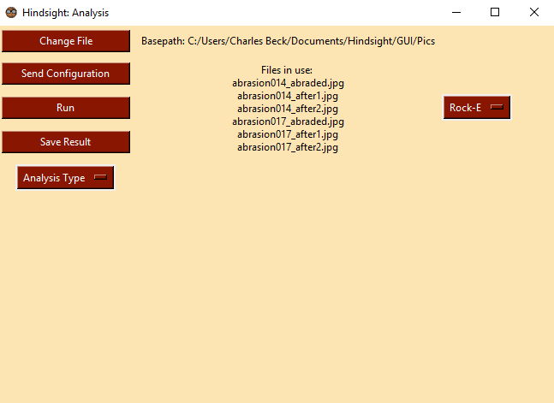
Analysis Window

Slide 19
Basepath - Filenames

Slide 20
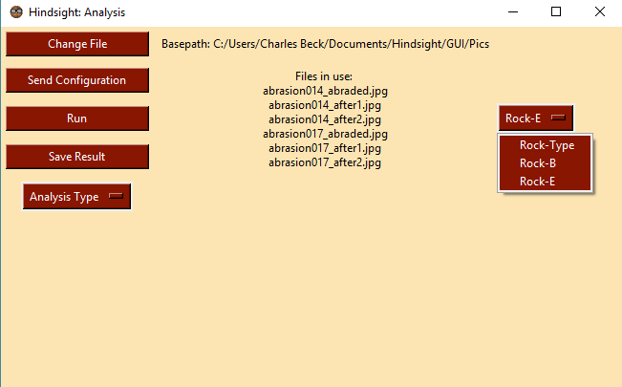
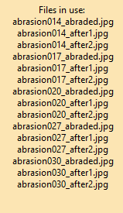
Analysis Window - Rock Type

Slide 21
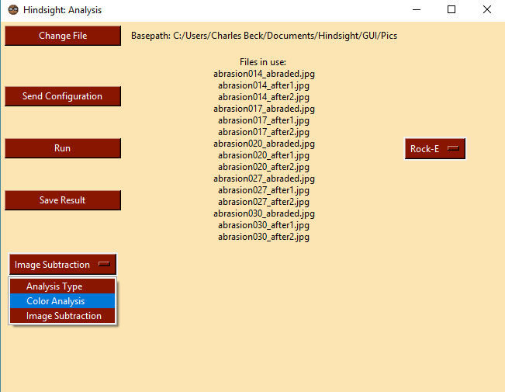
Select Image Analysis type

Slide 22
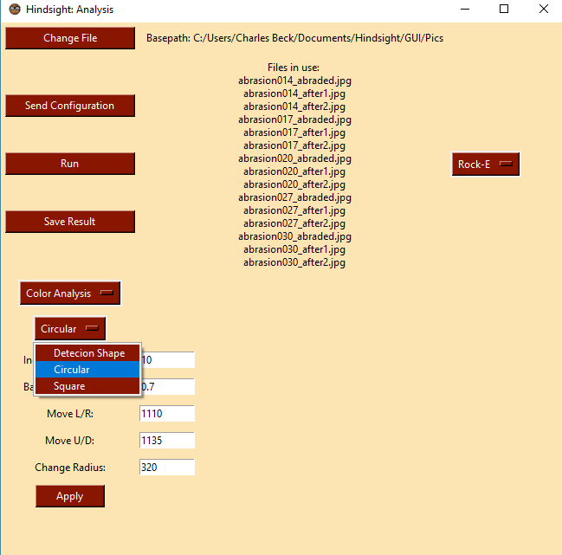
Select Detection shape

Slide 23
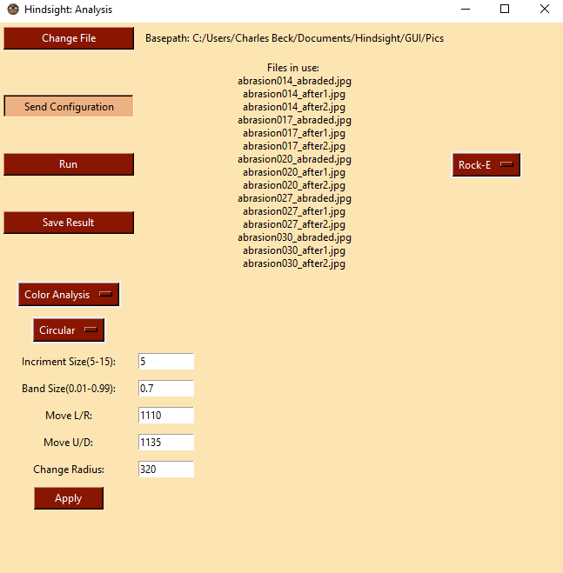
Send Configuration to
Control

Slide 24
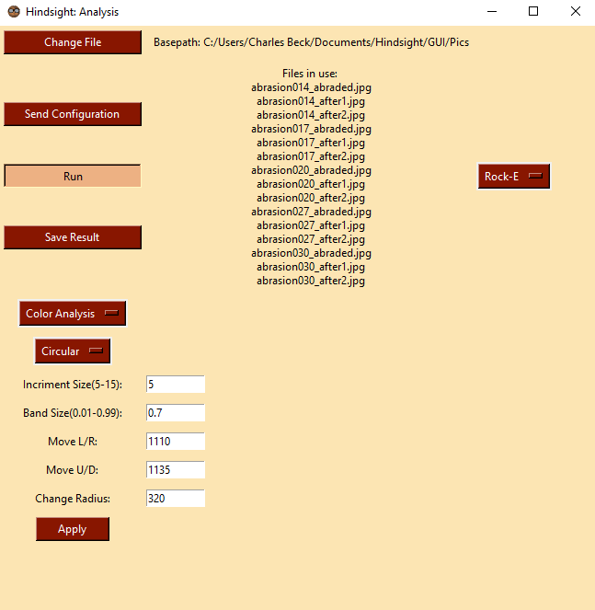
Running Analysis

Slide 25
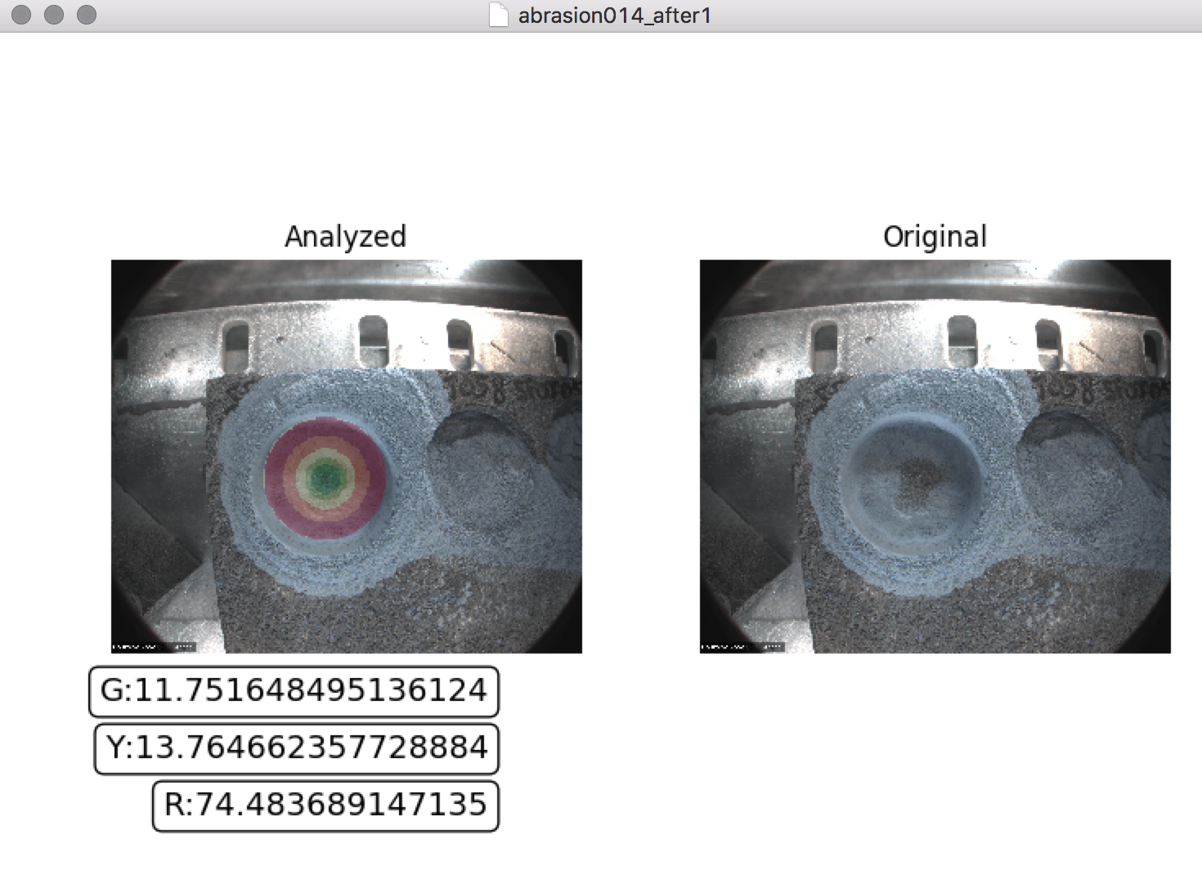
Output- Display For Each Analyzed Image

Slide 26
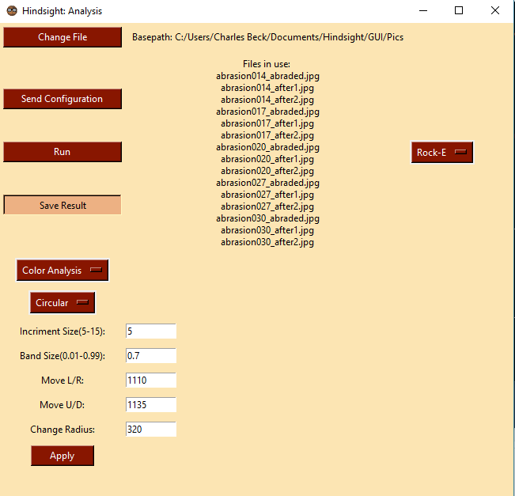
Save

Slide 27
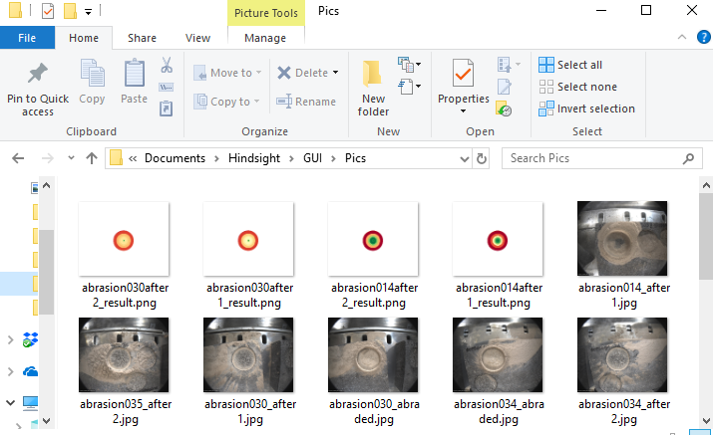

Slide 28
Challenges and Resolutions
Edge detection
After applying multiple algorithms and methods for detecting the edge, we found they led to a dead end
Resolution: Client suggested we do it based on camera parameters
Another team at JPL is working on edge detection alone
Status: Resolved
Color segmentation for other rock types
What we currently have for Rock Type E doesn’t work/may not work for other rock types
Resolution: Each rock type has a customized algorithm
Status: Have prototype for Rock Type B with further improvements on the way
Notes:
Time: about 2 minutes
Since our last design review, we have resolved one challenge and are still in the process of resolving the other challenge. For the edge detection, we have a function that draws a circle of where the abrasion edge is using hard coded values that were found by running the drawing function over multiple images, including ones from different rock types to get a good estimate of a uniform circle on all images. The color segmentation for Rock Type B is almost ready, we just need to compare the numbers we get from our analysis tool with the numbers that our client gave us. If it's within 10 percent of those values, then we will integrate the analysis functions into the final product. If it's not successful, then it will be dropped so that we can focus all of our attention on our Rock Type E analysis tool during the final week of implementation.

Slide 29
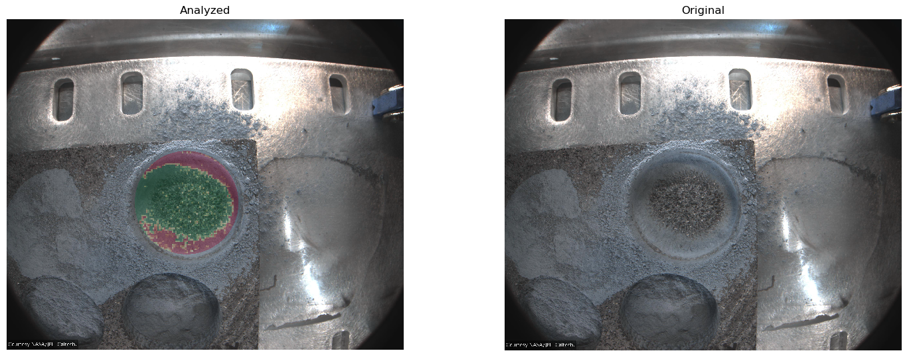
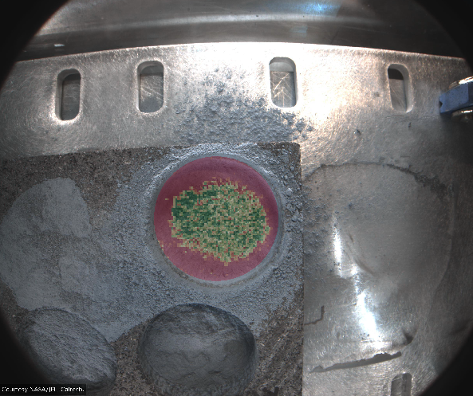
Challenges and Resolutions Cont.
Dark areas in abrasion image
Some abrasion images have shadows in the hole and this messes up the accuracy of our analysis tools
Resolution: Tweak color range to include darker regions
Notes:
Time: about 2 minutes
A new challenge we have is dealing with the dark areas in some of the abrasion images. Some of the images have shadows in the hole and this messes up the accuracy of our analysis tool since it works best in well-lit areas. We're going to try to see if we can increase the accuracy by taking the shadows into account by researching possible ways to remove the shadow so that it can correctly identify areas that have dust, no dust, or are inconclusive. We'll also test a mask that one of our team members made earlier that hasn't been incorporated yet and see if that improves the accuracy. If we reach a dead end by the end of the week, then we will have to drop this.

Slide 30
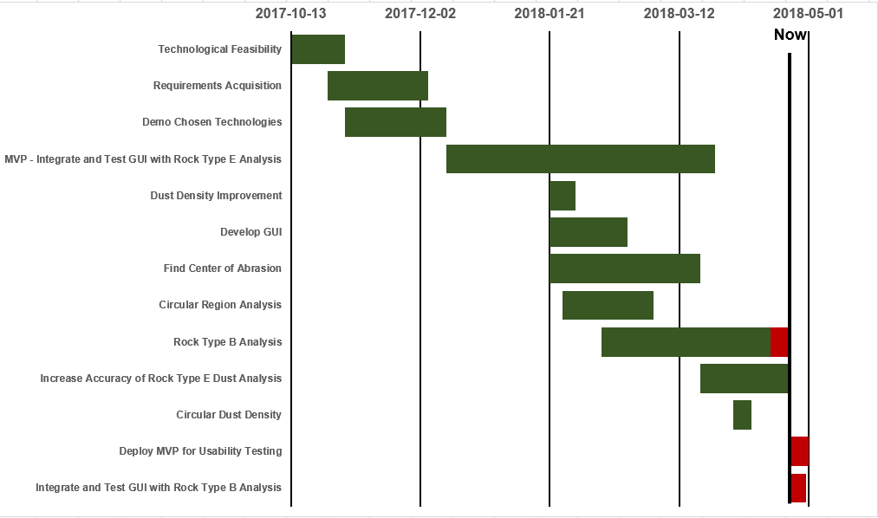
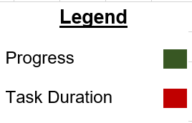
Schedule
Notes:
Time: about 1 minute
This is our current development schedule. The dark green bars indicate how far along we are in the task and the red is how long the task will ideally take to complete. Since last time, we've wrapped up the task for finding the center of the abrasion and finished with our MVP. We're working on improving the accuracy of our MVP and hoping to have a fully working Rock Type B analysis tool so that we can integrate into our MVP and test it.

Slide 31
Testing Plan: What we are testing
Image Processing/Analysis
Use of unit tests to enforce the correctness of our image processing, and analysis algorithms
Test image processing algorithms for producing a dust mask matching JPL’s analysis
Module Communication
Testing that all modules are integrated correctly using integration tests
Confirms that our system is able pipe data between modules with the desired result
GUI Testing
Testing the GUI and get user feedback from our client on displaying final analysis
Develop a more robust and user friendly GUI
Notes:
There are three areas of testing we plan to use to ensure a reliable and robust product.
First, we will be using unit tests on our image processing, and analysis algorithms. Each of these algorithms can be tested against one or multiple images, and compare the output to values that we expect. As such, these test will increase the accuracy of these algorithms, and bring them in line with the outputs we expect from our clients (JPL) analysis of these images. Currently we have after image processing, our analysis algorithms are within the 10% range that we set for our analysis and JPL’s analysis.
Next we will be using integration testing to make sure that the pipelines between our modules are working correctly, and that data is being passed between them correctly. These tests will mainly focus on the integration between the GUI and the Control as this is the only pipe that problems can occur within the system.
Finally, we will be doing usability testing with our client to help create a more fluid GUI. While we are able to use our GUI in its current state, this can often led to scenarios where others, specifically the client, will have a difficult time operating the GUI. As a result getting feedback about the GUI from the people who will be using it is a must. To do so we will have our users at JPL run batches of images and get feedback about how comfortable the GUI was to operate or what could be added in the future to make operation easier. This will lead to a more usable system for our client and make our GUI more robust in general.
This concludes my ted talk on testing.

Slide 32
Testing Plan: How we’ll respond to our testing
Image Processing/Analysis
Iterative adjustment of Processing/Analysis algorithms to better match JPL’s analysis
Will be a continuous process and adjusted as the need arises
Module Communication
Errors in communication between modules will be handled as they arise
Adjustments will be made to ensure correct data is being communicated between modules
GUI Testing
Will be sent to JPL for a period of testing and comeback closer to the end of the semester
All GUI modifications will be done in a week long period
Notes:
From our Image processing/analysis unit testing we expect to refine our image processing algorithms as we compare our results to more of our clients analysis. As such, we will be responding to those tests iteratively and as the need arises.
The errors in communication between modules will be handled as they arise. This will primarily focus on erroneous data being passed between modules, or if there is a change in the data being passed between modules.
As we will need to both send our program to JPL, allow them time to test it, and then have that feedback sent back. This will give us time to focus on fixing other problems with the code, until we get JPL’s requested adjustments back. Once we receive those, there will be a week long period solely focusing on the GUI.

Slide 33
Testing Plan: How we are testing
Pytest Testing Framework
Script style unit and integration testing for all necessary modules
Tests can be parameterized and minimize number of tests that need to be written
Also handles code coverage
Example
Given image is run through an analysis function
Is then compared against values that we are anticipating from the analysis
JPL Client Testing
Software will be sent to JPL for user testing with a questionnaire for feedback

Slide 34
Future Work
Laid groundwork for analysis for more rock types
Created with modularity and extensibility in mind.
JPL can implement other computer vision algorithms to analyze dust in other rock types
Parallelize analysis
Improve accuracy of analysis for rock types

Slide 35
Conclusion
Client and Problem
Solution Vision
Take in a batch of images
Automatically apply computer vision algorithms to detect dust
JPL can then run multiple tests in a single vacuum chamber pump down session
Get feedback on how effective their gas Dust Removal Tool is
Overview of:
Requirements/Specs
Architecture
Implementation
Product
Challenges and Resolutions
Testing Plan
Project Impact
Notes:
Time: < 1 minute
We are Team Hindsight and our client is Iona Brockie, a mechatronics engineer at JPL, and is one of the people working on the Mars 2020 rover. The mission of the Mars 2020 rover is to help discover if there was past life on Mars by drilling into rocks on Mars to collect samples that will be picked up by a future mission. The resulting dust from the drilling covers the hole, so JPL is testing their gas Dust Removal tool to see how effective it is at removing the dust. However, their current process is time consuming and there can be inconsistencies in the analysis.
Our solution will help automate the process of analyzing the images by taking in a batch of images, automatically apply computer vision algorithms based on the rock type to detect the dust. It will allow JPL to run multiple tests in a single vacuum chamber pump down session and get feedback on how effective their tool is.
Working closely with our client, we were able to complete our minimal viable product for this project.
The results we are getting are within 5% of JPL’s numbers and this product will save them countless hours of testing their gas Dust Removal tool. Our client has been pleased with the demo we showed her. Thank you for coming to our talk and please stop by our poster in the Skydome.

Slide 36
Sources
https://mars.nasa.gov/programmissions/missions/present/2003/
https://en.wikipedia.org/wiki/Mars_Pathfinder
https://www.jpl.nasa.gov
https://mars.nasa.gov/mars2020/mission/rover/

