Slide 1

Gnosis Solutions
Crowd Intelligence Grocery Shopping Mobile App
Notes:
Speak on our app.

Slide 2
Our Team and Mentor
Christopher Simcox - Database/Connections Lead
Kristoffer Schindele - Front End Developer
Thomas Back - Front End Lead
Kalen Wood-Wardlow - Team Leader
Our Client and Mentor: Dr. Michael Leverington
Notes:
Kalen
Introduce Team, Client/Mentor and Project name
Animate the order of introducing the graphic, one by ione

Slide 3






Problem Statement
What options are available to grocery shoppers to shop smarter and more efficiently?
At Home
No local product information
No pricing information offered.
No resource to quickly determine what store will offer the best value
Bill
Notes:
Allh e has to go on is the information hes already retained in his head from visiting stores before, and this is not a very reliable or efficient way to shop, grocery stores discontinue and continue selling various brands and products all the time, so going off of what he remembers is not the most effective way to his pursuit effectively. But let’s say he chooses his favorite store toshop at and moves on to shopping

Slide 4


Problem Statement
At Grocer
Has Shopping List App
If store is unfamiliar location of items is unknown
Even if familiar, marketing trends encourage shifting shelf and aisle locations
Organizes virtual shopping list
Crosses off items she’s found
Still does not resolve original problems
Bill
Susan
Notes:
For the lack of insight on being able to conduct research about specific grocers and what theirs tore contains, most people develop a favorite tore they frequent mainly because they are familiar with the layout and what is offered at this store.

Slide 5
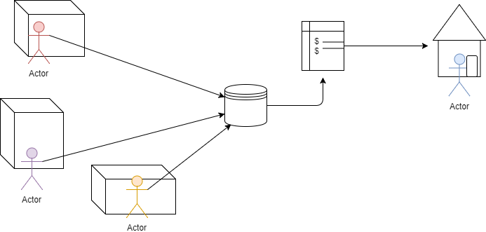
Solution Statement
Create a useful shopping list application to serve as an organization tool for users, that also allows users to share information of products they encounter to build a grocery product database.
Notes:
In short, the we want to create a consolidated source of information on local grocers and provide services where current applications are lacking which is for example the ability to compare prices of local grocers, and the ability to cut down on time spent searching through the store by knowing where each item is located on your list. In order to make this information more readily available to the public, we will build a collective database of each store’s products, placement of the products, and prices, through user contributed information on these products. Our solution to this goal is an application which will serve as the vehicle through which we will collect and analyze the data to improve the user’s experiences shopping.
Animate the order of introducing the graphic, one by ione

Slide 6
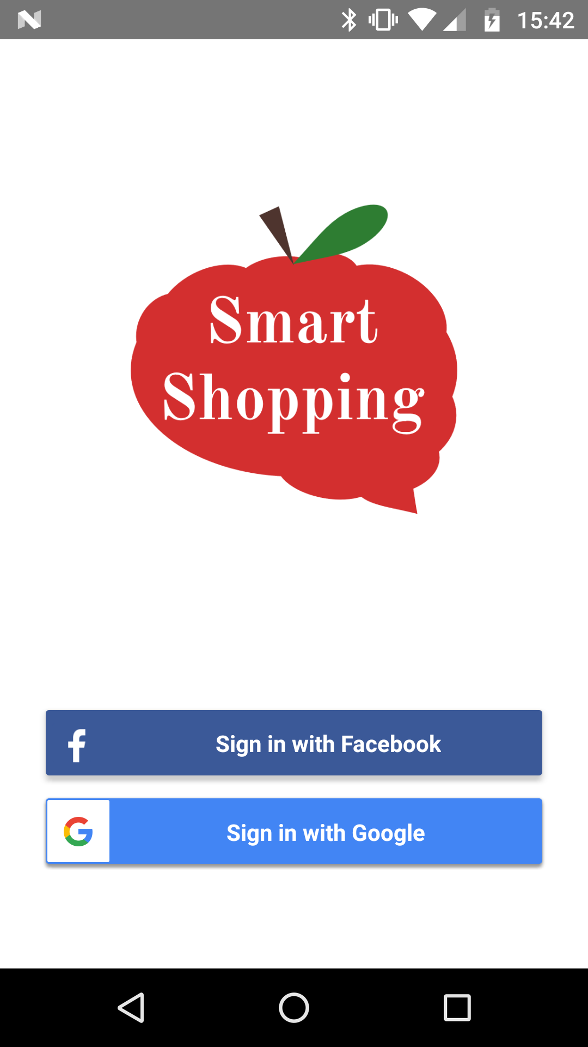
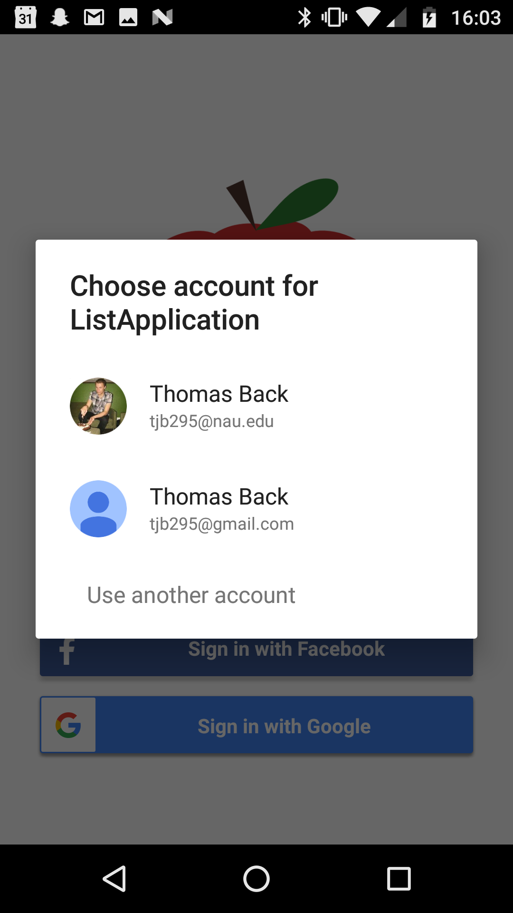
Solution Workflow: Step 1- User Accounts
Create user accounts for each individual
Database saves user’s list data under their account
Notes:
The app will go hand in hand with the user’s shopping experience in two parts, the preparation phase before heading to the store where list creation happens, and the actual shopping.
To accommodate the first phase, we will have designed a list making interface so that the user can have an electronically stored list that is easy to edit, save, and share.
Crowdsourcing applications involve an incentive to motivate users to contribute and part of our incentive will be this easy to manage list UI.
Once the user arrives at the store, they will need to check off and remove items from the list that they have collected. It is at this step that we will ask the user to enter details they found out about their item on site.
For UI mention
This includes the price of the item and the location of the item within the store
This information will be stored in a database, along with the store it was found at, and once sufficient data is built about each store, we can improve future shopping experiences by analyzing their list and providing services powered by our new found data of the stores.
As of now these services will be price comparisons of your list items between stores, and ordering their list based on a pathfinding feature that will display the best order to tackle their list within the store
Animate this slide, in order of steps,
Show where user’s end is,

Slide 7
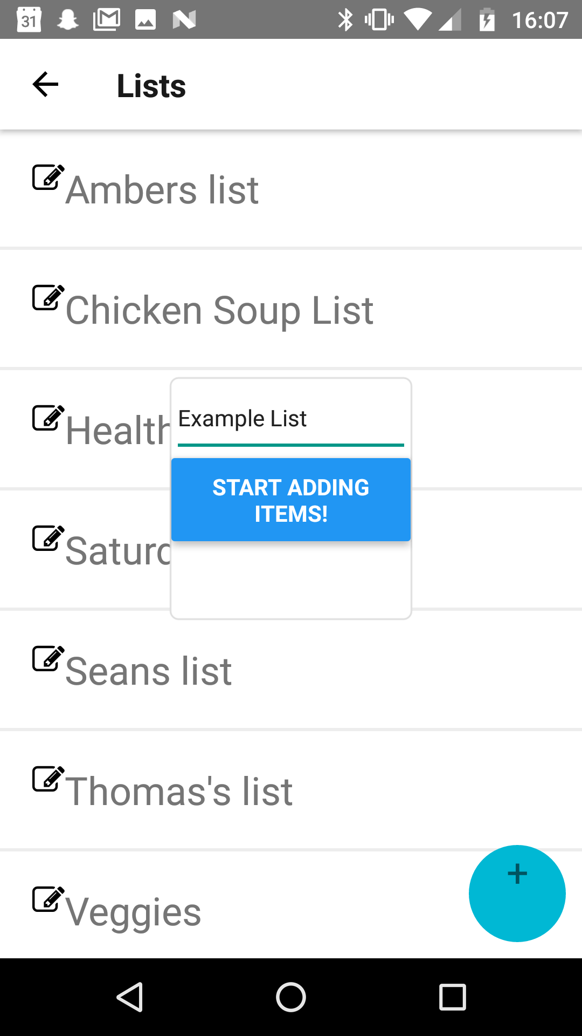
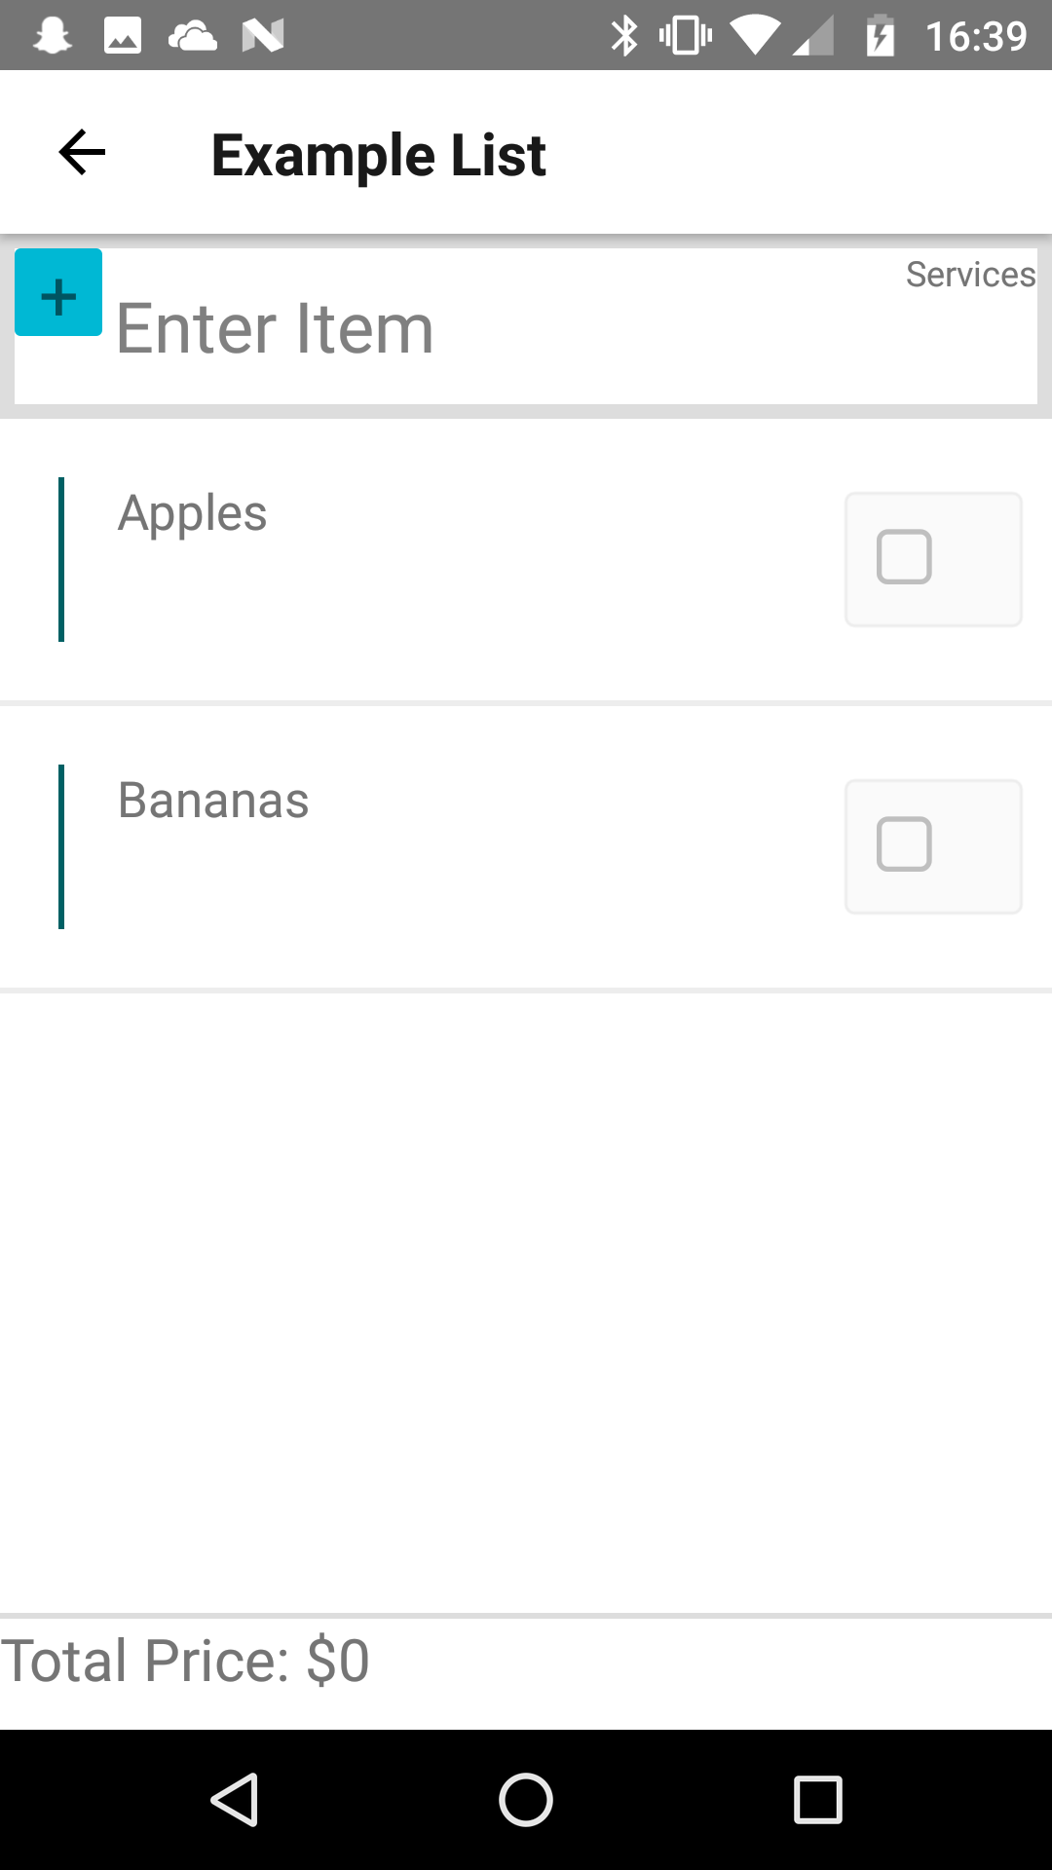
Solution Workflow: Step 2 - List Creation
User will create a new list
Desired items will be entered and the list will be saved
Notes:
The app will go hand in hand with the user’s shopping experience in two parts, the preparation phase before heading to the store where list creation happens, and the actual shopping.
To accommodate the first phase, we will have designed a list making interface so that the user can have an electronically stored list that is easy to edit, save, and share.
Crowdsourcing applications involve an incentive to motivate users to contribute and part of our incentive will be this easy to manage list UI.
Once the user arrives at the store, they will need to check off and remove items from the list that they have collected. It is at this step that we will ask the user to enter details they found out about their item on site.
This includes the price of the item and the location of the item within the store
This information will be stored in a database, along with the store it was found at, and once sufficient data is built about each store, we can improve future shopping experiences by analyzing their list and providing services powered by our new found data of the stores.
As of now these services will be price comparisons of your list items between stores, and ordering their list based on a pathfinding feature that will display the best order to tackle their list within the store
Animate this slide, in order of steps,
Show where user’s end is,

Slide 8
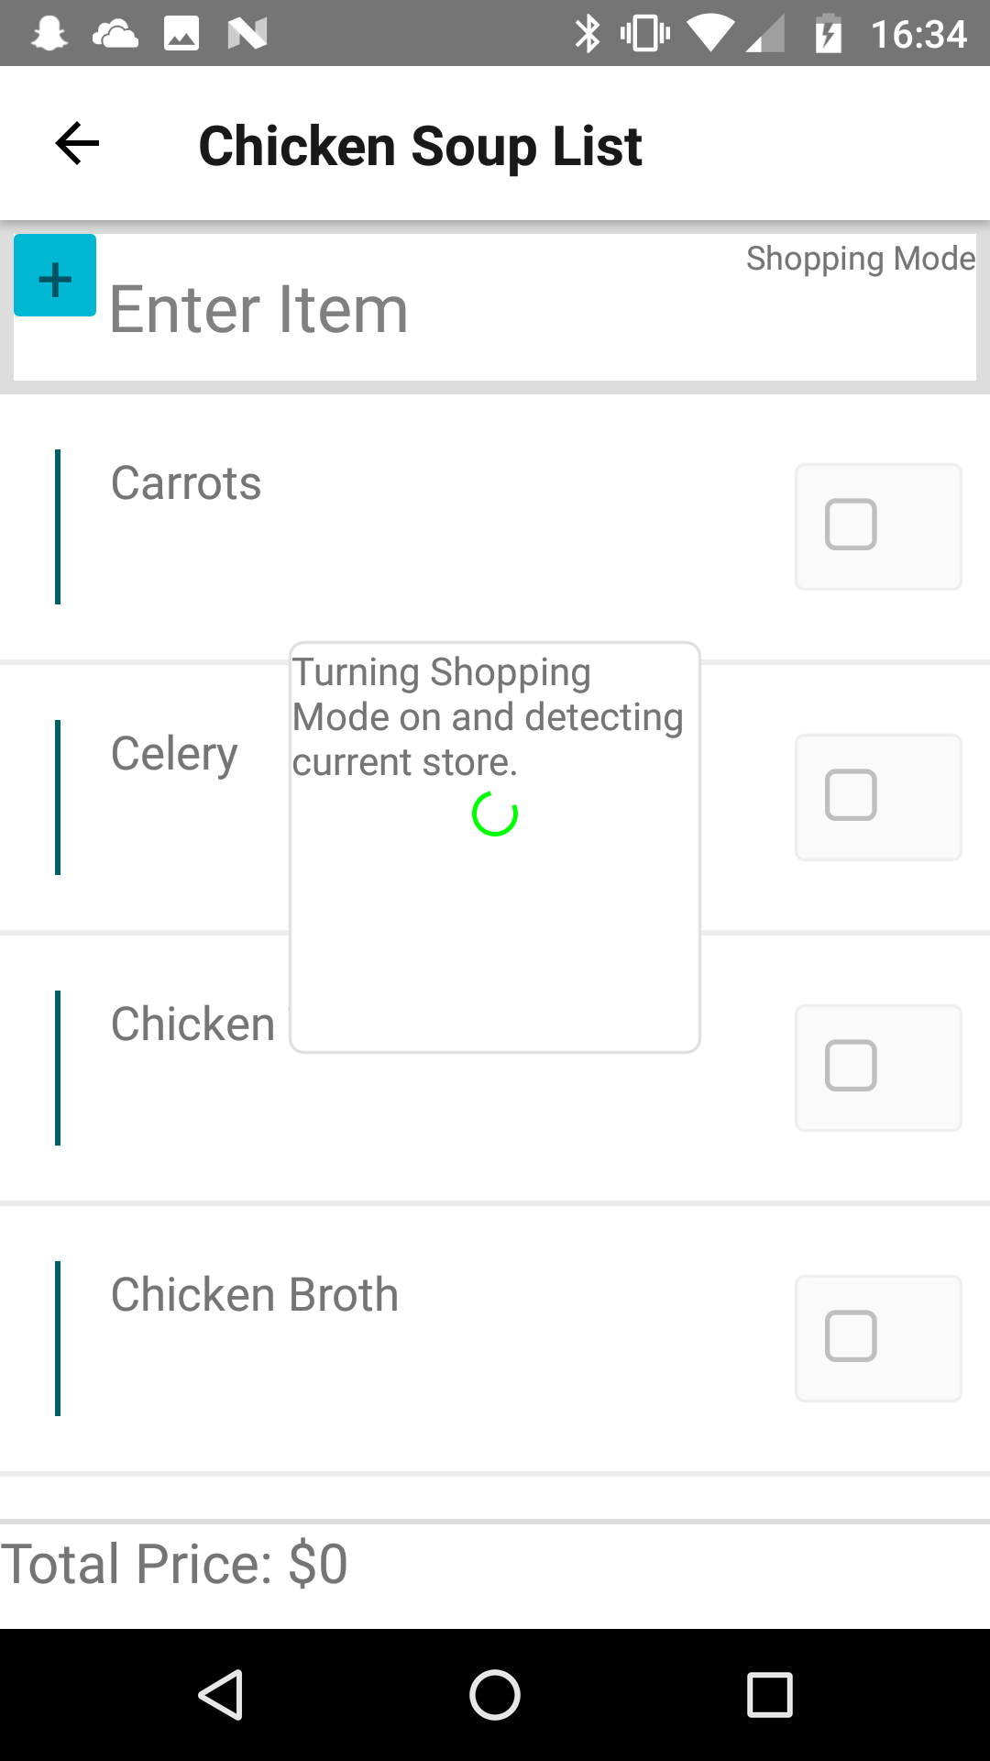
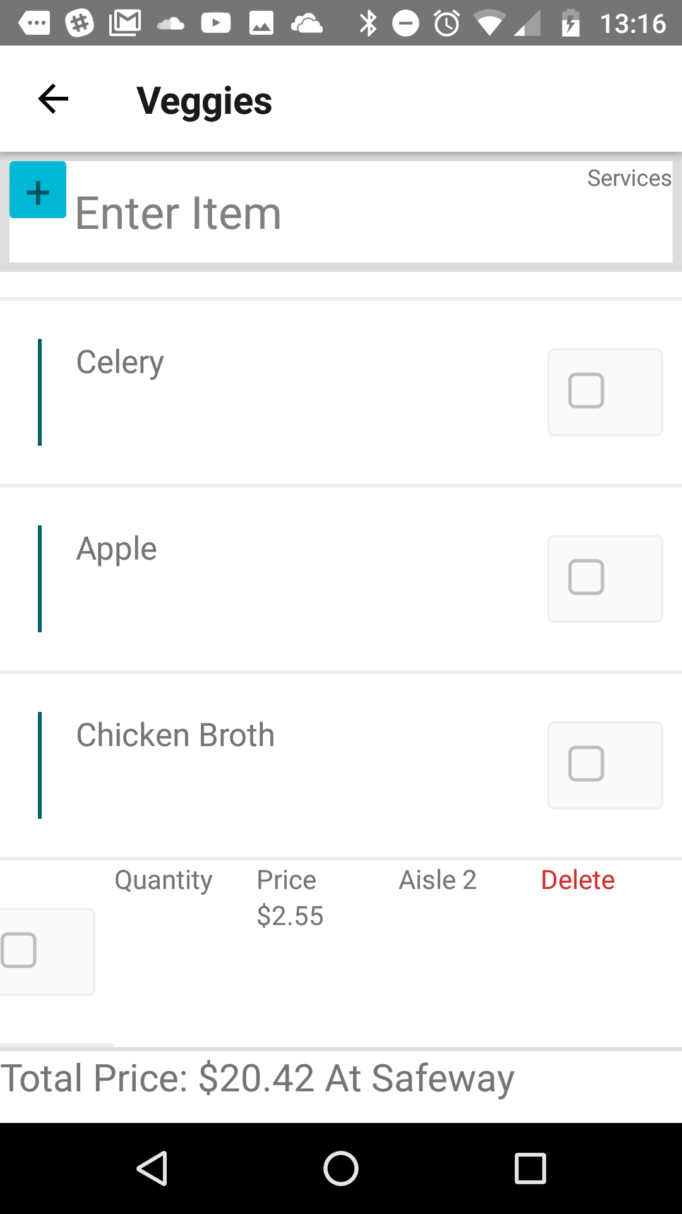
Solution Workflow: Step 3 - Shopping Mode
User will set shopping mode once they arrive at store
Once at store Geolocation tools will recognize store and route product data to that store’s table
Will also load in prices and location for already entered products
Notes:
The app will go hand in hand with the user’s shopping experience in two parts, the preparation phase before heading to the store where list creation happens, and the actual shopping.
To accommodate the first phase, we will have designed a list making interface so that the user can have an electronically stored list that is easy to edit, save, and share.
Crowdsourcing applications involve an incentive to motivate users to contribute and part of our incentive will be this easy to manage list UI.
Once the user arrives at the store, they will need to check off and remove items from the list that they have collected. It is at this step that we will ask the user to enter details they found out about their item on site.
This includes the price of the item and the location of the item within the store
This information will be stored in a database, along with the store it was found at, and once sufficient data is built about each store, we can improve future shopping experiences by analyzing their list and providing services powered by our new found data of the stores.
As of now these services will be price comparisons of your list items between stores, and ordering their list based on a pathfinding feature that will display the best order to tackle their list within the store
Animate this slide, in order of steps,
Show where user’s end is,

Slide 9
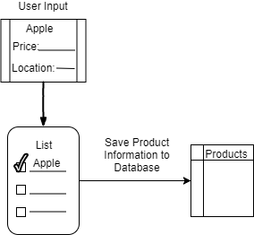
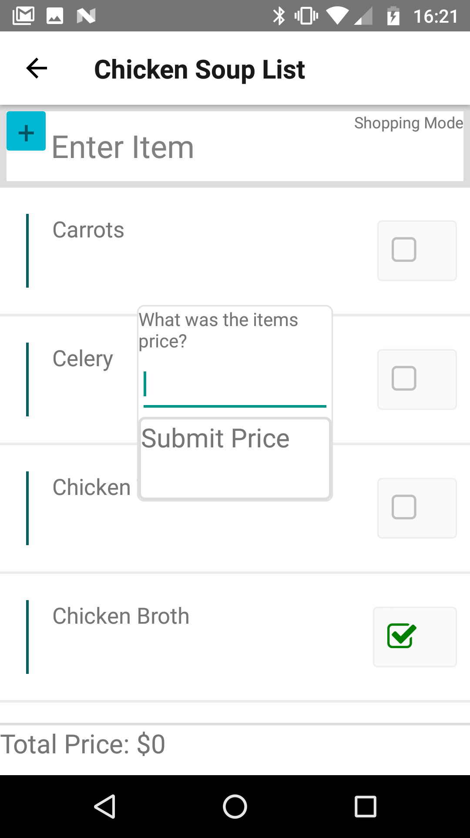
Solution Workflow: Step 4 -CrowdSourcing
When a user marks an item off their list, they will be prompted to enter location and price of item, or update price and location if change occured.
Entry for product with price and location will be stored on cloud database (or entry will be updated if different)
Figure 2. List Creation Phase
Notes:
The app will go hand in hand with the user’s shopping experience in two parts, the preparation phase before heading to the store where list creation happens, and the actual shopping.
To accommodate the first phase, we will have designed a list making interface so that the user can have an electronically stored list that is easy to edit, save, and share.
Crowdsourcing applications involve an incentive to motivate users to contribute and part of our incentive will be this easy to manage list UI.
Once the user arrives at the store, they will need to check off and remove items from the list that they have collected. It is at this step that we will ask the user to enter details they found out about their item on site.
This includes the price of the item and the location of the item within the store
This information will be stored in a database, along with the store it was found at, and once sufficient data is built about each store, we can improve future shopping experiences by analyzing their list and providing services powered by our new found data of the stores.
As of now these services will be price comparisons of your list items between stores, and ordering their list based on a pathfinding feature that will display the best order to tackle their list within the store
Animate this slide, in order of steps,
Show where user’s end is,

Slide 10
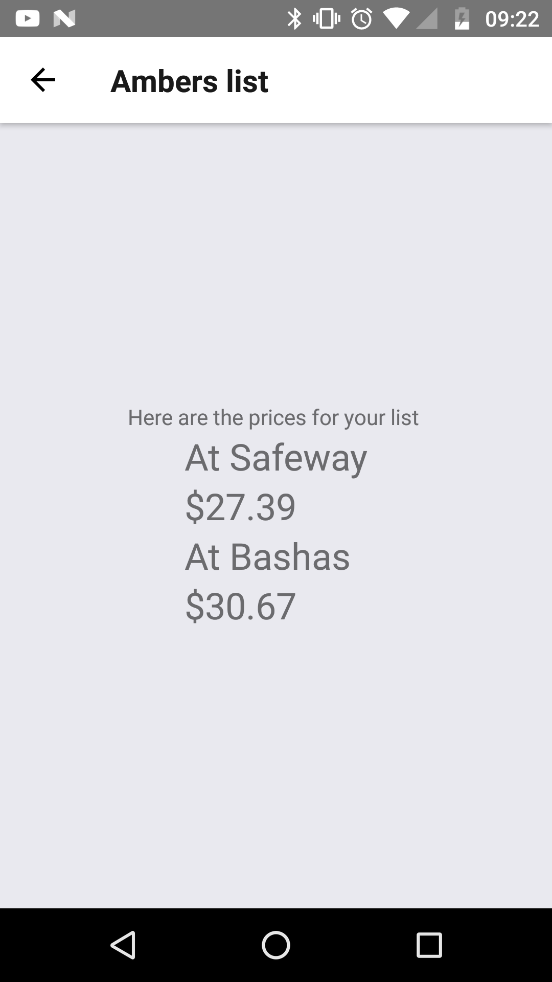
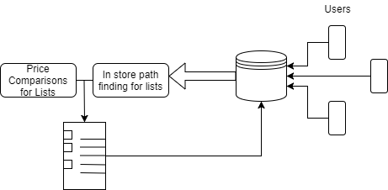
Solution Workflow: Step 5 -Provide Services
With sufficient data, the preparation phase offers services
Services include price comparisons for lists based on nearby stores; Shortest path for items in list
Figure 3. Services Offered
Notes:
The app will go hand in hand with the user’s shopping experience in two parts, the preparation phase before heading to the store where list creation happens, and the actual shopping.
To accommodate the first phase, we will have designed a list making interface so that the user can have an electronically stored list that is easy to edit, save, and share.
Crowdsourcing applications involve an incentive to motivate users to contribute and part of our incentive will be this easy to manage list UI.
Once the user arrives at the store, they will need to check off and remove items from the list that they have collected. It is at this step that we will ask the user to enter details they found out about their item on site.
This includes the price of the item and the location of the item within the store
This information will be stored in a database, along with the store it was found at, and once sufficient data is built about each store, we can improve future shopping experiences by analyzing their list and providing services powered by our new found data of the stores.
As of now these services will be price comparisons of your list items between stores, and ordering their list based on a pathfinding feature that will display the best order to tackle their list within the store
Animate this slide, in order of steps,
Show where user’s end is,

Slide 11
Requirements Overview
Key Requirements:
Cross platform, grocery shopping list, mobile application
The application must be visually appealing and easy to use
Crowd sourcing of user data
Minimal device impact
Notes:
Chris
Talk about aqcuisition graphics!
Mention managing of data remotely
Animate,

Slide 12
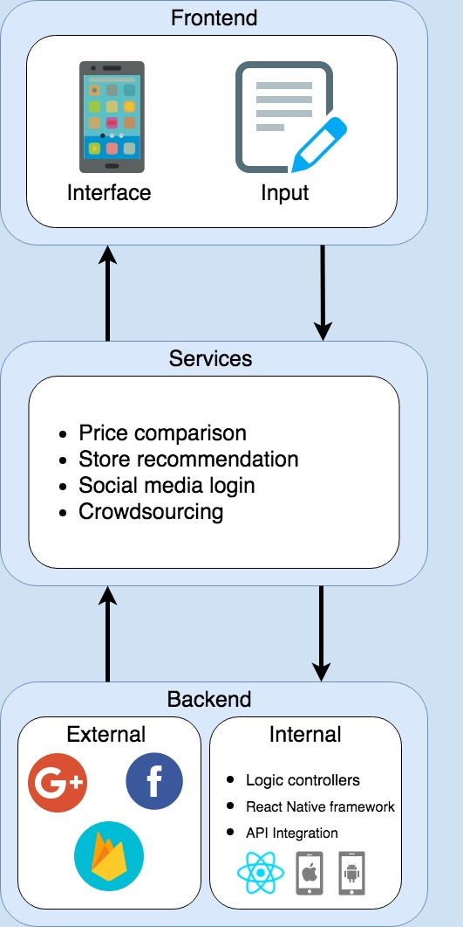
Architecture Overview
Backend
  Internal/External code
Services
  Features offered to users supported by backend
Frontend
  How the users interact with the app
Figure 5.
Notes:
Chris
Talk about aqcuisition graphics!
Mention managing of data remotely
Animate,

Slide 13
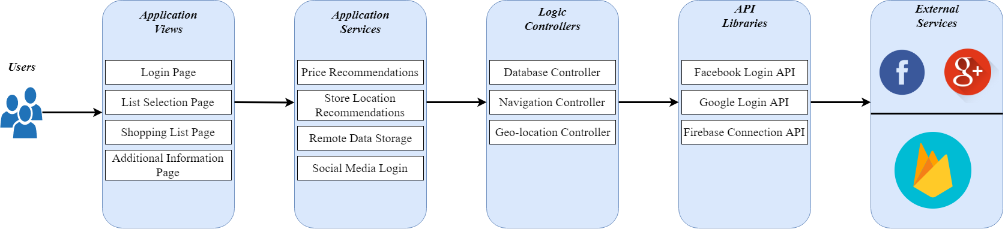
Implementation Overview
Figure 6.
Notes:
React native deploys on both android and ios platforms which allows users to interact with the firebase data solution to pass data back and forth.

Slide 14
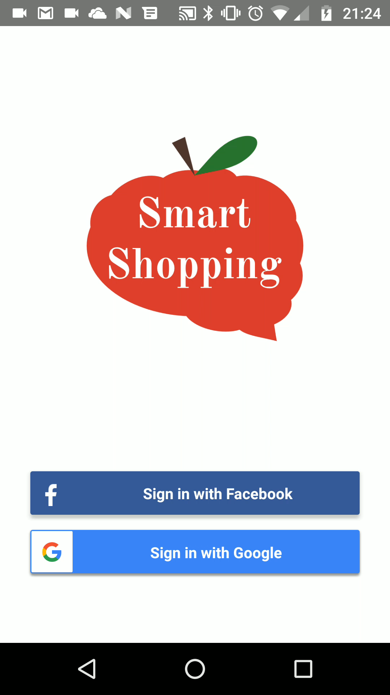
Prototype Demo
User logs in
User creates a new list
User adds items to list
User enters into shopping mode
Notes:
React native deploys on both android and ios platforms which allows users to interact with the firebase data solution to pass data back and forth.

Slide 15

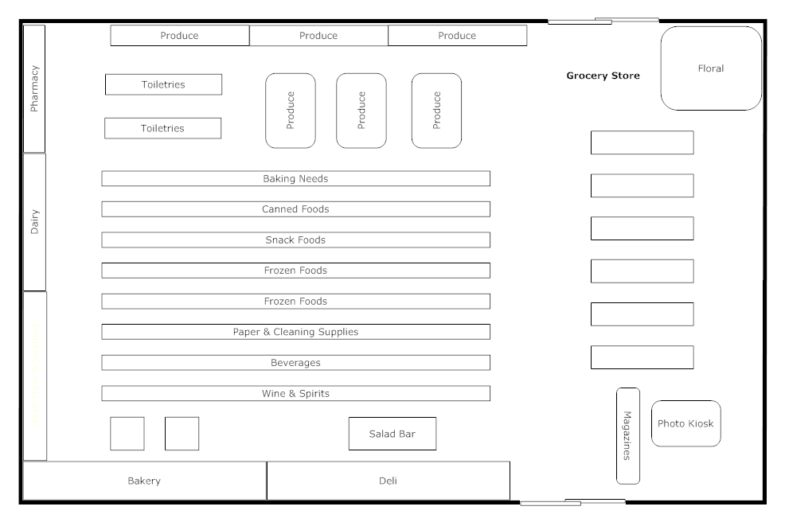

Challenges and Resolutions
Cross-platform Development
Custom Geolocation
Ambitious Features
Notes:
Kris

Slide 16
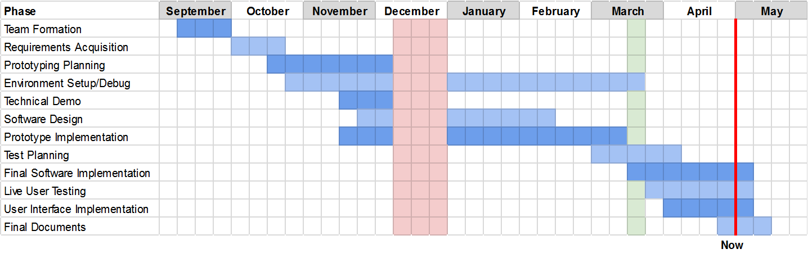
Schedule
“Always make time for Murphy . . . “
Notes:
Kris

Slide 17
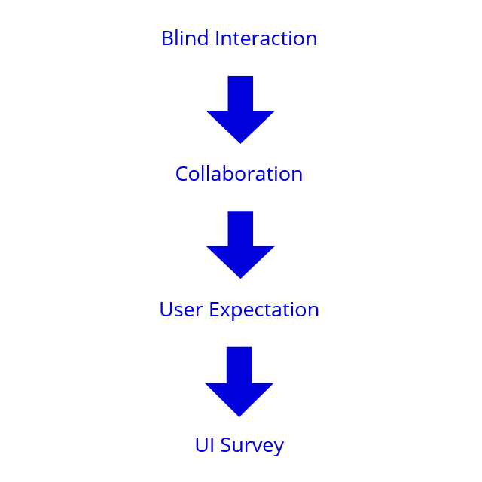
Testing
“So easy to use, they won’t want to put it down.”
Intuitive
Responsive
Attractive
Notes:
Kris

Slide 18


Results
Eye-opening Discoveries
Deployment Barriers
Experience Varies by Device
NOT
Notes:
Kris

Slide 19
Future Plans
Path finding service that shows user’s the fastest way to obtain groceries
Navigation to the nearest store with the best prices
Notes:
Kris

Slide 20

Conclusion
Give customers an consolidated source of knowledge on local grocers via a shared database on stores and their products
Notes:
Thomas
Strong conclusion
Graphics, pop things up and summarize our technologies as well,
Emphasize ease of use with UI,
Emphasize the data management
Show what user’s will do with the list
In conclusion given our powerful tools, our app smart shopping looks to create a simple easy to use application that will have a simple to use UI that will improve the effiencieny of users shopping expierience.

