Slide 1
File-Mate 1500
Design Review II
Keven Abbott
Tyler Crouse
Kiana Delventhal
Liam Westby

Slide 2
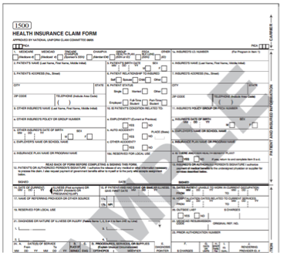
Introduction
CMS 1500 Health Insurance Claim Form
Issued by the Centers for Medicare and Medicaid Services
Used for making claims against a patient’s health insurance policy
Accepted by many private insurers and the Medicare and Medicaid programs
2
Notes:
Kiana
Approved by the American Medical Association, among other groups; industry standard form

Slide 3
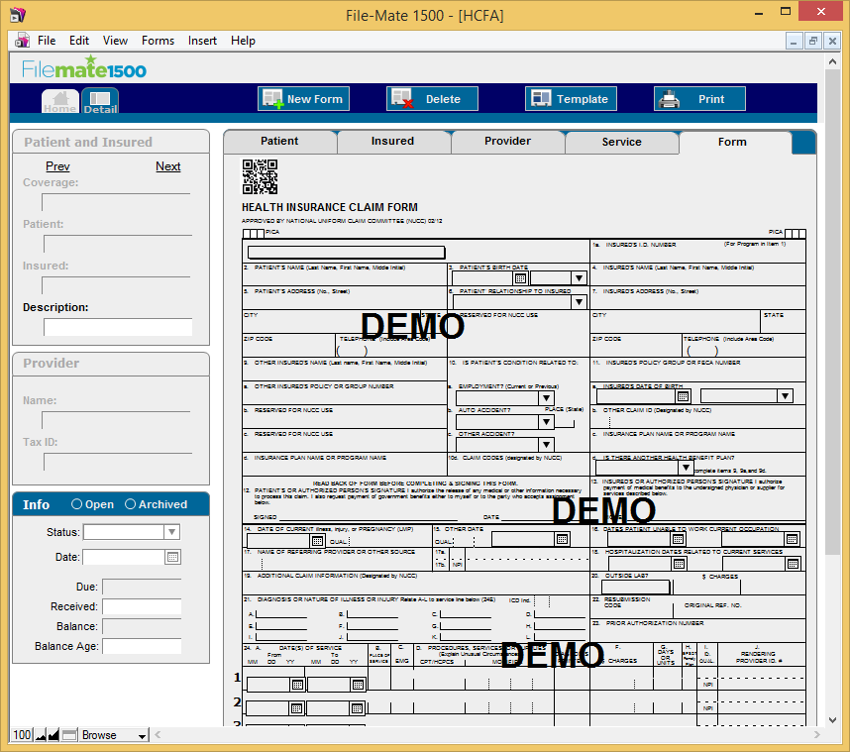
Introduction
File-Mate 1500
Automates the production of completed CMS 1500 forms
Stores data on patients and insurance policies
Saves completed forms that can be retrieved at any time
3
Notes:
Kiana

Slide 4
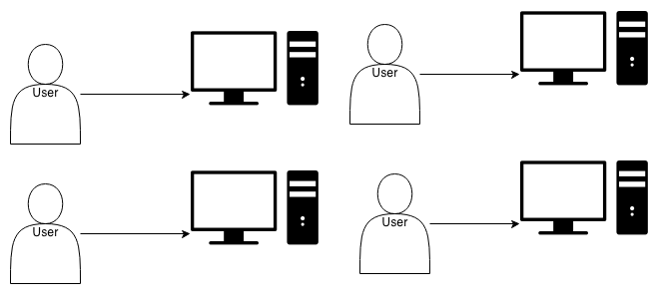
Problem
While the existing application is useful, it is a desktop client that lacks:
Scalability
Portability
Accessibility
4
Notes:
Tyler

Slide 5
Solution
Create a web-based version of the File-Mate 1500 application, accessible from any computer or tablet with a modern web browser.
The web-based system will:
Allow concurrent access to a shared data set
Enable access to the system without needing to install software
Scale to support the needs of an entire practice
5
Notes:
Tyler

Slide 6
Key Requirements
Support for major web browsers
Support for tablet devices
Secure concurrent access
Creation of different user groups
  Administrator, Registered, Trial
Generation of documents
Import/export of data
6
Notes:
Tyler

Slide 7
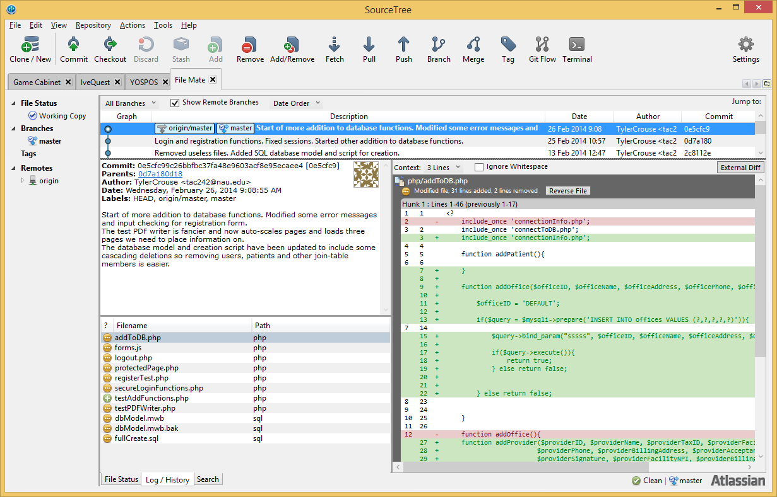
Development Methodology
Iterative Waterfall Cycle
(multiple versions of each)
Atlassian Bitbucket Repository
SourceTree for source control
Focus on implementing core pieces of functionality, then integrating them together
7
Notes:
We adopted iterative waterfall development lifecycle. this is similar to the traditional waterfall model but iterating on each step within the waterfall model to ensure that all content and requirements are met
Keven

Slide 8
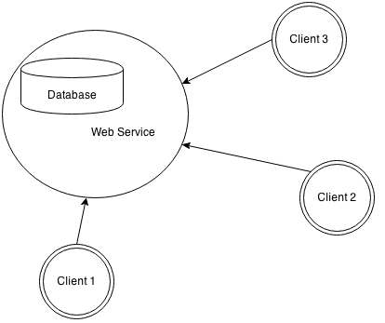
Client-Server Architecture
8
Notes:
Keven

Slide 9
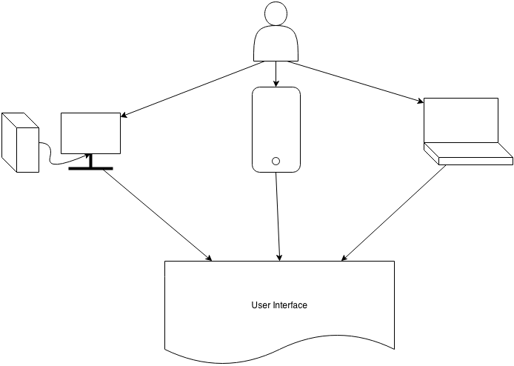
Client Side
Accessible from any device with internet access
9
Notes:
Keven. Computers, tablets and laptops

Slide 10
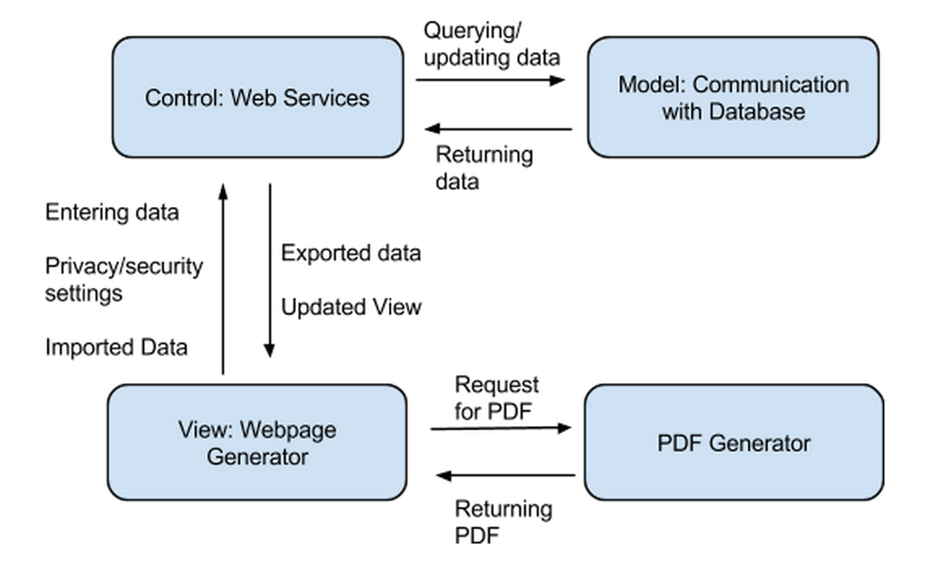
Server Side
10
Notes:
Keven. MVC data flow

Slide 11
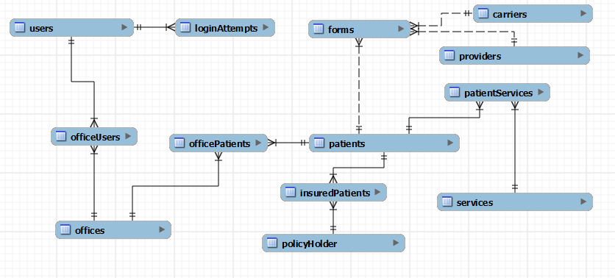
Database
11
Notes:
Keven. Entity Relationship Diagram. Describe users, patients and offices

Slide 12
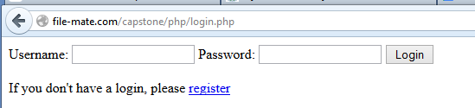
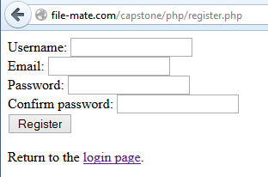
Implementation
Login System (preliminary)
New User Registration (preliminary)
12
Notes:
Liam
Current pages for login/registration system, focus was on backend functionality, including encryption and hacking prevention measures, input validation

Slide 13
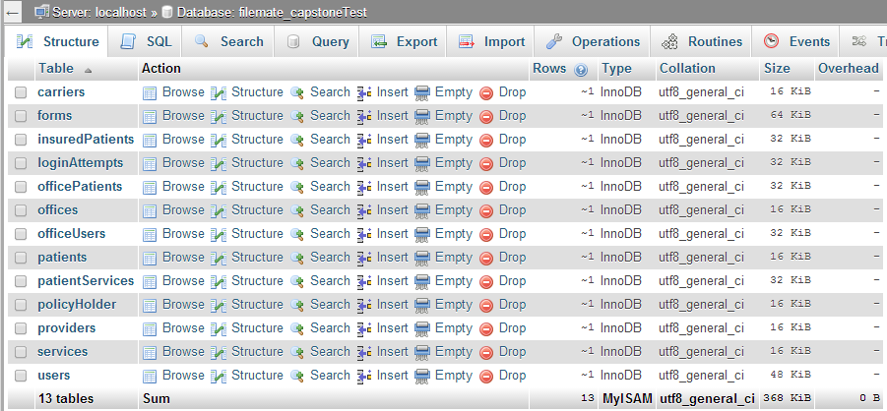
Database
13
Notes:
Liam
Screenshot from phpMyAdmin, this is a live database

Slide 14
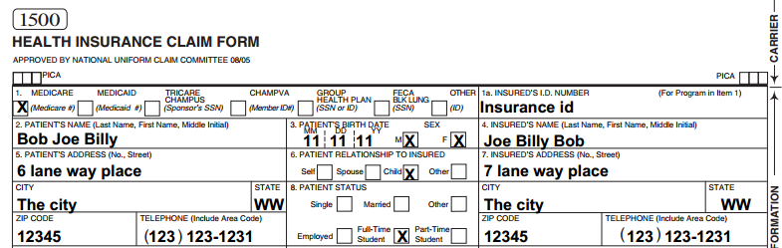
PDF Form Generation
14
Notes:
Liam
Sample of generated PDF from our system

Slide 15
Challenges and Risks
Risk | Likelihood | Severity | Mitigation Strategy
Loss of Data Integrity | Moderate | High | Ensure integrity is preserved by testing database and related modules throughout implementation.
Confidential Data Leak | Low | Extreme | Use strong encryption, ensure accounts cannot be accessed by anyone other than the user.
System Availability Compromised | Moderate | Moderate | Design system for concurrent access and conduct load testing
15
Notes:
Liam
Because our application is data driven, we must pay attention to common risks to information security: integrity, availability, and confidentiality

Slide 16
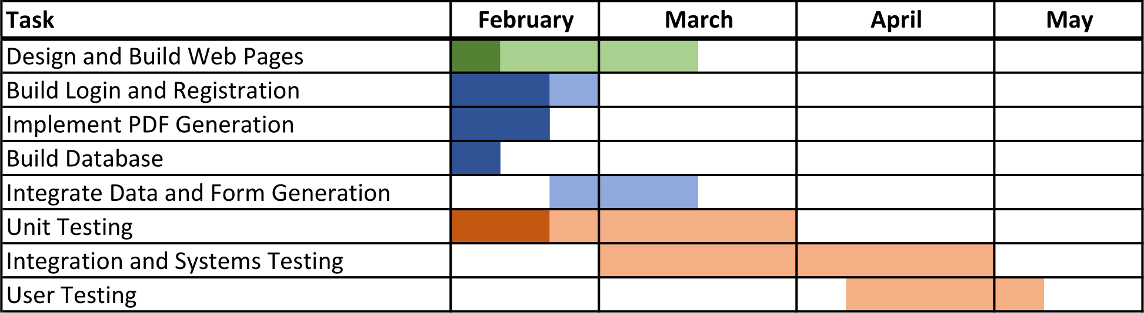
Schedule
16
Notes:
Kiana
client, server/database, testing

Slide 17
Conclusion
File-Mate 1500 is a desktop application; we are taking it to the network.
To that end, we have produced a database-backed client-server system.
With this solution, we are bringing a new level of scalability, portability, and accessibility to the File-Mate product.
17
Notes:
Kiana

Slide 18
Questions?
18

