Slide 1
File-Mate 1500
Design Review 1
November 19, 2013
Keven Abbott, Architect
Tyler Crouse, Sponsor Liason
Kiana Delventhal, Team Leader, REcorder
Liam Westby, Release Manager, Webmaster
Notes:
Kiana starts

Slide 2
Sponsor
Form Magic, Inc.
  Located in Flagstaff, Arizona
  Producer of software for automated filing of forms
  Project Sponsor is Dave Schurz

Slide 3
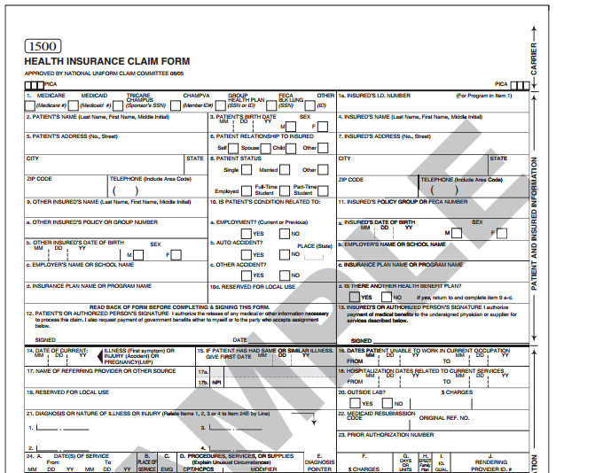
File-Mate 1500
File-Mate 1500
  Desktop application created to assist doctors and physicians assistants fill out the CMS 1500 Health Insurance Claim Form
  CMS 1500 is an industry standard form for making claims against patients’ insurance plans

Slide 4
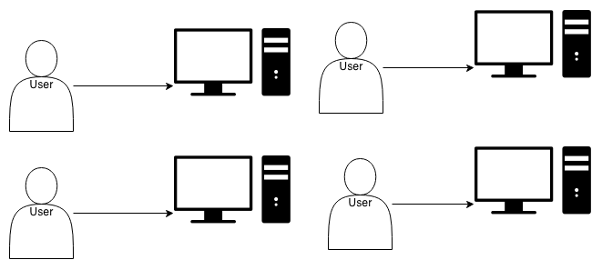
Problem
While the existing software is useful, the desktop client lacks:
  Scalability
  Portability
  Accessibility
Notes:
Give examples of each problem. It’s not scalable because… etc. Note the lack of communication between users
Compare to Microsoft Word.

Slide 5
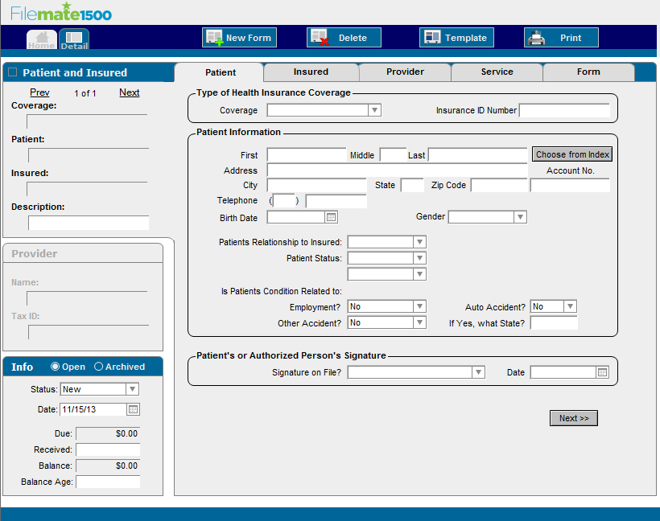
Current Application Interface

Slide 6
Solution
Create a web-based version of the File-Mate 1500 application, accessible from any computer with a modern web browser.
The web-based system will:
  Allow concurrent access to a shared data set
  Enable access to the system without needing to install software
  Scale to support the needs of an entire practice, or even multiple practices
Notes:
Compare to Google Docs.

Slide 7
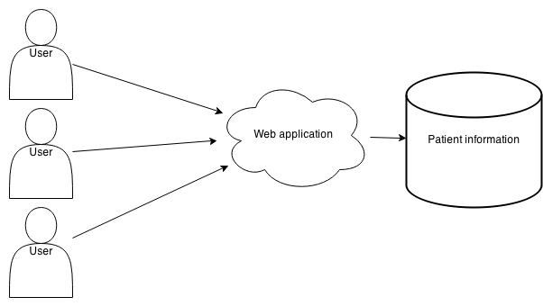
System Overview
Notes:
Elaborate on who the users are– primarily doctors or medical assistants filing the paperwork

Slide 8
Requirements
Notes:
Switch to Keven
Talk about how we got the requirements (met with sponsor over several weeks)

Slide 9
Functional Requirements: Client
Page Types
  Welcome Page
  Registration Pages
  Trial Pages
  Patient Information Pages
  User Account and Settings Pages
  Contact Page
Compatibility
  Browser support for leading desktop and mobile devices
Notes:
Support for leading browsers such as Internet Explorer, Firefox, and Chrome, and mobile devices running iOS, Android, and Windows.

Slide 10
Functional Requirements: Server
Support concurrent access to patient data
  Ensure data availability, confidentiality, and integrity
Support multiple types of users with separate permissions
  Administrator, registered user, trial user
Facilitate data import, export, and backup
  Allow users to add data from a file, or save it to a file for backup

Slide 11
Non-Functional Requirements
Security
  Data transfer between database and web service without any third-party interference
Scalability
  Allow any amount of patients per client (limitations may be imposed by purchased license level)
Performance
  Must retrieve data from database in less than 2 seconds and generate PDF form in less than 10 seconds
Usability
  Present data in a concise manner in order to allow user to interpret data easily.
Notes:
Switch to Liam

Slide 12
Environmental Requirements
Server
  Web Server: Apache
  Language: PHP
  Database: MySQL
Client
  Markup: HTML
  Styling: CSS
  Interactivity: JavaScript
Notes:
Sponsor has expressed preference for these technologies and we have not seen a good reason to research alternatives

Slide 13
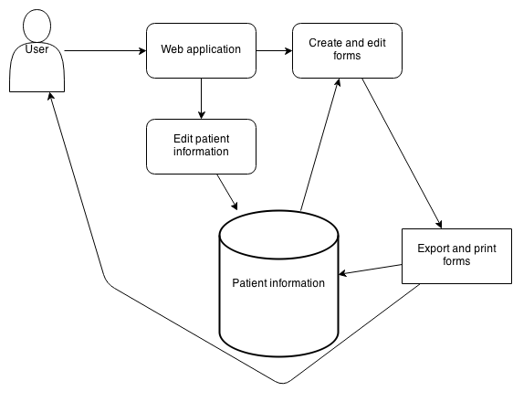
Architecture
Notes:
Explain each part of this diagram in detail for better understanding, show how a user might interact with it in a typical fashion

Slide 14
Current Application Interface
Notes:
Current application provides good interface prototype for web version; the closer we get to desktop File-Mate the easier it will be to train users of the old software on the new version.

Slide 15
Risks
Risk | Severity | Mitigation
Data Leaked | High | Database encryption Ensure HIPAA compliance
Data Corrupted | High | Backup data regularly
Website Inaccessible | Low | Ensure data integrity remains when outage is over
Notes:
Explain how we intend to mitigate these risks in detail.

Slide 16
Graphical Schedule
ID
Task Name
Oct 13, '13
Nov 3, '13
Nov 24, '13
Dec 15, '13
Jan 5, '14
Jan 26, '14
Feb 16, '14
Mar 9, '14
Mar 30, '14
Apr 20, '14
May 11, '14
T
F
S
S
M
T
W
T
F
S
S
M
T
W
T
F
S
S
M
T
W
T
F
S
S
M
1
Project Begins
11/17
2
Requirements
3
Gather and refine requirements
4
Design
5
Establish architecture
6
Develop database schema
7
User interface mockups
8
Design Complete
12/20
9
Implementation
10
Spring Semester
1/13
11
Create database
12
Create components from architecture
13
Build out user interface pages
14
Develop business logic
15
Create documentation
16
System Implemented
3/3
17
Testing
18
Unit testing
19
Load testing
20
User testing
21
Testing Complete
4/18
22
Deployment
23
Sign off on delivered project
24
Final presentation
25
Project complete
5/9
Notes:
Be sure to indicate the milestones (Design done, implementation done, testing done, project finished)

Slide 17
Conclusion
Problem
  Desktop application inefficient, inflexible
  Suitable for one user, not entire practice
Solution
  Web-based system offers scalability, flexibility
  Multiple users can access reliably
  Composed of three aspects
    Client
    Server
    Database
Notes:
We believe that this solution, though it will provide many benefits to the users of File-Mate, will not be difficult to successfully implement and ship.

Slide 18
File-Mate 1500
Design Review 1
Questions?
Notes:
The end

