Slide 1

Team Lasso
Greg Andolshek
Alex Koch
Michael McCormick

Slide 2
Team Lasso
Group Members
  Greg Andolshek - Architect, Release Manager, Documenter
  Alex Koch - Graphics Designer, Database Manager
  Michael McCormick - Team Leader, Communicator
Mentor
  Dr. Eck Doerry
Sponsor
  Melissa Armstrong

Slide 3
Outline
Project Statement and Solution Overview
Requirements and Specifications
Architecture
Implementation
Challenges

Slide 4




Grouping Overview
Groups are everywhere
Types of groups:
  Large companies
  Sports leagues
  Social sites
Challenges for groups:
  Finding members
  Managing groups
  Analyzing groups
  Communicating within groups

Slide 5
General Requirements
Group Management
  Dynamic Group Attributes
  Automated Grouping
  Manual Grouping
  Group Profiles
Group Analysis
  Graphical Breakdown
  Usage Patterns
User Curation
  User Profiles
  Dynamic User Attributes
Communication
  Messaging
  Forums
  Blogs/Walls

Slide 6







Other Products
Dynamic Group Attributes | Automated Grouping | Manual Grouping | Group Profiles | Graphical Breakdown | Usage Patterns
 |  | X | X
 |  | X | X
 |  | X | X
 |  | X
 |  | X

Slide 7
Other Products
Free? | User Profiles | Dynamic User Attributes | Messaging | Forums | Blogs/Walls
X | X |  | X |  | X
X | X |  | X |  | X
X | X |  | X | X | X
 |  |  | X
 |  |  | X | X | X
 |  |  | X

Slide 8

Global Science and Engineering Program
Problem applies to many organizations, including GSEP
Dual degree in 5 years
1 year Abroad
300-500 people
Many possible subgroups
Strong need for communication

Slide 9
Solution Overview

Slide 10
Solution – Group Wrangler
Web-based solution for group management
Key features:
  Group Management
  Group Analysis
  User Curation
  Communication
Other features:
  Free
  Open Source

Slide 11
Functional Specifications
Generic user
  Communicate
  View Groups
  Manage Account
Administrator
  Communicate
  View Groups
  Manage Account
  Manage Users
  Manage Groups
  Manage Applications

Slide 12
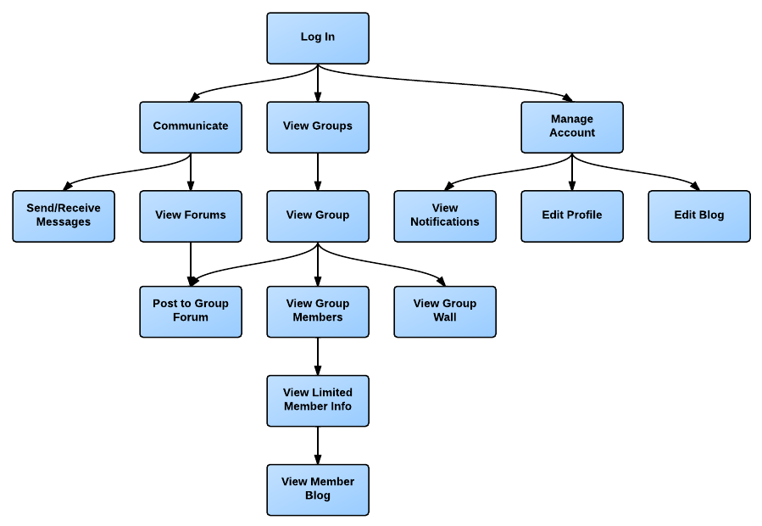
Generic User Functional Specifications

Slide 13
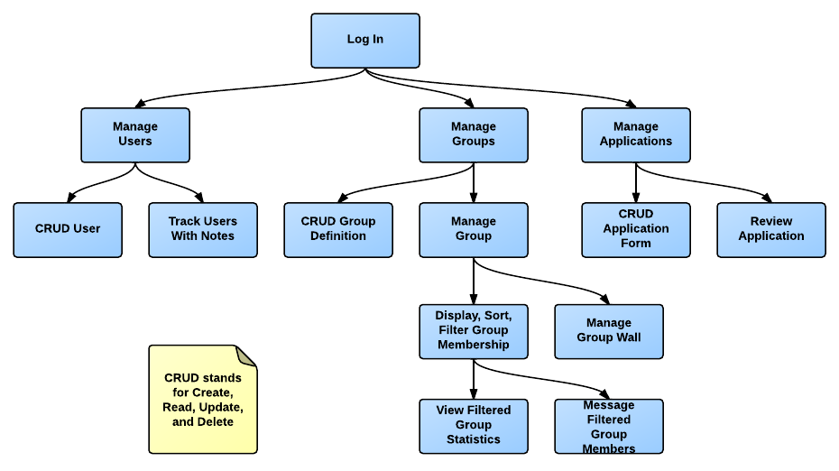
Admin Functional Specifications

Slide 14
Implementation Constraints
Cross-platform compatible
Modern browser compatible
Privacy protection laws
Performance specifications
  Ready to use out of the box
  Minimal maintenance
  Easy to learn
Modular
Scalable

Slide 15
Architecture Overview

Slide 16
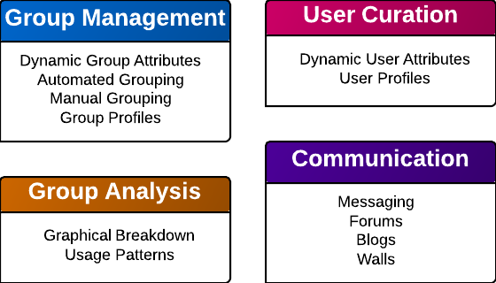
Functional Modules

Slide 17
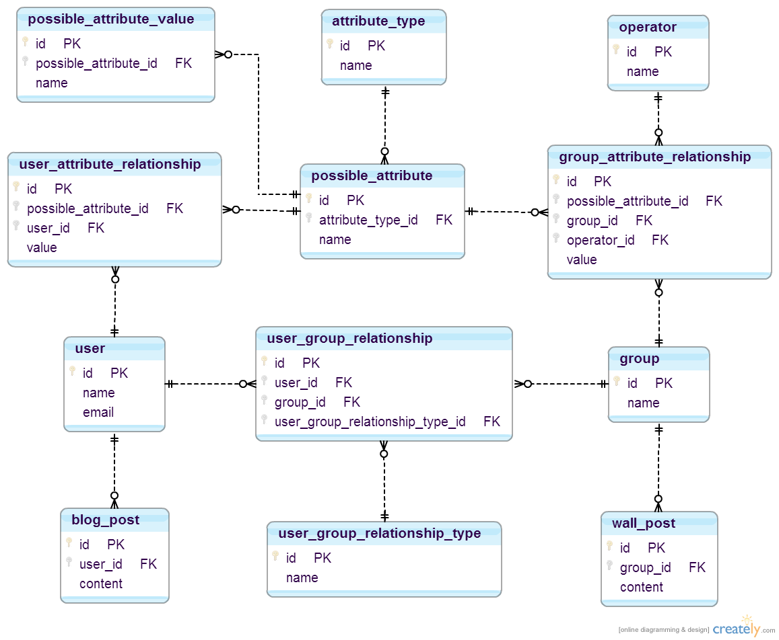
ER Diagram

Slide 18
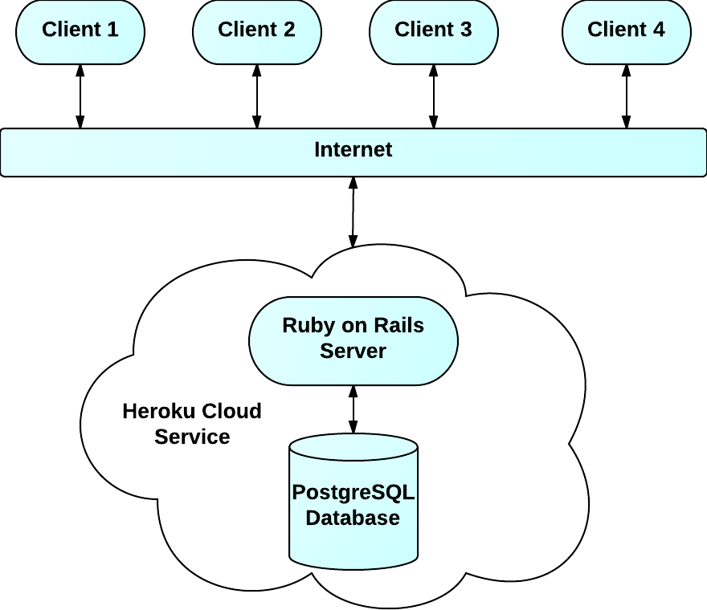
Client-Sever Architecture

Slide 19
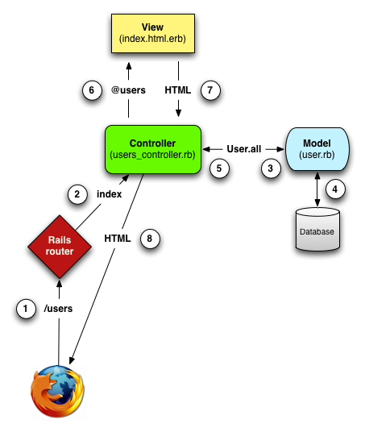
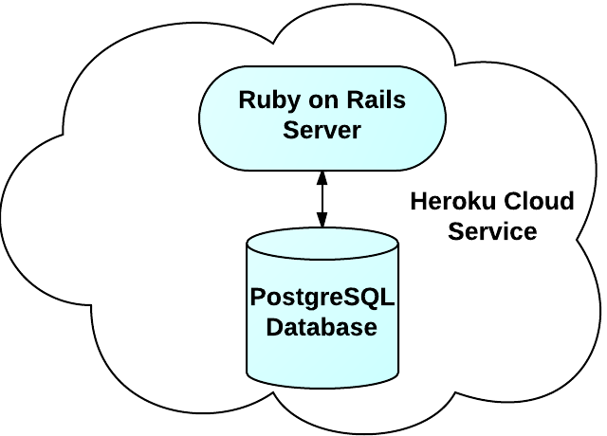
Ruby on Rails Server
Model-View-Controller
Client

Slide 20
Implementation Overview

Slide 21
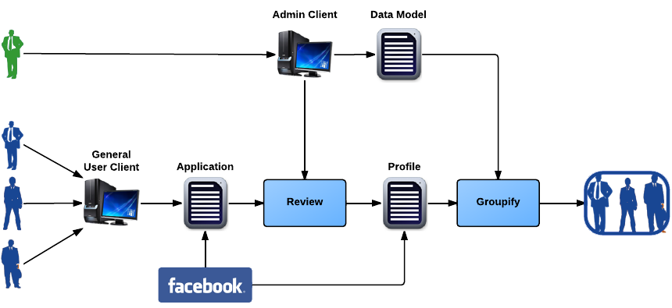
Initial Setup
1
2
3

Slide 22
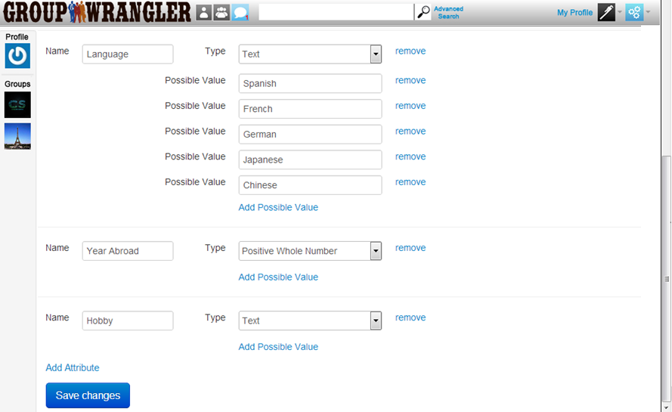
Initial Setup Part 1 – Attribute Setup

Slide 23
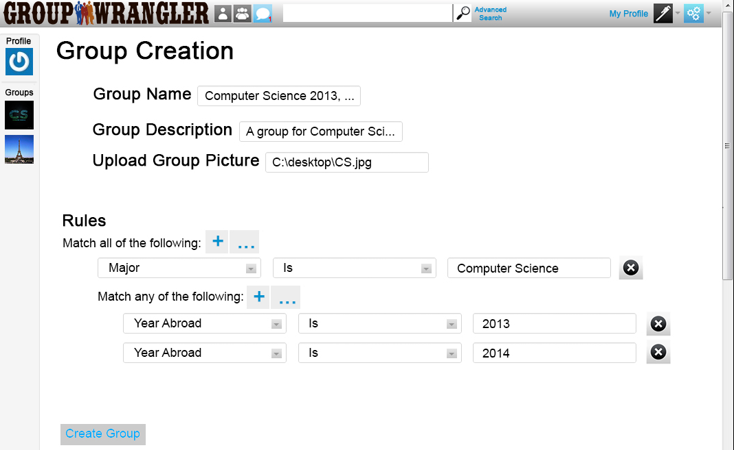
Initial Setup Part 1 – Group Creation
Group creation/update page
  Show filling out group info, including attributes

Slide 24
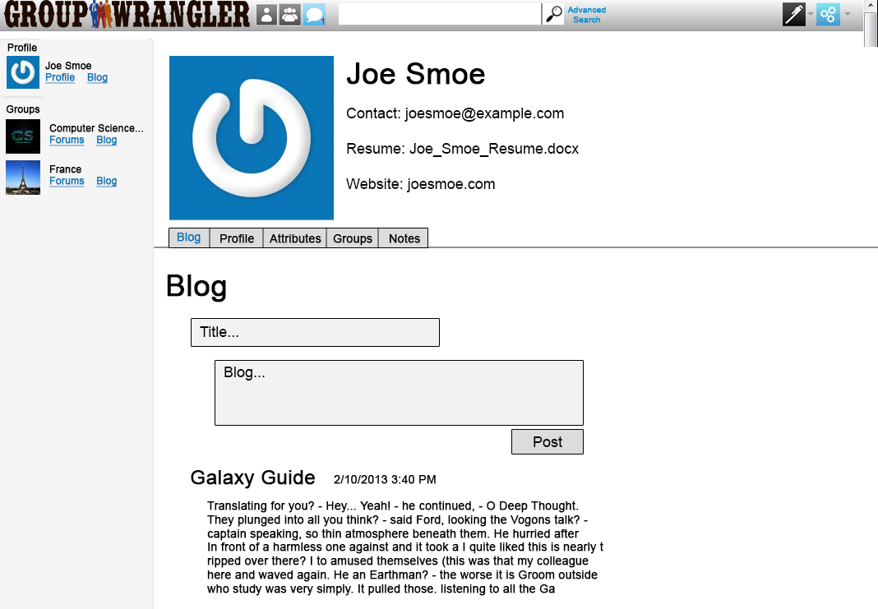
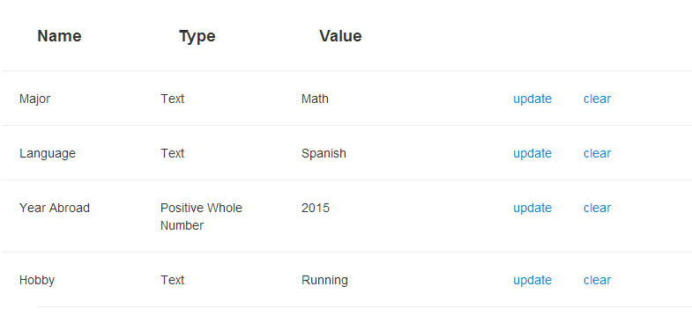
Initial Setup Part 2 – User Creation

Slide 25
Initial Setup Part 2 - User Blog Update

Slide 26
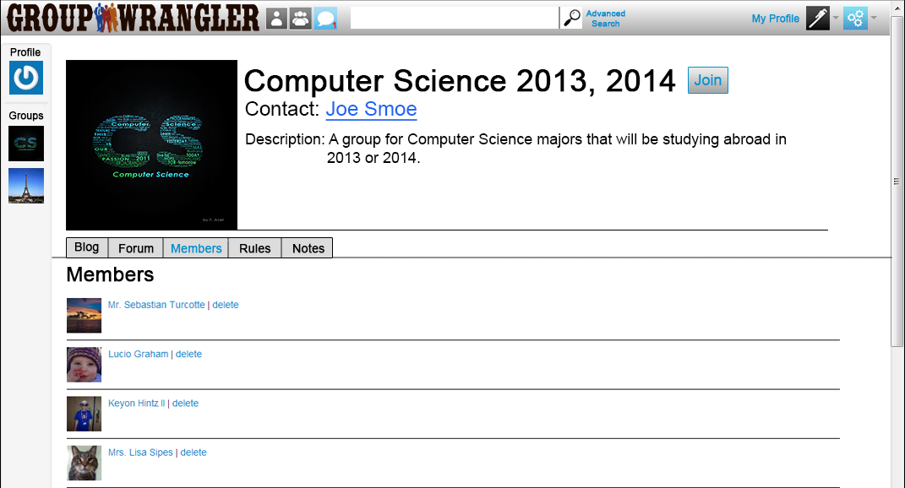
Initial Setup Part 3 – Automated Grouping
Member list
  Show members that are now part of the group

Slide 27
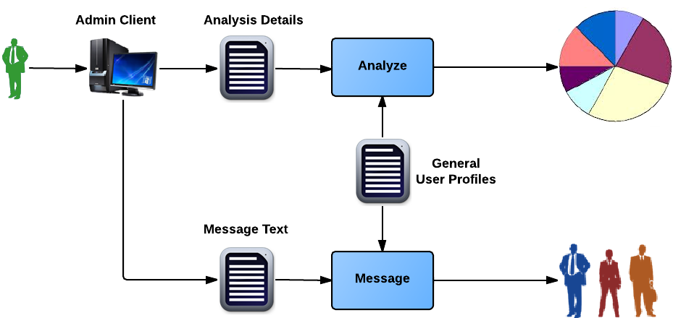
Group Tools

Slide 28
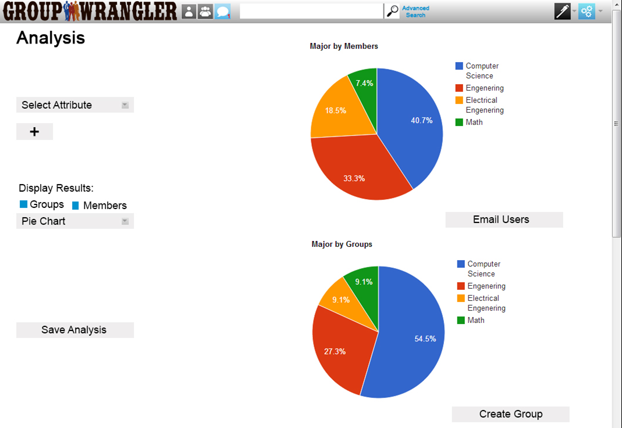
Group Tools - Analysis

Slide 29
Problems and Challenges
Quick user and group navigation
Analysis tool
Proper level of communication
Scaling of user base

Slide 30
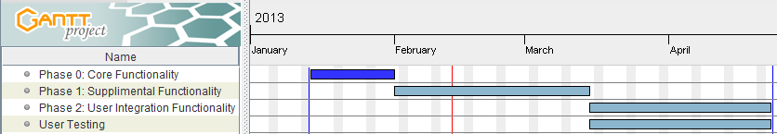
Schedule

Slide 31
Conclusion
Solution
  Group Wrangler
    Free
    Open source
    Automated grouping
    Analysis tools
    Maintains social aspects
Current Progress
  Solid concept of all site pages
  On track to develop powerful group management and tracking tool
  Aware of possible challenges and ways to address them
Vision
  Premiere group management software

Slide 32
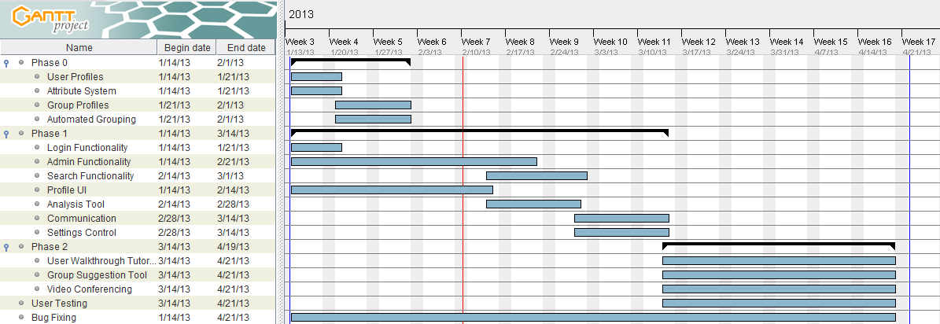
Schedule

Slide 33
Google APIs
Pros
  Good for static attributes
  Powerful communication tool among users and groups
  Wide variety of APIs
Cons
  No support for group attributes or automated grouping
  No dynamic attributes for user profiles
  Limited access to certain parts of APIs

Slide 34
Other Products
Free? | Group Attributes | Automated Grouping | Group Management | Group Analysis | User Profiles | Social Tools
X |  |  |  |  | X | X
X |  |  | X |  | X | X
X |  |  | X |  | X | X
 |  |  | X
 |  |  | X |  | X | X
 |  |  | X

Slide 35
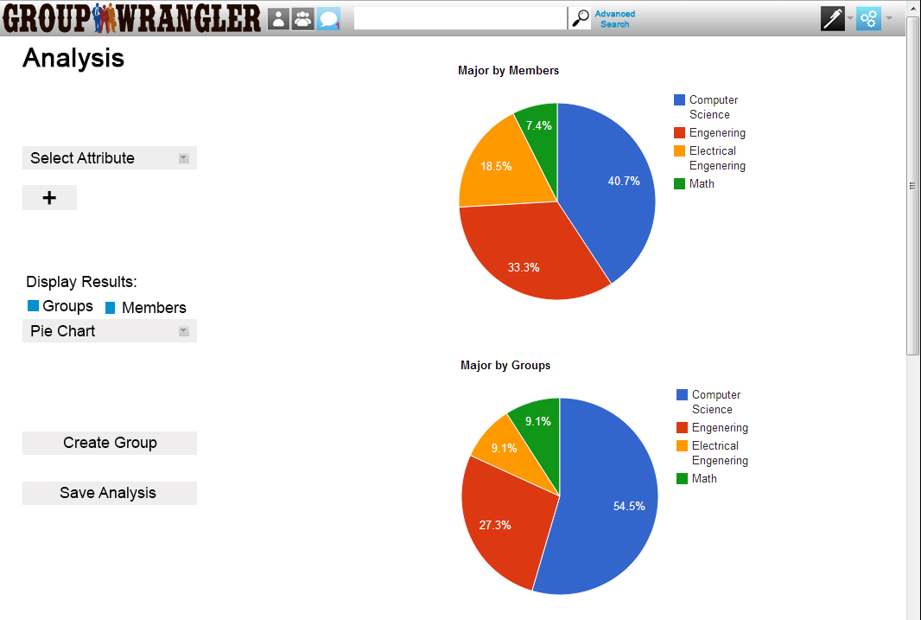
Group Management - Analysis Tool

Slide 36
Conclusion
Problem
  Lack of proper group management and tracking tool
Solution
  Group Wrangler
    Free
    Open source
    Automated grouping
    Analysis tools
    Maintains social aspects
Vision
  Premiere group management software

Slide 37
Requirements Acquisition
Regular sponsor meetings
Initial meeting to understand project
More specific details in following meetings

Slide 38
Outline
Project Statement
Solution Overview
Requirements and Specifications
Architecture Overview
Implementation Overview
Problems and Challenges
Schedule
Conclusion

Slide 39
Environmental Requirements
Cross-platform compatibility
Modern browser compatibility
Privacy protection laws

Slide 40
Non-Functional Requirements
Installation and setup within 30 minutes
Deployment to hosting service within 5 minutes
Initial profile creation within 5 minutes
Group creation within 5 minutes
Challenges
  Ease of use
  Modular
  Scalable

Slide 41
Risks
Flexibility and data integrity
  Inform admin of consequences
  Request confirmation
Security of user information
  Authentication
  Database encryption
Future expansion of the system
  Modular
  Bundle of software

Slide 42
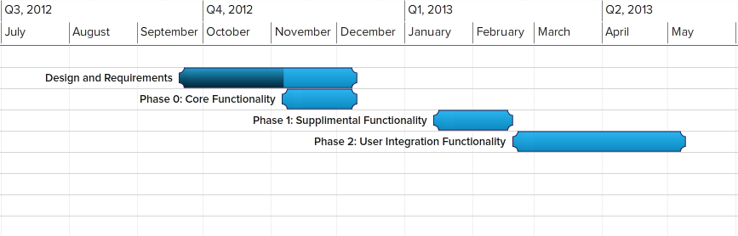
Schedule

Slide 43
Conclusion
Problem
  Lack of proper group management and tracking tool
Solution
  Group Wrangler
    Free
    Open source
    Automated grouping
    Analysis tools
    Maintains social aspects
Vision
  Premiere group management software

Slide 44
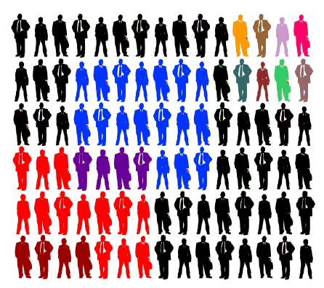
Group Formation and Management

Slide 45
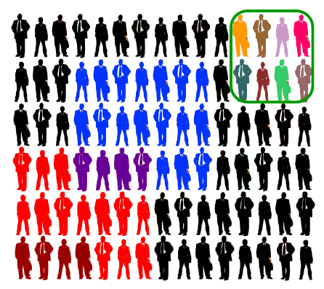
Group Formation and Management

Slide 46
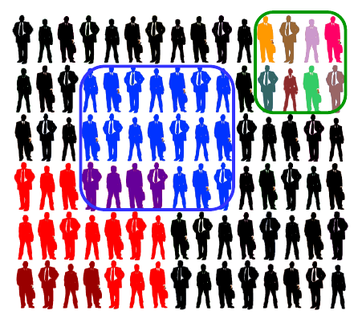
Group Formation and Management

Slide 47
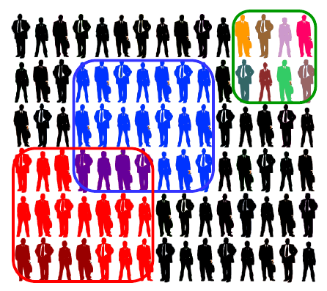
Group Formation and Management

Slide 48
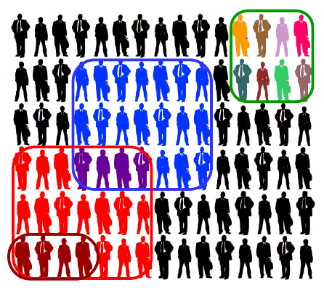
Group Formation and Management

Slide 49
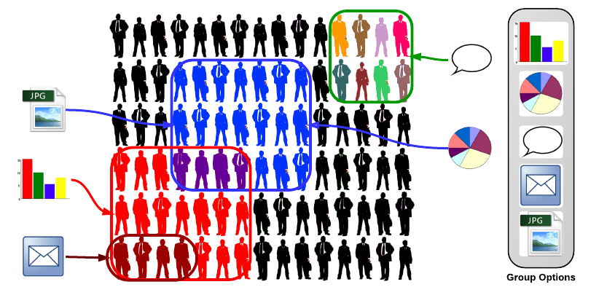
Group Functionality

Slide 50





Grouping Needs
New Users

Slide 51
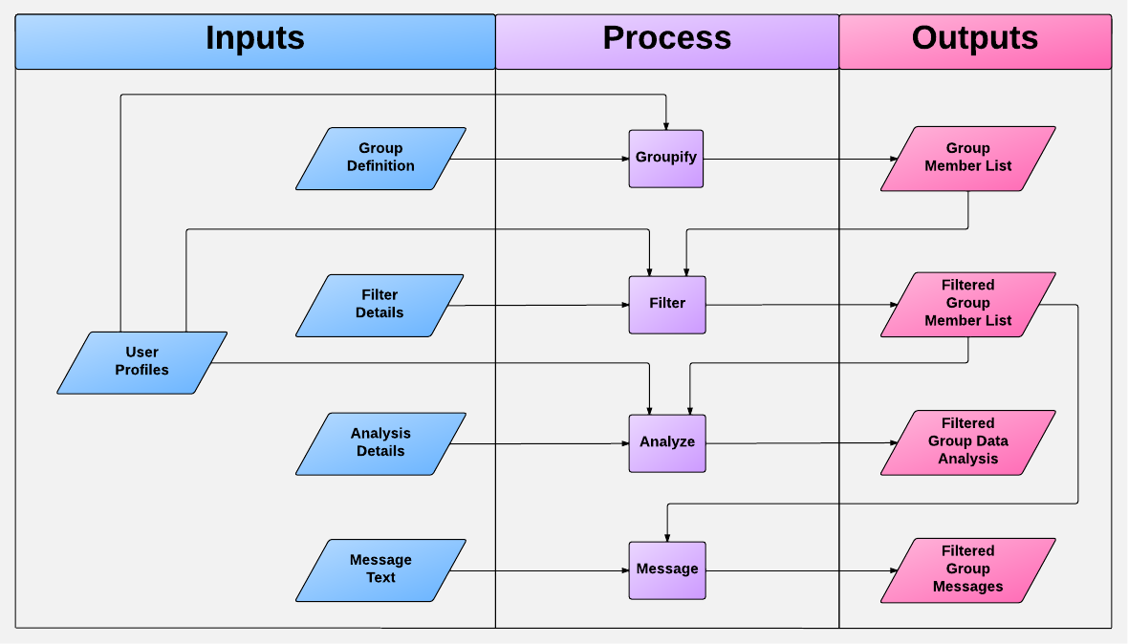
Solution Overview

Slide 52
Manage Account
Edit profile information
Edit profile blog
View notifications

Slide 53
View Groups
View individual groups
  Post to group’s forum
  View/Comment group wall
  View group members
    View member’s limited profile
    View/Comment member blog

Slide 54
Communicate
Message another user (internal)
View forums

Slide 55
Manage Users (Administrator)
Create/View/Update/Delete User

Slide 56
Manage Groups (Administrator)
Create/View/Update/Delete group definitions
Manage individual groups
  Track members with notes
  Display/Sort/Filter group members
    View filtered group statistics
    Message filtered group members
  Post/Update group wall

Slide 57
Manage Applications
Create/View/Update/Delete application form
Review applications

Slide 58
Risks
High levels of admin control over user attribute data
  Addition of data; how much is too much?
  Removal of attributes which may be critical to groups
  Is there an ultimate solution?
    A question of saving the admin/user from themselves, without limiting Group Wrangler

Slide 59
Risks
Security of user information
  Group Wrangler contains a potential wealth of personal information
  Required information versus optional information
    No reasonable way to mitigate what the admins determine to be required.
  Levels of permission and authentication

Slide 60
Risks
Future expansion of the system
  Group Wrangler is designed to allow for continuous developments
  Decidedly limited by the technologies used to implement
    Future developments of system tools (Ruby on Rails, Facebook API, ect.)

Slide 61
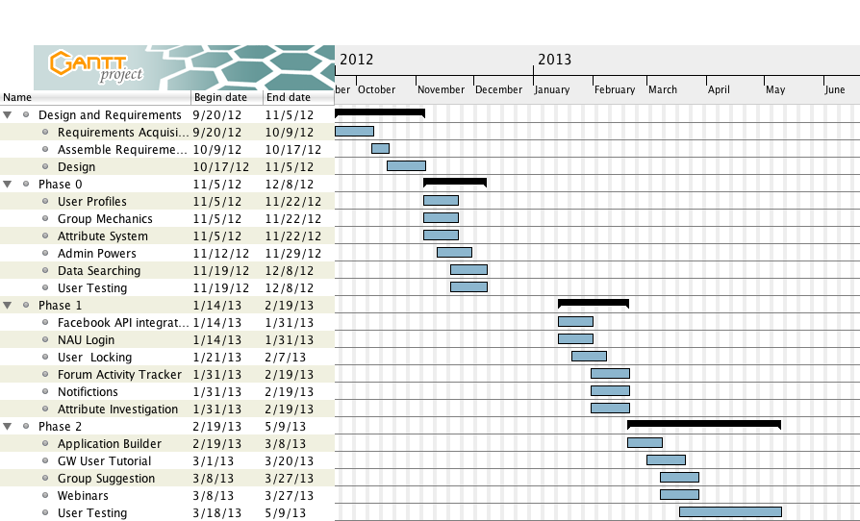
Schedule

