Slide 1

Team Lasso
Greg Andolshek
Alex Koch
Michael McCormick
Shane Russell

Slide 2
Team Lasso
Mentor
  Dr. Eck Doerry
Group Members
  Greg Andolshek - Architect, Release Manager
  Alex Koch - Graphics Designer, Database Manager
  Michael McCormick - Team Leader, Communicator
  Shane Russell - Documenter, Team Website Manager

Slide 3
Outline
Problem Statement
Solution Overview
Key Requirements
Risks
Schedule

Slide 4




Grouping Overview
Groups are everywhere
What groups are you a part of or in charge of?
Types of groups:
  Large companies
  Sports leagues
  Social sites
  Schools
  Political Parties
Need an easy way to:
  Manage groups
  Analyze groups
  Communicate within groups

Slide 5





Grouping Needs
New Users

Slide 6

GSEP
Sponsor
  Melissa Armstrong
Global Science and Engineering Program
Dual degree in 5 years
  Science or Engineering
  Language
1 year Abroad

Slide 7







Other Products
Automated Grouping | Group Management | User Profiles | Social Tools | Cost
 |  | X | X | Free
 |  | X | X | Free
 | X | X | X | Free
 | X |  |  | Setup Fee 1-150 Users $240 Year 15k+ Users $2750+ Year
 | X |  | X | $105 $169
 | X |  |  | $4-$8 Per User/Month

Slide 8
Solution Overview

Slide 9
What is Group Wrangler?
Web-based solution for group management
Key features:
  Group formation and management (smart groups)
  User curation
  Social networking
  Open source
  Free

Slide 10
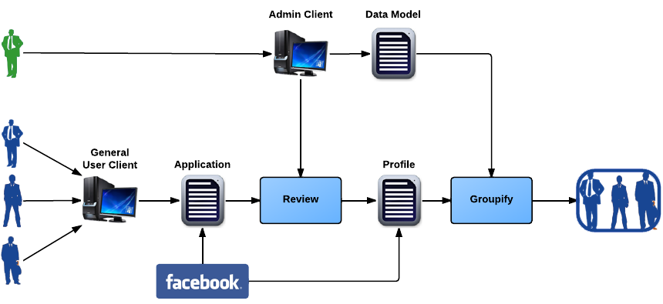
Data Input and Maintenance

Slide 11

Group Formation and Management

Slide 12
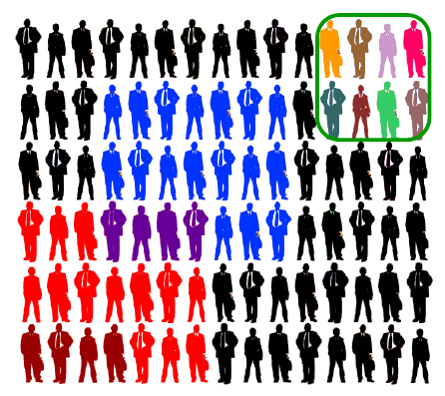
Group Formation and Management

Slide 13
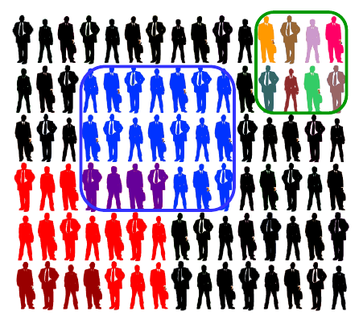
Group Formation and Management

Slide 14
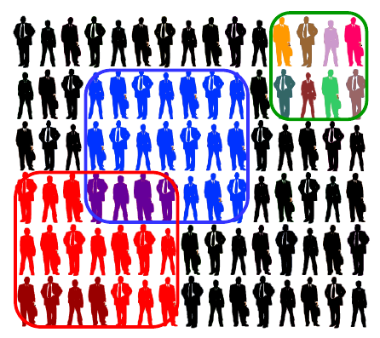
Group Formation and Management

Slide 15
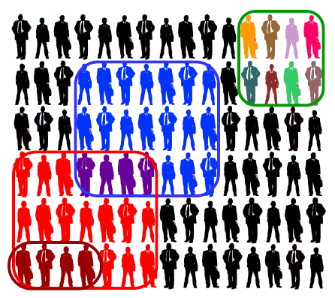
Group Formation and Management

Slide 16
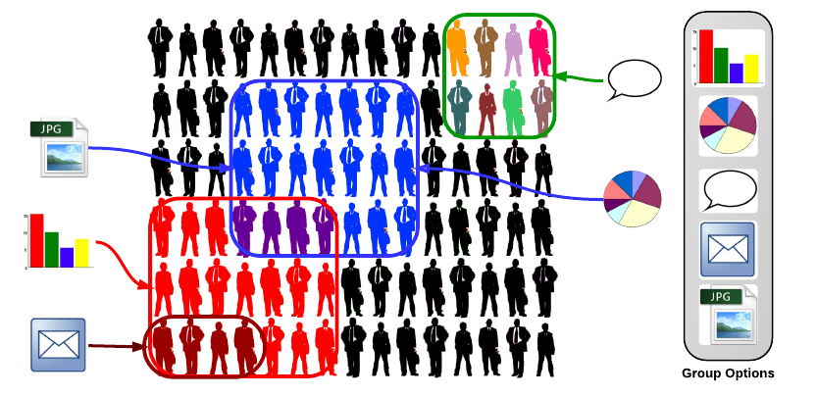
Group Functionality

Slide 17




Technologies
Framework
  Ruby on Rails
Hosting Service
  Heroku
DBMS
  PostgreSQL
Front-end libraries
  Google Chart Tools, JQuery, Angular

Slide 18
Requirements Acquisition
Regular sponsor meetings
Initial meeting to understand project
More specific details in following meetings

Slide 19
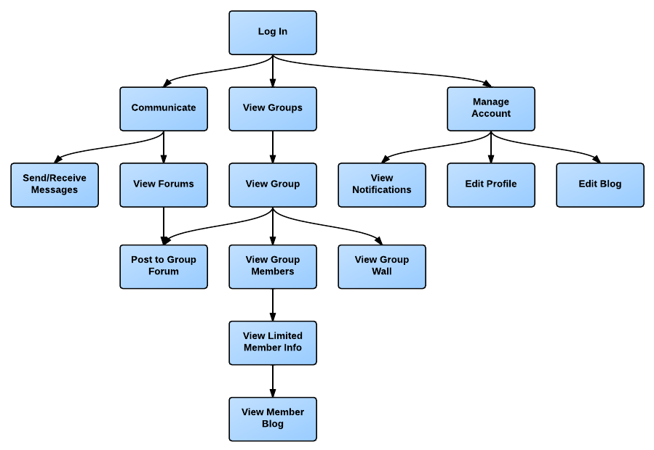
Generic User Functional Requirements

Slide 20
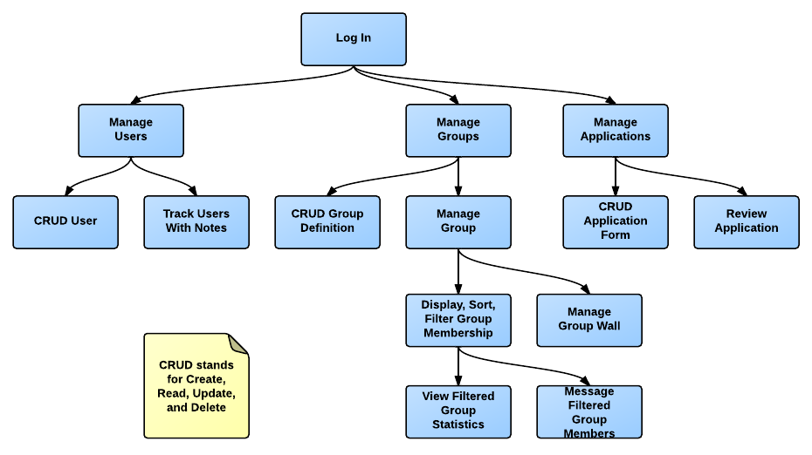
Admin Functional Requirements

Slide 21
Environmental Requirements
Cross-platform compatibility
Modern browser compatibility
Privacy protection laws

Slide 22
Non-Functional Requirements
Installation and setup within 30 minutes
Deployment to hosting service within 5 minutes
Initial profile creation within 5 minutes
Group creation within 5 minutes
Challenges
  Ease of use
  Modular
  Scalable

Slide 23
Risks
Flexibility and data integrity
  Inform admin of consequences
  Request confirmation
Security of user information
  Authentication
  Database encryption
Future expansion of the system
  Modular
  Bundle of software

Slide 24
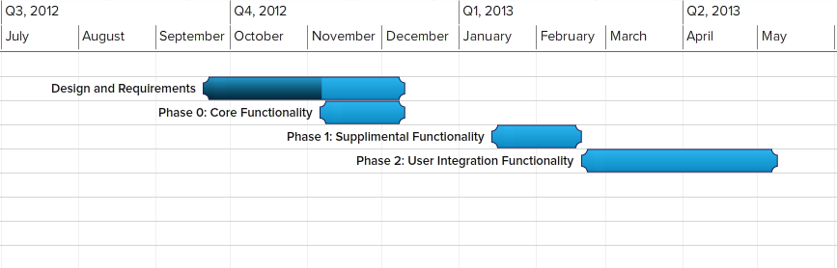
Schedule

Slide 25
Conclusion
Problem
  Lack of proper group management and tracking tool
Solution
  Group Wrangler
    Free
    Open source
    Automated grouping
    Analysis tools
    Maintains social aspects
Vision
  Premiere group management software

Slide 26
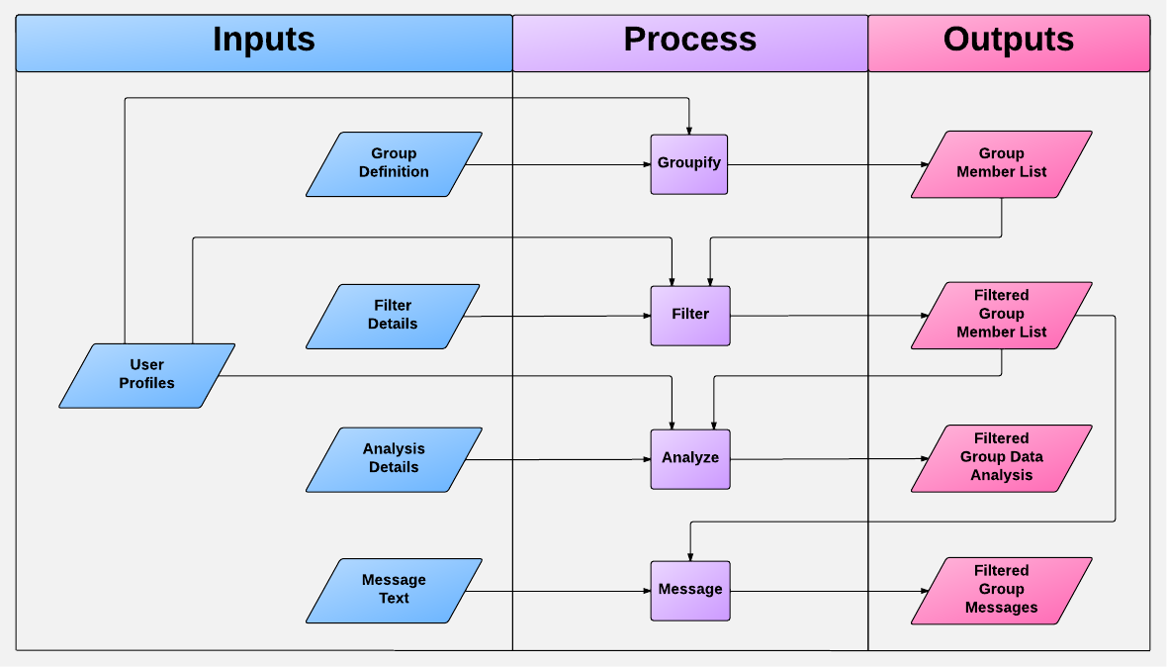
Solution Overview

Slide 27
Manage Account
Edit profile information
Edit profile blog
View notifications

Slide 28
View Groups
View individual groups
  Post to group’s forum
  View/Comment group wall
  View group members
    View member’s limited profile
    View/Comment member blog

Slide 29
Communicate
Message another user (internal)
View forums

Slide 30
Manage Users (Administrator)
Create/View/Update/Delete User

Slide 31
Manage Groups (Administrator)
Create/View/Update/Delete group definitions
Manage individual groups
  Track members with notes
  Display/Sort/Filter group members
    View filtered group statistics
    Message filtered group members
  Post/Update group wall

Slide 32
Manage Applications
Create/View/Update/Delete application form
Review applications

Slide 33
Risks
High levels of admin control over user attribute data
  Addition of data; how much is too much?
  Removal of attributes which may be critical to groups
  Is there an ultimate solution?
    A question of saving the admin/user from themselves, without limiting Group Wrangler

Slide 34
Risks
Security of user information
  Group Wrangler contains a potential wealth of personal information
  Required information versus optional information
    No reasonable way to mitigate what the admins determine to be required.
  Levels of permission and authentication

Slide 35
Risks
Future expansion of the system
  Group Wrangler is designed to allow for continuous developments
  Decidedly limited by the technologies used to implement
    Future developments of system tools (Ruby on Rails, Facebook API, ect.)

Slide 36
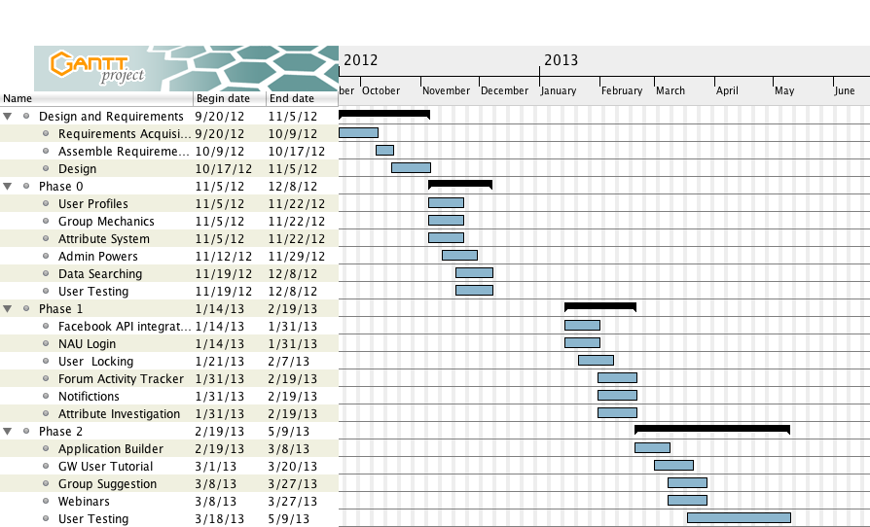
Schedule

