Slide 1
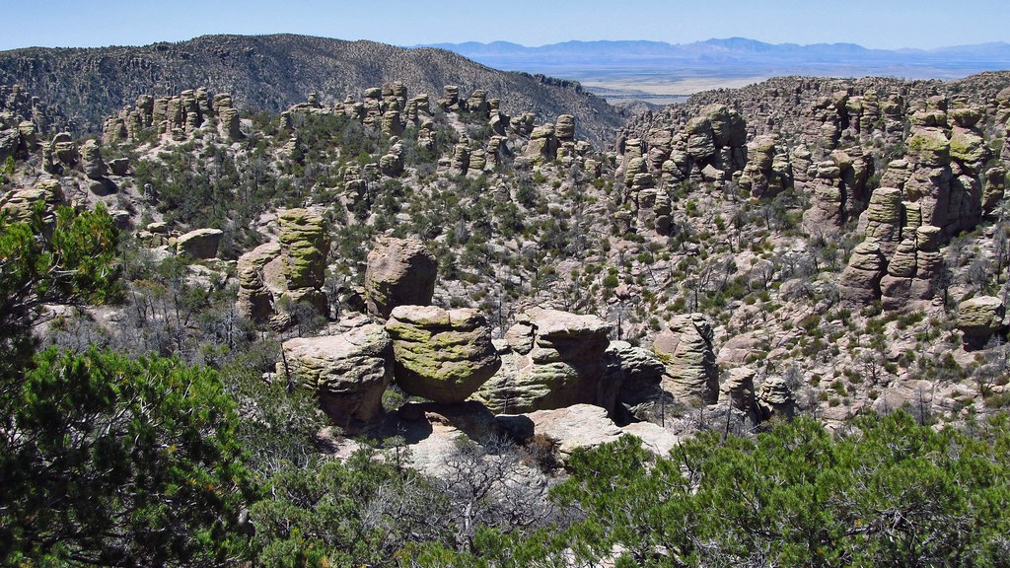

Chiricahua National Monument Septic Design
CENE 486, 5/2/2025
Jeevan Gill, Beizhe Shen, and Nicholas Wakefield
This Photo by Unknown Author is licensed under CC BY-NC-ND

Slide 2
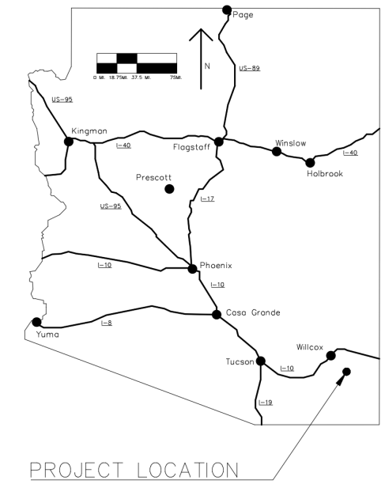

Project Purpose
Chiricahua NM, 30 miles SE of Wilcox, AZ.
NPS wants to expand volunteer housing
Need new RV pads with delivery & removal hookups.
Expected to be 7 units.
Design a wastewater treatment system
Existing wellhead & treatment building
Client: Sam Bell, NPS Chief of Facilities
TA: Ryan Mahar, CD&E
GI: Dr. Heiderscheidt, NAU
Figure 1. Location Map
Notes:
Jeevan

Slide 3
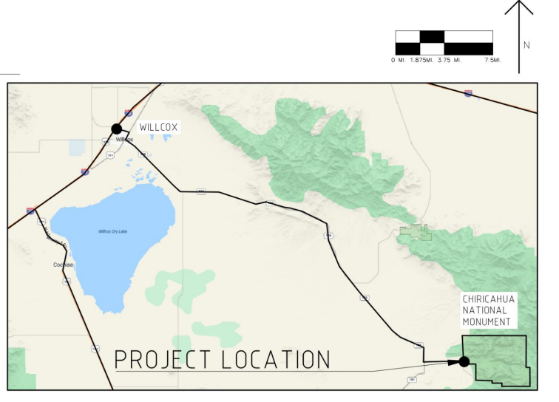
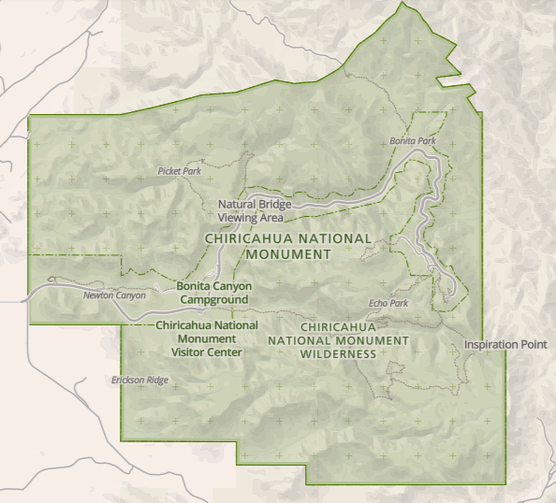
Project Location and Vicinity Maps
Figure 3. Monument Reference Map [4]
Figure 2. Vicinity Map
Notes:
Nick

Slide 4
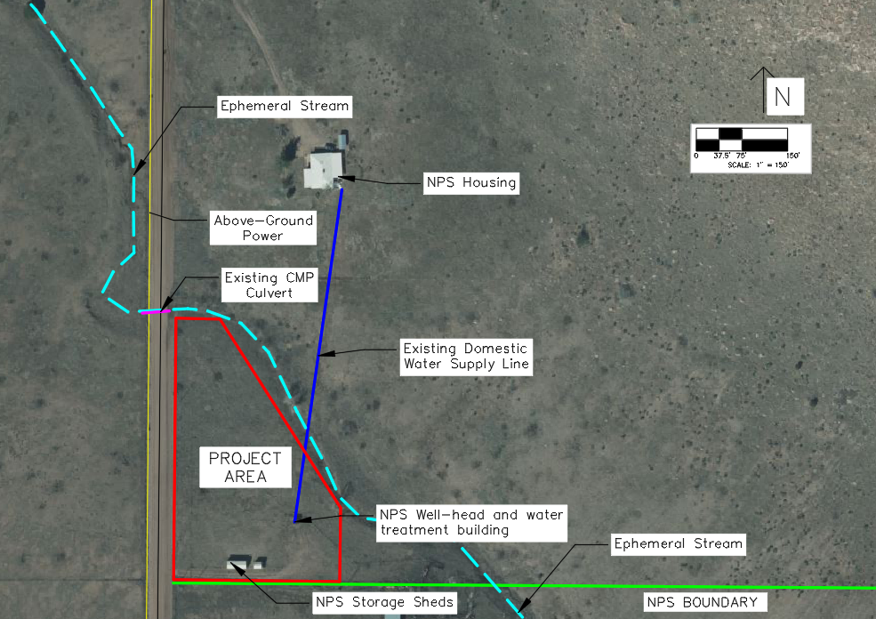
Existing Infrastructure
Figure 4. Existing infrastructure
Notes:
Nick

Slide 5
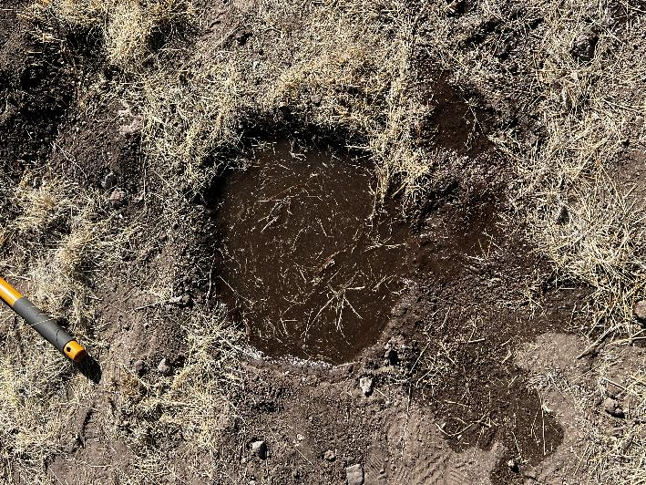
Site Visit and Percolation Testing
Rate: 12 minutes, 16 seconds per inch.​
0.081 in/min​
ADEQ R18-9-A310 req. 1-30 mins/inch [1]
Two on-site percolation tests. ​
First test scrapped, second test in best location on site.​
Utilized ASTM D5921​
1 cu. ft. hole.​
Results in table 1.
Table 1 – Percolation Test Results
Percolation test result (Time / inch)
Trial number | Time
Trial 1 | 11 minutes 40 seconds
Trial 2 | 12 minutes 38 seconds
Trial 3 | 12 minutes 10 seconds
Figure 5. Percolation Test Hole
Photo by J. Gill

Slide 6
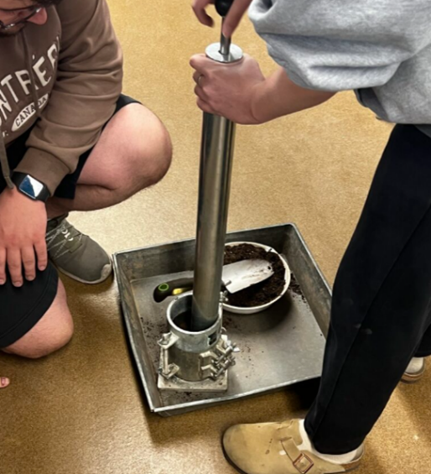
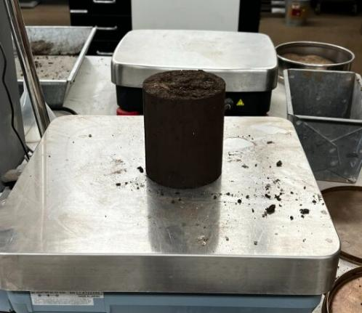
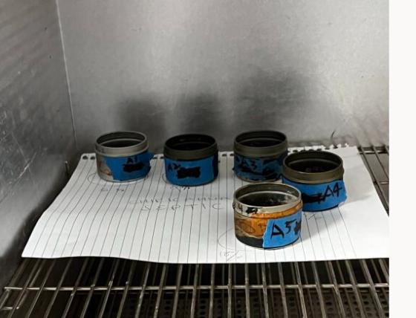
Proctor Compaction Testing
Modified Proctor Compaction (ASTM D1557)
Figure 7. Saturated Sample
Photo by J. Gill
Figure 8. Moisture Content Cans
Photo by J. Gill
Figure 6. Proctor Compaction
Photo by J. Gill

Slide 7
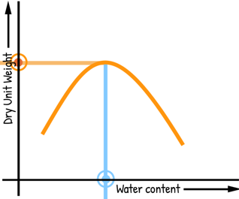
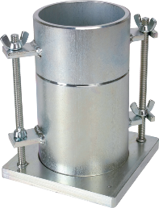
Proctor Compaction Data
Table 2 – Proctor Test Results
Proctor Data
MODIFIED | 1 (6%) | 2 (9%) | 3 (12%) | 4 (15%) | 5 (18%)
W1 (g) | 4610
D (in) | 4
H (in) | 6.63
W2 (g) | 6571 | 6584 | 6567 | 6497 | 6467
Moisture Content Data
Can weight (g) | 13.2 | 13.4 | 13.4 | 13.7 | 13.8
Can + wet soil | 50.4 | 48.2 | 47.7 | 58.4 | 64.4
Can + dried soil | 46.9 | 43.4 | 42.6 | 50.6 | 55.2
Max Dry Density
Optimum Moisture Content
Where:
W1 = Mold weight + base plate
D = Diameter
H = Height
W2 = Mold + base plate + soil
Graph 1 – Moisture Content Graph
Figure 9. Proctor Mold

Slide 8
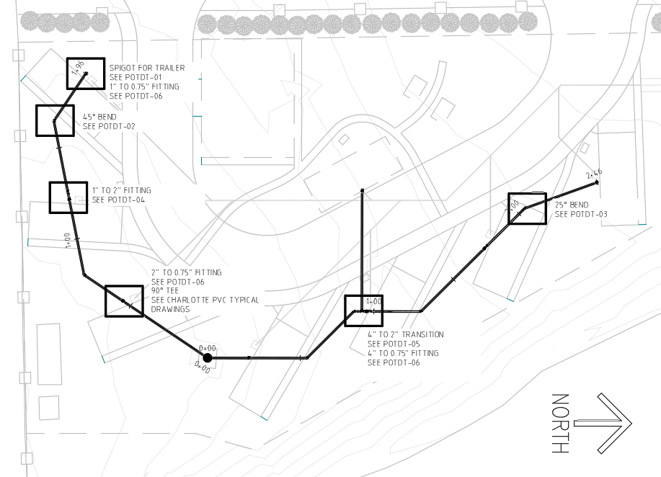
Potable Design
Figure 10. Septic Wide View

Slide 9
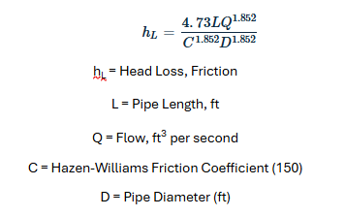
Potable Design Calculations
Table 3 – Pressure at Points
Utilized Energy Equation and solved for pressure to determine pressure at various points.
HDPE used system wide, used standard C = 150.
Hazen-Williams equation for determining headloss between points (below).
Location | End Elevation (ft) | Pressures (psi)
 |  | Well @ 40psi | Well @ 60psi
Trailer 1 | 5145.36 | 40.11 | 60.11
Trailer 2 | 5145.92 | 39.79 | 59.79
Trailer 3 | 5144.68 | 39.87 | 59.87
Trailer 4 | 5144.71 | 40.46 | 60.46
Trailer 5 | 5143.20 | 41.05 | 61.05
Trailer 6 | 5141.91 | 41.59 | 61.52
Trailer 7 | 5139.87 | 42.07 | 62.00
Laundry | 5141.49 | 41.37 | 61.37
Figure 11. Hazen-Williams Head-loss

Slide 10
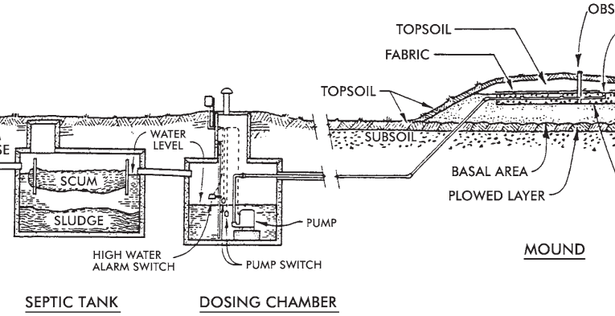
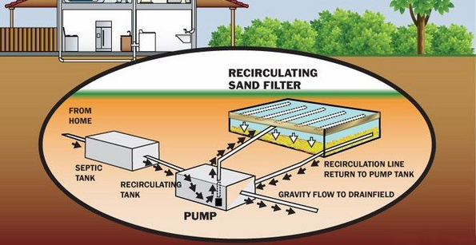
On-Site Wastewater Treatment Systems and Scoring
Figure 12. Septic and Mound System
1 - Least Optimum - Installation costs more than $30,000. Spacing requirements do not comply.
2 - Worse – this score's criteria ranges fall between scores one and three.
3 - Neutral - Installation costs fall within the more than $10,000 less than $20,000 range. Spacing requirements require some space.
4 - Better - this score’s criteria ranges fall between the values for scores three and five.
5 - Optimum - Installation costs for a score of five are less than $10,000. Spacing requirements represent not needing space.
Figure 13. RSF System

Slide 11
Wastewater Treatment System Decision Matrix
Table 4 – Decision Matrix
Design Decision Matrix |  | Septic System |  | Sand Filter |  | Mound System |  | Biomass Filtration
Criteria | Weight | Score | Weighted Score | Score | Weighted Score | Score | Weighted Score | Score | Weighted Score
Maintenance Costs | 2 | 5 | 10 | 3 | 6 | 2 | 4 | 2 | 4
Space Requirements | 3 | 2 | 6 | 5 | 15 | 3 | 9 | 5 | 15
System Longevity | 1 | 4 | 4 | 3 | 3 | 3 | 3 | 2 | 2
Cost of Implementation | 2 | 5 | 10 | 2 | 4 | 4 | 8 | 3 | 6
Total Score |  |  | 30 |  | 28 |  | 24 |  | 27

Slide 12
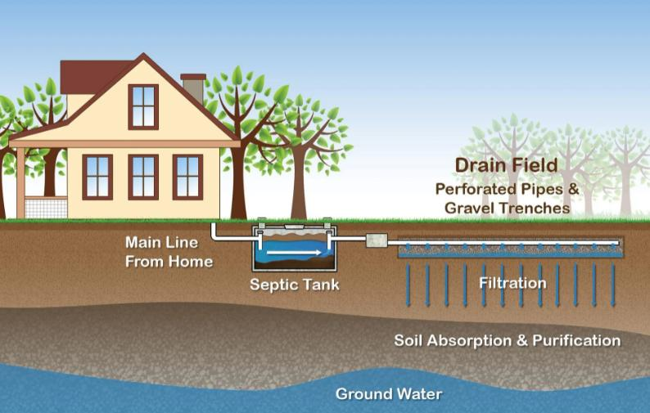
ADEQ R18-9-A314
Table 5 – ADEQ R18-9 Unit Design Flow Table
Wastewater Source | Applicable Unit | Sewage Design Flow per Applicable Unit, (gallons per day)
Airport | Passenger (average daily number) Employee | 4 15
Auto Wash | Facility | Per manufacturer, if consistent with this Chapter
Bar/Lounge | Seat | 30
Barber Shop | Chair | 35
Beauty Parlor | Chair | 100
Bowling Alley (snack bar only) | Lane | 75
Camp Day camp, no cooking facilities Campground, overnight, flush toilets Campground, overnight, flush toilets, and shower Campground, luxury Camp, youth, summer, or seasonal | Camping unit Camping unit Camping unit Person Person | 30 75 150 100-150 50
Figure 14. Septic System [3]

Slide 13
Septic System Design
Using R18-9-A310, the SAR (Soil Absorption Ratio) is found below.
Table 6 – SAR Table
Percolation Test Rate ​ (Minutes per inch) ​ | SAR, Trench, Chamber, and Pit ​ (Gal/day/ft^2) ​
15.0 ​ | 0.50 ​
Table 7 – Design Flow
Design Flow - Units ​
Design Flow Type from A18-9 ​ | Quantity per Unit ​ (GPD) ​ | Unit ​ | Units on Site ​ | Total Consumption (gal./day) ​
Campground, overnight, flush toilets and shower ​ | 150 ​ | Per Site ​ | 7 ​ | 1050 ​

Slide 14
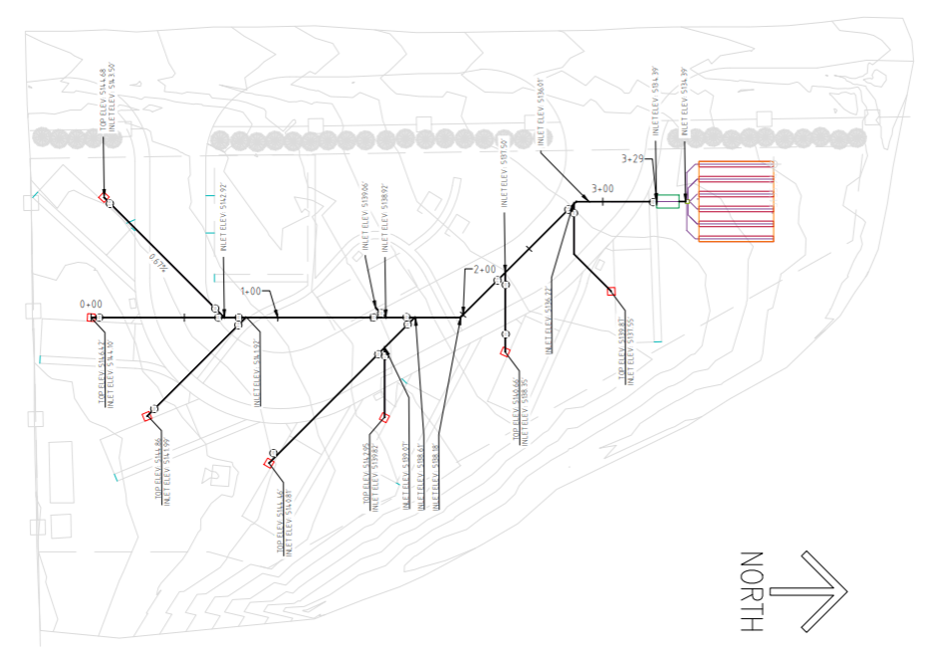
Proposed Infrastructure and On-Site Wastewater
Map
Figure 15. Septic System​

Slide 15
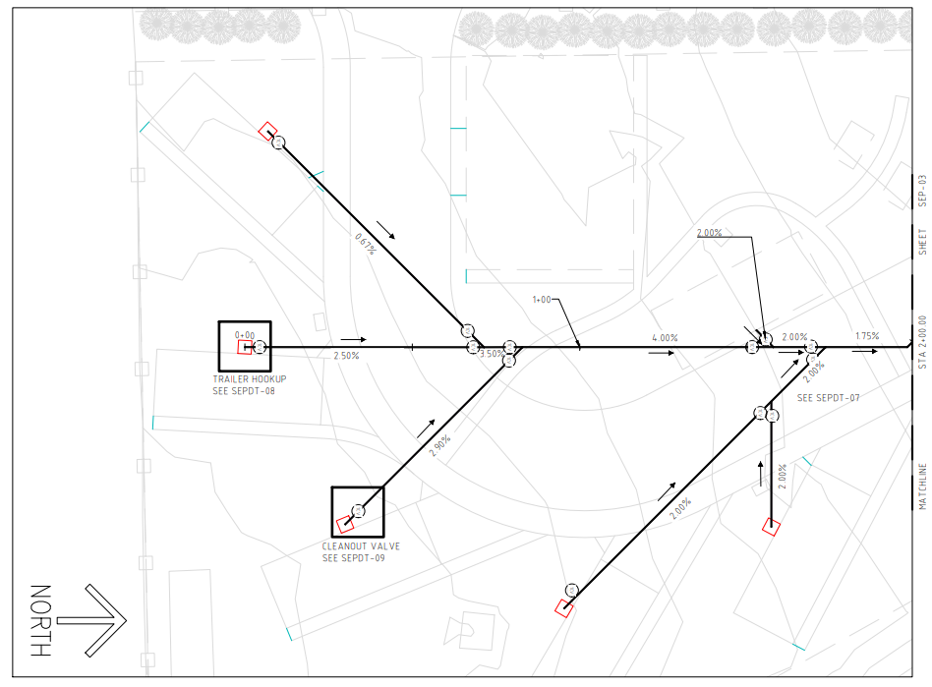
On-Site Wastewater Treatment Map Detail -1
Figure 16. Septic System​ Detail 1

Slide 16
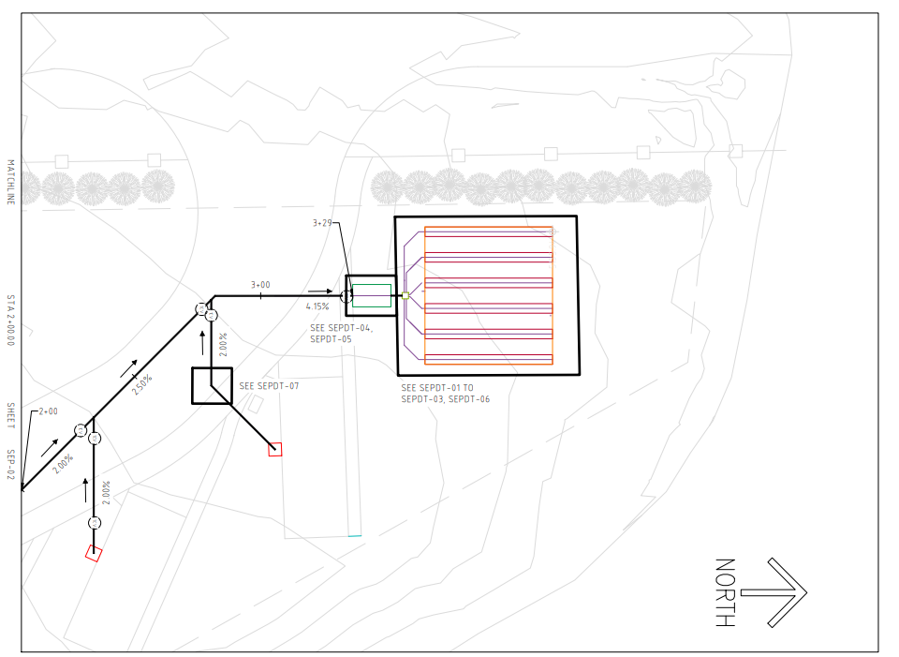
On-Site Wastewater Treatment Map Detail - 2
Figure 17. Septic System​ Detail 2

Slide 17
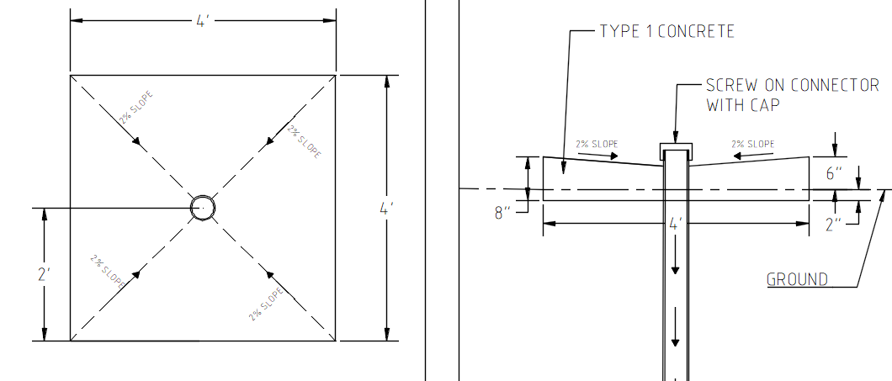
Septic Pipe Hookup
Figure 18. Hookup Detail

Slide 18
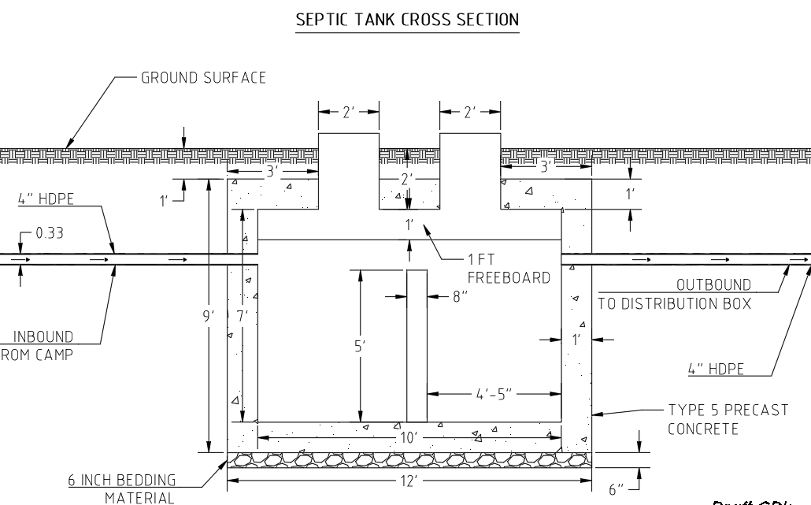
Septic Tank Design – Cross Section
Figure 19. Septic Tank Cross- Section

Slide 19
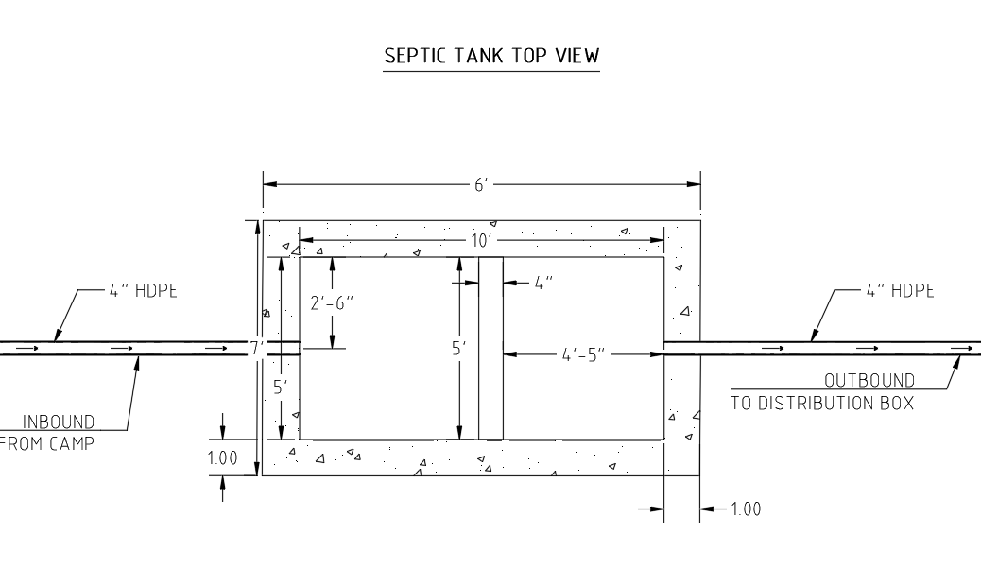
Septic Tank Design – Top View
Figure 20. Septic Tank Top View

Slide 20
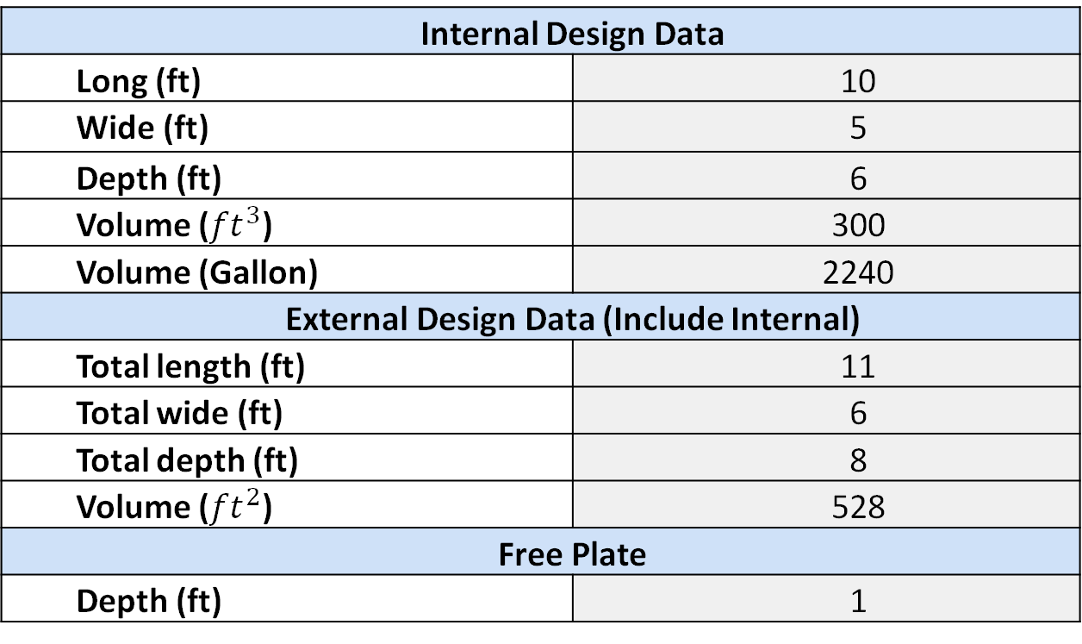
Septic Tank Design Data
Table 8 – Septic System Data
Internal Design Data
Long (ft) | 10
Wide (ft) | 5
Depth (ft) | 6
Volume (${ft}^{3}$) | 300
Volume (Gallon) | 2240
External Design Data (Include Internal)
Total length (ft) | 11
Total wide (ft) | 6
Total depth (ft) | 8
Volume (${ft}^{2}$) | 528
Free Plate
Depth (ft) | 1

Slide 21
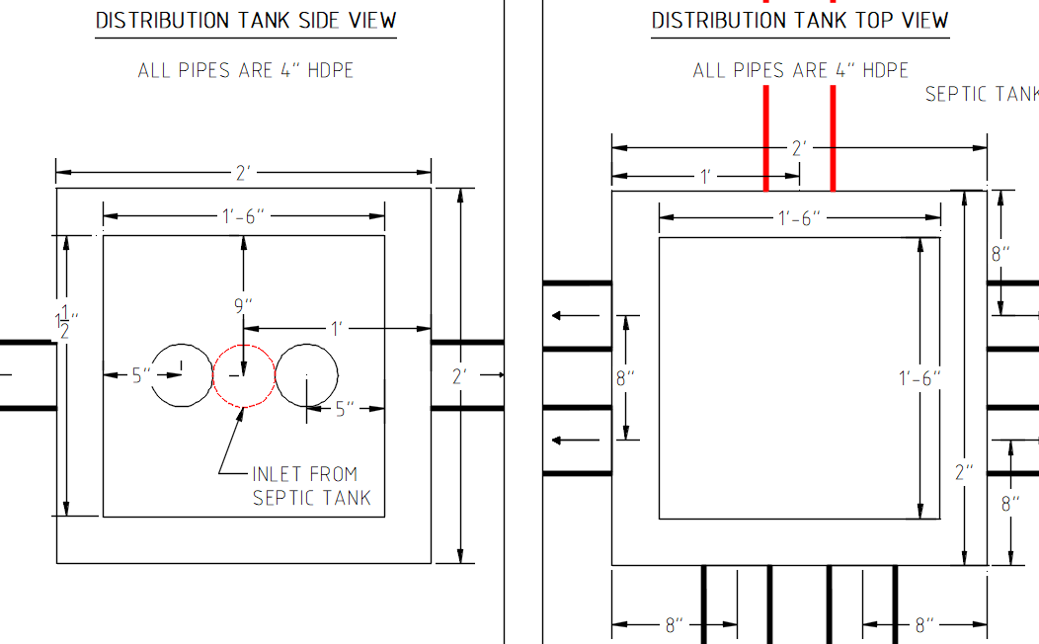
Distribution Box Design
Table 9 – Distribution Box Data
Distribution Box
Side length (ft) | 2
Outlet number | 6
Inlet number | 1
Outlet spacing(in) | 4
Figure 21. Distribution Box Side View
Figure 22. Distribution Box Top View

Slide 22
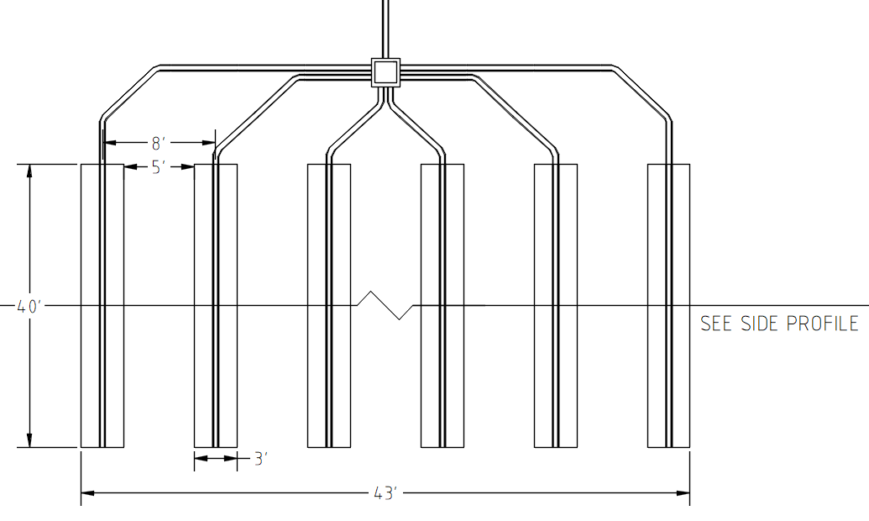
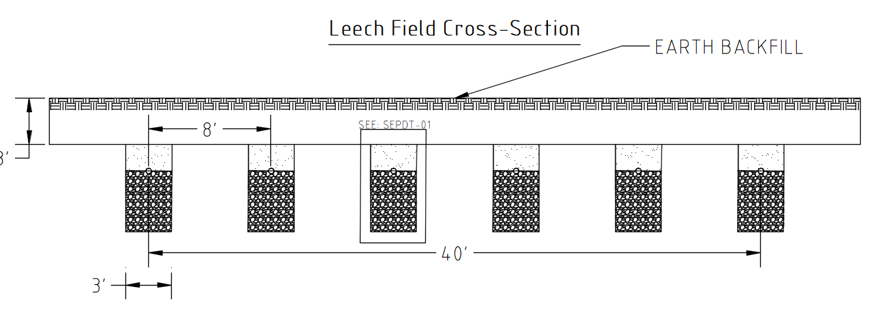
Leach Field Design
Dimensions are 40 feet by 43 feet.
Perforated HDPE Pipe Throughout
Crushed Stone beneath pipes as filter.
Area above pipe refilled with Earth backfill.
Figure 23. Leach Field Top View
Figure 24. Leach Field Cross-Section

Slide 23
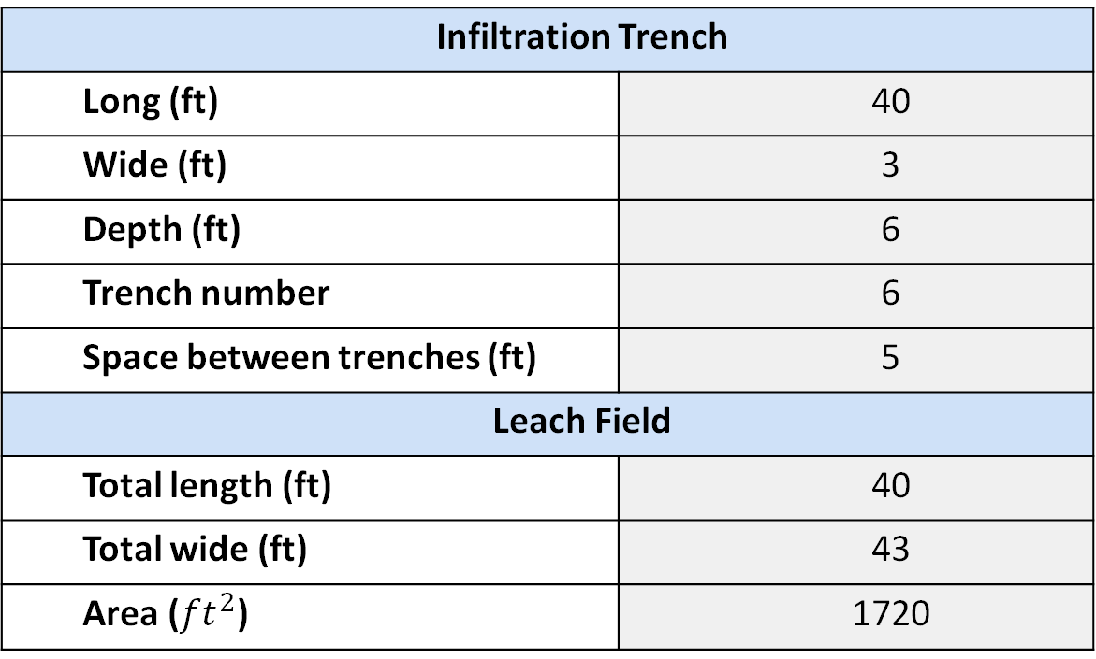
Leach Field Design Data
Table 10 – Leach Field Data
Infiltration Trench
Long (ft) | 40
Wide (ft) | 3
Depth (ft) | 6
Trench number | 6
Space between trenches (ft) | 5
Leach Field
Total length (ft) | 40
Total wide (ft) | 43
Area (${ft}^{2}$) | 1720

Slide 24
Cost Estimate - Wastewater
Table 11 – Wastewater cost estimate
Wastewater Collection System Construction Cost Estimate
Component | Unit | Quantity Estimate | Unit Cost ($) | Cost ($)
4'' HDPE Pipe | ft | 870 | 10 | 8,700
4’’ HDPE perforated Pipe | ft | 240 | 10 | 2,400
Septic Tank (2240 gallons) | unit | 1 | 4,500 | 4,500
Distribution Box (2' *2', 7 outlets) | unit | 1 | 200 | 200
Crushed Stone (Leach Field Bedding) | CY | 107 | 65 | 6,955
Earthwork (Excavation) | CY | 161 | 15 | 2,415
Earthwork (Backfill) | CY | 54 | 15 | 810
45-degree bend | unit | 4 | 23 | 92
45-degree wye junction | unit | 7 | 186 | 1,302
45° HDPE Bend (for 90° turn: 2 each) | unit | 14 | 23 | 322
Threaded Cleanout Adapter | unit | 7 | 18 | 126
HDPE Cap | unit | 7 | 7 | 49
Concrete Housekeeping Pad (2'x2') | unit | 7 | 65 | 455
Labor fee |  |  |  | 14,163
 |  |  | Total cost | $42,489

Slide 25
Cost Estimate - Potable
Table 12 – Potable water cost estimate
Freshwater Cost Estimate
Component | Unit | Quantity Estimate | Unit Cost ($) | Cost ($)
2’’ HDPE pipe | Ft | 363 | 2.2 | 799
1'' HDPE pipe | Ft | 146 | 0.8 | 117
0.75'' HDPE pipe | Ft | 10 | 0.6 | 6
Valve (Brass) | Unit | 8 | 65 | 520
Service Hookups (RV Pads) | Unit | 7 | 150 | 1,050
Earthwork (Excavation) | CY | 4 | 15 | 60
Earthwork (Backfill) | CY | 4 | 15 | 60
1'' 25 Degree Bend | unit | 1 | 6.2 | 7
1'' 45 Degree Bend | unit | 1 | 6.2 | 7
2'' 45 Degree Bend | unit | 4 | 13.2 | 53
2'' 90 Degree Bend | unit | 1 | 7.4 | 8
1'' 90 Degree Bend | unit | 2 | 6.2 | 13
2'' 90 Degree Tee | unit | 6 | 13.2 | 80
2'' to 1'' Fitting | unit | 2 | 9.2 | 19
2'' to 0.75'' Fitting | unit | 5 | 9 | 45
Labor fee |  |  |  | 14,400
 |  |  | Total cost | $17,244

Slide 26
Project Impacts
Environmental
Effluent is treated, through septic tank and leach field, removes harmful discharge to the local soil
NPS site, having a smaller site, minimal site disturbance for the local plants or wildlife
Economic
Smaller site area, costs for installing and maintaining this project will be relatively cheap compared to large scale commercial projects
Provides jobs for local workers and park service employees who will live in RV housing
Long-term savings for the NPS, as the low operation and maintenance costs for a septic system
Societal
Public health and local health, as there is no risk of exposure to untreated wastewater or sewage to those living in the area
Seasonal employees positively affected as there is clean and safe water on site, promotes workforce's wellbeing
Volunteers can enjoy the neighboring plants and vegetation being planted on the project site

Slide 27
Conclusion
Septic system best choice for on-site wastewater treatment.

Slide 28
References
[1] | ​"Ariz. Admin Code 18-9-A310," [Online]. Available: https://casetext.com/regulation/arizona-administrative-code/title-18-environmental-quality/chapter-9-department-of-environmental-quality-water-pollution-control/article-3-aquifer-protection-permits-general-permits/part-a-general-provisions/section-r18-9-a.
[2] | https://websoilsurvey.nrcs.usda.gov/app/WebSoilSurvey.aspx [Online].
[3] | https://www.cleanearthseptic.com/septic-system-101-how-things-work [Online].
[4] | TITLE 18. ENVIRONMENTAL QUALITY CHAPTER 9. DEPARTMENT OF ENVIRONMENTAL QUALITY WATER POLLUTION CONTROL, [Online]. Available: https://www.maricopa.gov/DocumentCenter/View/7495/Arizona-Administrative-Code-Title-18-Chapter-9-Articles-1-2-3-4-PDF

Slide 29




Thank you.

