Slide 1
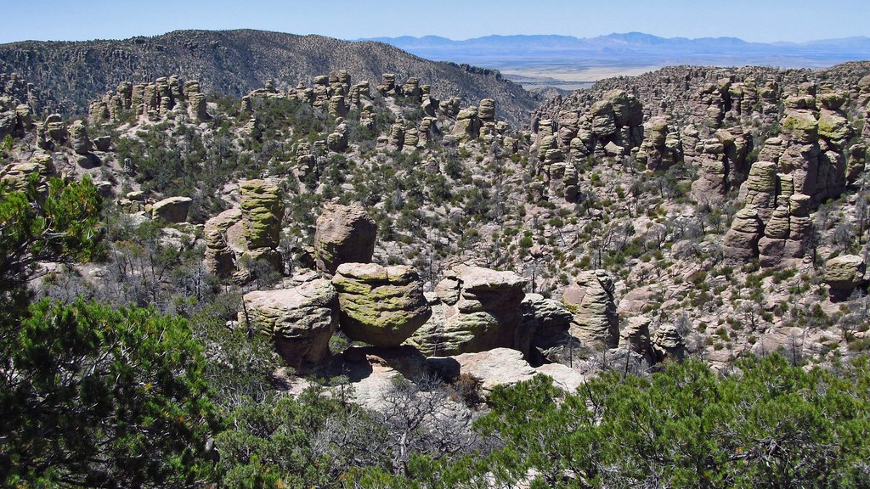

Chiricahua National Monument Septic Design
CENE 476, 12/6/2024
Jeevan Gill, Nicholas Wakefield, and Beizhe Shen
This Photo by Unknown Author is licensed under CC BY-NC-ND

Slide 2
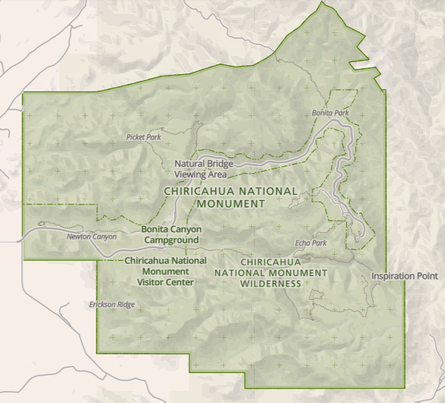
Project Purpose
Chiricahua NM, 30 miles SE of Wilcox, AZ.
NPS wants to expand volunteer housing
Need new RV pads with delivery & removal hookups.
Expected to be 5-7 units.
Design a wastewater treatment system
Existing wellhead & treatment building
Wilcox
Figure 1. Monument Reference Map [4]
Notes:
Jeevan

Slide 3

Client Information
Client:
  Sam Bell, National Park Service
  Chief of Facilities Management
Technical Advisor:
  Ryan Mahar, CD&E Flagstaff
Grading Instructor
  Dr. Heiderscheidt, Northern Arizona University
Notes:
Beiz

Slide 4
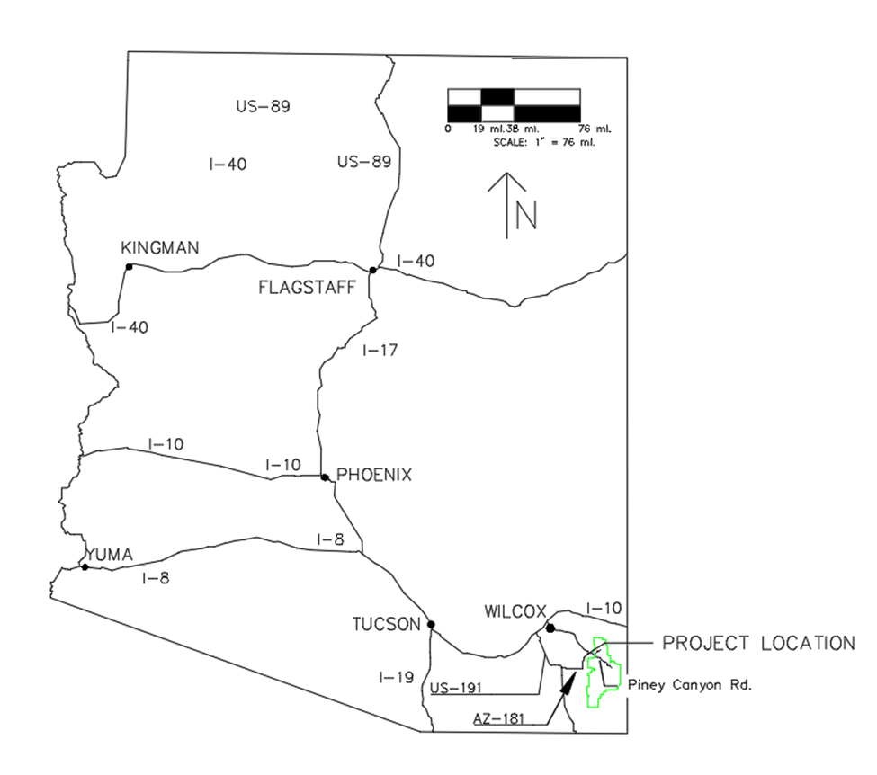
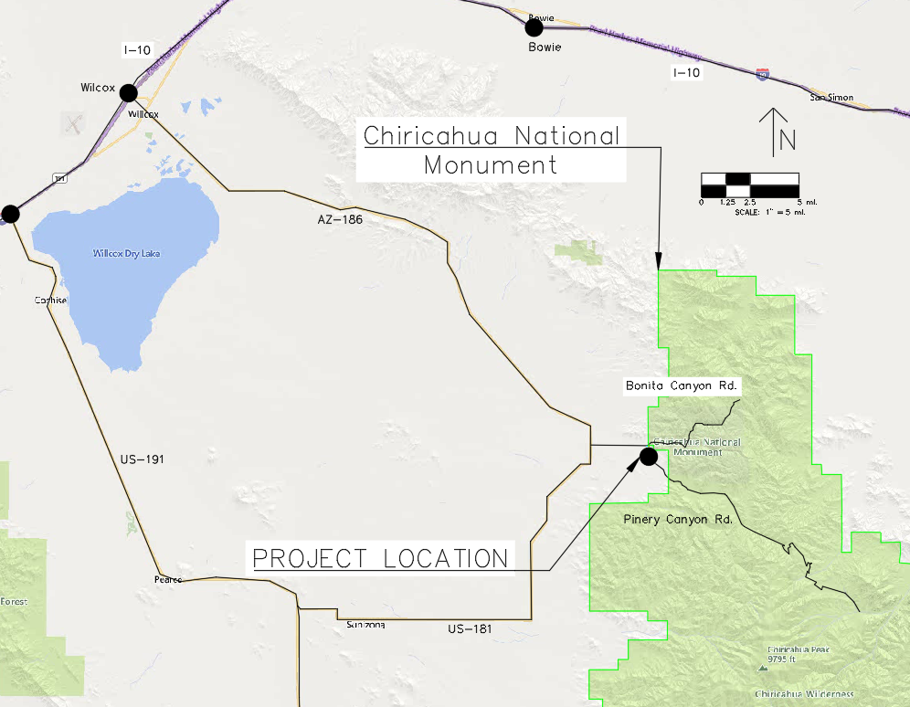
Project Location Map
Location Map
Figure 2.Location Map
Figure 3.Vicnity Map
Notes:
Nick

Slide 5
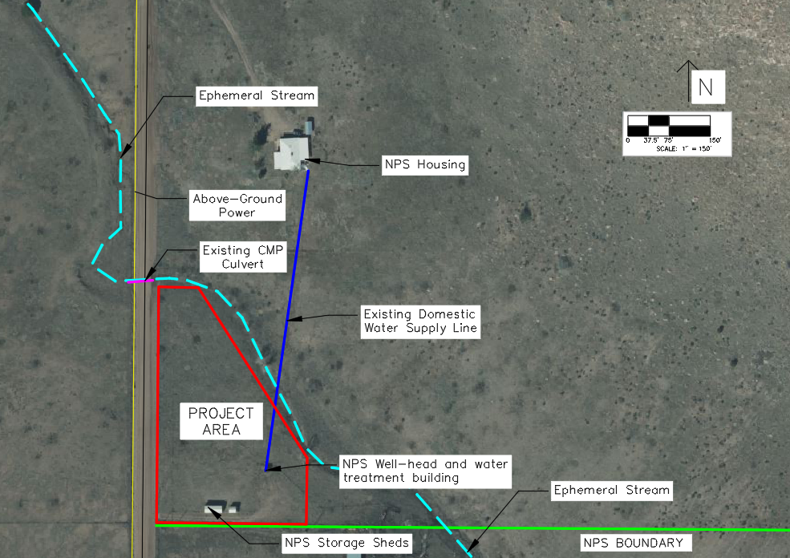
Existing Infrastructure
Figure 4. Existing infrastructure
Notes:
Nick

Slide 6
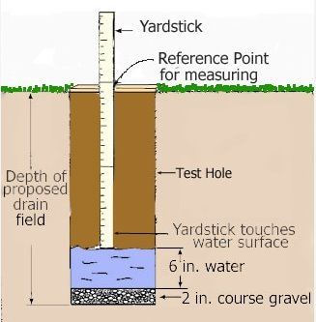
Scope Tasks 1-2
Task 1: Research and Existing Data
  Task 1.1: Regulatory Research
  Task 1.2: Research Onsite Wastewater Treatment Options
Task 2: Site Visit
  Task 2.1: Site Visit Planning
  Task 2.2: Land Survey
  Task 2.3: Existing Infrastructure Assessment
  Task 2.4: Percolation Test
  Task 2.5: Geotechnical Observations & Sampling
Figure 5. Percolation test [7]

Slide 7

Scope Tasks 3-5
Task 3: Geotechnical Sampling Analysis
  Task 3.1: Obtain Lab Access
  Task 3.2: Compaction Testing
  Task 3.3: Soil Classification
Task 4: Topographical Map Development
  Task 4.1: Import Map Data
  Task 4.2: Create Relevant Map Features
Task 5: Freshwater Distribution System
  Task 5.1: Determine Water Demand
  Task 5.2: Complete Pipe System Design

Slide 8
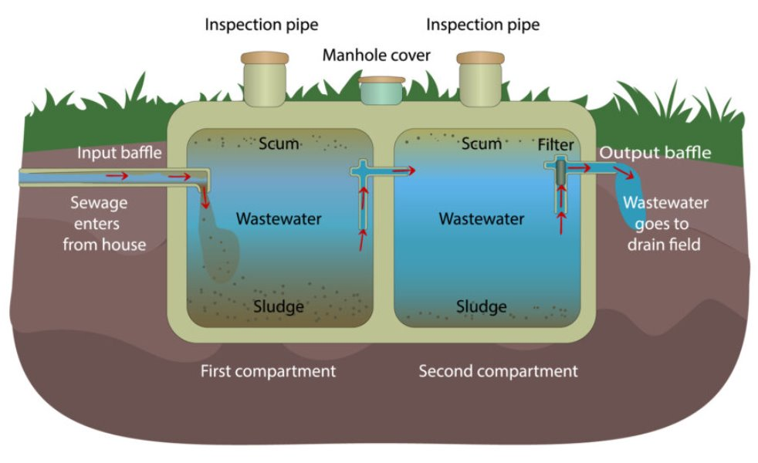
Scope Tasks 6-7
Task 6: Onsite Wastewater Treatment Design
  Task 6.1: Develop Treatment Alternative Concepts
  Task 6.2: Identify Criteria for Alternatives
  Task 6.3: Select Best Design
  Task 6.4: Final Treatment Design
Task 7: Wastewater Collection System Design
  Task 7.1: Calculate Wastewater Design Flow
  Task 7.2: Pipe Size and Material Selection
Figure 6. Two Chamber Septic Tank [3]

Slide 9

Scope Tasks 8-9
Task 8: Develop Construction Cost Estimate
Task 9: Plan Set Development
  Task 9.1: Cover Sheet Development
  Task 9.2: Existing Site Plan
  Task 9.3: Proposed Site Plan
  Task 9.4: Treatment System Plan and Profile
  Task 9.5: Detail Sheet Development

Slide 10
Scope Tasks 10-11
Environmental
Social
Economic
Task 10: Evaluate Project Impacts
Task 11: Deliverables
  Task 11.1: 30% Submittal
  Task 11.2: 60% Submittal
  Task 11.3: 90% Submittal
  Task 11.4: Final Submittal

Slide 11

Scope Task 12
Task 12: Project Management
  Task 12.1: Meetings
  Task 12.2: Schedule Management
  Task 12.3: Resource Management

Slide 12

Exclusions
Environmental Impact Assessment (EIA)
Hydrologic Analysis
  Drainage & Roadway
Notes:
Jeevan

Slide 13
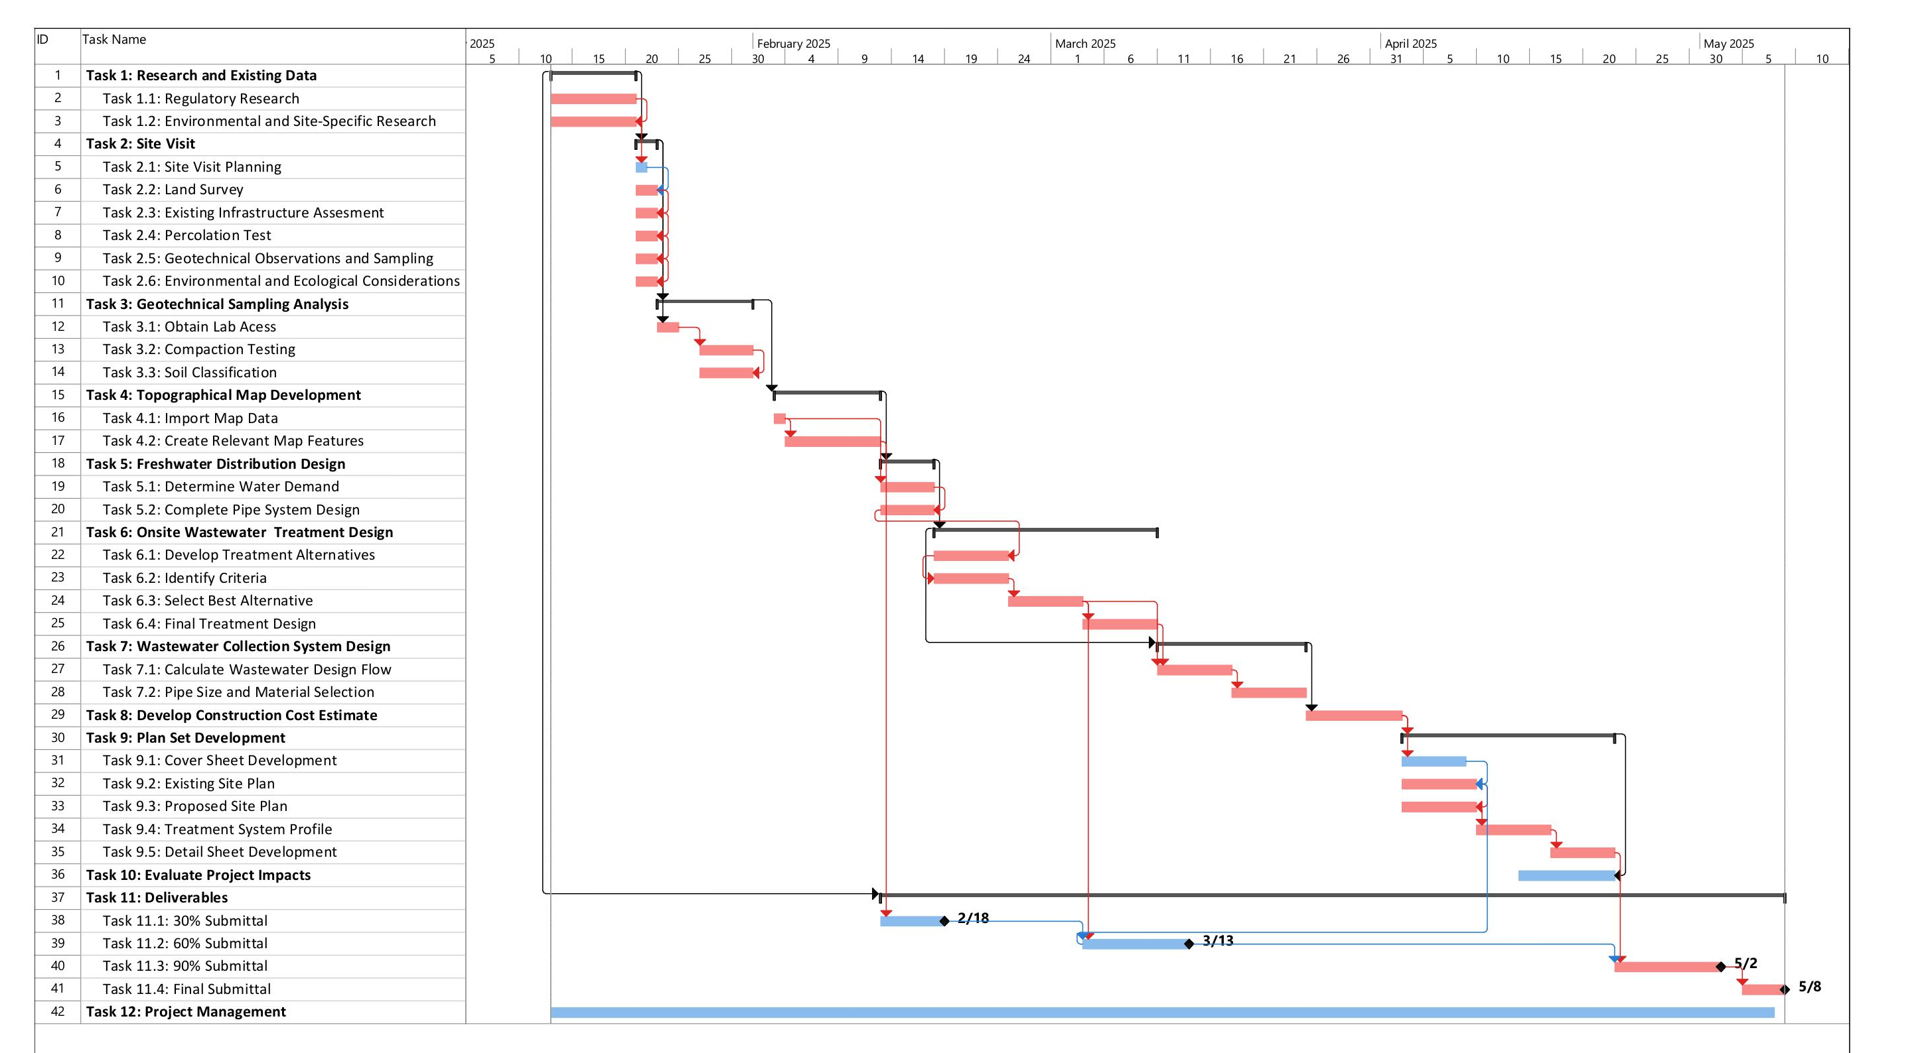

Slide 14
Staffing Positions
Four Roles:
Senior Engineer (SENG)
  M.S. in Civil or Enviornmental Preferred, not required
  PE License
  12+ Years of Industry Experience
Engineer (ENG)
  B.S. in Civil or Enviornmental Engineering Required
  PE License
  5+ Years of Industry Experience
Engineer-In-Training (EIT)
  B.S. in Civil or Enviornmental Engineering Required
  Passed FE Exam, EIT Certification
  1-2 Years of Industry Experience
Intern (INT)
  Enrolled in ABET Accredited Civil or Enviornmental Engineering Program

Slide 15
Staffing Matrix
Task Name | Senior Engineer | Engineer | EIT | Intern | TOTAL HOURS BY TASK
Task 1 Research and Existing Data | 0 | 2 | 7 | 8 | 17
Task 2 Site Visit | 1 | 8 | 26 | 13 | 48
Task 3 Geotechnical Sampling Analysis | 2 | 3 | 4 | 4 | 13
Task 4 Topographical Map Development | 1 | 1 | 4 | 16 | 22
Task 5 Freshwater Distribution Design | 10 | 21 | 66 | 33 | 130
Task 6 Onsite Wastewater Treatment Design | 11 | 19 | 19 | 15 | 64
Task 7 Wastewater Collection System Design | 2 | 5 | 2 | 3 | 12
Task 8 Develop Construction Cost Estimate | 1 | 2 | 5 | 2 | 10
Task 9 Plan Set Development | 3 | 13 | 38 | 43 | 96
Task 10 Evaluate Project Impacts | 3 | 6 | 2 | 0 | 11
Task 11 Deliverables | 8 | 8 | 16 | 24 | 56
Task 12 Project Management | 6 | 11 | 3 | 0 | 20
TOTAL | 51 | 103 | 196 | 165 | 514

Slide 16
Cost of Engineering Services
1.0 Personnel | Classification | Hours | Rate, $/Hour | Cost, $
 | SENG | 50.5 | 240 | $12,120
 | ENG | 102.5 | 180 | $18,450
 | EIT | 196 | 141 | $27,636
 | INT | 165 | 82 | $13,530
Personnel Total |  |  |  | $71,736
2.0 Travel | Classification | Items | Cost Per, $ | Cost, $
 | Car Rental | Mini Van,3 Days | $49.75/day | $150
 | Hotel | 3 Rooms, 2 Nights | $145/room/day | $870
 | Mileage | 744 miles | $0.26/mile | $194
 | Per Diem | 3 Person, 3 Days | $54/person/day | $486
Travel Total |  |  |  | $1,700
3.0 Supplies | Classification | Items | Cost Per, $ | Cost, $
 | 5 Gallon Bucket | 1 Unit | $4.00 | $4
 | Quart Ziplock Bags | 40 bags | $0.1/bag | $4
 | Surveying Equipment | 3 Days | $100/day | $300
 | Soils Lab Rental | 10 Days | $100/day | $1,000
Supplies Total |  |  |  | $1,308
Total Cost | $74,774

Slide 17
References
[1] | National Cooperative Soil Survey, U.S.A., "Soil Data Explorer - Chiricahua," 2013. [Online]. Available: https://casoilresource.lawr.ucdavis.edu/sde/?series=Chiricahua#osd.
[2] | "What Is The Best pH Level of Water For Drinking?," [Online]. Available: https://drinkflowater.com/what-is-the-best-ph-level-of-water-for-drinking/#:~:text=The%20U.S.%20Environmental%20Protection%20Agency,the%20middle%20at%20a%207.
[3] | "Septic Tank and Drain field Design" [Online], Available: https://dkkcinc.com/septic-tank-and-drainfield-design.
[4] | “Maps”, [Online]. Available: https://www.nps.gov/chir/planyourvisit/maps.htm.
[5] | “Public Domain Pictures”, [Online]. Available: https://www.publicdomainpictures.net/en/view-image.php?image=2928&jazyk=IT.
[6] | “Importance of Proctor Compaction Test in Soil Engineering ”, [Online]. Available: https://blog.certifiedmtp.com/importance-of-proctor-compaction-test-in-soil-engineering/
[7] | “Who can perform a perc test", [Online]. Available: https://buildingadvisor.com/who-should-i-hire-for-a-perc-test/

