Slide 1

Remediation of E. Coli Contaminated Surface Water in Arizona Via Fungi
CENE476 Proposal
By: David Hammond, Chase McLeod, & Mishael Umlor
Date: December 6, 2019
Notes:
David

Slide 2
Introduction
Purpose: Quantify the capability of Arizona native fungi to remediate E. coli from water using biofilters
Client & Stakeholder: Dr. Wilbert Odem & Hooper Undergraduate Research Award (HURA)
Location: Research Performed in the NAU Environmental (EnE) Lab & Science Lab Facility (SLF) Mycology Lab
Background: Past research proved fungi, including King Stropharia and Oyster Mushrooms, remediate E. coli from synthetic storm water in the Northwest [1,2].
Notes:
Mishael

Slide 3
1.0 Constraints & Criteria
1.1 Timing
Time of Growth
HURA Cutoff: April 30th
1.2 Native Fungi
Successful Growth Of Fungi
1.3 Contamination
Keeping Lab Samples Pure & Uncontaminated By Other Microorganisms
1.4 Budget
Available Personnel To Complete Large Data Pool
Equipment Funding: Signal Electron Microscope (SEM), Microphotography, Laminar Flow Hood, & lab use
Notes:
Chase

Slide 4
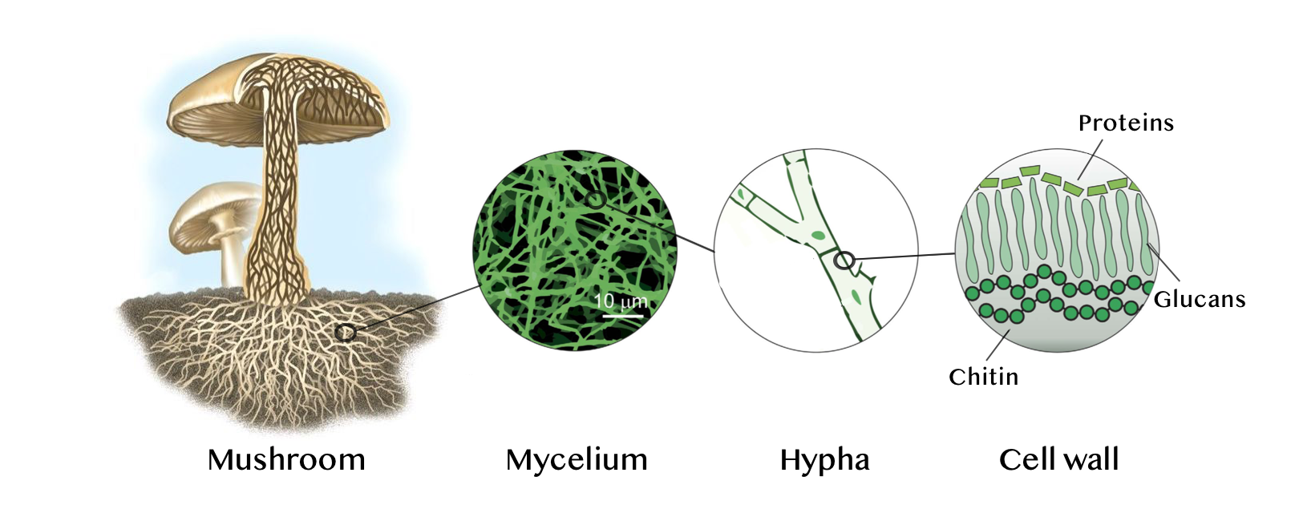
2.0 Project Scope
Task 1: Select Fungi
1.1 literature review:
Determine Adequate Fungal Candidates
1.2: Interview A Mycologist
Gain Scientist Perspective & Guidance
1.3 Decision Matrix
Select Four Amongst Determined Fungi
Figure 1. Schematic illustrating mycelium at different scales [3].
Notes:
David

Slide 5
2.0 Project Scope Cont’d
Task 2: Cultivate Fungi
2.1 Laboratory Access
Compile Protocol Binder
2.2 Obtain Fungal Spawn
Purchase Spawn
2.3 Fungal Growth
20-30 Days To Reach Maturity
2.3.1 Sterilization
Substrate Media
2.3.2 Inoculation
Aseptic Technique
2.4: Sustain Fungi Until Testing Phase
Storage Within Lab
Notes:
David

Slide 6
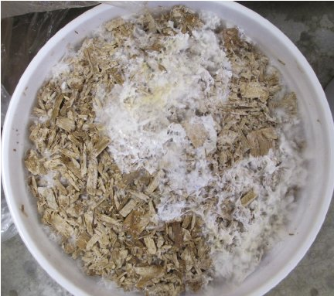
2.0 Project Scope Cont’d
Task 3: Design and Construction of Biofilters
3.1 Fabricate Biofilter Apparatuses
3.1.1 Biofilter Design
Design Parameters, Dimensions,
Shape, & Material
3.1.2 Purchase Supplies
3.2 Integrate Fungal Biomass Into
Biofilter Apparatuses
Experimental Control
Figure 2. Natural mycelium of King Stropharia [1].
Notes:
Mishael

Slide 7
2.0 Project Scope Cont’d
Task 4: Biofilter Analysis
4.1 Create E. coli Contaminated Water Supply
Water With Known E.coli Concentration
Units: Colony Forming Units (CFU) Per 100 mL
4.1.1 Cultivate E. coli
Culture Plate & Agar Broth
4.1.2 E. coli Concentration Testing
EPA Standard Method 9222: Membrane Filter Technique For Members Of The Coliform Group [4]
4.2 Test Biofilters
5 to 10 Trials Per Biofilter
Notes:
Chase
http://www.ruf.rice.edu/~bioslabs/bios318/318manual.htm

Slide 8

2.0 Project Scope Cont’d
Task 5: Data Analysis
Task 6: Project Impacts
Quantify E. Coli Removal For Each Biofilter
6.3 Environment
Contamination Reduction
6.4 Socioeconomic
Research, Learning & Cost
6.1 Regulations
Stormwater
6.2 Public Health
Recreation In Surface Water
Equation 1. Percent removal
equation [1]
Notes:
Mishael

Slide 9
2.0 Project Scope Cont’d
Task 7: Project Deliverables
7.1 CENE 486 Deliverables
30, 60, 90 Reports & Presentations
Final Report, Website, & UGRADS Presentation
7.2 HURA Deliverables
Interim & Final Reports, HURA Poster Presentations, & UGRADS Presentation Presentations
7.3 Publication
Prepare Manuscript
Notes:
Chase ****Maybe Take Off the subsection numbers for the deliverables that aren’t subtasks. Generally talking about the CENE deliverables because they won’t be submitted in this order.**** Talk About Thursday Morning

Slide 10
2.0 Project Scope Cont’d
Task 8: Project Management
8.1 Resource Management
Personnel Hours & Resources
8.2 Client & Technical Advisor Meetings
8.3 Grading Instructor Meetings
Schedule Updates & Feedback
8.4 Team Meetings
8.5 Project Schedule Management
Notes:
What to add to make look less empty?

Slide 11
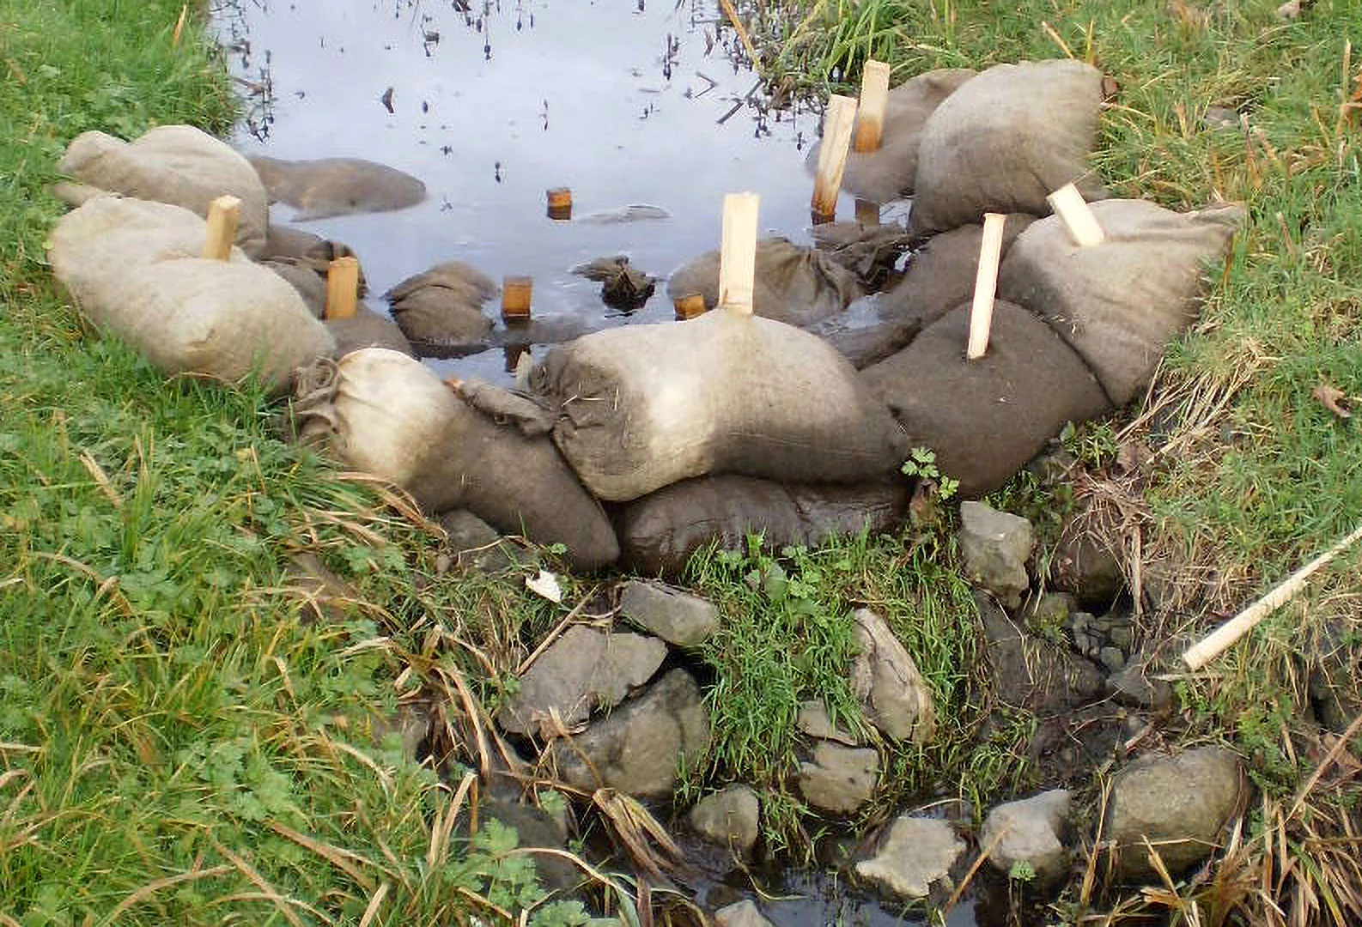
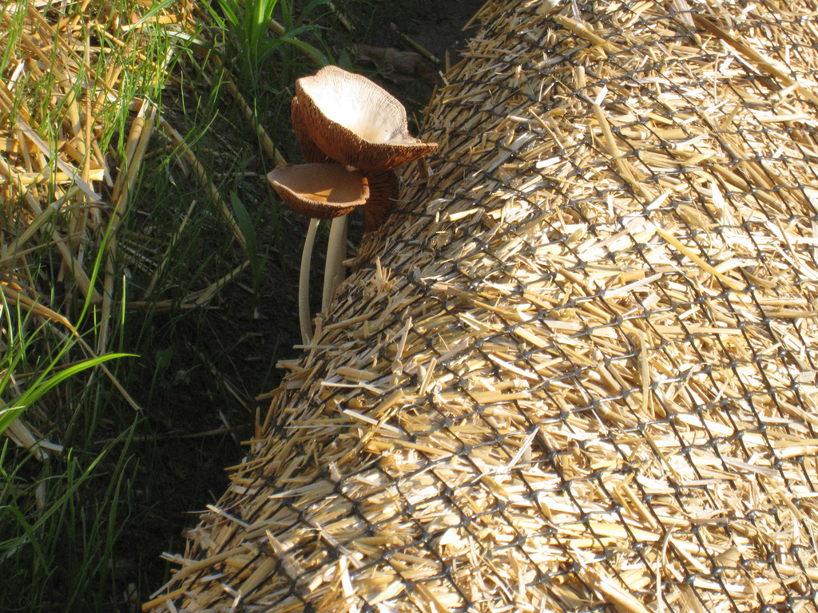
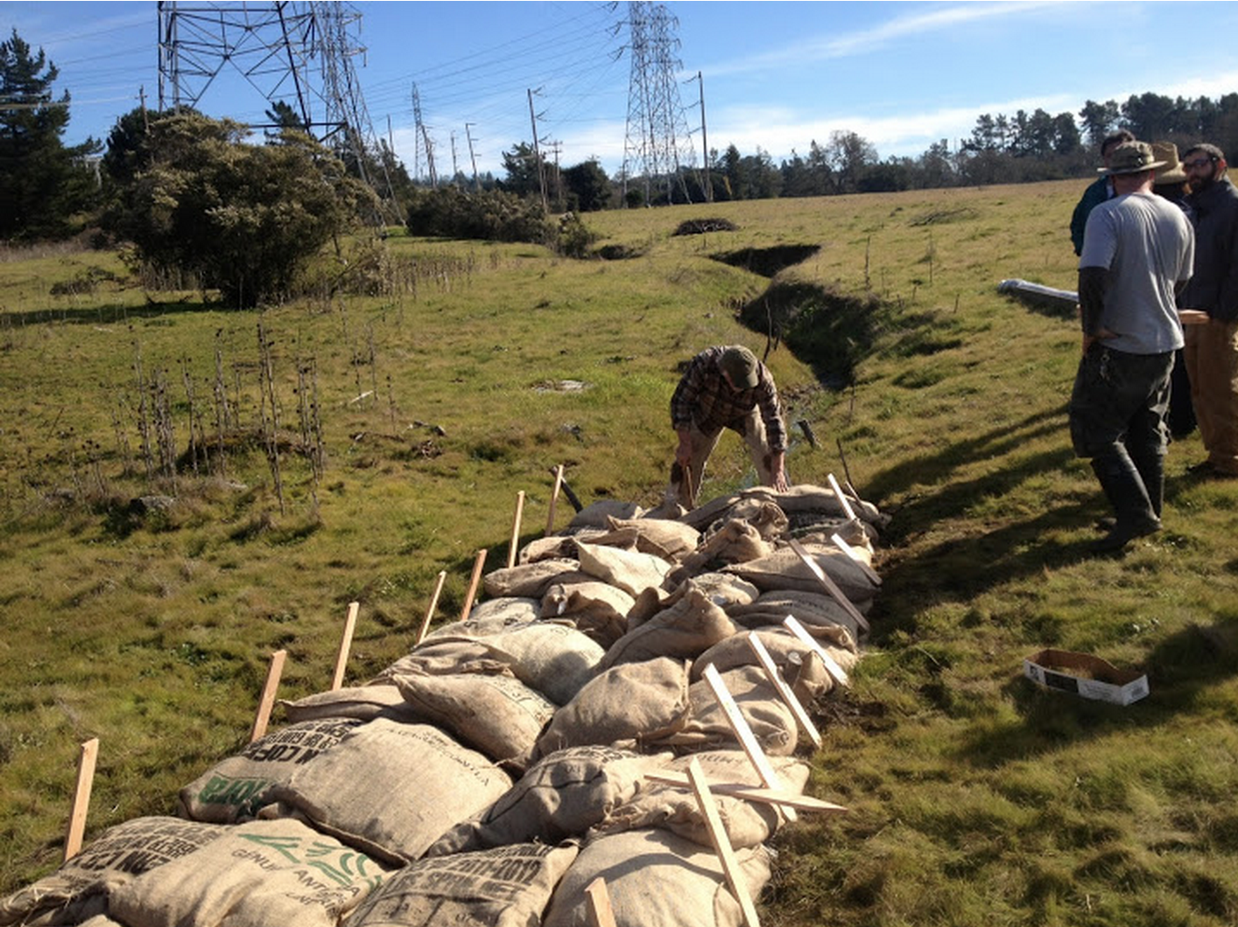
Exclusions
Field Application Of Tested Fungi
Figure 3. Past mycoremediation projects [5].
Notes:
Mishael

Slide 12
3.0 Project Schedule Hours
Task Name | Senior Engineer | Project Engineer | Engineer in Training | Lab Technician | Admin. Assistant | Total Hours
Task 1 Select Fungi | 4 | 8 | 19 | 0 | 0 | 31
Task 2: Cultivate Fungi | 6 | 14 | 36 | 54 | 0 | 110
Task 3: Design and Construction Of Biofilters | 4 | 10 | 31 | 11 | 3 | 59
Task 4: Loading and Testing Biofilters | 3 | 15 | 29 | 210 | 0 | 257
Task 5: Data Analysis | 6 | 30 | 40 | 6 | 0 | 82
Task 6: Evaluate Project Imapcts | 2 | 8 | 20 | 0 | 1 | 31
Task 7: Project Deliverables | 15 | 39 | 85 | 0 | 17 | 156
Task 8: Project Management | 19 | 45 | 31 | 0 | 36 | 130
Sum Of Hours Per Position | 58 | 168 | 291 | 281 | 57 | 855
Notes:
Chase - (alternative style)

Slide 13
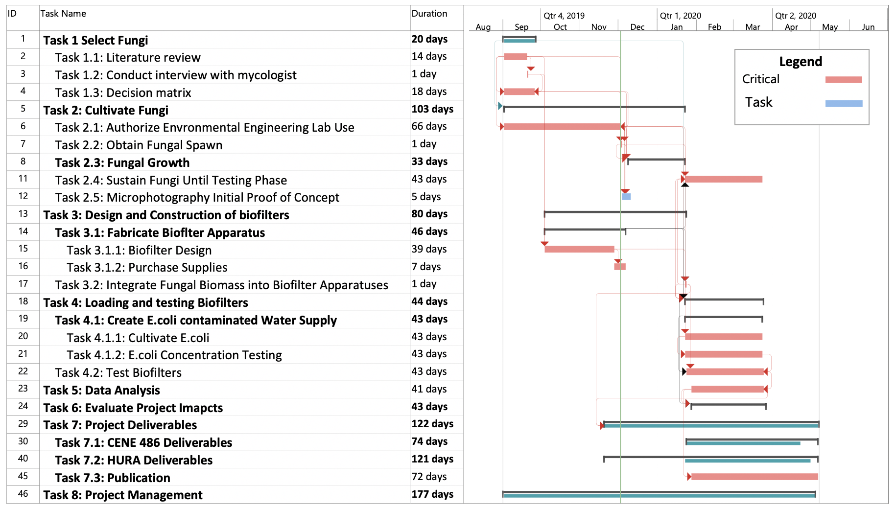

Slide 14
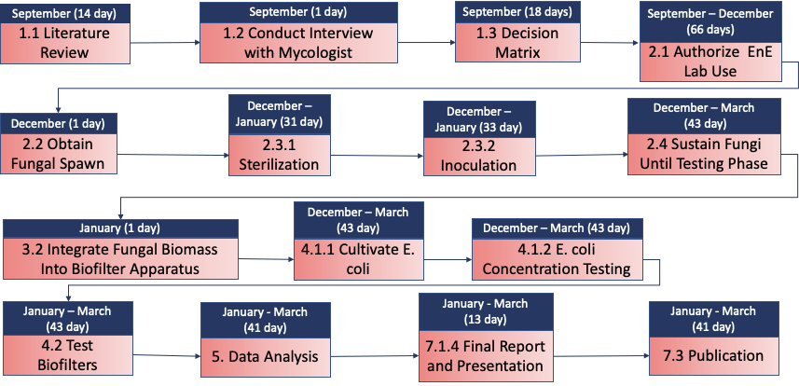
3.0 Project Schedule Critical Path

Slide 15
4.0 Cost of Engineerings Services
1.0 Personnel | Classification | Hours | Rate $/hr | Cost
 | Senior Engineer | 58 | 240 | $ 13,920
 | Project Engineer | 168 | 120 | $ 20,160
 | Engineer in Training | 291 | 100 | $ 29,050
 | Lab Technician | 281 | 40 | $ 11,240
 | Admin. Assistant | 57 | 20 | $ 1,140
 | Total Personnel Cost |  |  | $ 75,510
2.0 Travel |  | Person(s) | Rate $/Person
 | 2.1 Roundtrip Flights | 3 | 350 | $ 1,050
 |  | Days | Rate $/Night/Rm.
 | 2.2 Hotel | 4 | 94 | $ 1,128
 |  | Days | Rate $/Day/Person
 | 2.3 Per Diem | 5 | 55 | $ 825
3.0 Supplies |  | # of Items | Rate $/Item
 | 3.1 Fungal Spawn | 5 | 25 | $ 125
 | 3.2 Biofilter Materials
 | 3.2.1 Apparatus Materials |  |  | $ 200
 | 3.2.2 Filter Media |  |  | $ 5
 | 3.3 Coliscan MF Kit | 2 | 72 | $ 144
4.0 Fees |  | Days | $/Day
 | 4.1 Laboratory Use | 15 | 75 | $ 1,125
5.0 Total |  |  |  | $ 80,112
Cost Summary:
4.1 Personnel cost:
$ 75,510
4.2 Travel cost:
$ 3,003
4.3 Supplies Cost:
$ 474
4.4 Fees:
$ 1,125
4.5 Total Cost of Engineer-
ing Services:
$ 80,112
Notes:
Mishael - alternative design

Slide 16
References
[1] A. Taylor, A. Flatt, M. Beutel, M. Wolff, K. Brownsen and P. Stamets, "Removal of Escherichia coli from synthetic stormwater using mycofiltration," Ecological Engineering, vol. 78, pp. 78-86, May 2015.
[2] S. Thomas, L. Aston, D. Woodruff and V. Cullinan, "Field Demonstrations of Mycoremediation for Removal of Fecal Coliform Bacteria and Nutrients in the Dungeness Watershed Washington," 2009.
[3] S. Tonevitskaya, "When mushrooms go in the lab: growing design," MycoTEX, 3 Deceber 2018. [Online]. Available: https://medium.com/@stonev/when-mushrooms-go-in-the-lab-growing-design-882bff633aa8.
[4] American Public Health Association, "9222 MEMBRANE FILTER TECHNIQUE FOR MEMBERS OF THE COLIFORM GROUP," Standard Methods For the Examination of Water and Wastewater, 27 August 2018. [Online]. Available: https://www.standardmethods.org/doi/abs/10.2105/SMWW.2882.193. [Accessed September 2019].
[5] P. Stamets, "Mycofiltration for Urban Storm Water Treatment Receives EPA Research and Development Funding," Fungi Perfecti, 20 May 2013. [Online]. Available: https://fungi.com/blogs/articles/mycofiltration-for-urban-storm-water-treatment-receives-epa-research-and-development-funding. [Accessed 2019]
Notes:
Chase

