Slide 1

Northern Arizona University
Concrete Canoe 2018
December 1, 2017
Katlynn Adams
Gina Boschetto
Joshua Leon
Branden Petersen
Zachary Radovich

Slide 2
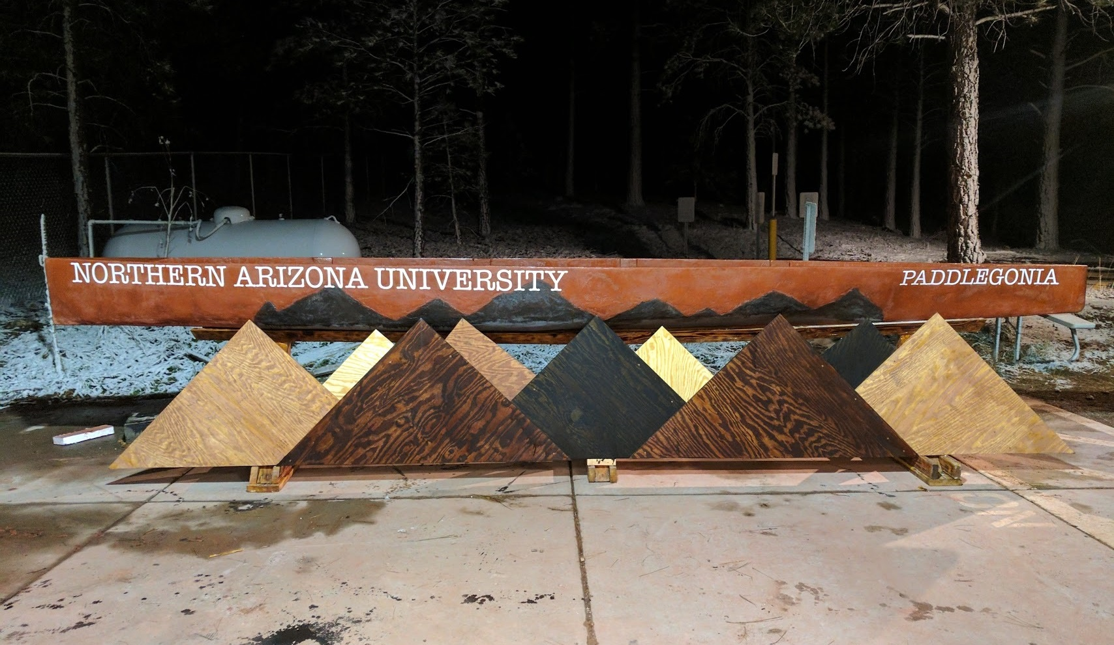
Concrete Canoe Competition
ASCE hosts the concrete canoe competiton on a regional and a national level annually
ASU and NAU are co-hosting the PSWC regional conference for 2018
Location and Date
Tempe, Arizona
April 12-14, 2018
CNCCC writes the rules and regulations for the competition
Judging Criteria (25% each) [1]
Final product
Final design report
Oral presentation
Racing
Figure 1. Paddlegonia, 2017 Concrete Canoe [2]

Slide 3
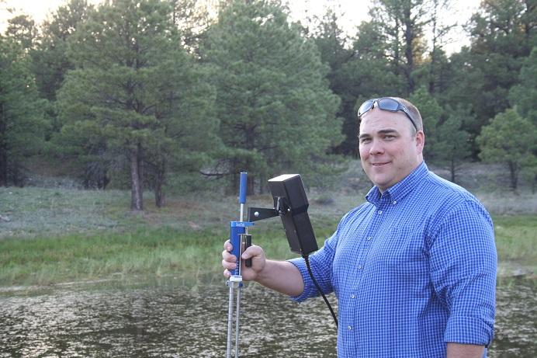

1.0 Project Understanding
Stakeholders
Client: Mark Lamer
Technical Advisor: Taylor Layland
ASCE NAU Chapter
Northern Arizona University (NAU)
CEMEX, Salt River Materials, BASF, and other private donors
Major Design Rules [1]- Released on September 11, 2017
25% of the mix volume must be aggregate
25% of the aggregate by volume must be ASTM C330 compliant
Reinforcement thickness shall not exceed 50% of the total canoe thickness
Canoe envelope- 22 feet long and 3 feet wide
Figure 2. Client Mark Lamer [3]
Figure 3. Tech. Advisor Taylor Layland [4]

Slide 4
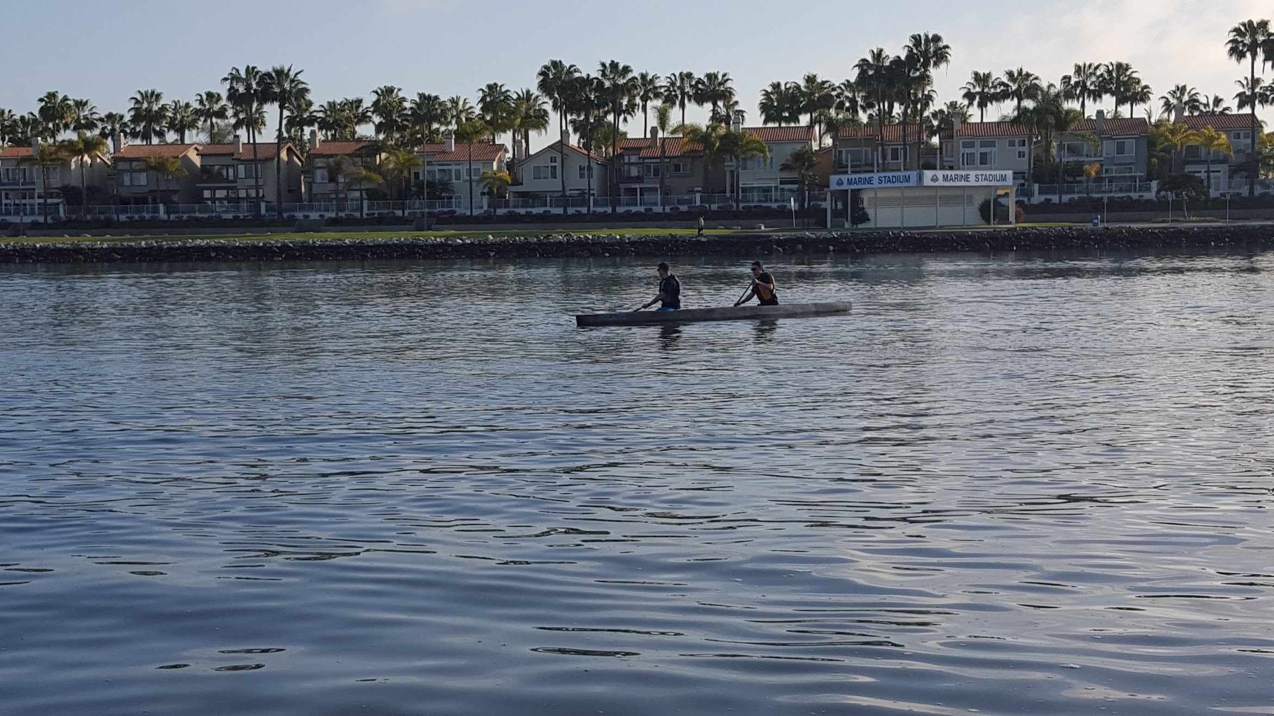
2.0 Scope
Scope Overview:
2.1 Fundraising
2.2 Mix Design
2.3 Hull Design
2.4 Reinforcement Design
2.5 Construction
2.6 Competition
2.7 Project Management
2.8 Project Challenges
Major Design Tasks:
2.2 Mix Design
2.3 Hull Design
2.4 Reinforcement Design
2.5 Construction
Figure 4. Paddling [5]

Slide 5
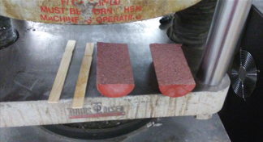
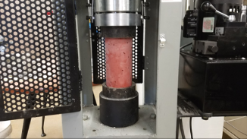
2.2 Mix Design
Research
Rules that apply to mix
Previous years’ concrete canoe mixes
Different materials used to make the mix stronger and lighter
Developing Mix
Use material in proportions compliant with rules
Determine minimal amount of material needed for testing
Change proportions based on testing
Testing [1]
Slump (ASTM C143)
Unit Weight (ASTM C138)
Strength (Compressive and Tensile) (ASTM C39 and ASTM C496)
Figure 5. Split Tensile Test [2]
Figure 6. Compression Test [2]

Slide 6
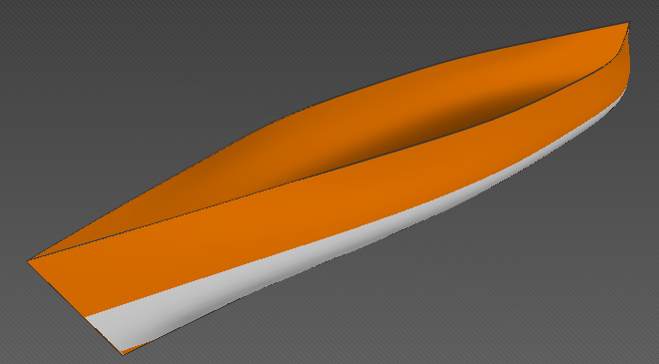
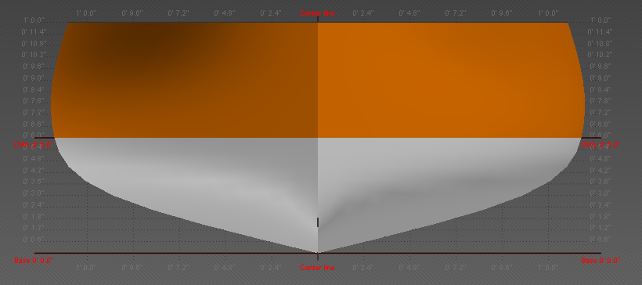
2.3 Hull Design
Design envelope [1]
Maximum length of 22 feet
Maximum width of 3 feet
Determine the shape
Bottom shape
Curve of walls
Keel design
Create a 3-D model
Complete structural analysis for the design
Hand calculations
Software modeling
Design a mold
Figure 7. Delftship Side View, Created By: Zachary Radovich
Figure 8. Delftship Front View, Created By: Zachary Radovich

Slide 7
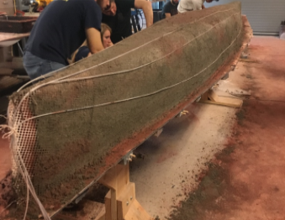
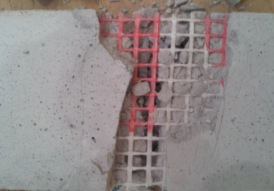
2.4 Reinforcement Design
Research
NCCC permitted materials
Previous reinforcement materials used
Testing
Tension
Flexural
Decision Matrix
Comparison of material performance
Determine reinforcement required
Layers of mesh
Fibers
Number of cables
Figure 9. Cable Reinforcement being Applied to Paddlegonia [2]
Figure 10. Flexural testing failure of concrete and mesh [2]

Slide 8
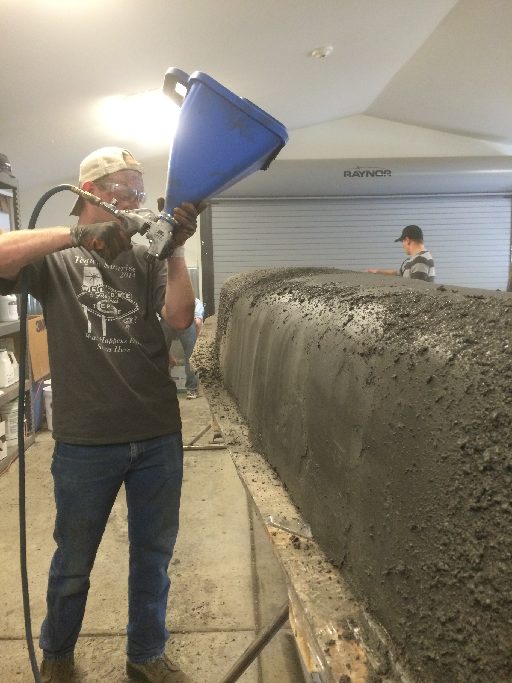
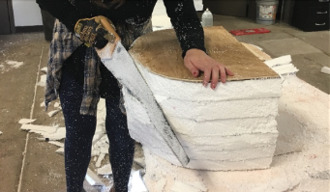
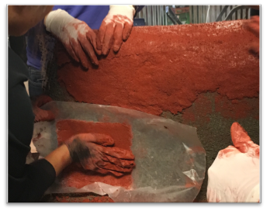
2.5 Construction
Two major subtasks: construction plan and pour day
Shaping Mold
Method for shaping canoe into desired shape
Casting Canoe (Pour Day)
Method for applying concrete on mold
Constructing a curing chamber
Removing mold
Finishing
Figure 11. Shotcrete Placing [5]
Figure 12. Shaping Mold [2]
Figure 13. Placing Concrete [2]

Slide 9
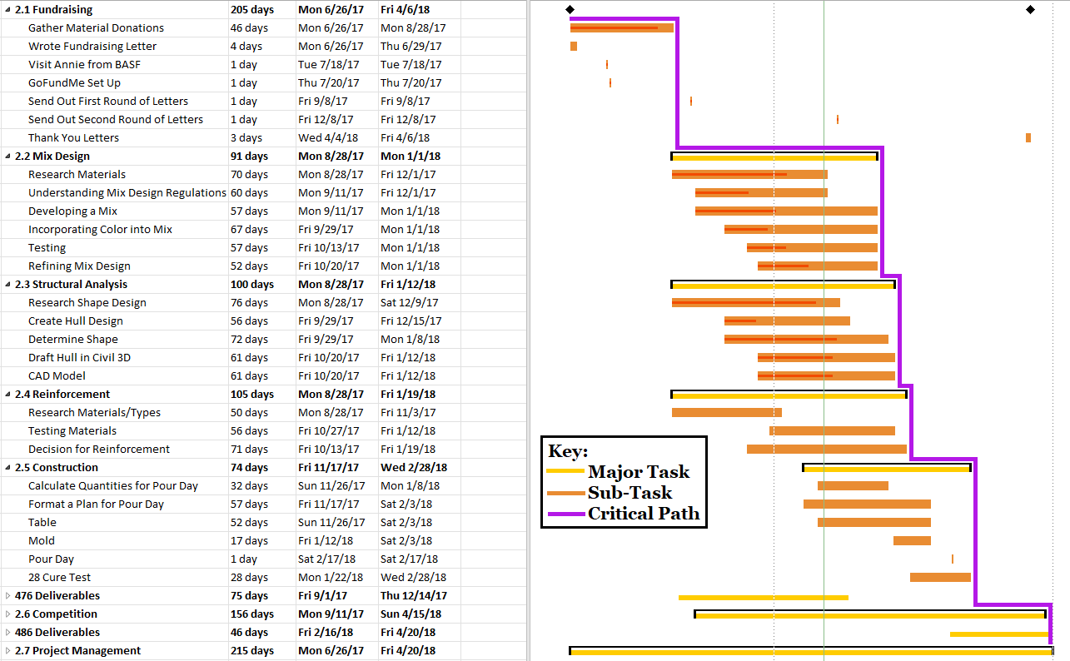
Schedule
Figure 14. Gantt Chart, Created By: Gina Boschetto

Slide 10
Project Staffing
Table 1. Project Staffing Projected Hours of Work
Table 2. Billing Rates for Engineering Project Positions

Slide 11
Cost of Services
Table 3. Projection of Staffing Costs

Slide 12
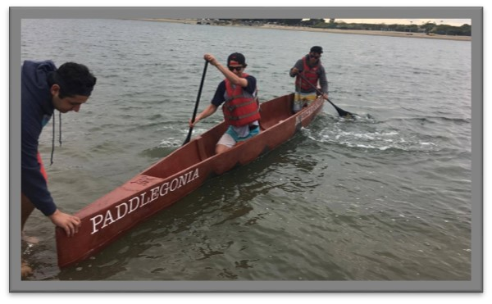

References
[1]Committee on National Concrete Canoe Competitions. (2017). “2018 ASCE National Concrete Canoe Competition: Rules and Regulations.” Pacific Southwest Conference 2018, ASCE, VA., 1-54.
[2]https://www.cefns.nau.edu/capstone/projects/CENE/2017/ConcreteCanoe/
[3]http://knau.org/post/brain-food-arizonas-first-infrastructure-report-card
[4]https://nau.edu/cefns/engineering/orgs/asce/officers/faculty-advisors/
[5]https://www.cefns.nau.edu/capstone/projects/CENE/2016/ConcreteCanoe/
Figure 15. Paddlegonia Practice [2]
Figure 16. ASCE NCCC Logo [2]

