Slide 1

Dani Halloran
Kelsey Hammond
Haley Michael
Taylor Oster
Robert Reny
Red Cloud Mine Site assessment

Slide 2
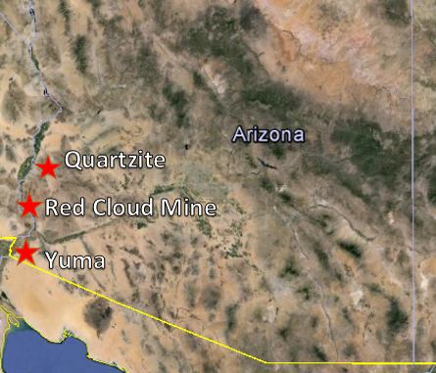
Project Purpose
Bureau of Land Management (BLM) project
  Client: Eric Zielske, Professional Environmental Engineer
Stake Holders
  Primary: BLM
  Secondary
    Community (recreational use)
    Quechan and Cocopah tribe
    Yuma Proving Ground
Mine located on private land
Preliminary Assessment and Site Inspection (PA/SI)
Contaminants of Concern (COCs)
  Lead
  Zinc
  Iron
Figure 1: Location of Red Cloud Mine (created in Google Earth by Kelsey Hammond)
Notes:
Taylor

Slide 3
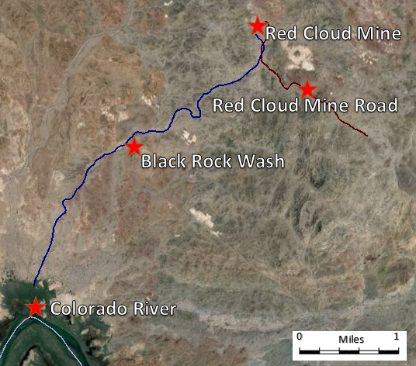
Red Cloud Mine
La Paz County
50 miles south of Quartzite
23 miles north of Yuma
Colorado River
  5 miles south fed by Black Rock Wash
Non-residential
  nearest community 20 miles away
Figure 2: Colorado River and Black Rock Wash. (created in Google Earth by Kelsey Hammond)
Notes:
Dani

Slide 4

History
1878-1890
  Silver Ore
1890-1950 (WWI & WWII)
  US Government owned
  Lead
1950-Current
  Many Different owners
  Wulfenite
Tailings pile south of the mine
Figure 3: Wulfenite Crystal https://commons.wikimedia.org/wiki/File:Wulfenite-271366.jpg
Notes:
Dani

Slide 5
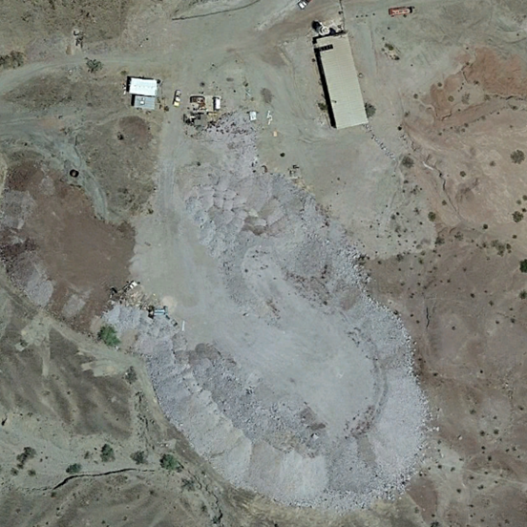
Tailings & Black Rock Wash
Previous Investigation (2003)
  1.3 acres, 10-12 feet deep
  Black Rock Wash follows tailings pond for 376 feet
  Significant water migration from tailings into wash
    Annual Precipitation 3.57 inches
    Caliche soil
  Concentration levels of Lead are above the Arizona Soil Remediation Levels
    Lead Concentration: 4,428 mg/kg
    AZ Standards: 800 mg/kg
Water table 500 feet below
Colorado River is the only surface water source in the area
  Yuma’s main source of water
Figure 4: Tailings Piles (created by Kelsey Hammond in Google Earth)
Notes:
Kelsey

Slide 6
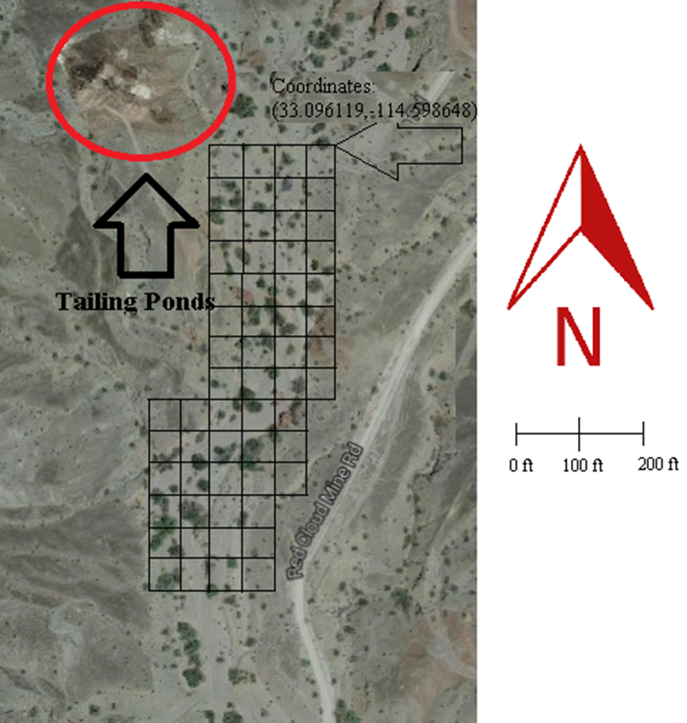
Field Sampling
Objective
  Determine extent and toxicity of mine tailings
  in Black Rock Wash
Sample collection will take place on
January 30th, 2016
Sampling Approach
  Grid (80 samples)
  Hot Spots (30 Samples)
  Background (10 Samples)
Figure 5: Example of Grid sampling (created by Robert Reny in Google Earth)
Notes:
Robert

Slide 7
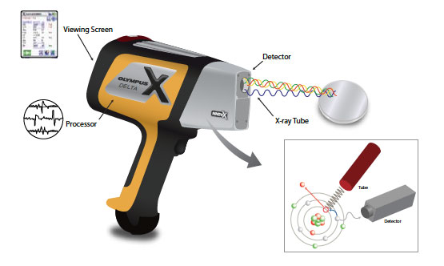
Lab Analysis
Drying and Sieving
  EPA method 6200
  Homogenize the sample
X-Ray Fluorescence (XRF)
  Concentrations (broad average)
  9 quadrants
Atomic Absorption (AA)
  EPA method 3050b
  Concentrations (specific concentration)
  NAU Chemistry lab
Figure 6: X-Ray Fluorescence machine
(http://www.olympus-ims.com/vi/xrf-xrd/delta-handheld/delta-lead-paint/)
Notes:
Hailey

Slide 8

Risk
Arizona Department of Quality Soil Remediation (ADEQ) Levels
Evaluation of risk to public health and ecosystem
  Carcinogenic and Non-carcinogenic
Adult Lead Methodology (ALM)
  Blood Lead levels in adults
Figure 7: ADEQ Logo
(https://yt3.ggpht.com/-WrcQ5X62-i0/AAAAAAAAAAI/AAAAAAAAAAA/CZRS293L0Ak/s900-c-k-no/photo.jpg)
Notes:
Taylor
Oral slope factor (OSF) is an estimate of the increased cancer risk from oral exposure to a dose of 1 mg/kg-day for a lifetime. The OSF can be multiplied by an estimate of lifetime exposure (in mg/kg-day) to estimate the lifetime cancer risk.
Oral reference dosereference doseAn estimate (with uncertainty spanning perhaps an order of magnitude) of a daily oral exposure to the human population (including sensitive subgroups) that is likely to be without an appreciable risk of deleterious effects during a lifetime. It can be derived from a NOAEL, LOAEL, or benchmark dose, with uncertainty factors generally applied to reflect limitations of the data used. Generally used in EPA's noncancer health assessments. [Durations include acute, short-term, subchronic, and chronic and are defined individually in this glossary]. (RfDRfDAn estimate (with uncertainty spanning perhaps an order of magnitude) of a daily oral exposure to the human population (including sensitive subgroups) that is likely to be without an appreciable risk of deleterious effects during a lifetime. It can be derived from a NOAEL, LOAEL, or benchmark dose, with uncertainty factors generally applied to reflect limitations of the data used. Generally used in EPA's noncancer health assessments. [Durations include acute, short-term, subchronic, and chronic and are defined individually in this glossary].) is the amount of a chemical that one can ingest every day for a lifetime that is not anticipated to cause harmful noncancer health effects. The RfD can be compared to an estimate of exposure in mg/kg-day.
Inhalation reference concentrationreference concentrationAn estimate (with uncertainty spanning perhaps an order of magnitude) of a continuous inhalation exposure to the human population (including sensitive subgroups) that is likely to be without an appreciable risk of deleterious effects during a lifetime. It can be derived from a NOAEL, LOAEL, or benchmark concentration, with uncertainty factors generally applied to reflect limitations of the data used. Generally used in EPA's noncancer health assessments. [Durations include acute, short-term, subchronic, and chronic and are defined individually in this glossary]. (RfCRfCAn estimate (with uncertainty spanning perhaps an order of magnitude) of a continuous inhalation exposure to the human population (including sensitive subgroups) that is likely to be without an appreciable risk of deleterious effects during a lifetime. It can be derived from a NOAEL, LOAEL, or benchmark concentration, with uncertainty factors generally applied to reflect limitations of the data used. Generally used in EPA's noncancer health assessments. [Durations include acute, short-term, subchronic, and chronic and are defined individually in this glossary].) is the concentration of a chemical that one can breathe every day for a lifetime that is not anticipated to cause harmful noncancer health effects. The RfC can be compared to an estimate of exposure concentration in mg/m³.

Slide 9

Training
HAZWOPER (Hazardous Waste Operations and Emergency Response)
XRF License Training
NAU Field Safety Training
NAU Chemical Hygiene Training
Figure 8: HAZWOPER Training Logo
(http://www.hazwopertraining.com/img/logocircle.png)
Notes:
Kelsey

Slide 10
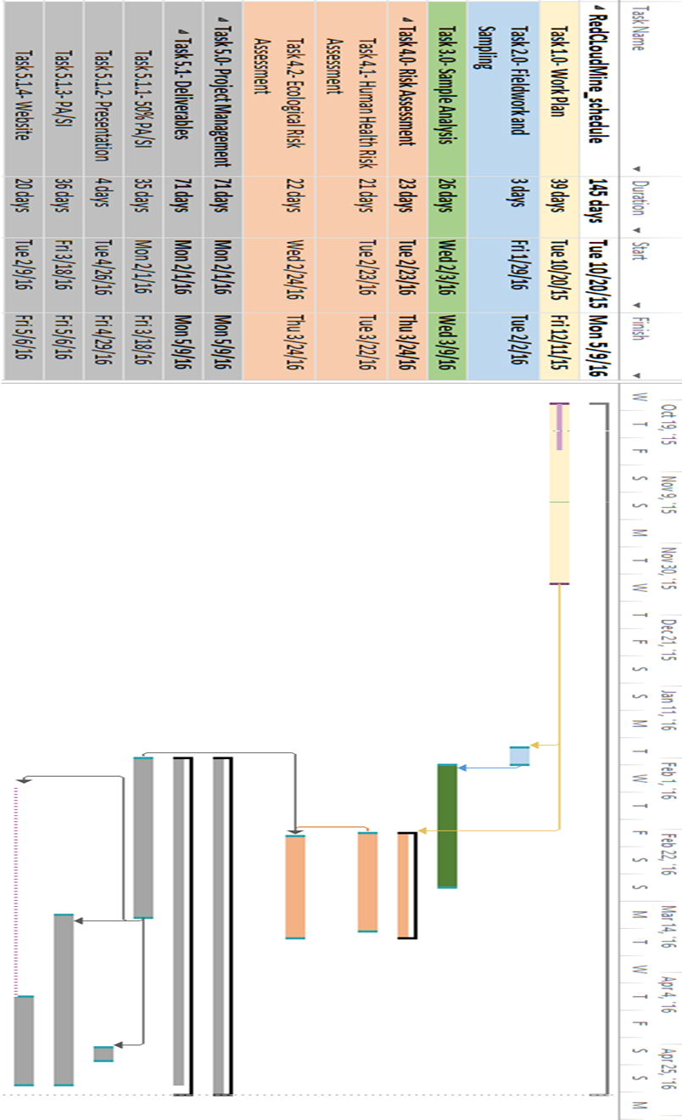
Project Management
Table 1: Critical Paths and project Deadlines (created in Microsoft Project by Dani Halloran and Taylor Oster)
Notes:
Taylor

Slide 11
Staffing
Task | Total Hours | SENG | ENG | LAB | INT
Task 1.0 WORK PLAN | 100 | 15 | 70 | 0 | 15
1.1 Sampling and Analysis Plan | 70 | 10 | 50 | 0 | 10
1.2 Health and Safety Plan | 30 | 5 | 20 | 0 | 5
TASK 2.0 SAMPLING | 130 | 0 | 100 | 0 | 30
TASK 3.0 ANALYSIS | 48 | 0 | 13 | 30 | 7
3.1 Sample Preparation | 8 | 0 | 4 | 0 | 4
3.2 XRF | 36 | 0 | 6 | 30 | 0
3.3 Sample Preparation for AA | 3 | 0 | 3 | 0 | 3
TASK 4.0 RISK ASSESSMENT | 20 | 0 | 15 | 0 | 5
4.1 Human Health | 10 | 0 | 8 | 0 | 2
4.2 Ecological Health | 10 | 0 | 7 | 0 | 3
TASK 5.0 PA/SI | 70 | 50 | 20 | 0 | 0
TASK 6.0 PROJECT MANAGEMENT | 10 | 10 | 0 | 0 | 0
Table 2: Project Staffing breakdown (created by Robert Reny)
Notes:
Robert

Slide 12
Total Project Cost
Personnel | Classification | Hours | Rate, $/hr | Cost, $
Senior Engineer | SENG | 80 | 195 | 15600
Engineer | ENG | 271 | 67 | 18157
Intern | INT | 119 | 22 | 2618
Lab Technician | LAB | 280 | 48 | 13440
 | Total Personnel | 750 | - | 49815
2.0 Travel Expenses | - | - | - | 1764
2.1 Hotel | 3 days | - | - | 800
2.2 Per Diem | 3 days | - | - | 500
2.3 Rental Vehicle | 3 days |  |  | 200
2.4 Travel | Travel for sampling | 660 miles | $0.40/mi | 264
3.0 Subcontract | Analytical Chemistry | 30 samples | 5$/sample | 150
4.0 Total Cost | - | - | - | 53493
Table 3: Total Project Cost breakdown (created by Robert Reny)

Slide 13

Conclusion
Fall Semester
Work Plan
  Complete
Sampling and Analysis Plan (SAP)
  Complete
Health and Safety Plan (HASP)
  Complete
Spring Semester
Field Sampling
Lab Analysis
PA/SI
Notes:
Kelsey

Slide 14
References
BKERSHAW, "Bureau of Land Management Protection and Response Information
System Live Site Summary Report," Bureau of Land Management, Yuma, Arizona, 2003 .
[2] “Arizona’s Classic Red Cloud Mine,” Treasure Mountain Mining. November 30, 2011. From: http://www.treasuremountainmining.com/index.php?route=pavblog/blog&id=20
[3] P. D. C. M. W. P. R. O. Dr. Larry P. Wilding, "Caliche Soils as a Filter Medium for Treatment and Disposal of Wastewater," Texas Natural Resource Conservation Commission, Austin, TX, 2001.
[4] "City-Data.com," Onboard Informatics, 2015. [Online]. Available: http://www.city data.com/city/Quartzsite-Arizona.html. [Accessed 7 October 2015].
[5] O. Cruz, "2014 Drinking Water Consumer Confidence Report," Quartzsite Water Department , Quartzsite, AZ, 2014 .
[6] "United States Census," U.S. Department of Commerce, 2014. [Online]. Available: http://quickfacts.census.gov/qfd/states/04/04027.html. [Accessed 7 October 2015].
[7] J. S. M.P.A, "Annual Water Quality Report," City of Yuma, Yuma, AZ, 2014.
[8] Title 18: Environmental Quality. Department of Environmental Quality. Print.
[9] Person, Carl, “Field Sampling Plan and Quality Assurance Project Plan, Red Cloud Mine Tailings,” Yuma, AZ: U.S Department of Interior Bureau of Land Management, 2009.
[10] Environmental Protection Agency. (1995) Contaminated Sites Sampling Design Guidelines. Sydney, Australia. pp. 1-44.
[11] Amptek. (2015) What is XRF? [Online]. Retrieved Sept. 27, 2015 from .
[12] Gideon Labs. Inductive Coupled Plasma and Atomic Absorption. [Online]. Retrieved Sept 28, 2015 from: http://www.gideonlabs.com/inductive-coupled-plasma-and-atomic-absorption-icp-and-aa/
[13] Environmental Protection Agency. Method 7000B Flame Atomic Absorption
Spectrophotometry. [Online]. Retrieved October 3, 2015 from: http://www3.epa.gov/epawaste/hazard/testmethods/sw846/pdfs/7000b.pdf
[14] Environmental Protection Agency. Method 6010B Inductively Coupled Plasma-Atomic Emission Spectrometry. [Online]. Retrieved October 3, 2015 from: http://www2.epa.gov/sites/production/files/documents/6010b.pdf
[15] Arizona Department of Environmental Quality. Title 18. Environmental Quality Chapter 7. Department of Environmental Quality Remedial Action. [Online]. Retrieved October 3, 2015 from: http://apps.azsos.gov/public_services/Title_18/18-07.pdf
[16] M. Lagrega et al. “Quantitative Risk Assessment,” in Hazardous Waste Management. 2nd ed. Long Grove, IL: Waveland Press Inc, 2010, ch. 14, pp. 865-910.
[17] Environmental Protection Agency. EPA’s Stochastic Human Exposure and Dose Simulation (SHEDS) Model [Online]. Retrieved Sept 29, 2015 from: http://www.epa.gov/heasd/research/sheds.html.

