Slide 1
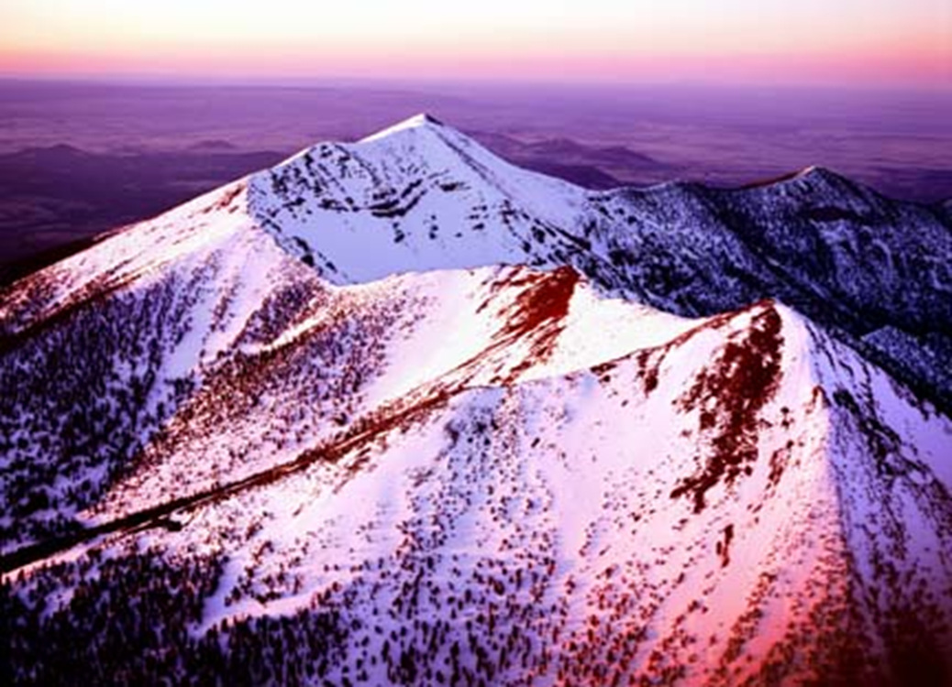

The Potential of Landscape Scale Treatments to Reduce Sublimation Losses of Critical Water Supply Snowpack in the Western United States
Department of Civil and Environmental Engineering
Spring 2011
Snowpack Engineering
Adam Bringhurst
Keri Williamson
Kevin Werbylo

Slide 2
Overview of Presentation
Project Understanding
Background
Scope of Services
Schedule
Methodology
Results
Analysis
Conclusions and Recommendations
Final Budget

Slide 3

Project Understanding
Originated by Dr. Rand Decker at Northern Arizona University
Investigate at the “study plot scale”, treatments that will minimize sublimation losses of winter snowpack into the air
What is Sublimation?
Why?
  To increase the amount of surface water flows
Project Requirements
  Consider forest health issues
  Unique treatment ideas
  Tested on multiple landscapes
  Landscape scale
  Cost effective

Slide 4
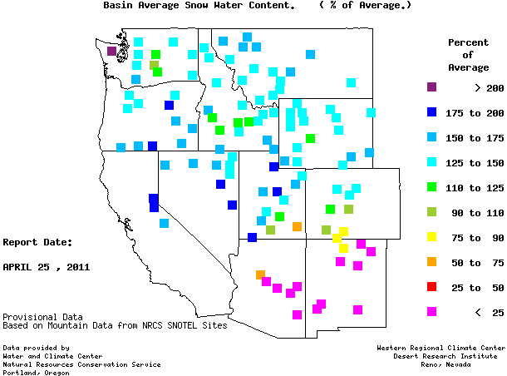
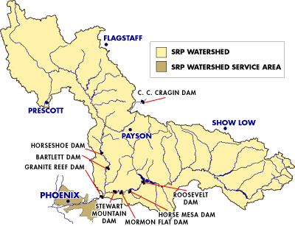
Project Background
Why focus on snow and sublimation?
  Arid climates are most dependent on snowpack for water supply
  Up to 70-80% of water in western US comes from snowpack
Why is this important in Arizona?
  Half of Arizona’s total water originates as snowpack
  Sublimation rates can account for over 50% of snow loss in Arizona

Slide 5
Scope of Services
Task 1- Project Management
Task 2- Research and Background
Task 3- Experiment Design
Task 4- Experimental Setup and Data Collection
Task 5- Data Analysis
Task 6- Cost Analysis
Task 7- Results and Recommendations
Task 8- Presentation of Results
Exclusions-
  Water quality considerations
  Long-term environmental impacts
  Required permits for treatment applications

Slide 6
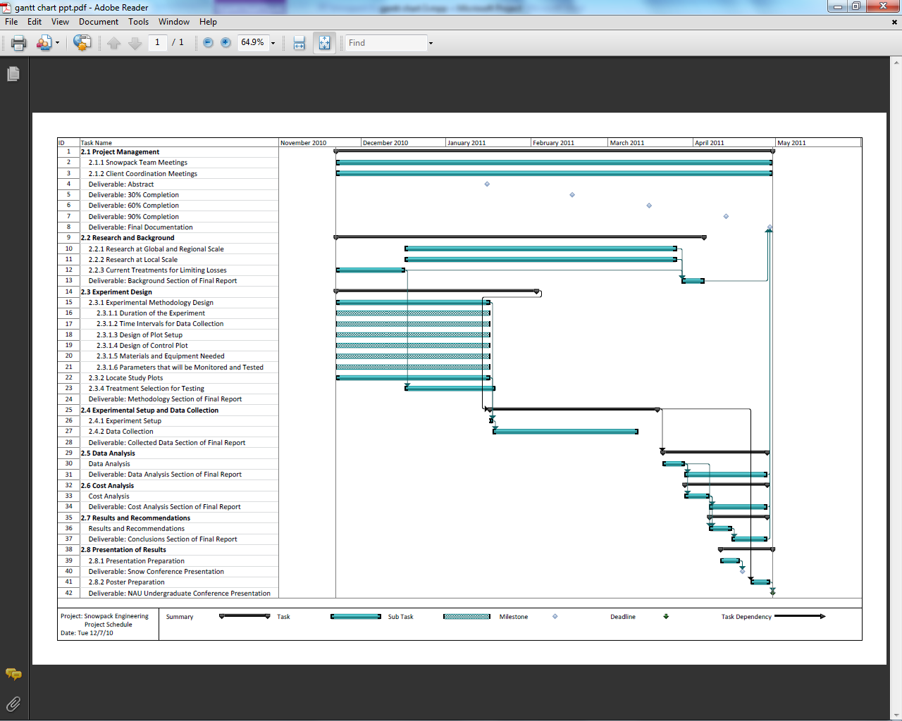
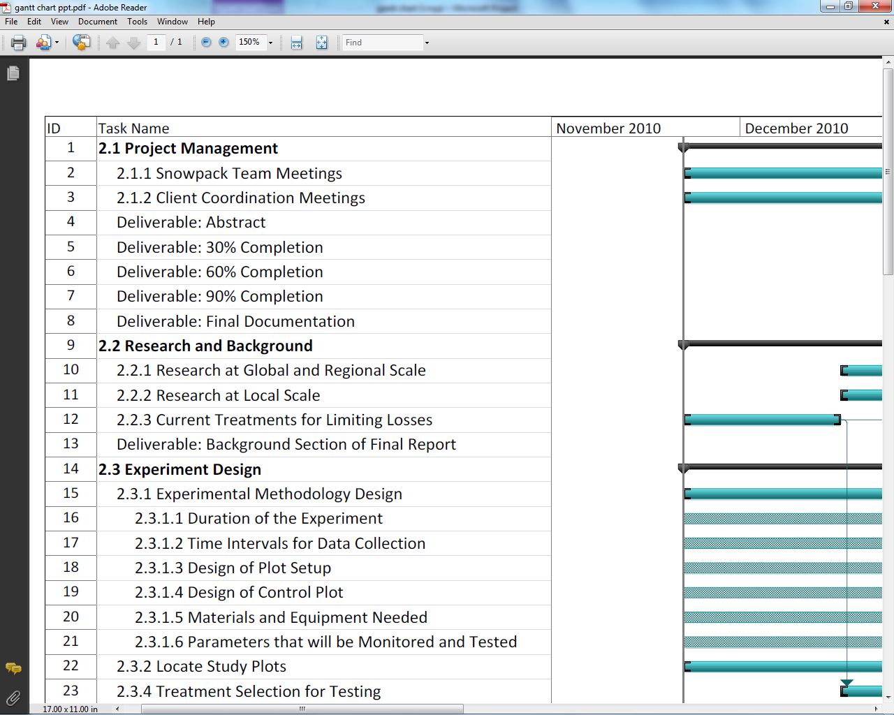
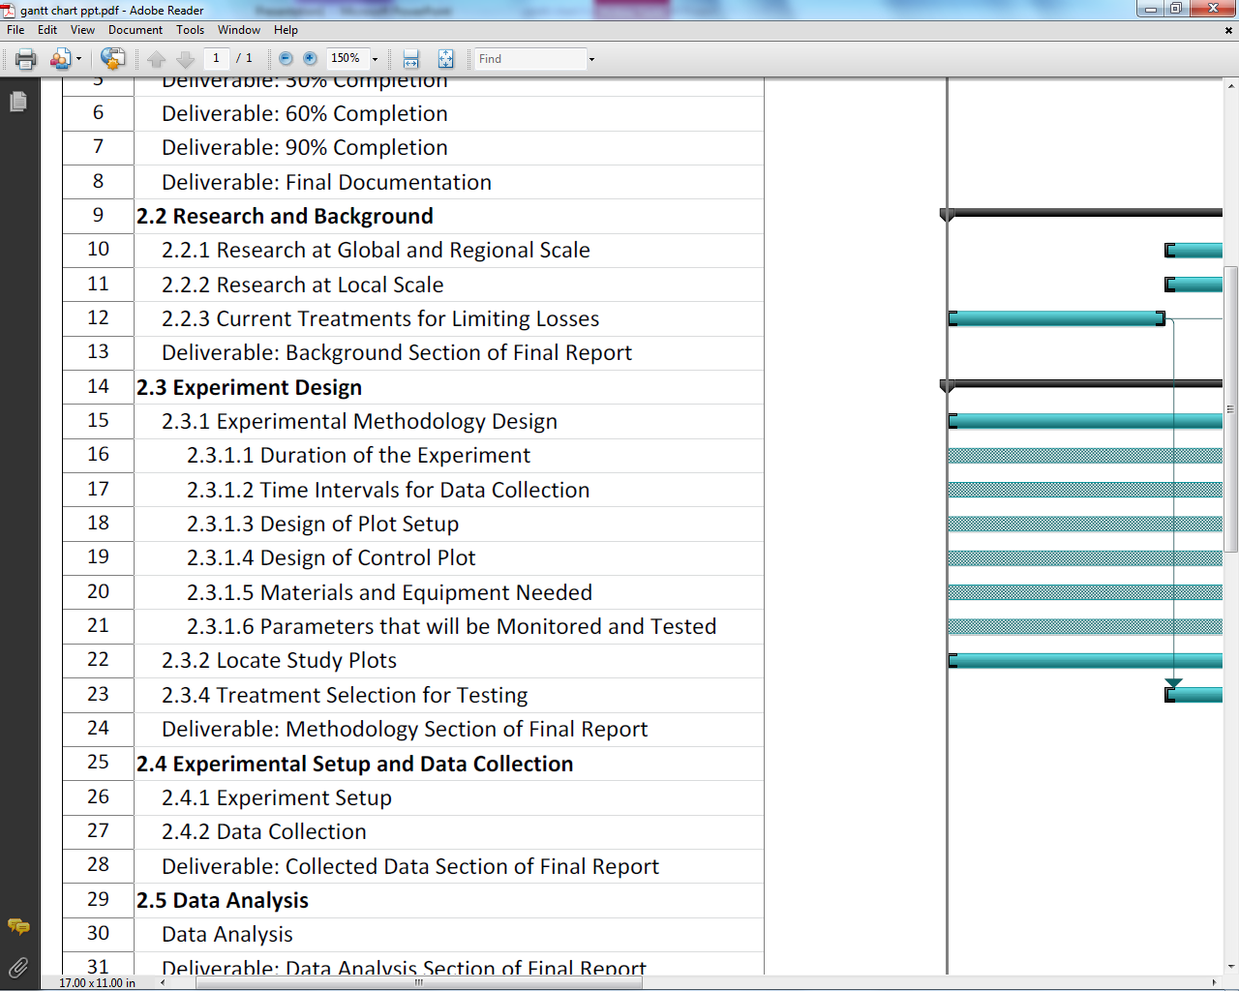
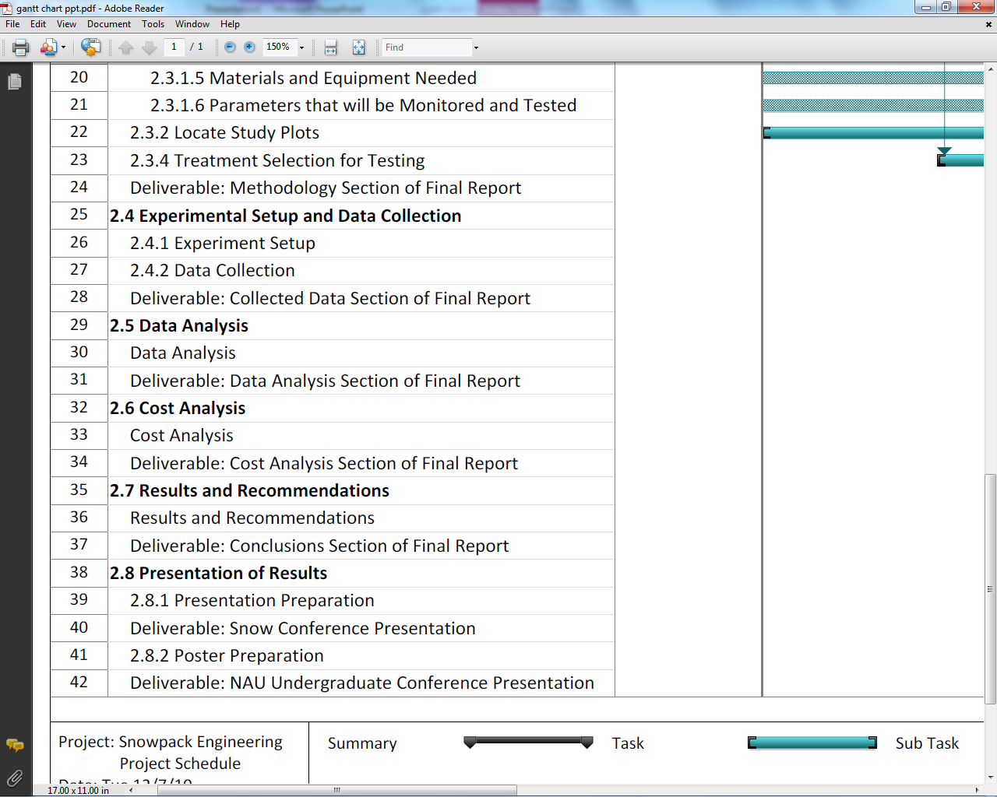
Schedule
Notes:
Project schedule begins November 22, 2010 and ends April 29, 2011.

Slide 7
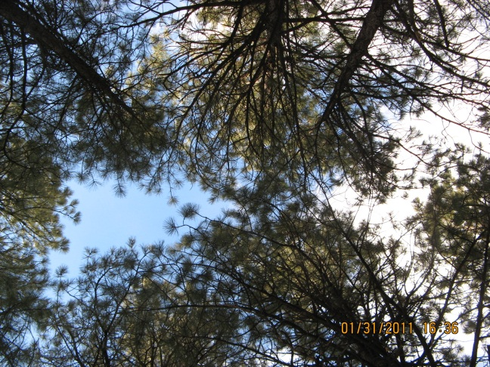
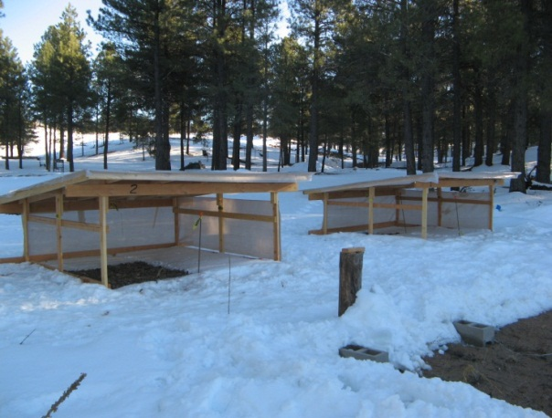
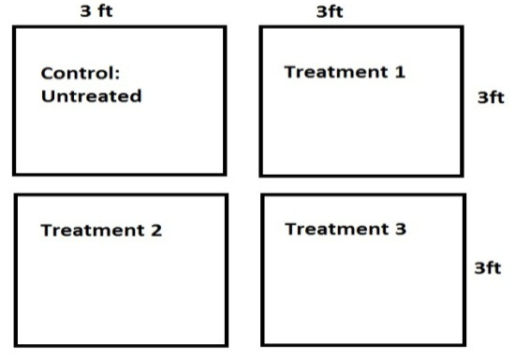
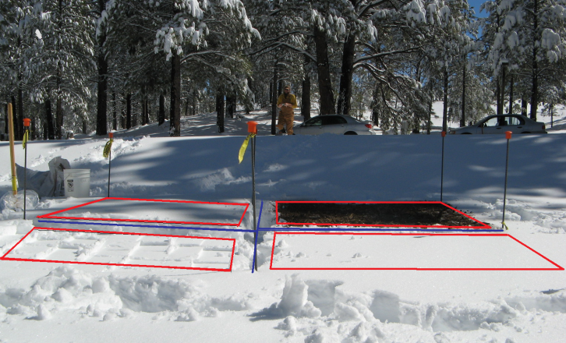
Planned Methodology
Four sampling sites
  Canopy
    Repeated application
  Meadow
    Repeated application
  Two roof structures
    Start to finish data collection
Four subplots
to a site

Slide 8
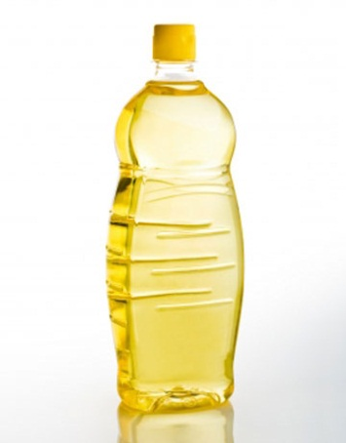
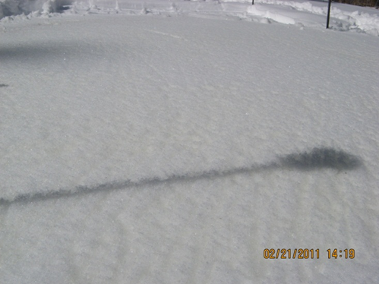
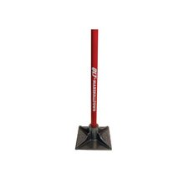
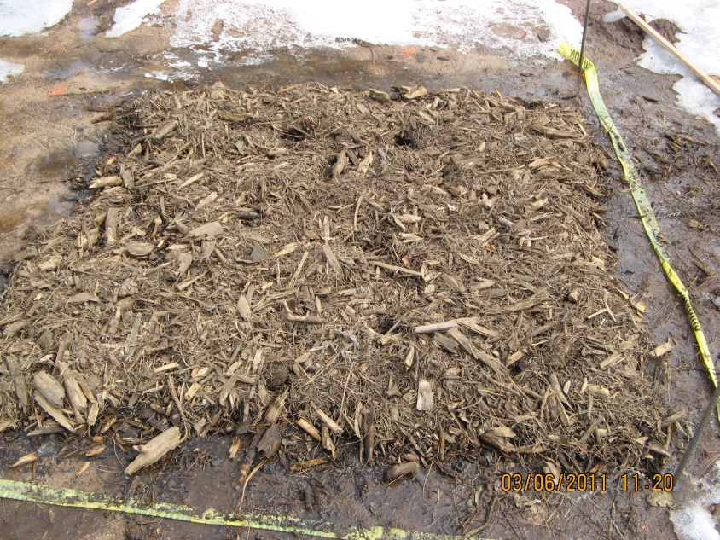
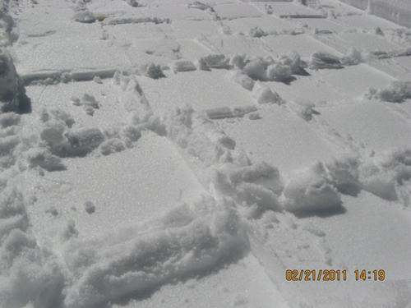
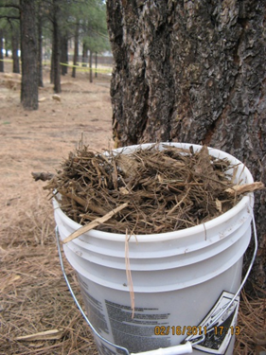
Planned Methodology
Selected Treatments for Testing
  Vegetable Oil
  Compaction
  Biomass blanket

Slide 9
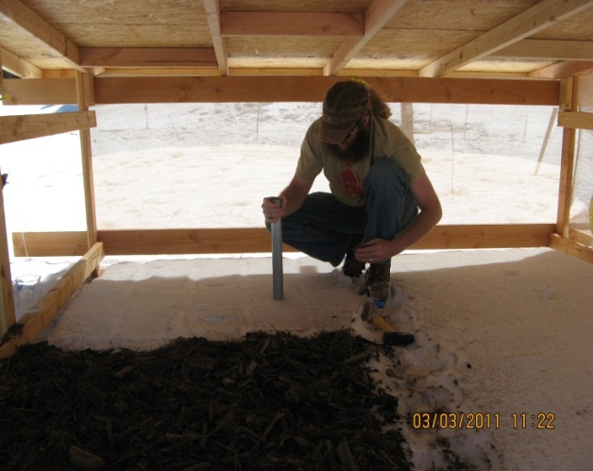
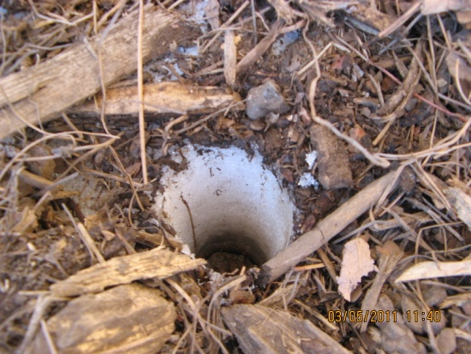
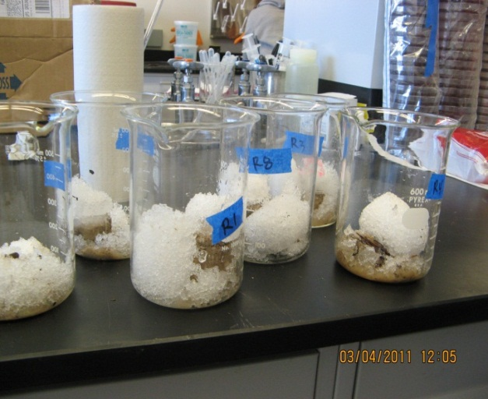
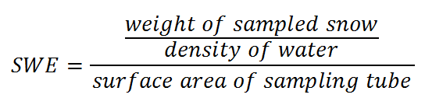
Planned Methodology
On-site temperature recording
Collect samples using a snow sampling tube
Weight and density
Calculate snow water equivalent (SWE)

Slide 10
Methodology as Performed
Changes:
  Unable to begin sampling until late February
  Started with thin biomass layer switched to thick layer
  Temperature loggers produced unusable data, left temperature recordings out

Slide 11
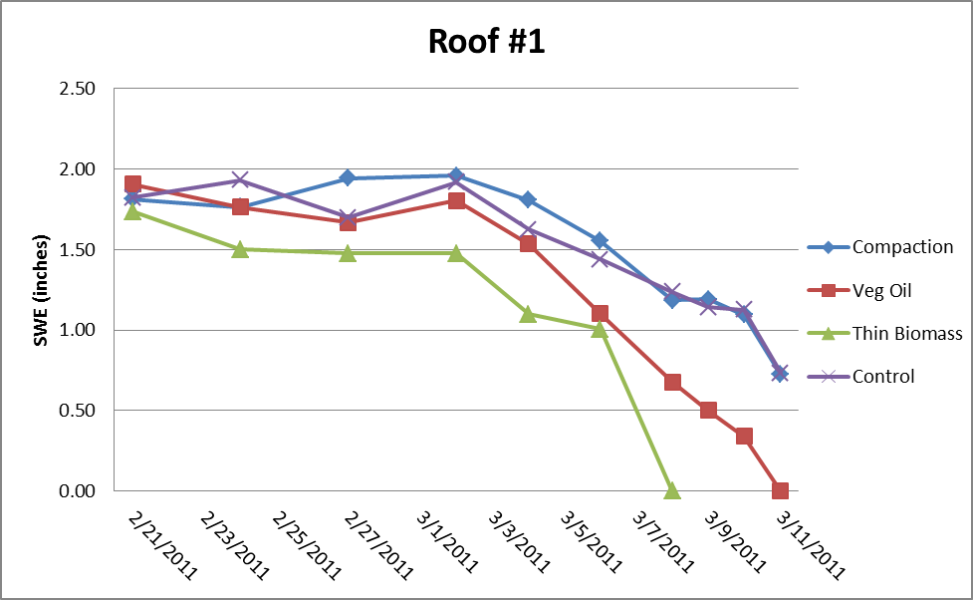
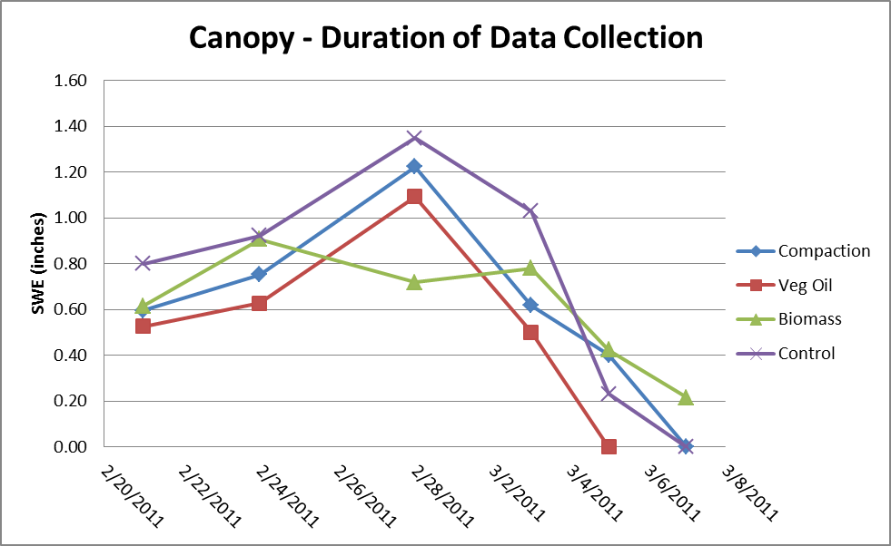
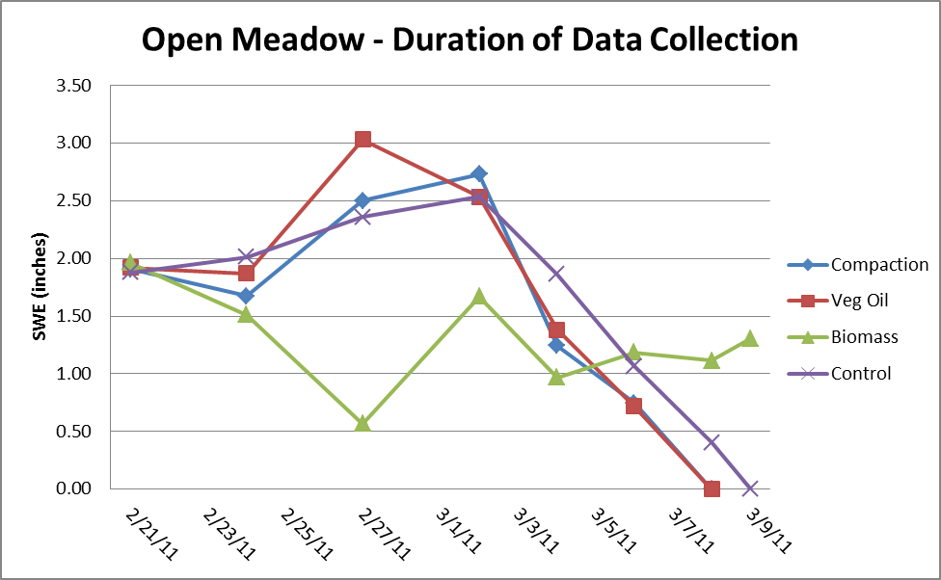
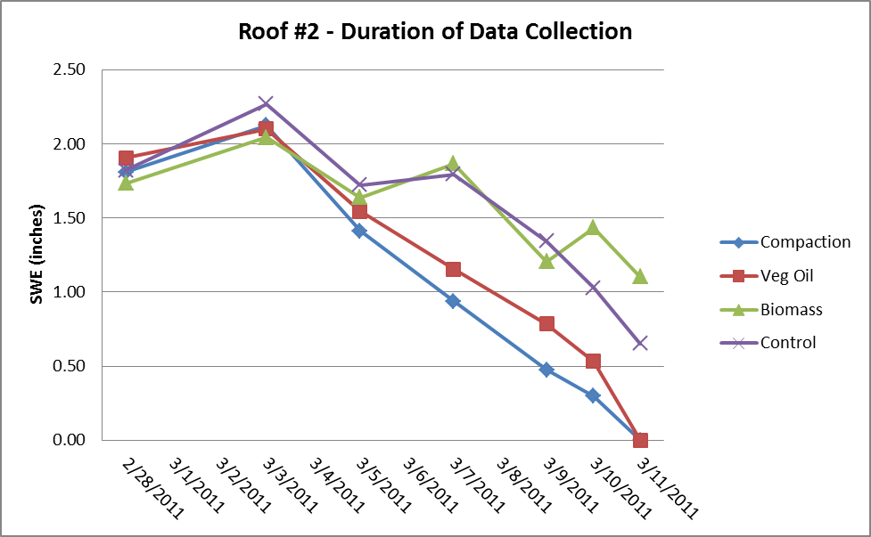
Results
Notes:
Open meadow, canopy, roof #1, roof #2

Slide 12
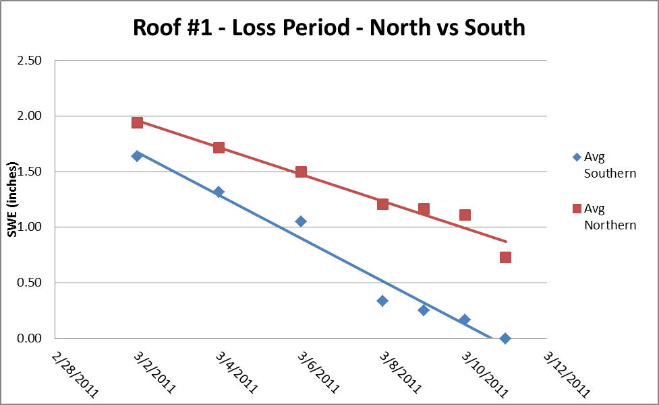
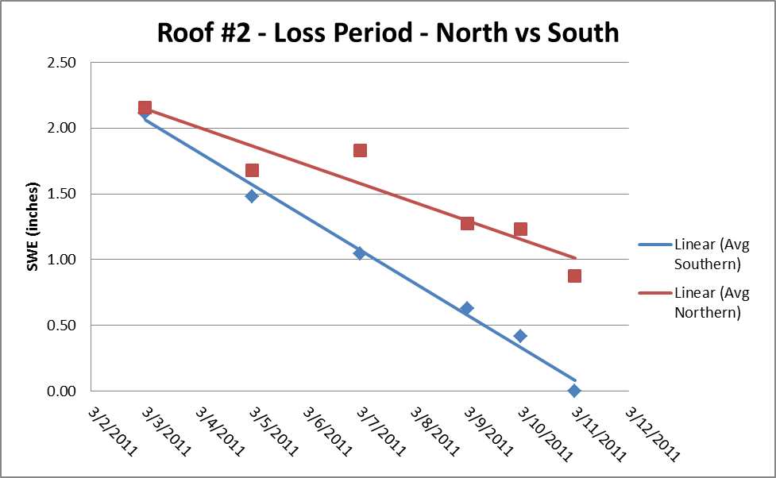
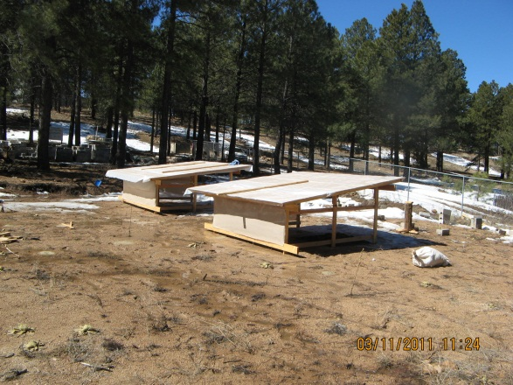
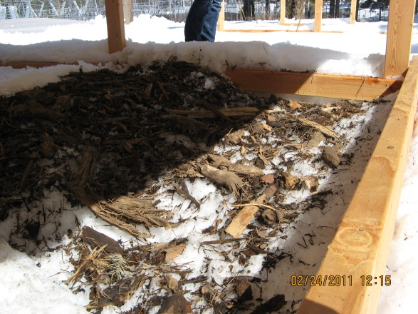
Analysis – Roof Structures
Roofs had sun exposure on southern subplots
Faster rates of snow loss observed visually and confirmed with sampling
Strong correlation between subplot location and snow loss

Slide 13
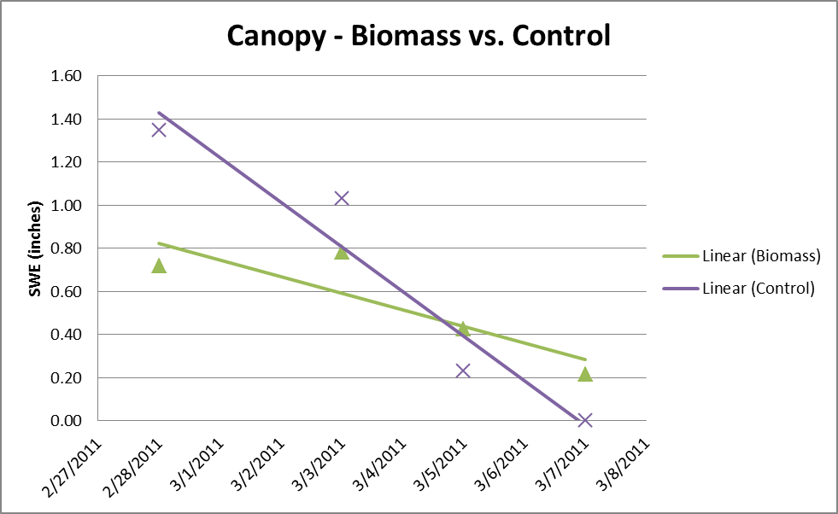
Analysis – Canopy
Captured two storms
  Second storm analyzed, more data points
Biomass performed best
  Only treatment that retained more snow than control
  Retained 30% of SWE when all other subplots completely ablated
Canopy | Slope (inches SWE/day) | R² Value
Control | -0.21 | 0.93
Thick Biomass | -0.08 | 0.75

Slide 14
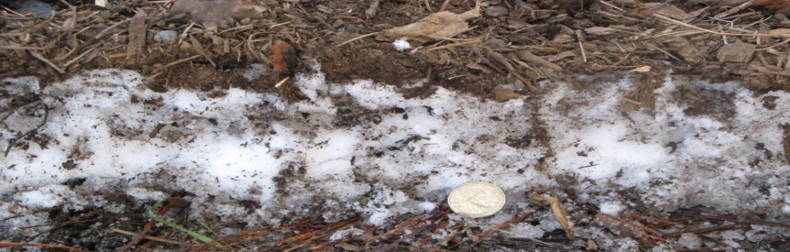
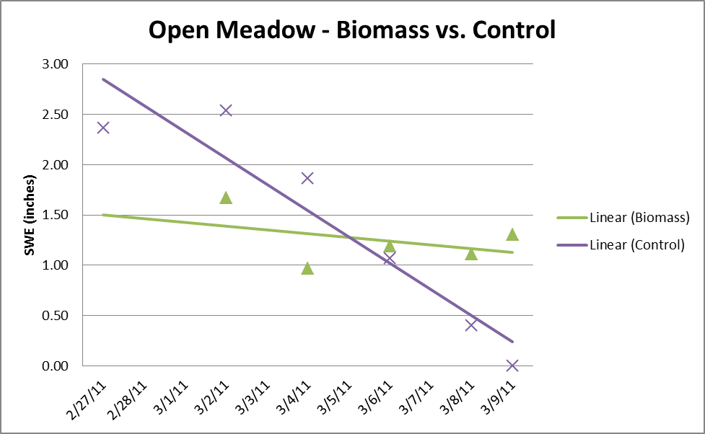
Analysis –Open Meadow
Captured two storms
  Second storm analyzed, more data points
Biomass performed best
  Only treatment that retained more snow than control
  Retained 78% of SWE when all other subplots completely ablated
  Low R² due to mounding
Meadow | Slope (inches SWE/day) | R² Value
Control | -0.26 | 0.89
Biomass | -0.04 | 0.16

Slide 15
Cost
Cost was analyzed for application of biomass
  Use “slash” piles for chipping
  Excluded:
    Chipping labor
    Transportation of chipped piles
    Start up costs of buying equipment
Included:
  Cost of operating a wood chipper
  Maintenance costs of a spreader
  Cost of operating a tractor
Operation Cost
Wood Chipper | $229.50
Woodchip Spreader | $3.60
Tractor Operation | $132.40
Total for 4 inches over 1 acre | $365.50

Slide 16
Conclusions
Isolation of sublimation monitoring was not achieved
  Losses included sublimation and melt
Canopy and Meadow study plots showed that a biomass blanket of 3 to 4 inches will limit losses of snowpack
However, treatment would be very expensive to implement at a landscape scale

Slide 17
Recommendations
Further study of biomass treatment to quantify how much sublimation has been prevented
Hydrologic study to determine amount of additional water that would be delivered to surface waters
Economic study to determine rate of return on the price of equipment, labor and application

Slide 18
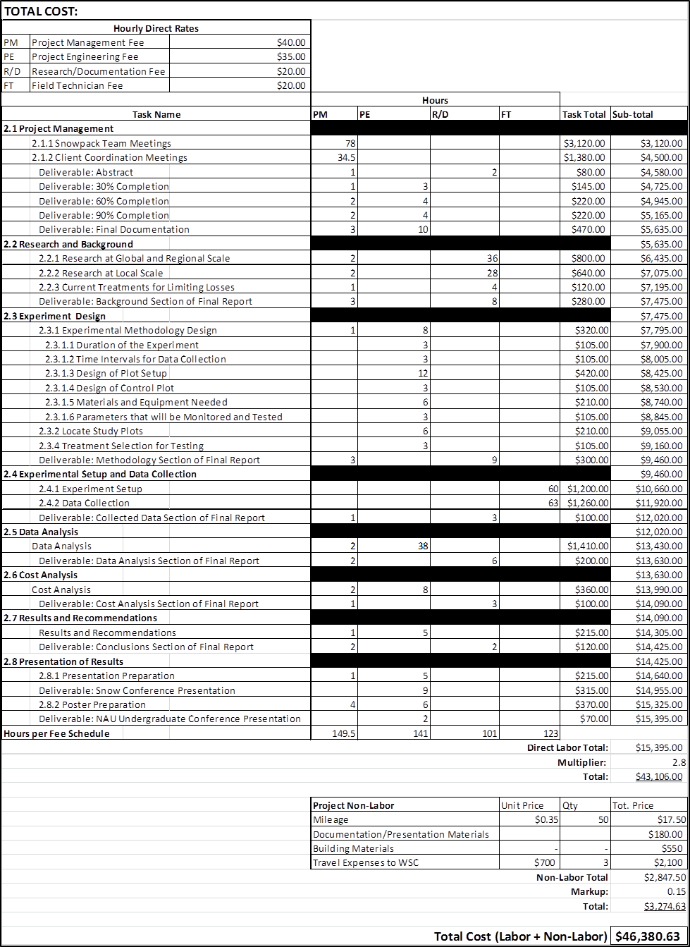
Final Budget

Slide 19
References
USGS. “The Water Cycle: Snowmelt Runoff”. Web. Feb 2011. http://ga.water.usgs.gov/edu/watercyclesnowmelt,html
Arizona Department of Water Resources. “Statewide Cultural Water Demand in 2001-2005 and 2006”. 2010. Web. 14 April 2011. www.adwr.state.az.us/.../StatewidePlanning/WaterAtlas/.../statewide_demand_wed.pdf
“Salt River Project”. Web. 27 April 2011. http://www.scottsdaleaz.gov/Water/Water_Supply_Planning/Sustainable_Supply/Salt_River_Project

Slide 20
Questions?

